Slide 1
NEXTHIKES IT SOLUTIONS
Internship Project Report on Bike Rental Analysis Using Excel
Name:-Kareena Aneja
Role:- Data analyst Intern
Date:-24th October,2025

Slide 2
INTRODUCTION
Overview:
This project analyzes bike-sharing data to explore how factors such as weather, time, and holidays influence bike rental patterns. Using advanced Excel techniques, the goal is to clean, merge, and analyze datasets to uncover actionable insights that support data-driven business planning.
Purpose:
To leverage Excel for comprehensive business data analysis, enabling the identification of key trends and insights.
Tools Used:
MICROSOFT EXCEL(PivotTables, Charts, Data Cleaning, and Data Merging techniques).
PROJECT OBEJECTIVES:
Conduct in-depth data cleaning and integration from multiple Excel workbooks.
Identify and interpret key business trends and behavioral patterns within the consolidated dataset.
Present analytical findings through visualizations to support strategic decision-making.

Slide 3
Datasets Information
We have been provided with three Datasets:
Dataset_1
Dataset_2
Dataset_3
These datasets contain key variables such as Temperature, Holiday, Windspeed, Weather Condition, Humidity, Days, and Time of Day.
Using these datasets, we will apply a range of advanced Excel operations — including Data Cleaning, Data Merging, Pivot Tables, and Data Visualization — to analyze how various factors influence bike rental patterns.
The objective is to derive meaningful insights into how environmental and temporal conditions impact user behavior across different datasets.

Slide 4
Data Preparation Process
1. Verified Data Structure and Column Consistency: Reviewed datasets from multiple sources to ensure consistent structure and column alignment before merging. Checked for missing or duplicate columns and standardized the schema for accuracy.
2. Standardized Column Names for Merging: Renamed and reformatted column headers across all datasets to maintain consistency, ensuring smooth and accurate data merging and analysis in Excel.
3. Ensured Correct Data Types and Formatting: Converted columns to suitable data types (e.g., numeric, date, text) to support accurate calculations and visualizations. Applied uniform date and number formats for consistency.
4. Managed Missing and Inconsistent Data: Identified and resolved missing values, duplicates, and data inconsistencies using Excel’s data cleaning tools to maintain dataset quality and integrity.
5. Validated Data Accuracy: Conducted quality checks and cross-verifications post-cleaning and merging to confirm data accuracy, ensuring reliable insights for analysis.

Slide 5
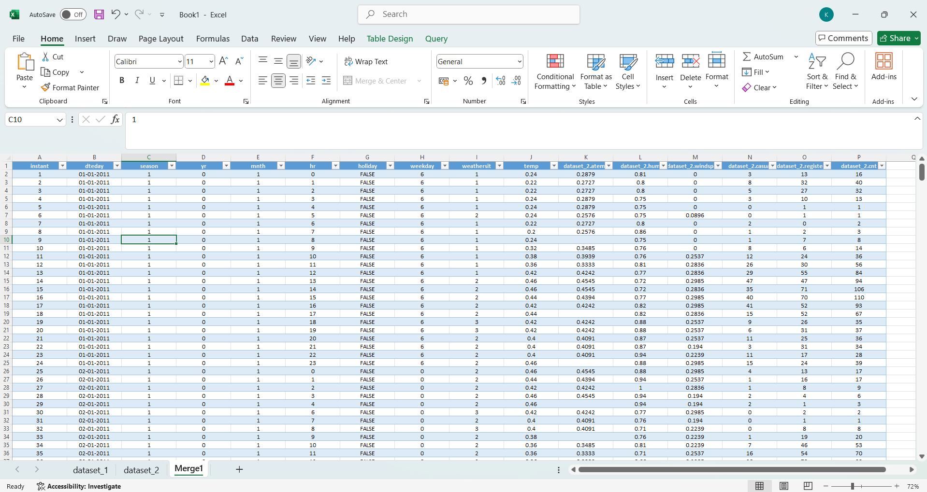
Merging Process
At first , I have two datasets:
Dataset_1 and Dataset_2
These datasets were cleaned and then merged into a single dataset named Merge1. The merging process was performed by identifying a common column, Instant, present in both datasets. Using this column as the key, the datasets were combined through the Merge Query feature available under the Get Data tab in the Data section of Excel.
Also, some columns have been renamed to get more meaningful data like Temp2,Humidity,Weather Type, Day part, Wind Speed as shown Highlighted.

Slide 6
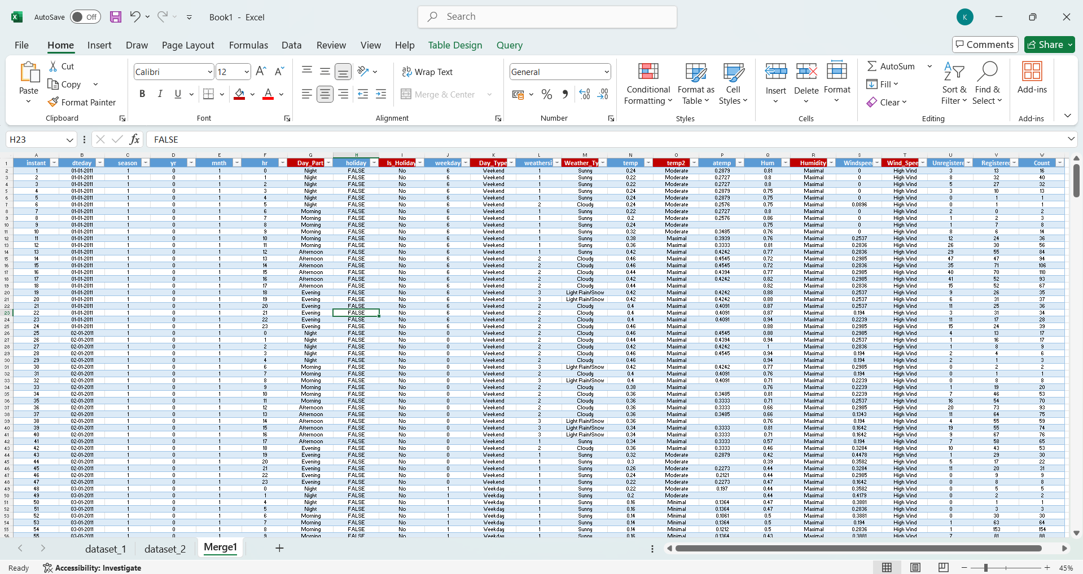
Final Dataset Merging
After creating the Merge1 sheet, I opened a new workbook containing both Dataset_3 and Merge1. Instead of using the merge query method, I utilized the Append Query feature to combine the rows from both datasets. This process resulted in the creation of the final dataset, named Final_Merge .
During data refinement, unnecessary columns such as Year and Month were removed, as their information was already represented in the Dteday column. I also attempted to delete certain columns previously used to derive new values through logical formulas. However, removing these columns caused the derived columns to return a #REF! error. After multiple unsuccessful attempts to resolve the issue, I chose to retain those columns to preserve data integrity.
Using the Final_Merge dataset, I proceeded with data analysis, created Pivot Tables and Pivot Charts, and developed an interactive dashboard to provide insights into how bike rentals vary under different conditions. The following image illustrates a reference snippet of this process.

Slide 7
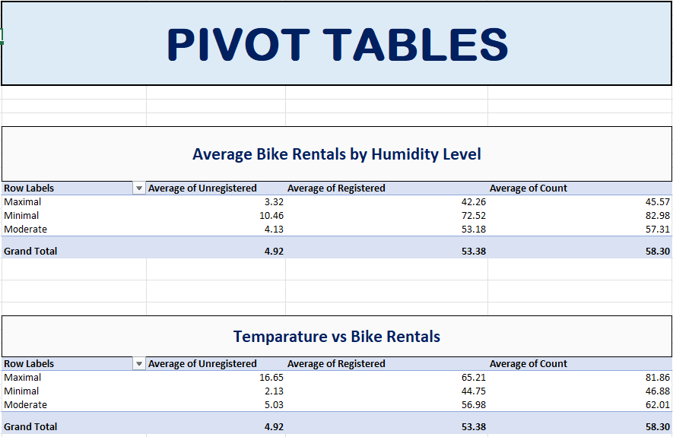
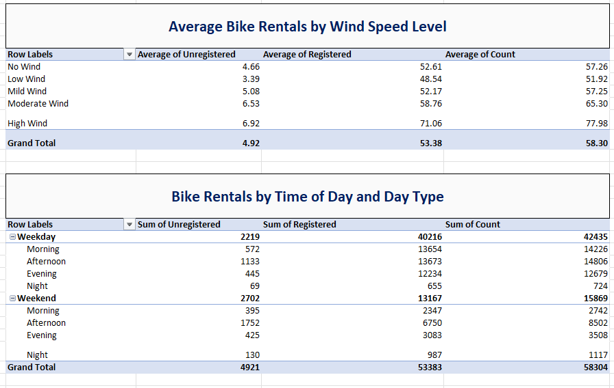
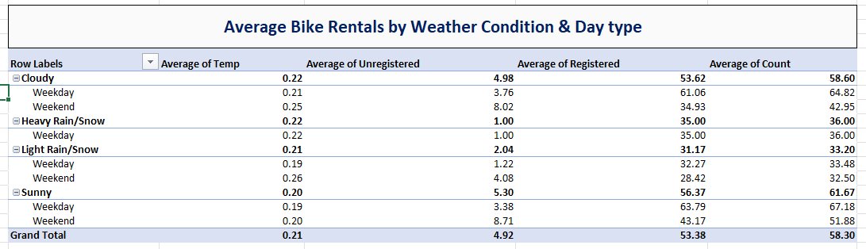
Pivot Tables
The Pivot Table analysis of the Final_Merge dataset provides valuable insights into factors influencing bike rental patterns.
The findings indicate that rentals peak on weekdays, particularly during afternoon and evening hours, and are positively correlated with warmer temperatures and favorable weather conditions. Lower wind speeds and humidity levels also contribute to increased usage.
These insights can assist in strategic planning, resource allocation, and developing targeted initiatives to enhance bike utilization during periods of lower demand.

Slide 8
Data Columns Overview
This dataset includes several key columns that provide essential information for analyzing bike-sharing trends. Each attribute contributes to understanding how various factors influence user behavior and rental patterns.
1. Date/Time Represents the specific date and time when each record was captured.
Facilitates the analysis of time-based trends such as daily, weekly, and seasonal variations in bike rentals.
Enables time-series analysis to identify peak hours and rental patterns across different periods.
2. Weather Type Indicates the prevailing weather conditions during the observation period (e.g., Sunny ,cloudy , heavy rain, Light rain).
Helps evaluate the influence of weather on user activity and rental frequency.
Assists in identifying patterns such as reduced rentals during unfavorable weather and increased demand on clear days.
3. Temperature & Humidity
Temperature: Represents the average recorded temperature (in °C or °F).
Humidity: Denotes the percentage of atmospheric moisture at the time of observation. Both are critical environmental factors that affect rider comfort and the likelihood of using bike-sharing services.
4. User Type Categorizes users as Registered (subscribed members) or Unregistered (casual users).
Supports comparative analysis between regular and one-time riders.
Provides insights into how variables such as promotions, holidays, and weather conditions influence different user groups.

Slide 9
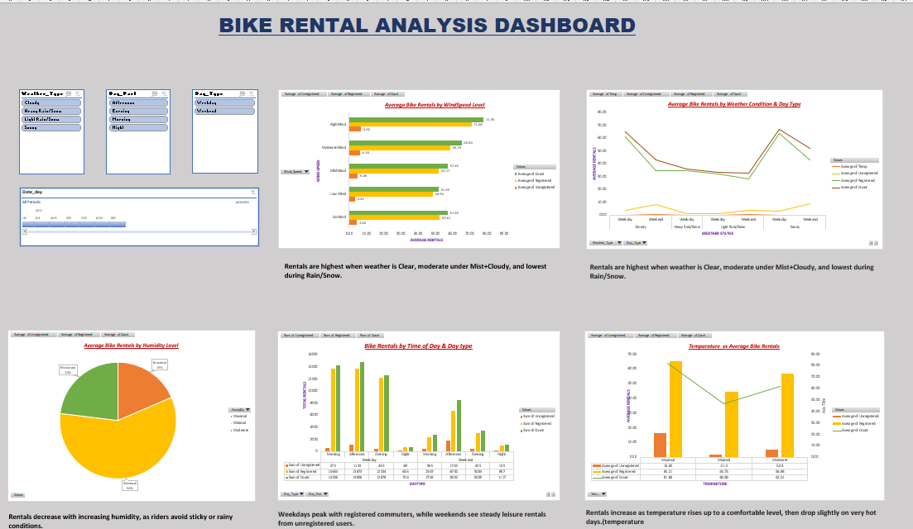
Data Visualization
In this stage of the data analysis process, insights are derived to understand how bike sales are influenced by key factors such as Humidity, Temp2, Weather_Type, Wind_Speed, Day_Type, and Day_Part . This is achieved by generating Pivot Charts and incorporating Slicers and Timelines within a dedicated worksheet titled Dashboard. A reference snippet of the dashboard is provided below.
Slicer :A Slicer is an interactive visual filtering tool used in Pivot Tables, Pivot Charts, or Tables to simplify data analysis. It presents buttons for each unique value within a selected field, enabling users to quickly filter and display data for specific categories with ease.
Timeline: A Timeline is a specialized type of slicer designed to filter data based on date or time fields. It provides an interactive slider or scroll bar that allows users to select and analyze data across specific time periods such as days, months, quarters, or years.

Slide 10
Challenges Faced
Faced issues with missing or incomplete data (e.g., temperature, humidity, rental count).
Resolved inconsistencies in column names, data types, and formats across datasets.
Standardized headers and formats before merging data.
Ensured a clean and reliable dataset for accurate Pivot Table and Chart analysis.

Slide 11
Learning and Skills gained
Advanced Excel Data Cleaning and Transformation Learned to efficiently handle missing, inconsistent, and incorrectly formatted data .
Applied advanced Excel functions to maintain data accuracy and integrity . Ensured datasets were properly validated and standardized before analysis.
Merging Multi-Sheet and Multi-File Data Gained practical experience in consolidating data from multiple workbooks and worksheets . Standardized column names, data types, and formats for consistency . Verified data alignment and completeness before merging datasets.
Pivot-Based Analysis and Visualization Developed expertise in creating and customizing PivotTables and Pivot Charts for large datasets . Used Slicers and Timelines for interactive filtering and time-based trend analysis . Enhanced ability to convert raw data into meaningful visuals that highlight key insights.

Slide 12
CONCLUSION
Successfully completed comprehensive dataset analysis and visualization, demonstrating strong analytical and technical proficiency.
Effectively identified key business trends and environmental patterns, providing valuable insights for data-driven decision-making.
Significantly enhanced understanding of Excel-based analytical techniques and their application in real-world scenarios.

Slide 13
THANKYOU
.

