Slide 1
NEXTHIKES IT SOLUTIONS
Internship Project-2 Scientific Calculator Using Tkinter in Python
Name - Kareena
Role - Data analyst Intern
Date - 25/11/2025

Slide 2
Python GUI Libraries
Python GUI (Graphical User Interface) libraries make it possible to build desktop applications with interactive visual components such as:
Buttons
Text boxes
Windows
Drop-down menus
Dialog boxes
These libraries allow users to interact visually rather than using the command line.
Some popular Python GUI libraries include:

Slide 3
Popular Python GUI Libraries
Tkinter – Python’s built-in GUI toolkit; simple, lightweight, great for beginners
PyQt / PySide – Feature-rich, professional-grade; suitable for complex applications
Kivy – Ideal for touch interfaces and mobile-friendly apps
wxPython – Offers native-style interfaces across different platforms
PyGTK / PyGObject – Designed for building GNOME desktop applications

Slide 4
Why Tkinter is a Great Choice
(Especially for Interns)
Built Into Python
Tkinter comes pre-installed, so you can start building GUIs without downloading any extra packages.
Ideal for Small to Medium Projects
Applications like calculators or simple tools don’t require heavy frameworks—Tkinter is lightweight and efficient for such tasks.
Beginner-Friendly & Easy to Use
Tkinter is one of the simplest GUI libraries, making it perfect for interns or anyone just starting with GUI development.
Produces Clean, Readable Code
GUI elements are organized clearly, helping beginners maintain good coding practices.
Great for Rapid Prototyping
Supervisors often look for quick, functional prototypes. Tkinter allows fast development with minimal setup, making it ideal for internship projects.

Slide 5
References
Simple GUI calculator using Tkinter-Python – GeeksforGeeks
Link: https://www.geeksforgeeks.org/simple-gui-calculator-using-tkinter-python/
Top 5 Best Python GUI Libraries – AskPython
Link: https://www.askpython.com/python-modules/top-5-best-python-gui-libraries

Slide 6
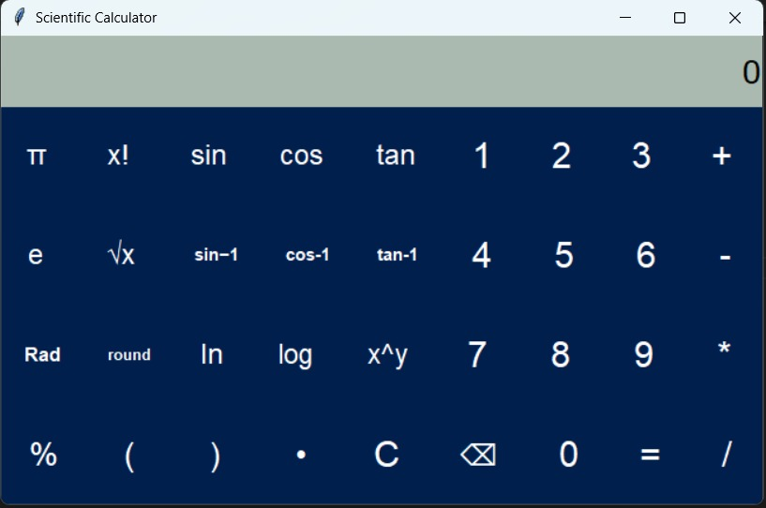
RESULT

Slide 7
Thankyou

