Slide 1
Introduction to Error Control Protocols Evaluation
Notes:
Video 01

Slide 2

Overview
Objectives
Evaluation of Stop-and-Wait Without Errors
Review Error Control Concepts and Principles.
Evaluation of Stop-and-Wait With Errors .
Sliding Window protocols
Requirements
Know well concepts of propagation time, bit rate, time units (ms, μs,..)..
Read Intro of Section 3.3 and Sections 3.3.1-3.3.3, 3.4.2
References (Not Required)
“Communication Networks
A First Course” by Jean Walrand

Slide 3
Evaluation Of Stop-And-Wait Without Errors (Part I)
Introduction
Protocol Evaluation
Performance
Correctness
Delay Review
Evaluation of Stop-And-Wait Without Errors
Throughput
Efficiency
No particular reading

Slide 4
Error Control Protocols
Data Link Layer (point-to-point)
Point-to-point protocol (PPP)
High-level Data Link Control (HDLC)
Transport Layer (end-to-end)
Transmission Control Protocol (TCP) (detects and correct by retransmission)
UDP (detects only)

Slide 5
Protocol Evaluation
Correctness
Does the protocol work as expected?
Does the protocol “freeze”?
Performance
Throughput: amount of bits transported (from sender to receiver) per unit time
Efficiency: fraction of time a channel is used to carry data (from sender to receiver).

Slide 6
Delay Review
Upper Layer Feeder
If feeding rate larger than bit rate …
Queueing Time
Receiver
Sender
bit rate
Speed of signal
Transmission Time
Propagation Time
Loading Time
Transmission Time
Travel Time
Propagation Time (Tp)

Slide 7
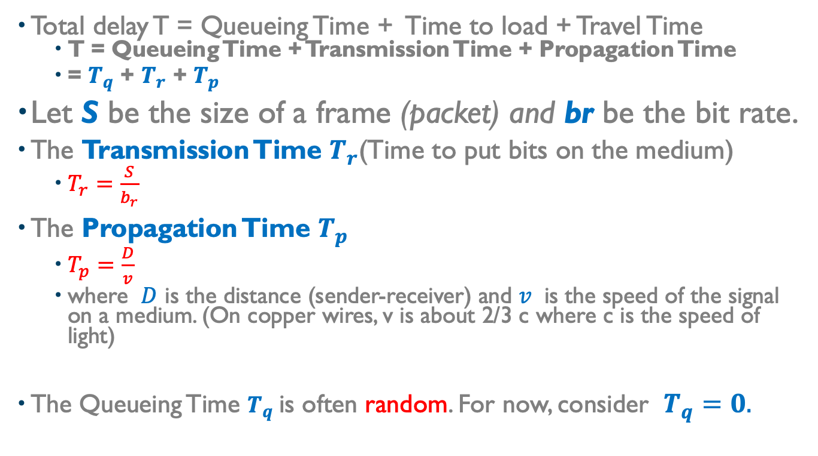
Delay (Cont’d)
Total delay T = Queueing Time + Time to load + Travel Time
T = Queueing Time + Transmission Time + Propagation Time
= $T_{q}$ + $T_{r}$ + $T_{p}$
Let S be the size of a frame (packet) and br be the bit rate.
The Transmission Time $T_{r}$(Time to put bits on the medium)
$T_{r}=\frac{S}{b_{r}}$
The Propagation Time $T_{p}$
$T_{p}=\frac{D}{v}$
where $D$ is the distance (sender-receiver) and $v$ is the speed of the signal on a medium. (On copper wires, v is about 2/3 c where c is the speed of light)
The Queueing Time $T_{q}$is often random. For now, consider $T_{q}=0.$

Slide 8
Review… Delay : units, constants, conventions
The speed of light c is 299,792,458 m/s. Throughout this course use this approximation: c = 3 10⁸ m/s = 3 10⁵ km/s.
The speed on copper is about 2/3 the speed of light (2 10⁵ km/s )
The bit rate is often expressed in Kbits/s (Kilobit = 10³ bits), Mbits/s (Megabit = 10⁶ bits), or Gbits/s (Gigabit = 10⁹ bits).
Important, when expressing a bit rate
Kilo = 10³
Mega = 1K * 1K = 10³ * 10³ =10⁶
Giga = 1K * 1 M = 10³ * 10⁶ = 10⁹
Important, when expressing data size (storage, packet size…)
Kilo = 2¹⁰
Mega = 1K * 1K = 2¹⁰ * 2¹⁰ = 2²⁰
Giga = 1K * 1 M = 2¹⁰ * 2²⁰ = 2³⁰
Time units
milliseconds (ms) (10⁻³ s)
microseconds (μs) (10⁻⁶ s)
nanoseconds (ns) (10⁻⁹ s)

Slide 9
Transmission Time vs Propagation Delay
Transmission Time (bit rate):
the number of bits transmitted or received per unit time. This is a measure of the time it takes to put/get a given number of bits on/from the medium.
Propagation delay (distance, kind of medium:
the time it takes the first bit to travel from source to destination. This parameter depends on the medium and is limited by the speed of light.

Slide 10
Evaluation Of Stop-And-Wait Without Errors (Part II)
Introduction
Protocol Evaluation
Performance
Correctness
Delay Review
Evaluation of Stop-And-Wait Without Errors
Throughput
Efficiency
Read Sections 3.3.1 and 3.3.2
Notes:
Video 02

Slide 11
Stop-And Wait Evaluation
Stop-and-Wait Protocol
A sender sends a new frame F and stops to wait for an acknowledgement (ack). No new frame will be sent unless an ack is received for Frame F.
If an ack is not received by the sender within some delay (timeout), the sender must resend Frame F.
Correctness
Does the protocol work as expected?
Does the protocol “freeze”?
Performance
Throughput: amount of bits transported (from sender to receiver) per unit time
Efficiency: fraction of time a channel is used to carry data (from sender to receiver).

Slide 12








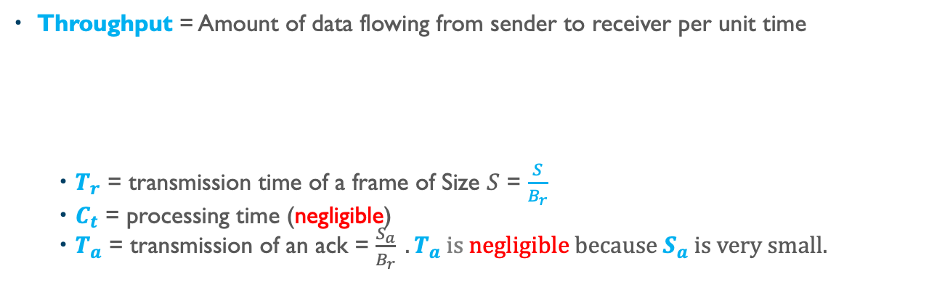







Deriving the Throughput for Stop-And-Wait
Throughput = Amount of data flowing from sender to receiver per unit time
$T_{r}$ = transmission time of a frame of Size $S$ = $\frac{S}{B_{r}}$
$C_{t}$ = processing time (negligible)
$T_{a}$ = transmission of an ack = $\frac{S_{a}}{B_{r}} .T_{a} is negligible because{ S}_{a} is very small.$
Sender
Receiver
bit rate $B_{r}$
Transmission Time $T_{r}$
Propagation Time $T_{p}$
Time 0
T
T
$$T_{r}$$
$$T_{r}$$
Sender
time
Receiver
$$T_{p}$$
$$T_{r}$$
$$T_{a}$$
$$T_{p}$$
$$T_{p}$$
$$T_{r}$$
$$T_{a}$$
$$T_{p}$$
$$C_{t}$$
$$C_{t}$$

Slide 13
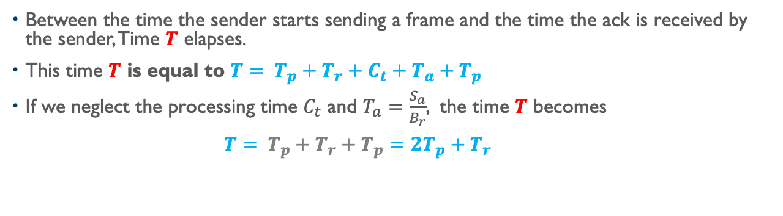
Deriving the Throughput for Stop-And-Wait (Cont’d)
Between the time the sender starts sending a frame and the time the ack is received by the sender, Time $T$ elapses.
This time $T$ is equal to $T= T_{p}+T_{r}+C_{t}+T_{a}+T_{p}$
If we neglect the processing time $C_{t}$ and $T_{a}=\frac{S_{a}}{B_{r}}$, the time $T$ becomes
$T= T_{p}+T_{r}+T_{p}=2T_{p}+T_{r}$
Time 0
T
T
$$T_{r}$$
$$T_{r}$$
Sender
time
Receiver
$$T_{p}$$
$$T_{r}$$
$$T_{a}$$
$$T_{p}$$
$$T_{p}$$
$$T_{r}$$
$$T_{a}$$
$$T_{p}$$
$$C_{t}$$
$$C_{t}$$

Slide 14
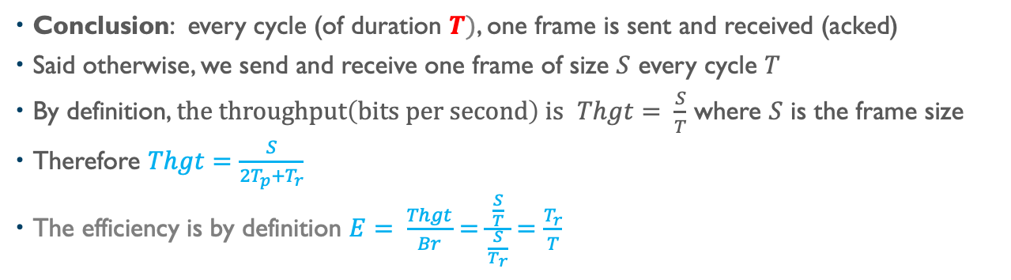
Deriving the Throughput for Stop-And-Wait (Cont’d)
Conclusion: every cycle (of duration $T)$, one frame is sent and received (acked)
Said otherwise, we send and receive one frame of size $S$ every cycle $T$
By definition, $the throughput\left(bits per second\right) is$ $Thgt= \frac{S}{T}$ where $S$ is the frame size
Therefore $Thgt=\frac{S}{2T_{p}+T_{r}}$
The efficiency is by definition $E= \frac{Thgt}{Br}=\frac{\frac{S}{T}}{\frac{S}{T_{r}}}=\frac{T_{r}}{T}$
Time 0
T
T
$$T_{r}$$
$$T_{r}$$
Sender
time
Receiver
$$T_{p}$$
$$T_{r}$$
$$T_{a}$$
$$T_{p}$$
$$T_{p}$$
$$T_{r}$$
$$T_{a}$$
$$T_{p}$$
$$C_{t}$$
$$C_{t}$$

Slide 15
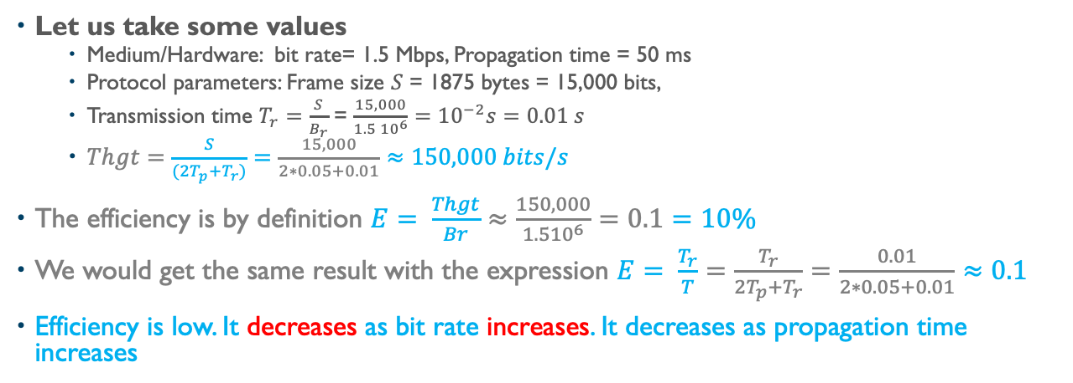
Is Stop-And-Wait Efficient? Example
Let us take some values
Medium/Hardware: bit rate= 1.5 Mbps, Propagation time = 50 ms
Protocol parameters: Frame size $S$ = 1875 bytes = 15,000 bits,
Transmission time $T_{r}=\frac{S}{B_{r}}$ = $\frac{15,000}{1.5 {10}^{6}}={10}^{−2}s=0.01 s$
$Thgt=\frac{S}{(2T_{p}+T_{r})}=\frac{15,000}{2∗0.05+0.01}≈150,000 bits/s$
The efficiency is by definition $E= \frac{Thgt}{Br}≈\frac{150,000}{1.5{10}^{6}}=0.1=10\%$
We would get the same result with the expression $E= \frac{T_{r}}{T}=\frac{T_{r}}{2T_{p}+T_{r}}=\frac{0.01}{2∗0.05+0.01}≈0.1$
Efficiency is low. It decreases as bit rate increases. It decreases as propagation time increases
Time 0
T
T
$$T_{r}$$
$$T_{r}$$
Sender
time
Receiver
$$T_{p}$$
$$T_{r}$$
$$T_{a}$$
$$T_{p}$$
$$T_{p}$$
$$T_{r}$$
$$T_{a}$$
$$T_{p}$$
$$C_{t}$$
$$C_{t}$$

Slide 16
Wrap-Up Stop-And-Wait
The throughput of Stop-And-Wait is low (even without errors).
The efficiency of Stop-And-Wait is low (even without errors).
The problem from having the sender waiting (not transmitting while the channel is available)
The higher the propagation time, the worse is the efficiency.
The higher the bit rate, the worse is the efficiency.
Two questions:
What is the efficiency when there are errors?
How to improve the performance?
Time 0
T
T
$$T_{r}$$
$$T_{r}$$
Sender
time
Receiver
$$T_{p}$$
$$T_{r}$$
$$T_{a}$$
$$T_{p}$$
$$T_{p}$$
$$T_{r}$$
$$T_{a}$$
$$T_{p}$$
$$C_{t}$$
$$C_{t}$$

Slide 17
Error Control Review
Introduction
Types of errors
Bit error rare and packet Error Rate
No particular reading
Notes:
Video 03

Slide 18
Error Control
What? Technique(s) used to enable reliable delivery of data to a destination.
Why? Signal may get corrupted and packets may disappear
How? (We covered this earlier)
Error Detection
Error Correction
Frame, packet, segments, or datagram?
Layer/Protocol | Data Unit
(Data) Link Layer | Frame
Network (Internet) Layer | Packet
TCP | Segment
UDP | Datagram

Slide 19
Types of Errors
Bit corruption:
one or multiple bits in a frame are corrupted (0 flipped to 1, or 1 flipped to 0) during transmission/transfer. Results in packet corruption. Bit error rate (ber) very low on terrestrial links.
Packet Error:
Corruption (packet error rate per)
Loss (often due to congestion (buffer overflow)), packet loss rate)
Duplication
Reordering

Slide 20



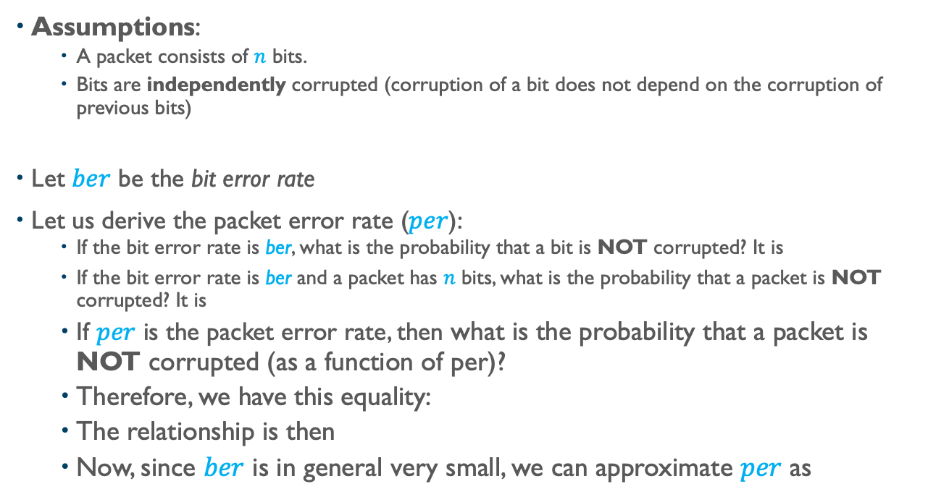



Relationship Between ber and per
Assumptions:
A packet consists of $n$ bits.
Bits are independently corrupted (corruption of a bit does not depend on the corruption of previous bits)
Let $ber$ be the bit error rate
Let us derive the packet error rate ($per$):
If the bit error rate is ber, what is the probability that a bit is NOT corrupted? It is
If the bit error rate is ber and a packet has $n$ bits, what is the probability that a packet is NOT corrupted? It is
If $per$ is the packet error rate, then what is the probability that a packet is NOT corrupted (as a function of per)?
Therefore, we have this equality:
The relationship is then
Now, since $ber$ is in general very small, we can approximate $per$ as
$${(1−ber)}^{}$$
$${(1−ber)}^{n}$$
$$1−per$$
$${1−per=(1−ber)}^{n}$$
$${per=1−(1−ber)}^{n}$$
$${per≈n.ber}^{}$$

Slide 21
Adapted Error Control
Types of Channels
Ideal
Channel with corruption only
“Lossy” channel
Countermeasures
Detection
Acknowledgments
Correction
Retransmission
Timeout
No particular reading
Notes:
Video 04

Slide 22
Types of Channels and Countermeasures (One outstanding packet)
Ideal Channel:
The channel carries the packet to the destination without any change (corruption).
X
Detection?
Sender
Receiver
X
Correction?

Slide 23
Types of Channels and Countermeasures (One outstanding packet)
Ideal Channel:
The channel carries the packet to the destination without any change.
X
Detection?
Sender
Receiver
X
Correction?

Slide 24
Types of Channels and Countermeasures (One outstanding packet)
Corrupting Channel:
The channel corrupts (flips) some bits in the packet.
Such a channel needs
At the receiver
Detection
Acknowledgement mechanism to alert sender
Correction (if sender does not use retransmission)
At the sender
Retransmission (if correction not used at receiver)
Detection?
Sender
Receiver
Retransmission?
ACK
Correction?

Slide 25
Types of Channels and Countermeasures (One outstanding packet)
Corrupting Channel:
The channel corrupts (flips) some bits in the packet.
Such a channel needs
At the receiver
Detection
Acknowledgement mechanism to alert sender
Correction (if sender does not use retransmission)
At the sender
Retransmission (if correction not used at receiver)
Detection?
Sender
Receiver
Retransmission?
ACK
Correction?

Slide 26
Types of Channels and Countermeasures (One outstanding packet)
“Lossy” Channel:
The channel looses the packet. The packet never makes it to the receiver.
Such a channel needs
At the receiver
Detection?
Acknowledgement mechanism to alert sender about loss?
Correction?
At the sender
Timeout
Retransmission
X
X
X
X
Timeout
Detection?
Sender
Receiver
X
X
Retransmission?
ACK
Correction?

Slide 27
Types of Channels and Countermeasures (One outstanding packet)
“Lossy” Channel:
The channel looses the packet. The packet never makes it to the receiver.
Such a channel needs
At the receiver
Detection?
Acknowledgement mechanism to alert sender?
Correction?
At the sender
Timeout
Retransmission
X
X
X
X
Timeout
Detection?
Sender
Receiver
X
X
Retransmission?
ACK
Correction?

Slide 28
How Long Should The Timeout Be?
Consider a lossy channel
How long should a sender wait before resending?
If the timeout is too large, the sender will waste time waiting for the ack of a lost packet
If the timeout is too small, the sender may resend a packet that was not lost
Solution: keep track of the round trip time. If interested, read work by Karn and Partridge “Improving Round-Trip Times Estimates in Reliable Transport Protocols”

Slide 29
Retransmission or Forward Error Correction?
How to correct?
Retransmission (by sender)
OR
Forward-Error-Correction (FEC) (by receiver)
No particular reading
Notes:
Video 05

Slide 30
How to Correct Corrupted Packets?
Retransmission
The receiver detects the corruption in Packet P
The receiver somewhat alerts the sender
The sender retransmits the packet P
Forward Error Correction
The receiver detects the corruption in Packet P
The receiver corrects the corrupted packet without requesting a retransmission by the sender
This is possible with techniques such as Hamming Codes or Crossed Parities (covered earlier).

Slide 31
Retransmission or Forward Error Correction?
Consider a frame of n bits to be sent
In order to detect up to k corrupted bits, we need to add m check bits.
To be able to detect and correct up to k corrupted bits, we need m’ check bits.
Frame (n bits)
Frame (n bits)
m check bits
Frame (n bits)
m’ check bits
m’ > m

Slide 32
Retransmission or Forward Error Correction?
Consider a channel with packet error rate is p (there are never more than k corrupted bits per packet sent).
If we use error detection with retransmission, each frame has size n+m
If we use forward error correction, each frame has size n+m’
Frame (n bits)
m check bits
Frame (n bits)
m’ check bits
m’ > m

Slide 33
Retransmission or Forward Error Correction?
If we use forward error correction, a packet is always successfully received. So, the cost of sending each packet and is equal to the time it takes to send (n+m’) bits. Denote this time as T(n+m’).
If we use error detection (retransmission), the packet must be resent whenever the packet gets corrupted. Suppose that the penalty to resend a packet is equal to A. The penalty A includes the time to realize that the packet is corrupted. How much time does it take to send successfully a packet when using error detection?

Slide 34
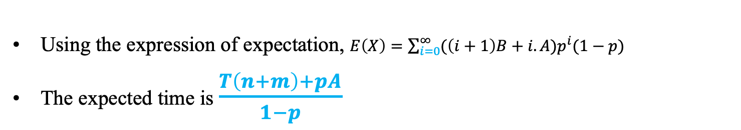
Retransmission or Forward Error Correction?
We are trying to answer the question: how much time X does it take to send successfully a packet when using error detection only?
We can in fact derive the expected time E(X) it would take to send successfully a packet when using error detection.
For simplicity, let us denote T(n+m) = B
The time is :
B if successful the first time with probability (1-p)
2.B+A if successful the second time with probability p.(1-p)
3.B+2.A if successful the third time with probability p².(1-p)
…………………………….
i.B +(i-1).A if successful the i^{th} time with probability p^{i-1}.(1-p)
Using the expression of expectation, $E\left(X\right)=\sum_{i=0}^{∞}{({\left(i+1\right)B+i.A)p}^{i}(1−p)}$
The expected time is $\frac{T\left(n+m\right)+pA}{1−p}$

Slide 35
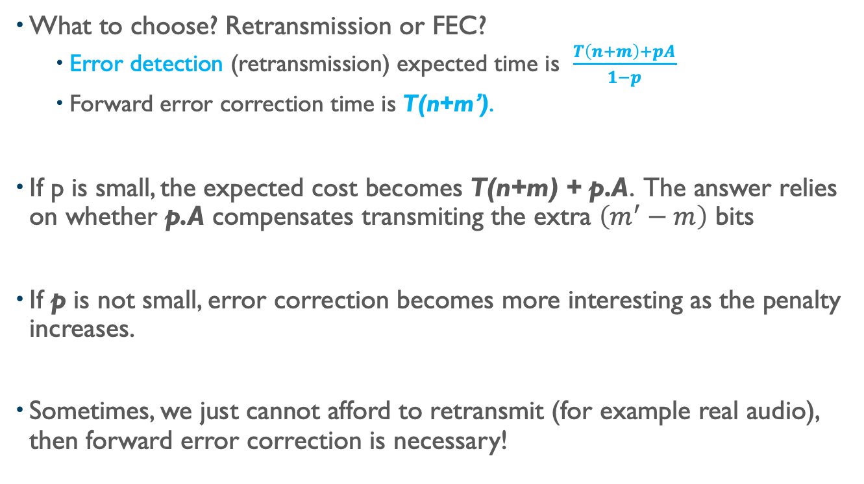
Retransmission or Forward Error Correction?
What to choose? Retransmission or FEC?
Error detection (retransmission) expected time is $\frac{T\left(n+m\right)+pA}{1−p}$
Forward error correction time is T(n+m’).
If p is small, the expected cost becomes T(n+m) + p.A. The answer relies on whether p.A compensates transmiting the extra $\left(m^{′}−m\right)$ bits
If p is not small, error correction becomes more interesting as the penalty increases.
Sometimes, we just cannot afford to retransmit (for example real audio), then forward error correction is necessary!

Slide 36
Evaluation Stop-And-Wait With Errors
Evaluation of Stop-And-Wait With Errors
Throughput
Efficiency
No particular reading
Notes:
Video 06

Slide 37
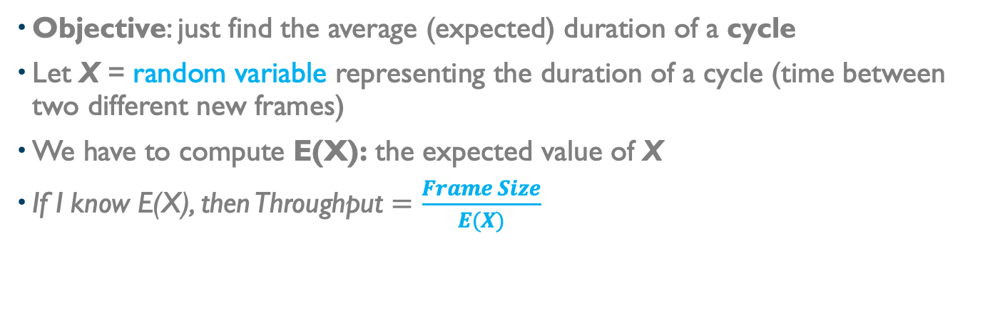
(Big Picture) Throughput in Presence of Errors
Objective: just find the average (expected) duration of a cycle
Let X = random variable representing the duration of a cycle (time between two different new frames)
We have to compute E(X): the expected value of X
If I know E(X), then Throughput $=\frac{Frame Size}{E(X)}$
T_{o} (when unsuccessful)
T (if successful)
Sender
#n
Receiver

Slide 38
Throughput in Presence of Errors
We can say:
1) When the n^{th} packet is successfully sent, X = T
2) When unsuccessful, X = To + Y, where Y is a random variable representing the time it would take before we send the (n+1)^{th} frame
Based on above, we can say:
X = T with probability (1-PER) (PER= Packet Error Rate)
X = To + Y with probability PER
What is then E(X), the expected value of X?
T_{o} (when unsuccessful)
T (if successful)
Sender
#n
#n+1
#n
Receiver

Slide 39
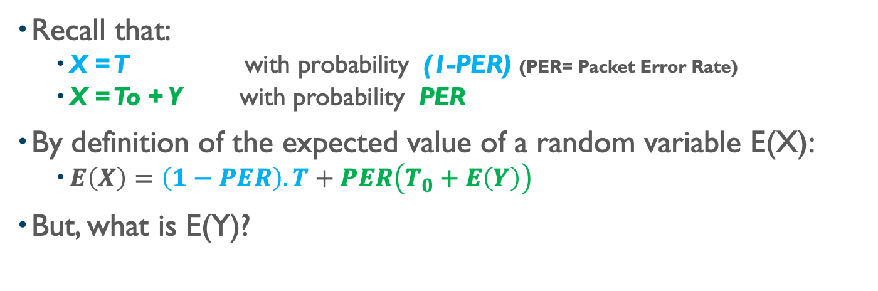
Throughput in Presence of Errors
Recall that:
X = T with probability (1-PER) (PER= Packet Error Rate)
X = To + Y with probability PER
By definition of the expected value of a random variable E(X):
$E\left(X\right)=\left(1−PER\right).T+PER\left(T_{0}+E\left(Y\right)\right)$
But, what is E(Y)?
T_{o} (when unsuccessful)
T (if successful)
Sender
#n
#n+1
#n
Receiver

Slide 40
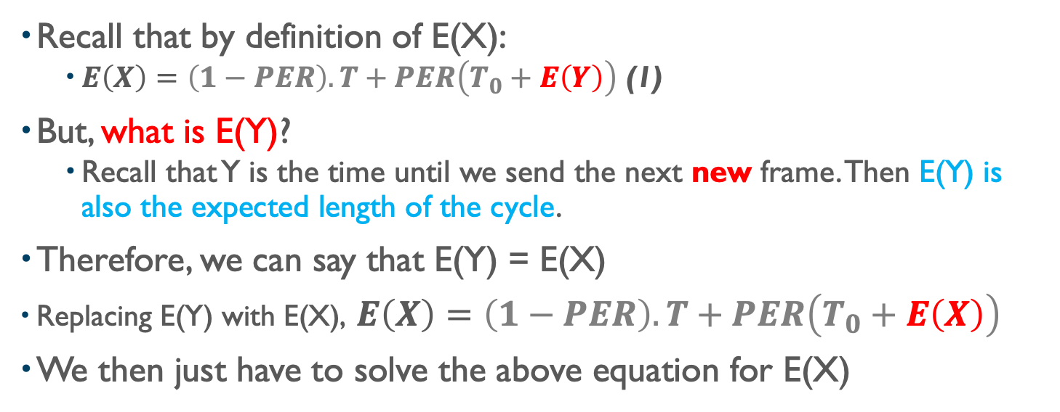
Throughput in Presence of Errors
Recall that by definition of E(X):
$E\left(X\right)=\left(1−PER\right).T+PER\left(T_{0}+E\left(Y\right)\right)$ (1)
But, what is E(Y)?
Recall that Y is the time until we send the next new frame. Then E(Y) is also the expected length of the cycle.
Therefore, we can say that E(Y) = E(X)
Replacing E(Y) with E(X), $E\left(X\right)=\left(1−PER\right).T+PER\left(T_{0}+E\left(X\right)\right)$
We then just have to solve the above equation for E(X)
T_{o} (when unsuccessful)
T (if successful)
Sender
#n
#n+1
#n
Receiver

Slide 41
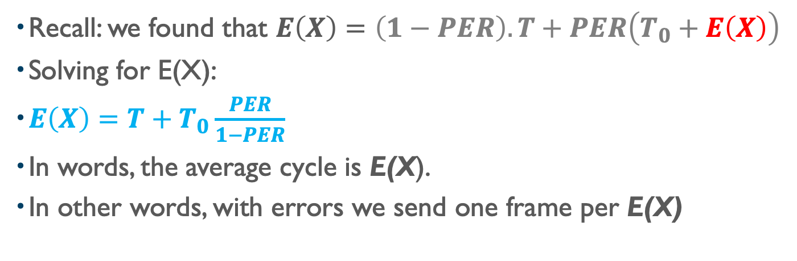
Throughput in Presence of Errors
Recall: we found that $E\left(X\right)=\left(1−PER\right).T+PER\left(T_{0}+E\left(X\right)\right)$
Solving for E(X):
$E\left(X\right)=T+T_{0}\frac{PER}{1−PER}$
In words, the average cycle is E(X).
In other words, with errors we send one frame per E(X)
E(X) (on average)
T (if successful)
Sender
#n
#n+1
#n
Receiver

Slide 42
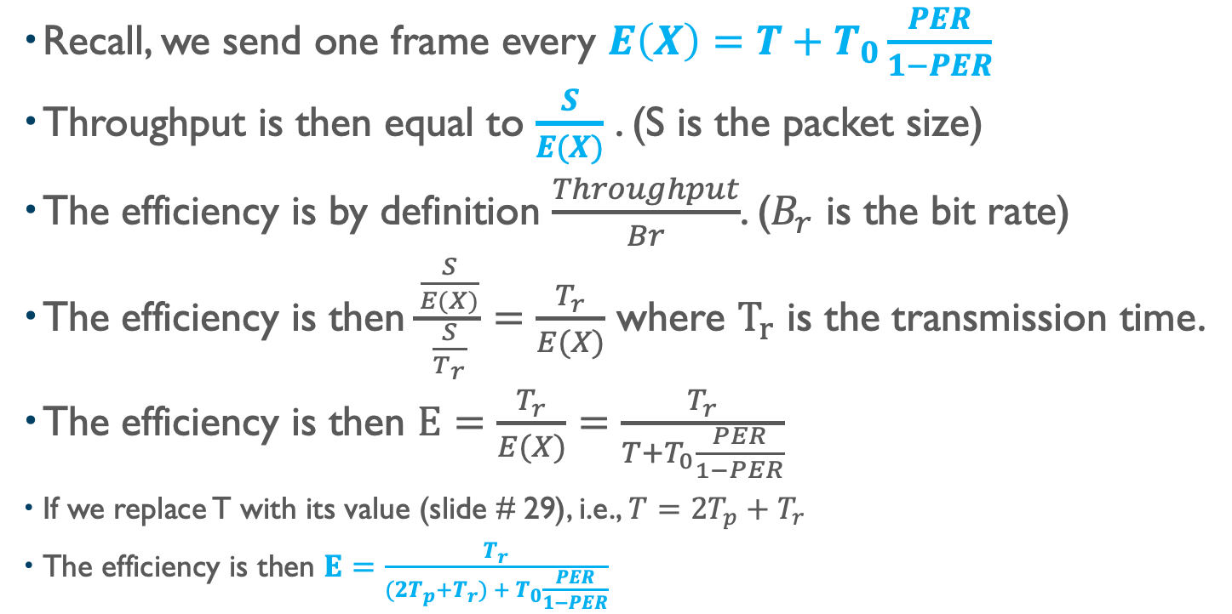
Throughput in Presence of Errors
Recall, we send one frame every $E\left(X\right)=T+T_{0}\frac{PER}{1−PER}$
Throughput is then equal to $\frac{S}{E(X)}$ . (S is the packet size)
The efficiency is by definition $\frac{Throughput}{Br}$. ($B_{r}$ is the bit rate)
The efficiency is then $\frac{\frac{S}{E(X)}}{\frac{S}{T_{r}}}=\frac{T_{r}}{E(X)}$ where $T_{r}$ is the transmission time.
The efficiency is then $E=\frac{T_{r}}{E(X)}=\frac{T_{r}}{T+T_{0}\frac{PER}{1−PER}}$
If we replace T with its value (slide # 29), i.e., $T=2T_{p}+T_{r}$
The efficiency is then $E=\frac{T_{r}}{(2T_{p}+T_{r}) + T_{0}\frac{PER}{1−PER}}$

Slide 43
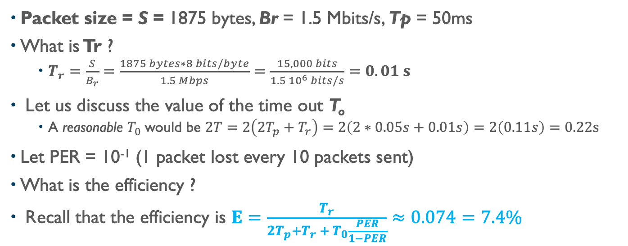
Throughput in Presence of Errors (Example)
Packet size = S = 1875 bytes, Br = 1.5 Mbits/s, Tp = 50ms
What is Tr ?
$T_{r}=\frac{S}{B_{r}}=\frac{1875 bytes∗8 bits/byte}{1.5 Mbps}=\frac{15,000 bits}{1.5 {10}^{6} bits/s}=0.01 s$
Let us discuss the value of the time out T_{o}
A reasonable $T_{0}$would be $2T=2\left(2T_{p}+T_{r}\right)=2\left(2∗0.05s+0.01s\right)=2\left(0.11s\right)=0.22s$
Let PER = 10⁻¹ (1 packet lost every 10 packets sent)
What is the efficiency ?
Recall that the efficiency is $E=\frac{T_{r}}{2T_{p}+T_{r} + T_{0}\frac{PER}{1−PER}}≈0.074=7.4\%$
E(X) (on average)
T (if successful)
Sender
Tr
#n
#n+1
#n
Receiver

Slide 44
SWP Performance With Errors
How is the performance of SWP impacted by
the packet error rate
packet size?
No particular reading
Notes:
Video 07

Slide 45
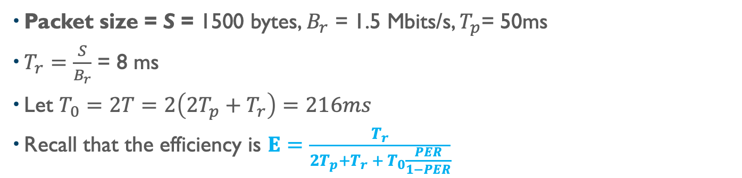
Impact of PER on SWP
Packet size = S = 1500 bytes, $B_{r}$ = 1.5 Mbits/s, $T_{p}$= 50ms
$T_{r}=\frac{S}{B_{r}}$ = 8 ms
Let $T_{0}=2T=2\left(2T_{p}+T_{r}\right)=216ms$
Recall that the efficiency is $E=\frac{T_{r}}{2T_{p}+T_{r} + T_{0}\frac{PER}{1−PER}}$

Slide 46
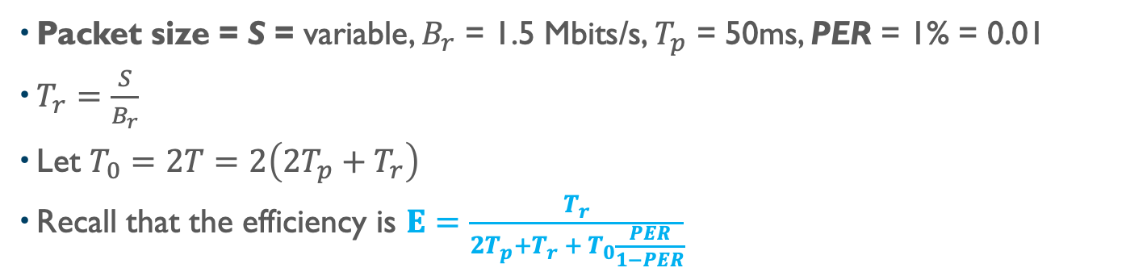
(Pitfall) Impact of Packet Size S on SWP
Packet size = S = variable, $B_{r}$ = 1.5 Mbits/s, $T_{p}$ = 50ms, PER = 1% = 0.01
$T_{r}=\frac{S}{B_{r}}$
Let $T_{0}=2T=2\left(2T_{p}+T_{r}\right)$
Recall that the efficiency is $E=\frac{T_{r}}{2T_{p}+T_{r} + T_{0}\frac{PER}{1−PER}}$

Slide 47
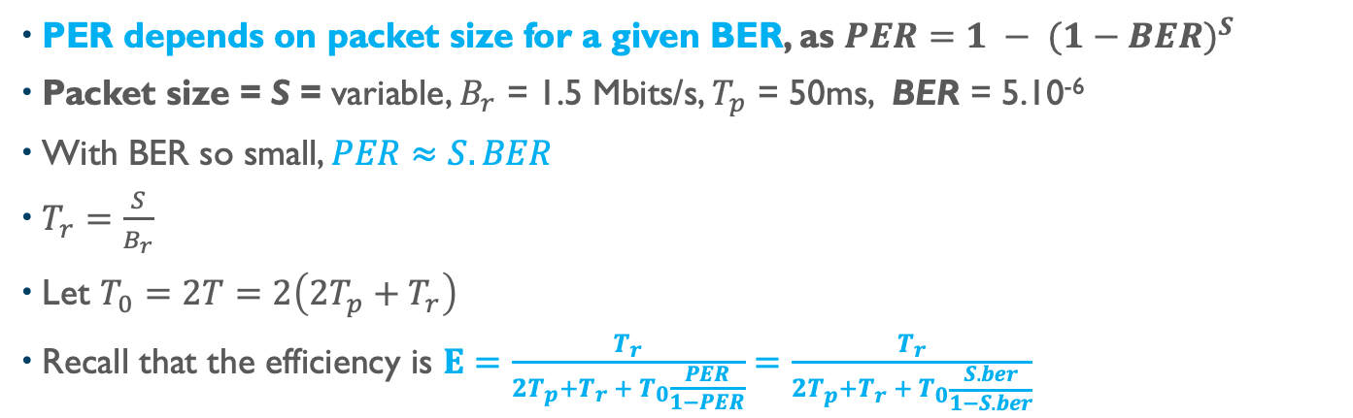
True Picture Impact of Frame Size on SWP
PER depends on packet size for a given BER, as $PER=1 − {(1−BER)}^{S}$
Packet size = S = variable, $B_{r}$ = 1.5 Mbits/s, $T_{p}$ = 50ms, BER = 5.10⁻⁶
With BER so small, $PER≈S.BER$
$T_{r}=\frac{S}{B_{r}}$
Let $T_{0}=2T=2\left(2T_{p}+T_{r}\right)$
Recall that the efficiency is $E=\frac{T_{r}}{2T_{p}+T_{r} + T_{0}\frac{PER}{1−PER}}=\frac{T_{r}}{2T_{p}+T_{r} + T_{0}\frac{S.ber}{1−S.ber}}$

Slide 48
Window Based Protocols
Performance of Stop-And-Wait Is Too Low
Sliding Window Protocols
Go Back n protocol
Read Section 3.4.2
Notes:
Video 09

Slide 49
Stop-And-Wait Protocol Deficiencies
Efficiency is low as soon as the round trip exceeds a few ms and the bit rate exceeds the Mbps
Nothing to do against propagation time (cannot exceed speed of light)
Increasing the bit rate decreases the efficiency.
Round Trip Latency Per Region (Source Verizon)
What to do?
Region | Average Round Trip Latency
North America | 45 ms
Europe | 30 ms
Latin America | 140 ms
Trans Pacific | 140 ms
Asia Pacific | 125 ms

Slide 50
Sliding Window Protocol
Keep sending packets without waiting for acknowledgements.
How many packets should be outstanding without acks?
The number of oustanding frames is the window size W
0
1
2
3
4
5
6
7
Sender
time
S=0
S=1
S=2
S=3
S=4
S=5
S=6
Receiver
ack=0
ack=1
ack=2
ack=3
ack=0
ack=0

Slide 51
W Is Maintained by Sender
51
Window Principle (Maintained by the Sender)
Window Size = W = 7
(advertised by receiver or limited by network conditions)
34 35 36 37 38 39 40 45 46 47 48 49 50…...
Sent and
acked
Sent, not
acked
May be sent
if data available
Cannot be
sent
Sequence
number

Slide 52
Go Back n Protocol
If packet # i is not acked, the sender will resend all packets starting from packet # i.
Example: let us use a window W = 4 frames
To (Timeout)
Sender
0
1
2
3
0
1
2
3
0
Receiver
Discarded

Slide 53
Speeding Up Go Back n
Use negative acknowledgments
No need to wait for To (Timeout)
Sender
0
1
2
3
0
1
2
3
0
NAK
Receiver

Slide 54
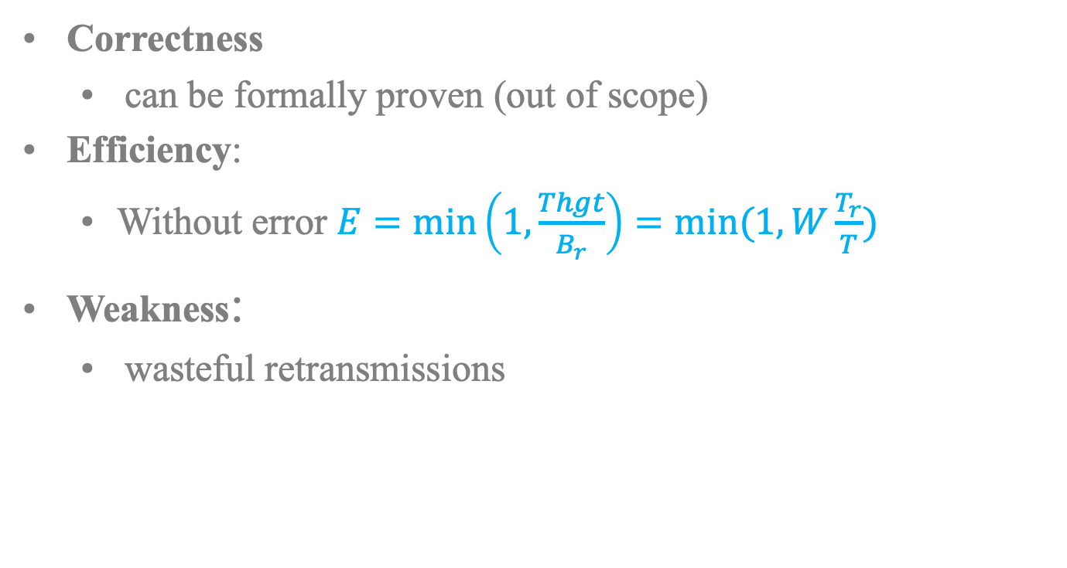
Go Back n (Wrap Up)
Correctness
can be formally proven (out of scope)
Efficiency:
Without error $E=\min\left(1,\frac{Thgt}{B_{r}}\right)=min⁡(1,W\frac{T_{r}}{T})$
Weakness:
wasteful retransmissions
Sender
0
To (Timeout)
1
2
3
0
1
2
3
0
Receiver

Slide 55
Wrap Up
Evaluation of Stop-and-Wait Without Errors
A system (medium, transmitter) sets the propagation time and the bit rate. (No error)
A protocol defines how you use the system to send as many bits as possible through the medium
Key to determine the throughput is to determine the duration of the cycle T. At each cycle T, one packet is sent.
Stop-And-Wait has a pretty bad throughput and efficiency on a system with high propagation time
Review Error Control Concepts and Principles.
Type of channels
Countermeasures (detections, acks, timeout, forward-error-correction, retransmission)
Evaluation of Stop-and-Wait With Errors
A system (medium, transmitter) sets the propagation time and the bit rate. (With error)
The problem is that the duration of the cycle is a random variable X. We determined the expected value of X (i.e. E(X))
Impact of packet error rate and packet size on the performance
Sliding Window Protocols
Go back n protocol
Notes:
Video Module 09

