Slide 1
Introduction to MAC Protocols Evaluation
Notes:
Video Module 1-01

Slide 2

Overview
Objectives
Introduction to Medium Access Control
Learn, understand, and analyze A Key Result from Queue Theory.
Learn, understand, and analyze Pure Aloha.
Learn, understand, and analyze Slotted Aloha
Requirements
Know basic probability :probability distribution, Poisson Process, Exponential Distribution
Read Introduction to Chapter 4
Read Section 4.1
Read Introduction to Section 4.2
Read Section 4.2.1

Slide 3
Introduction to Medium Access Control
Where in the OSI Reference Model
Problem Statement
Potential Solutions
Static allocation
Dynamic allocation
A Key Result from Queueing Theory
Read Introduction to Chapter 4
Read Introduction to Section 4.1
Skim Section 4.1.1
Read Section 4.1.2

Slide 4
Where in the OSI Reference Model ?
Application
Presentation
Session
Transport
Network
Logical Link sublayer
Data Link Layer
Medium Access Control
Physical

Slide 5
Why Do We Need a MAC Layer ?
Let us consider different topologies
Point-to-point channel
full duplex: channel allows simultaneous communication in both directions
Do I need medium access control?
Answer:
No, each user has a dedicated channel not shared with the other. It like a two way street. Cars can use the street in both ways at the same time.
half duplex: : channel allows alternate communication in both directions. Cannot handle simultaneous transmissions in opposite directions
Do I need medium access control?
Answer:
Yes. Half duplex is like a bridge that can accommodate only cars going in ONE direction. Cars going in opposite directions must take turns.
Broadcast channel
When one stations transmits, every station on the channel hears and understand
When two or more transmit, every station on the channel hears, but does not understand ANYTHING.
Do I need medium access control?
Answer:
Yes. It is like people in the same room. The speaker must “acquire” the floor
Notes:
Is a landline phone half or full duplex? Maybe broadcast?
Broadcast, random access, multi-access
Where do we use typically each one?

Slide 6
How To Manage The Access To A Broadcast Channel?
Consider a channel with Capacity C (e.g., C = 100 Mbps)
How to share it among N stations?
Static allocation: divide the channel in N shares and allocate statically each share to one station
Dynamic allocation: Allocate dynamically the full channel to one station at a time.

Slide 7






Static Allocation for N Stations
Consider a channel with Capacity C (e.g., C = 100 Mbps)
Using for example TDM or FDM, the channel is divided in $N$channels with a capacity $\frac{C}{N}$ for each station.
Queue 1
Channel 1 with Capacity $\frac{C}{N}$
Station 1
Queue 2
Channel 2 with Capacity $\frac{C}{N}$
Station 2
Queue 3
Channel 3 with Capacity $\frac{C}{N}$
Station 3
Channel i with Capacity $\frac{C}{N}$
Queue i
Station i
Queue N
Channel N with Capacity $\frac{C}{N}$
Station N

Slide 8





Example : Static Allocation for 4 Stations
Consider a channel with Capacity C = 100 Mbps
Using for example TDM or FDM, the channel is divided in $N$channels with a capacity $\frac{C}{4}=25Mbps$ for each station.
Queue 1
Channel 1 with Capacity $\frac{C}{4}=25Mbps$
Station 1
Queue 2
Channel 2 with Capacity $\frac{C}{4}=25Mbps$
Station 2
Queue 3
Channel 3 with Capacity $\frac{C}{4}=25Mbps$
Station 3
Channel 4 with Capacity $\frac{C}{4}=25Mbps$
Queue 4
Station 4

Slide 9
Problems with Static Allocation
Imagine we use a static allocation of one channel of your Wifi at home and there is some way to divide the channel is equal shares.
How many channels will you create?
Do all your family members or roommates use Wifi at the same time?
How about when you have friends for a party?
The problems with static allocation are:
Computers (data devices) have a bursty traffic: they are silent most of the time and communicate in short bursts.
Since the traffic is bursty, channels may not be used most of the time (capacity waste)
During a party, some friends won’t have a channel… or you will have to create smaller shares…that won’t be fully used anyway.
Under some assumptions, the average time to send a packet is much higher than with dynamic allocation (result from Queueing Theory: we will see this later).

Slide 10

Dynamic Allocation for N Stations
Consider a channel with Capacity C (e.g., C = 100 Mbps)
Do not divide the channel: allocate the full channel to one station when it can access it.
Station 1
Station 2
Channel with Capacity $C$
Station 3
Unique Queue
Station i
Station N

Slide 11
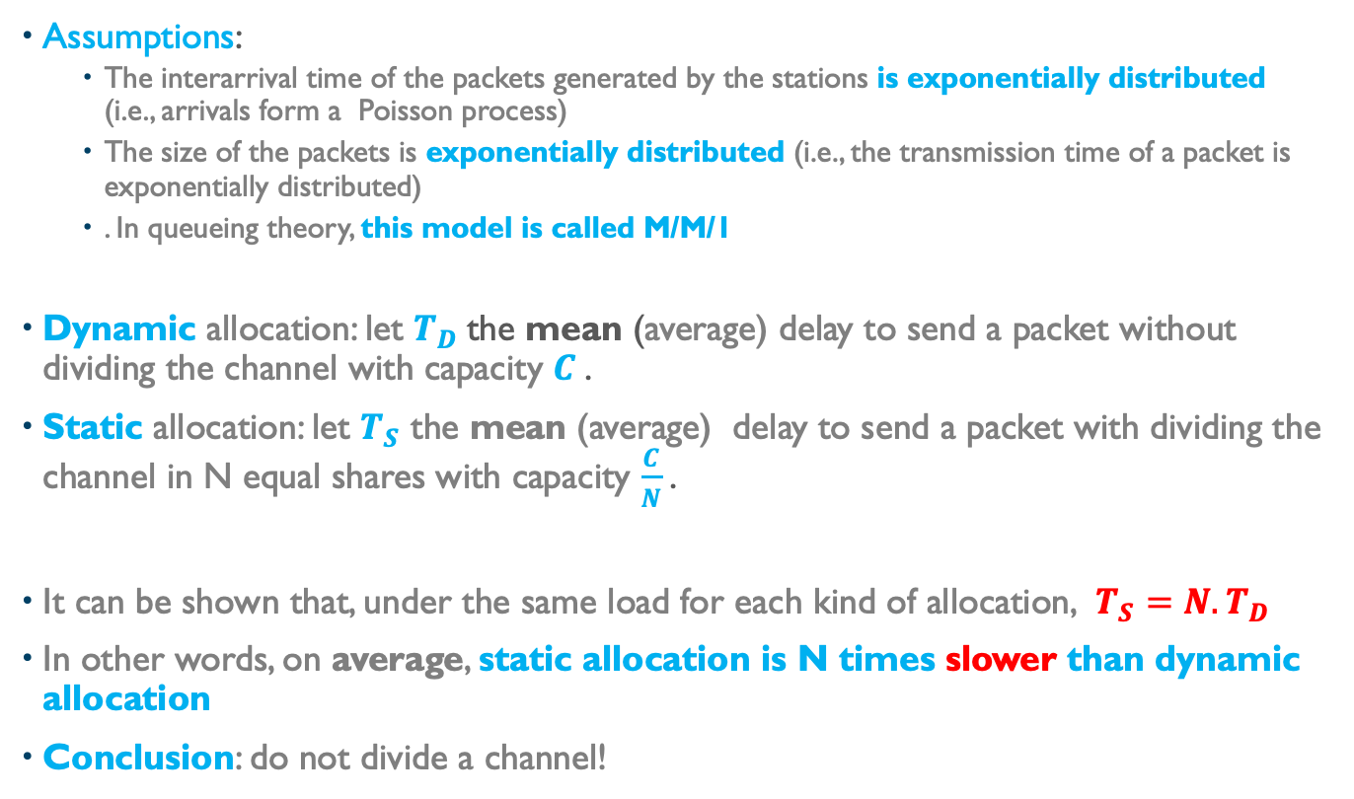
A Key Result from Queueing Theory
Assumptions:
The interarrival time of the packets generated by the stations is exponentially distributed (i.e., arrivals form a Poisson process)
The size of the packets is exponentially distributed (i.e., the transmission time of a packet is exponentially distributed)
. In queueing theory, this model is called M/M/1
Dynamic allocation: let $T_{D}$the mean (average) delay to send a packet without dividing the channel with capacity $C$.
Static allocation: let $T_{S}$ the mean (average) delay to send a packet with dividing the channel in N equal shares with capacity $\frac{C}{N}$.
It can be shown that, under the same load for each kind of allocation, $T_{S}=N.T_{D}$
In other words, on average, static allocation is N times slower than dynamic allocation
Conclusion: do not divide a channel!

Slide 12
Caveats
No guaranteed upper bound on the delay with dynamic allocation.
The exponential distribution does not accurately represent (data) bursty traffic.
This model used because it is tractable
It provides only an approximation of the expected performance (mostly utilization/efficiency).
The implementation of a UNIQUE queue for independent stations is not easy. We need to find some schemes to approximate a unique queue.
“Multiple Access Protocols” try somewhat to implement that virtual unique queue:
Contention based protocols
Collision free protocols

Slide 13
Multiple Access Protocols
Contention based: (collisions are possible)
Good average delivery time
No guaranteed delivery time (no upper bound on delay)
Collision-free
Higher average delivery time ( higher than contention based protocols’. This is bad)
Guaranteed upper bound delivery time (bounded waiting time)
Higher efficiency with sustained/regular traffic at all stations

Slide 14
Pure Aloha Evaluation
Objectives of the evaluation of a MAC protocol
(Pure) Aloha protocol
(Pure) Aloha evaluation
Read Section 4.1.2
Read Introduction to Section 4.2
Read “Pure Aloha” part in Section 4.2.1

Slide 15
Objectives of the Evaluation
Evaluation allows to establish relationships between a MAC protocol and:
an upper bound on efficiency (in this course)
maximum length of medium
bit rate
minimum frame size
We could evaluate these MAC protocols:
Contention based protocols:
Aloha protocol (in this course)
Slotted Aloha (in this course)
CSMA
CSMA/CD
Collison free protocols:
Token Passing (Token Ring)

Slide 16
Pure Aloha
Designed by Abramson (wireless)
A station emits whenever it has a frame to send
If another station emits while a transmission is progressing, a collision happens
If a collision occurs, the frame must be resent after a random time
Best possible utilization is 18% (assuming an M/M/1 system)
To be proven in the next slides.

Slide 17
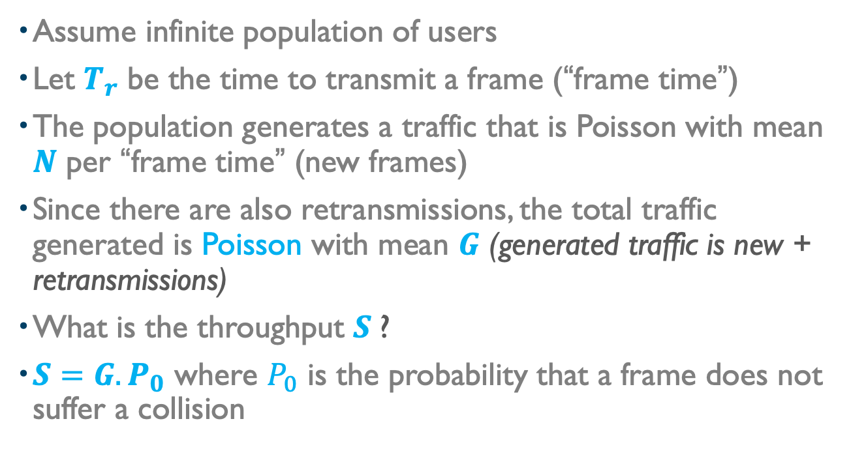
Analysis of Pure Aloha
Assume infinite population of users
Let $T_{r}$ be the time to transmit a frame (“frame time”)
The population generates a traffic that is Poisson with mean $N$ per “frame time” (new frames)
Since there are also retransmissions, the total traffic generated is Poisson with mean $G$ (generated traffic is new + retransmissions)
What is the throughput $S$?
$S=G.P_{0}$ where $P_{0}$ is the probability that a frame does not suffer a collision

Slide 18
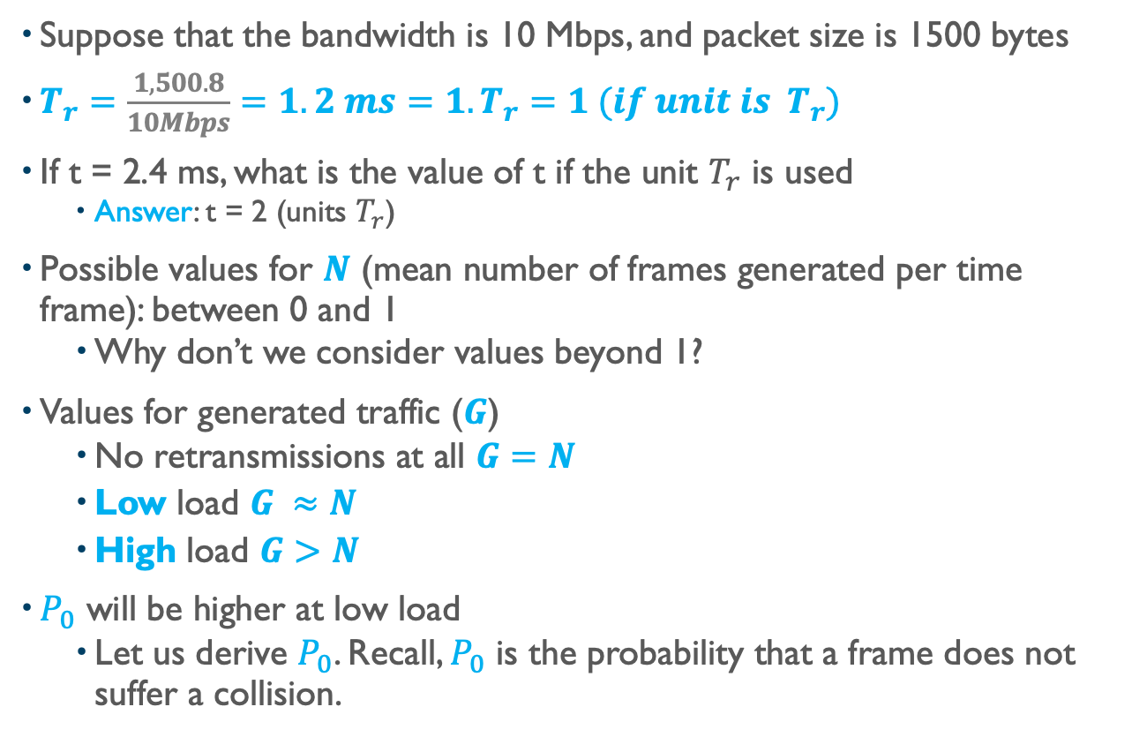
Analysis of Pure Aloha (2) (Example)
Suppose that the bandwidth is 10 Mbps, and packet size is 1500 bytes
$T_{r}=\frac{1,500.8}{10Mbps}=1.2 ms=1.T_{r}=1 (if unit is T_{r})$
If t = 2.4 ms, what is the value of t if the unit $T_{r}$ is used
Answer: t = 2 (units $T_{r}$)
Possible values for $N$ (mean number of frames generated per time frame): between 0 and 1
Why don’t we consider values beyond 1?
Values for generated traffic ($G$)
No retransmissions at all $G=N$
Low load $G ≈N$
High load $G>N$
$P_{0}$ will be higher at low load
Let us derive $P_{0}$. Recall, $P_{0}$ is the probability that a frame does not suffer a collision.

Slide 19
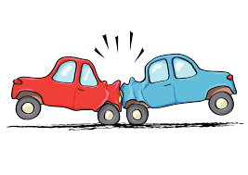
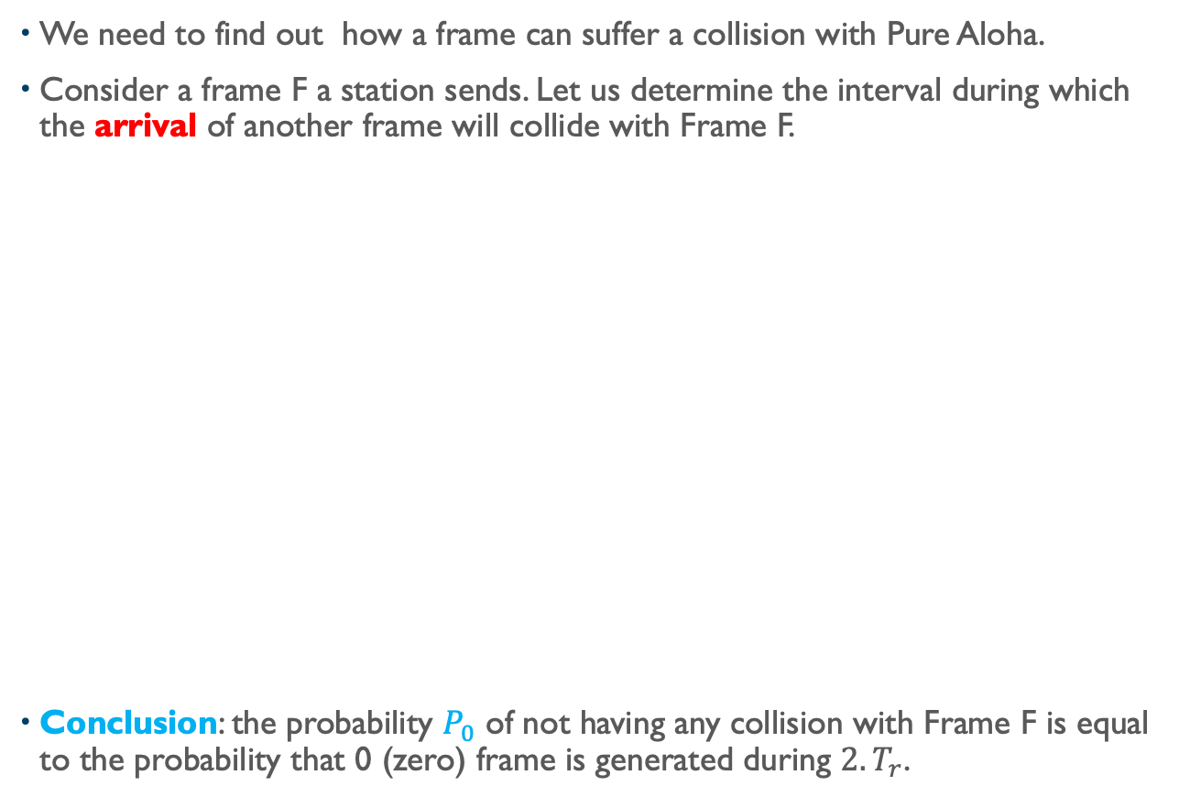


Pure Aloha. Let us derive $P_{0}$
We need to find out how a frame can suffer a collision with Pure Aloha.
Consider a frame F a station sends. Let us determine the interval during which the arrival of another frame will collide with Frame F.
Conclusion: the probability $P_{0}$ of not having any collision with Frame F is equal to the probability that 0 (zero) frame is generated during $2.T_{r}$.
$$T_{r}$$
Frame F
time
No collision
No collision
Vulnerable Zone
$${2.T}_{r}$$

Slide 20
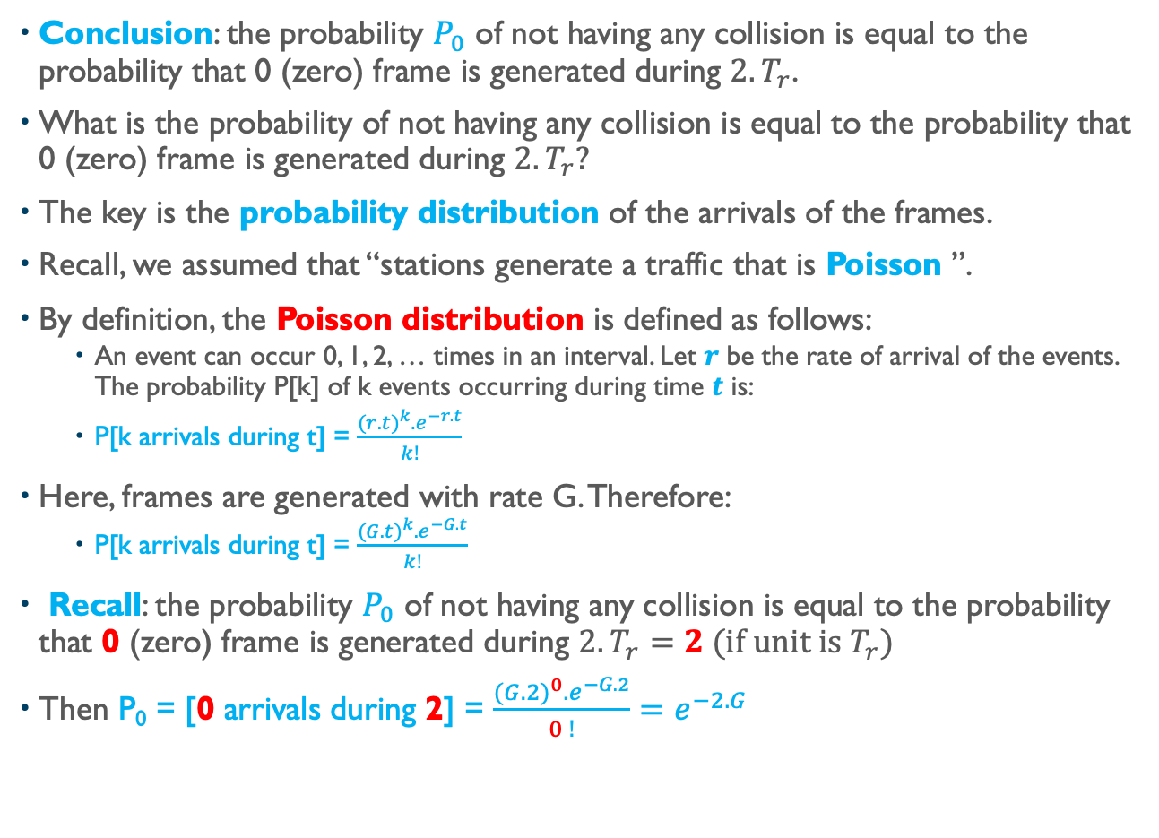
Pure Aloha. Let us derive $P_{0}$
Conclusion: the probability $P_{0}$ of not having any collision is equal to the probability that 0 (zero) frame is generated during $2.T_{r}$.
What is the probability of not having any collision is equal to the probability that 0 (zero) frame is generated during $2.T_{r}?$
The key is the probability distribution of the arrivals of the frames.
Recall, we assumed that “stations generate a traffic that is Poisson ”.
By definition, the Poisson distribution is defined as follows:
An event can occur 0, 1, 2, … times in an interval. Let $r$ be the rate of arrival of the events. The probability P[k] of k events occurring during time $t$ is:
P[k arrivals during t] = $\frac{{(r.t)}^{k}.e^{−r.t}}{k!}$
Here, frames are generated with rate G. Therefore:
P[k arrivals during t] = $\frac{{(G.t)}^{k}.e^{−G.t}}{k!}$
Recall: the probability $P_{0}$ of not having any collision is equal to the probability that 0 (zero) frame is generated during $2.T_{r}=2 (if unit is T_{r})$
Then P₀ = [0 arrivals during 2] = $\frac{{(G.2)}^{0}.e^{−G.2}}{0 !}=e^{−2.G}$

Slide 21
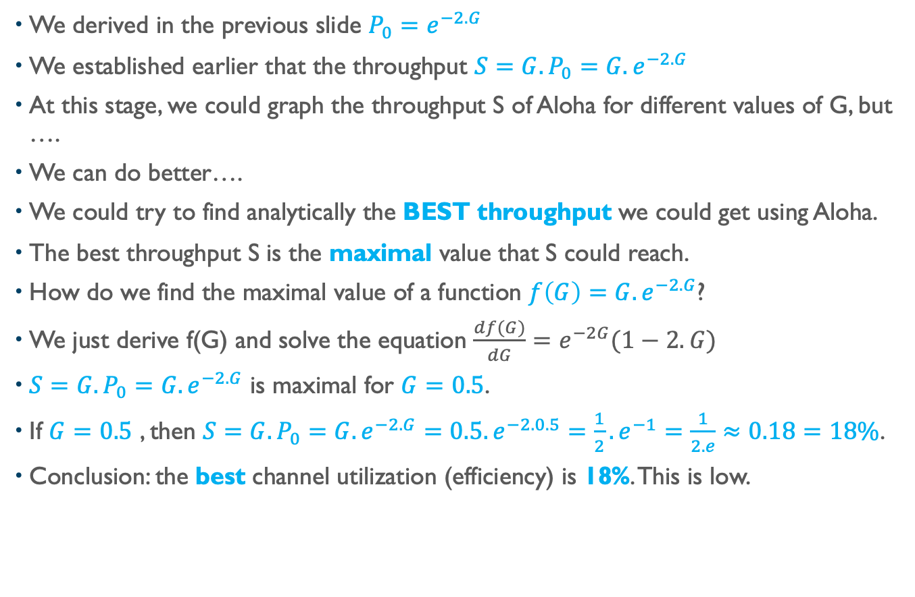
Pure Aloha. Let us now derive the Throughput $S_{}$
We derived in the previous slide $P_{0}=e^{−2.G}$
We established earlier that the throughput ${S=G.P}_{0}=G.e^{−2.G}$
At this stage, we could graph the throughput S of Aloha for different values of G, but ….
We can do better….
We could try to find analytically the BEST throughput we could get using Aloha.
The best throughput S is the maximal value that S could reach.
How do we find the maximal value of a function $f\left(G\right)=G.e^{−2.G}$?
We just derive f(G) and solve the equation $\frac{df(G)}{dG}=e^{−2G}(1−2.G)$
${S=G.P}_{0}=G.e^{−2.G}$ is maximal for $G=0.5$.
If $G=0.5$ , then ${S=G.P}_{0}=G.e^{−2.G}=0.5.e^{−2.0.5}=\frac{1}{2}.e^{−1}=\frac{1}{2.e}≈0.18=18\%$.
Conclusion: the best channel utilization (efficiency) is 18%. This is low.

Slide 22
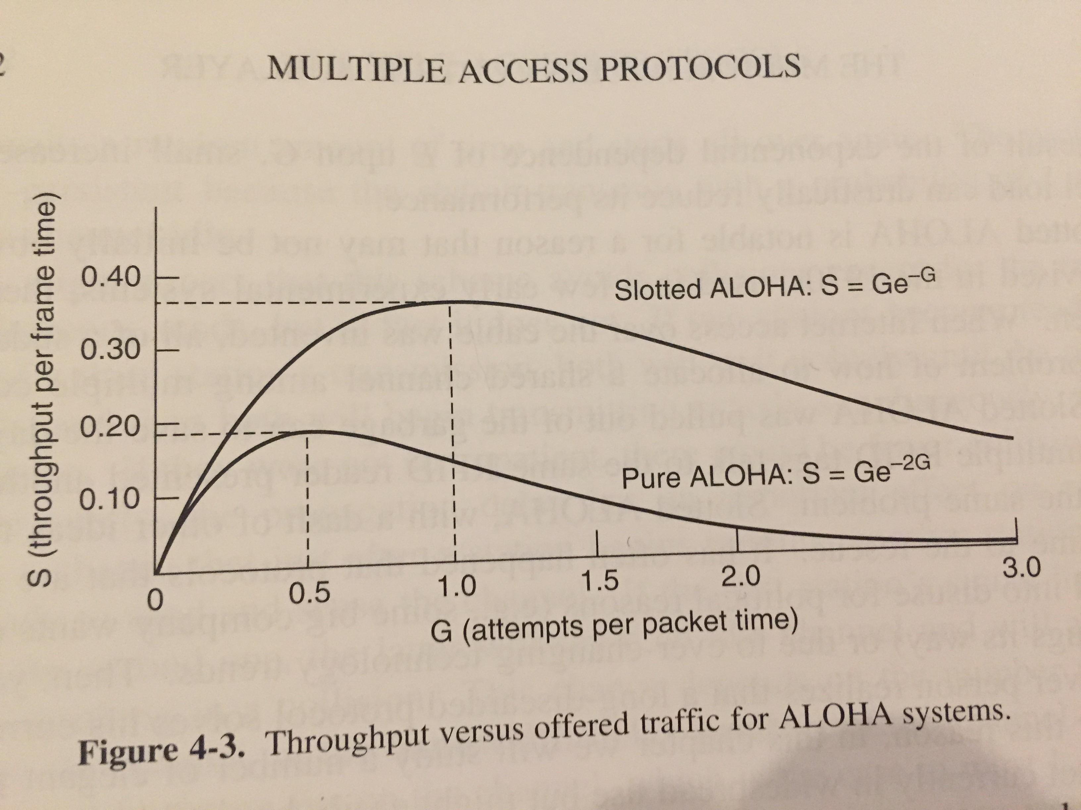
Pure Aloha Throughput Plot

Slide 23
Slotted Aloha Evaluation
Slotted Aloha protocol
Slotted Aloha evaluation
Read Section 4.1.2
Read Introduction to Section 4.2
Read “Slotted Aloha” part in Section 4.2.1

Slide 24
Slotted Aloha
Designed by Roberts (wireless)
Requires synchronization and division of time in discrete slots
A station emits whenever it has something to send AND MUST WAIT FOR THE BEGINNING OF a SLOT.
Consequence: stations must be clock synchronized.
Best possible utilization is 37% (assuming an M/M/1 system)
To be proven in the next slides.

Slide 25
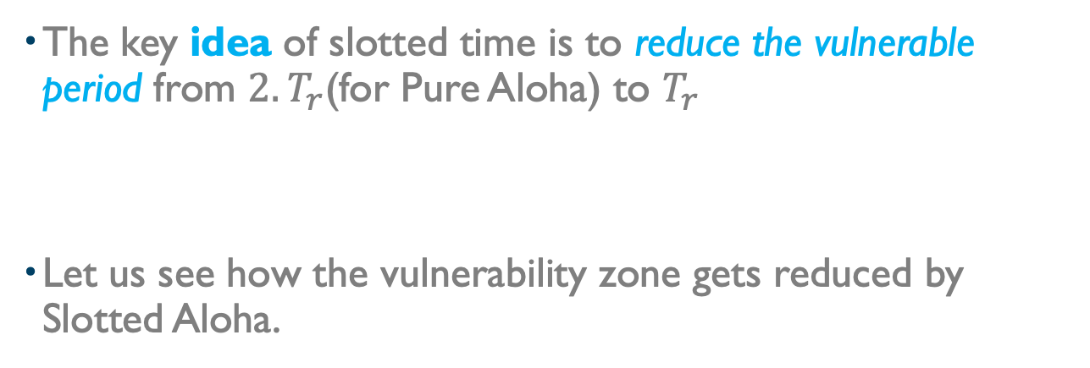
Analysis of Slotted Aloha (2)
The key idea of slotted time is to reduce the vulnerable period from $2.T_{r}$(for Pure Aloha) to $T_{r}$
Let us see how the vulnerability zone gets reduced by Slotted Aloha.

Slide 26
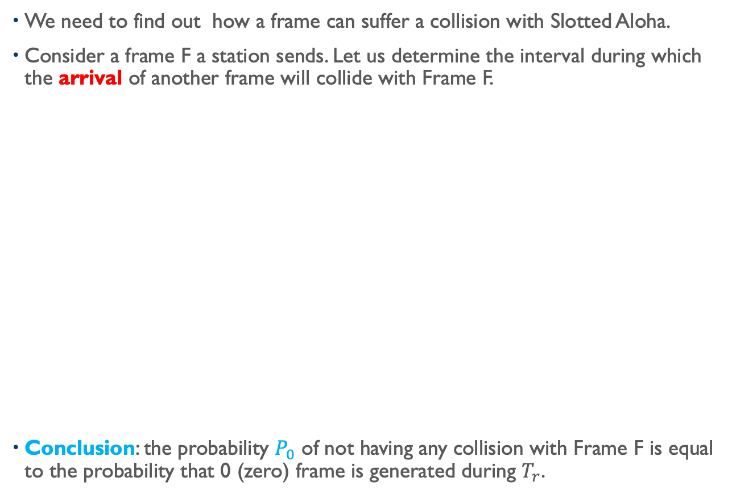

How Does Sloted Aloha Reduces the Vulnerability Zone?
We need to find out how a frame can suffer a collision with Slotted Aloha.
Consider a frame F a station sends. Let us determine the interval during which the arrival of another frame will collide with Frame F.
Conclusion: the probability $P_{0}$ of not having any collision with Frame F is equal to the probability that 0 (zero) frame is generated during $T_{r}$.
$$T_{r}$$
Frame F
time
Will wait next slot ➔ No collision
Vulnerable
Zone
Will wait next slot ➔ No collision
No collision
$$T_{r}$$

Slide 27
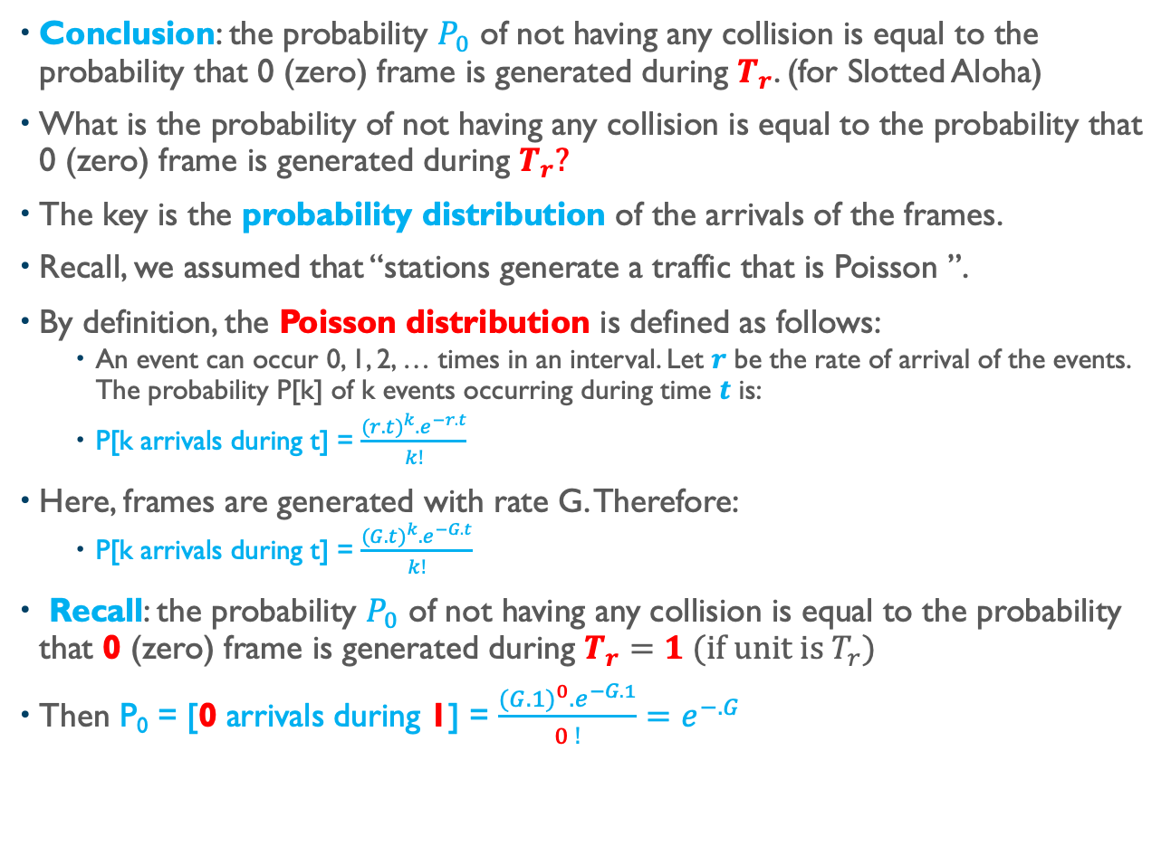
Slotted Aloha. Let us derive $P_{0}$
Conclusion: the probability $P_{0}$ of not having any collision is equal to the probability that 0 (zero) frame is generated during $T_{r}$. (for Slotted Aloha)
What is the probability of not having any collision is equal to the probability that 0 (zero) frame is generated during $T_{r}?$
The key is the probability distribution of the arrivals of the frames.
Recall, we assumed that “stations generate a traffic that is Poisson ”.
By definition, the Poisson distribution is defined as follows:
An event can occur 0, 1, 2, … times in an interval. Let $r$ be the rate of arrival of the events. The probability P[k] of k events occurring during time $t$ is:
P[k arrivals during t] = $\frac{{(r.t)}^{k}.e^{−r.t}}{k!}$
Here, frames are generated with rate G. Therefore:
P[k arrivals during t] = $\frac{{(G.t)}^{k}.e^{−G.t}}{k!}$
Recall: the probability $P_{0}$ of not having any collision is equal to the probability that 0 (zero) frame is generated during $T_{r}=1 (if unit is T_{r})$
Then P₀ = [0 arrivals during 1] = $\frac{{(G.1)}^{0}.e^{−G.1}}{0 !}=e^{−.G}$

Slide 28
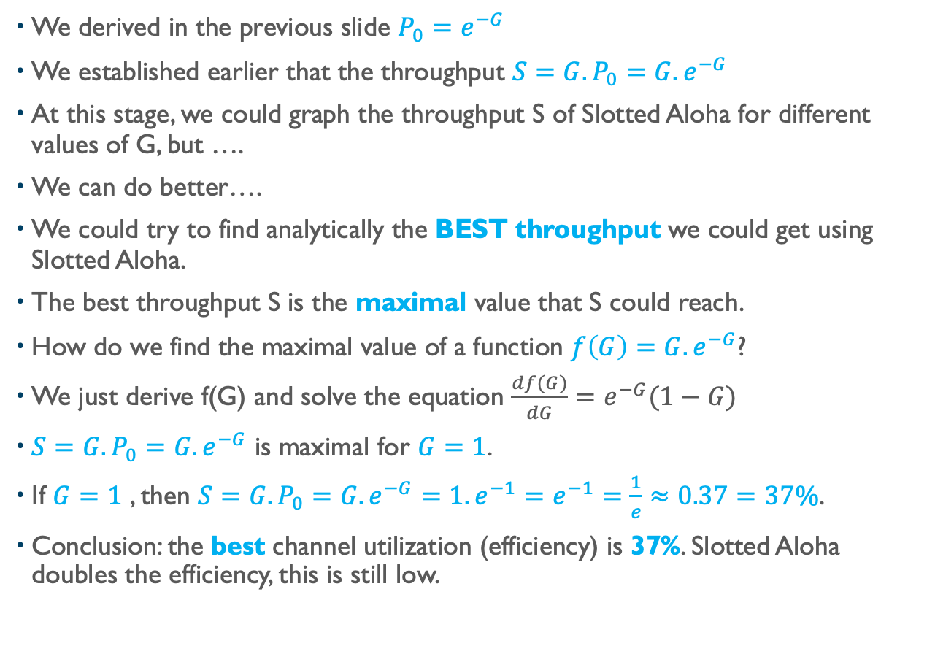
Slotted Aloha. Let us now derive the Throughput $S_{}$
We derived in the previous slide $P_{0}=e^{−G}$
We established earlier that the throughput ${S=G.P}_{0}=G.e^{−G}$
At this stage, we could graph the throughput S of Slotted Aloha for different values of G, but ….
We can do better….
We could try to find analytically the BEST throughput we could get using Slotted Aloha.
The best throughput S is the maximal value that S could reach.
How do we find the maximal value of a function $f\left(G\right)=G.e^{−G}$?
We just derive f(G) and solve the equation $\frac{df(G)}{dG}=e^{−G}(1−G)$
${S=G.P}_{0}=G.e^{−G}$ is maximal for $G=1$.
If $G=1$ , then ${S=G.P}_{0}=G.e^{−G}=1.e^{−1}=e^{−1}=\frac{1}{e}≈0.37=37\%$.
Conclusion: the best channel utilization (efficiency) is 37%. Slotted Aloha doubles the efficiency, this is still low.

Slide 29
Aloha Throughput Plot

Slide 30
Word About Carrier Sense Multiple Access CSMA
Designed by Metcalfe, analyzed by Kleinrock and Tobaggi
A station listens to the channel before sending.
If channel busy, wait until it becomes idle
When channel free, send with probability 1
Are collisions still possible?
Answer: Yes
The key objective is to reduce the vulnerability zone.
CSMA decreases the vulnerability zone, but as the distance between farthest stations increases, the vulnerability zone increases.
This is the reason why we do not use CSMA MAC protocols over distance beyond a couple of kms.
CSMA MAC protocols are used for “local” networks.
For long distance, we use point to point links.

Slide 31
Wrap Up
Introduction to Medium Access Control
OSI ref. model, need of MAC, static and dynamic allocation
Shortcomings of static allocation
Learn, understand, and analyze A Key Result from Queue Theory.
Key advantage of dynamic allocation (key result from queueing theory)
Caveats about dynamic allocation
Learn, understand, and analyze Pure Aloha.
Pure Aloha protocol, assumptions and notations, notion vulnerable zone, Poisson distribution, Probability P₀ of no collision, maximum throughput.
Learn, understand, and analyze Slotted Aloha
Slotted Aloha protocol, assumptions and notations, notion vulnerable zone, how does Slotted Aloha decrease the vulnerable zone, Probability P₀ of no collision, maximum throughput.
Notes:
Video Module 1-07

