Slide 1
The Logical Link Layer
A sublayer of the Data Link Layer
Notes:
Video Module 4A-01

Slide 2

Overview
Objectives
Learn and understand the Logical Link Layer (Role and services)
Learn and understand framing.
Learn and understand error control.
Overview of key Elementary data link protocols
Learn and understand the flow control.
Requirements
Know the OSI Reference Model
Read the related sections from the textbook:
Introduction to Chapter 3
Introduction of Section 3.1
Sections 3.1.1-3.1.4
Section 3.2
Section 3.3

Slide 3
Logical Link Layer (sublayer)
Logical Link Layer in the OSI Reference Model
Services
Read
Introduction of Chapter 3
Introduction of Section 3.1
Section 3.1.1

Slide 4
Where in the OSI Reference Model ?
Application
Presentation
Session
Transport
Network
Logical Link Layer
Data Link Layer
Medium Access Control
Physical

Slide 5
Data Link Layer Services
Provides service to the network layer
Consists of two sublayers
Logical Link Layer (LLL)
Provides a well-defined service interface to the network layer
Framing
Addressing
Deals with transmission errors (Error control)
Regulates flow of data for receivers slower than senders (flow control)
Medium Access Control (MAC)
In the case of a shared medium, this function provides means for sharing optimally the medium

Slide 6
Logical Link Layer Functions
Framing (3.1.2)
Byte count, Flag bytes with byte stuffing, Flag bits with bit stuffing, physical layer coding violation
Error control (3.1.3 and 3.2)
Detection and correction
Flow control (3.1.4)

Slide 7
Framing
What is framing?
Framing techniques
Byte count
Flag
byte stuffing
bit stuffing
Physical layer violations
Read Section 3.1.2
Notes:
Video Module 4A-02

Slide 8
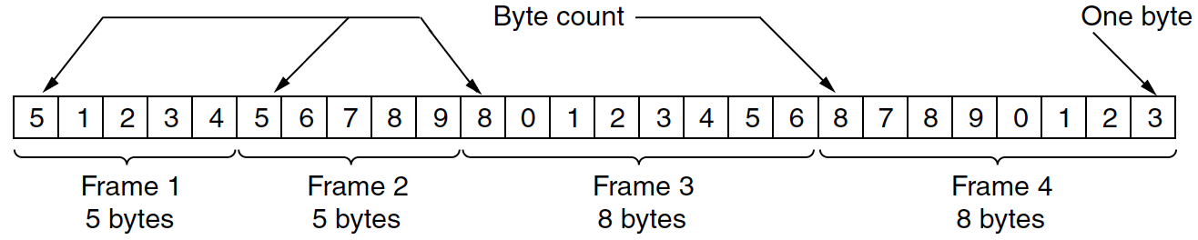
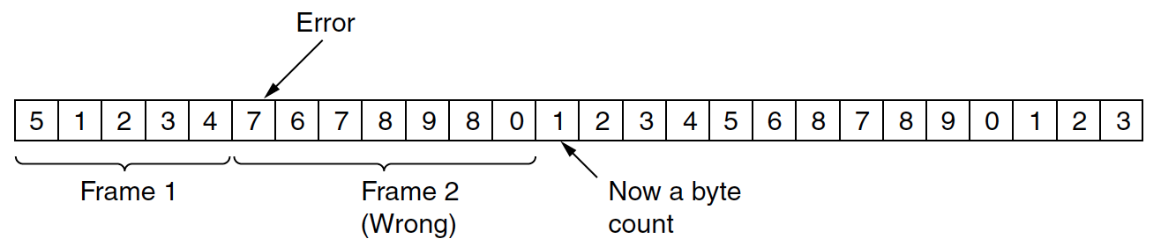
Byte Counting
Start each frame with the number of bytes in the frame (Including Byte counting).
Example:
Problems:

Slide 9
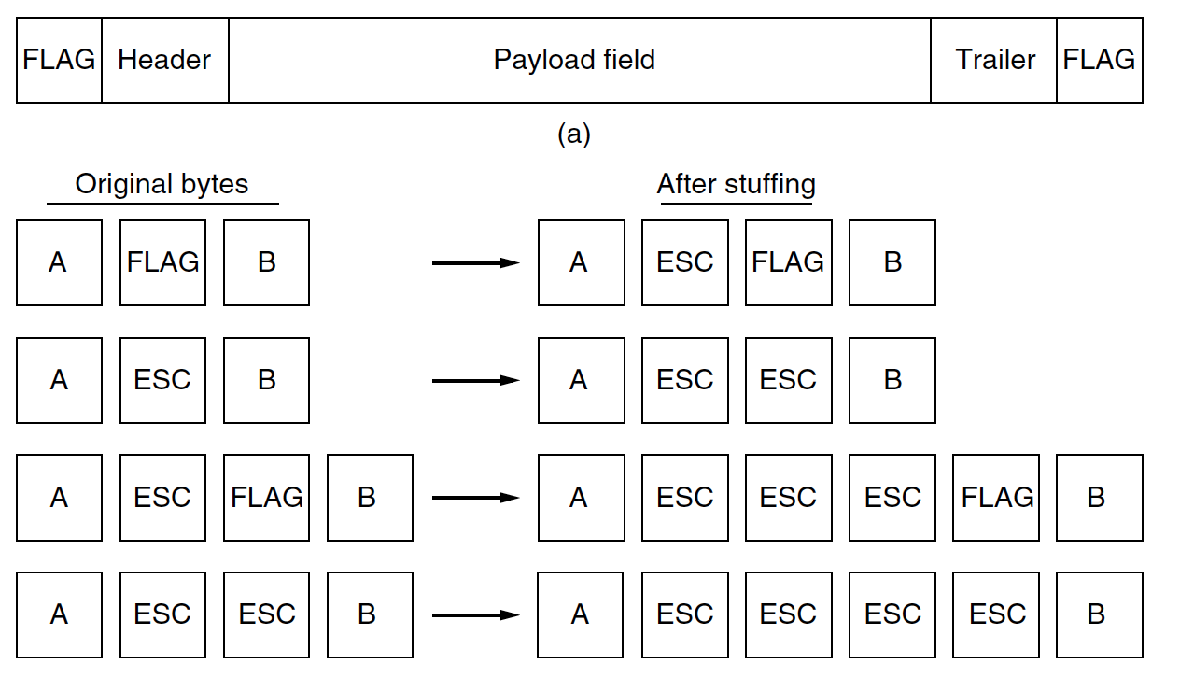
Flag Bytes with Byte Stuffing

Slide 10
Flag Bytes with Byte Stuffing

Slide 11
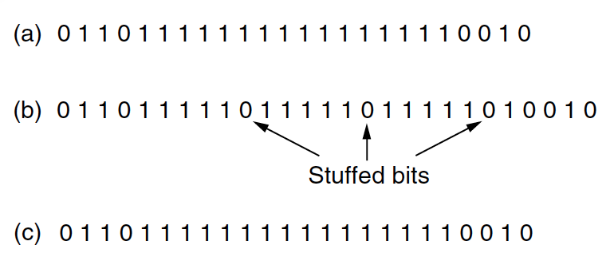
Flag Bits with Bit Stuffing
Flag in binary = 0x7E = 01111110
How to send a Flag as part of the payload field?
Answer:
At the sender: after every sequence of 5 1s, insert a 0
At the receiver: after every sequence of 5 1’s, remove the 0 (if there is one..)
To be sent

Slide 12
Flag Bits with Bit Stuffing
Flag in binary = 0x7E = 01111110
How to send a Flag as part in the payload field?
Answer:
At the sender: after every sequence of 5 1s, insert a 0
At the receiver: after every sequence of 5 1’s, remove the 0 (if there is one..)
To be sent

Slide 13
Error Control
What?
detects error transmission
may correct error transmissions (next lecture)
Why?
Physical layer cannot guarantee an ideal channel (no corruption)
How ?
Essentially adding check bits to detect and possibly correct.
Read Section 3.1.3
Notes:
Video Module 4A-03

Slide 14
Error Control
Error detection (only)
Parity
Cyclic Redundancy Code
Checksum
Error correction
Crossed parity
Hamming Code

Slide 15
Parity (Error Detection)
The sender adds a parity bit to the word such that the total number of bits (including the parity bit) is even (Even parity)
Example: 1011 0101 → 1011 0101 1
The receiver can then detect only odd number of corrupted bits
6 One’s

Slide 16
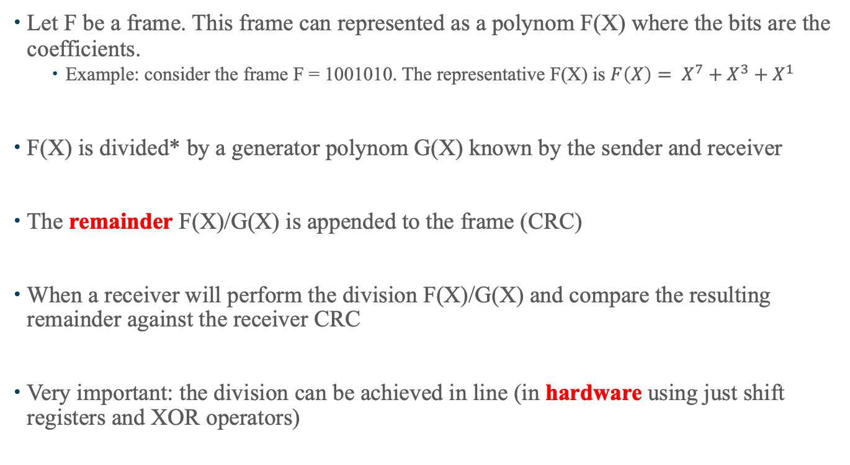
Cyclic Redundancy Code
Let F be a frame. This frame can represented as a polynom F(X) where the bits are the coefficients.
Example: consider the frame F = 1001010. The representative F(X) is $F\left(X\right)= X^{7}+X^{3}+X^{1}$
F(X) is divided* by a generator polynom G(X) known by the sender and receiver
The remainder F(X)/G(X) is appended to the frame (CRC)
When a receiver will perform the division F(X)/G(X) and compare the resulting remainder against the receiver CRC
Very important: the division can be achieved in line (in hardware using just shift registers and XOR operators)

Slide 17
Error Control (Detect and Correct)
What?
detects and correct error transmissions
Why?
Physical layer cannot guarantee an ideal channel (no corruption)
How ?
Essentially adding check bits to detect and possibly correct.
Read Section 3.1.3
Notes:
Video Module 4A-04

Slide 18
Crossed Parity
Each word is added a parity bit (horizontal parity)
A word of parity bits is appended to every group of n words (Vertical parity)
Example:
suppose we want to send 1011 0001 1001 in groups of three words using an even parity
Parity bits
1 | 0 | 1 | 1 | 1
0 | 0 | 0 | 1 | 1
1 | 0 | 0 | 1 | 0
0 | 0 | 1 | 1 | 0
Parity bits

Slide 19
Crossed Parity
Each word is added a parity bit (horizontal parity)
A word of parity bits is appended to every group of n words (Vertical parity)
Example:
suppose we want to send 1011 0001 1001 in groups of three words using an even parity
Parity bits
1 | 0 | 1 | 1 | 1
0 | 0 | 0 | 1 | 1
1 | 0 | 0 | 1 | 0
0 | 0 | 1 | 1 | 0
X
1
Parity bits

Slide 20
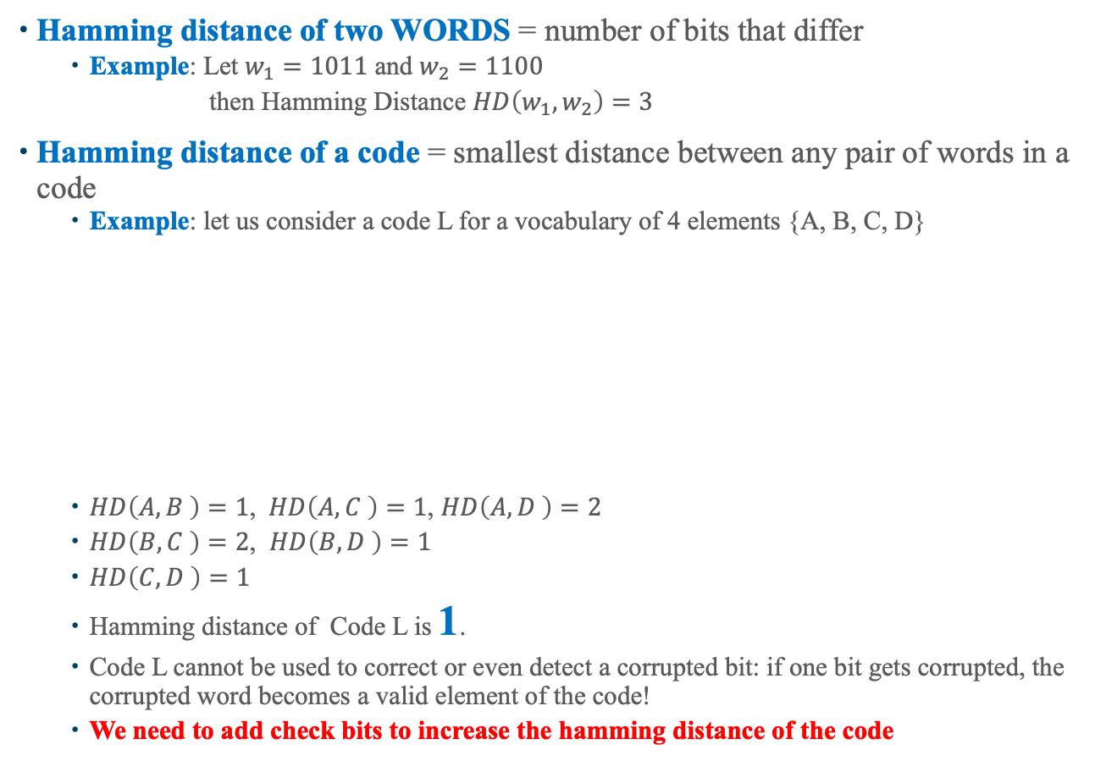
Hamming Code
Hamming distance of two WORDS = number of bits that differ
Example: Let $w_{1}=1011$ and $w_{2}=1100$
then Hamming Distance $HD\left(w_{1},w_{2}\right)=3$
Hamming distance of a code = smallest distance between any pair of words in a code
Example: let us consider a code L for a vocabulary of 4 elements {A, B, C, D}
$HD\left(A,B \right)=1$, $HD\left(A,C \right)=1$, $HD\left(A,D \right)=2$
$HD\left(B,C \right)=2$, $HD\left(B,D \right)=1$
$HD\left(C,D \right)=1$
Hamming distance of Code L is 1.
Code L cannot be used to correct or even detect a corrupted bit: if one bit gets corrupted, the corrupted word becomes a valid element of the code!
We need to add check bits to increase the hamming distance of the code
L
X
A | 0 | 0
B | 0 | 1
C | 1 | 0
D | 1 | 1
1
X
1

Slide 21
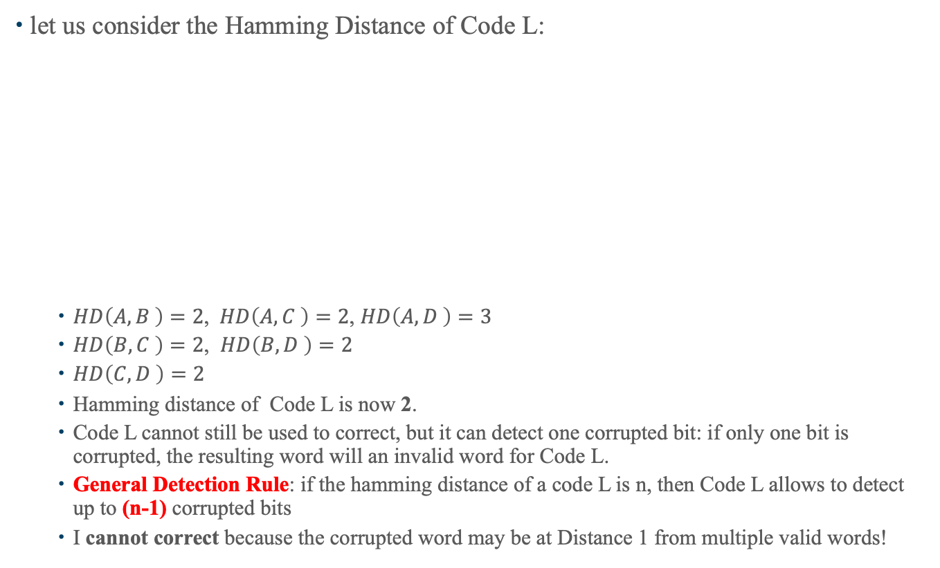
How to Increase the Hamming Distance of a Code?
let us consider the Hamming Distance of Code L:
$HD\left(A,B \right)=2$, $HD\left(A,C \right)=2$, $HD\left(A,D \right)=3$
$HD\left(B,C \right)=2$, $HD\left(B,D \right)=2$
$HD\left(C,D \right)=2$
Hamming distance of Code L is now 2.
Code L cannot still be used to correct, but it can detect one corrupted bit: if only one bit is corrupted, the resulting word will an invalid word for Code L.
General Detection Rule: if the hamming distance of a code L is n, then Code L allows to detect up to (n-1) corrupted bits
I cannot correct because the corrupted word may be at Distance 1 from multiple valid words!
Check Bits
L
A | 0 | 0 | 0
B | 0 | 1 | 1
C | 1 | 0 | 1
D | 1 | 1 | 0
X
0
X
1

Slide 22
How to Increase the Hamming Distance of a Code?
let us consider the Hamming Distance of Code L:
$HD\left(A,B \right)=2$, $HD\left(A,C \right)=2$, $HD\left(A,D \right)=3$
$HD\left(B,C \right)=2$, $HD\left(B,D \right)=2$
$HD\left(C,D \right)=2$
Hamming distance of Code L is now 2.
Code L cannot still be used to correct, but it can detect one corrupted bit: if only one bit is corrupted, the resulting word will an invalid word for Code L.
General Detection Rule: if the hamming distance of a code L is n, then Code L allows to detect up to (n-1) corrupted bits
I cannot correct because the corrupted word may be at Distance 1 from multiple valid words!
Check Bits
L
A | 0 | 0 | 0
B | 0 | 1 | 1
C | 1 | 0 | 1
D | 1 | 1 | 0

Slide 23
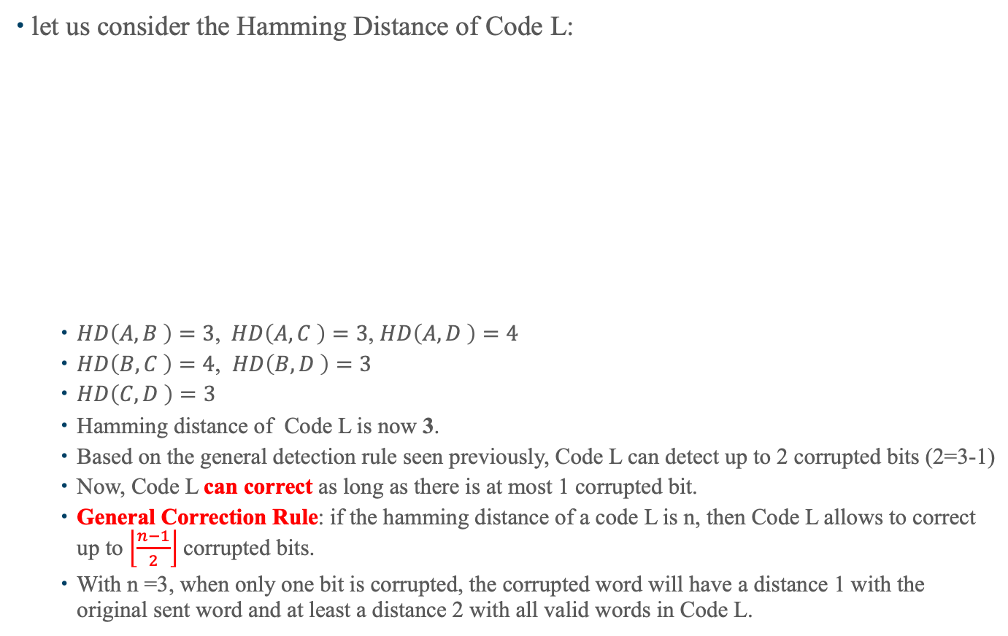
How to Increase the Hamming Distance of a Code?
let us consider the Hamming Distance of Code L:
$HD\left(A,B \right)=3$, $HD\left(A,C \right)=3$, $HD\left(A,D \right)=4$
$HD\left(B,C \right)=4$, $HD\left(B,D \right)=3$
$HD\left(C,D \right)=3$
Hamming distance of Code L is now 3.
Based on the general detection rule seen previously, Code L can detect up to 2 corrupted bits (2=3-1)
Now, Code L can correct as long as there is at most 1 corrupted bit.
General Correction Rule: if the hamming distance of a code L is n, then Code L allows to correct up to $\left\lfloor \frac{n−1}{2}\right\rfloor$corrupted bits.
With n =3, when only one bit is corrupted, the corrupted word will have a distance 1 with the original sent word and at least a distance 2 with all valid words in Code L.
Check Bits
L
A | 0 | 0 | 0 | 0 | 0
B | 0 | 1 | 1 | 0 | 1
C | 1 | 0 | 1 | 1 | 0
D | 1 | 1 | 0 | 1 | 1
X
0

Slide 24
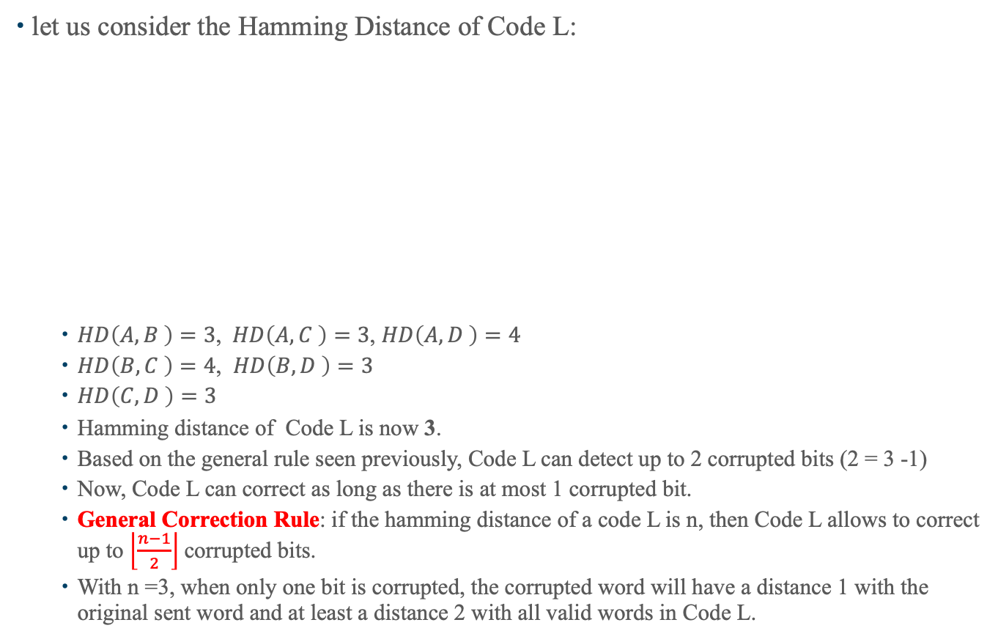
How to Increase the Hamming Distance of a Code?
let us consider the Hamming Distance of Code L:
$HD\left(A,B \right)=3$, $HD\left(A,C \right)=3$, $HD\left(A,D \right)=4$
$HD\left(B,C \right)=4$, $HD\left(B,D \right)=3$
$HD\left(C,D \right)=3$
Hamming distance of Code L is now 3.
Based on the general rule seen previously, Code L can detect up to 2 corrupted bits (2 = 3 -1)
Now, Code L can correct as long as there is at most 1 corrupted bit.
General Correction Rule: if the hamming distance of a code L is n, then Code L allows to correct up to $\left\lfloor \frac{n−1}{2}\right\rfloor$corrupted bits.
With n =3, when only one bit is corrupted, the corrupted word will have a distance 1 with the original sent word and at least a distance 2 with all valid words in Code L.
Check Bits
L
A | 0 | 0 | 0 | 0 | 0
B | 0 | 1 | 1 | 0 | 1
C | 1 | 0 | 1 | 1 | 0
D | 1 | 1 | 0 | 1 | 1
X
0

Slide 25
Elementary Data Link Protocols
Stop and wait
Window based
Performance
Read Section 3.3
Notes:
Video Module 4A-05

Slide 26
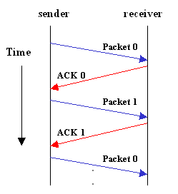
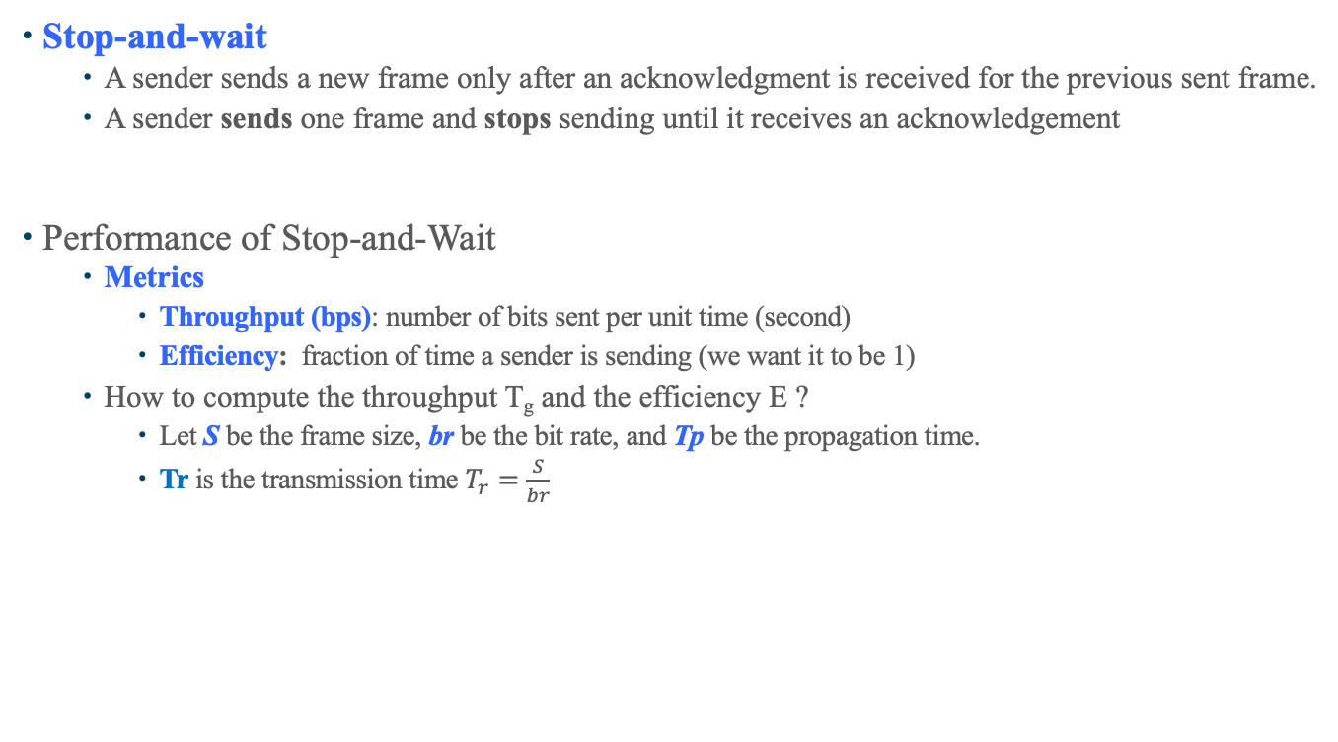
Elementary Data Link Protocols
Stop-and-wait
A sender sends a new frame only after an acknowledgment is received for the previous sent frame.
A sender sends one frame and stops sending until it receives an acknowledgement
Performance of Stop-and-Wait
Metrics
Throughput (bps): number of bits sent per unit time (second)
Efficiency: fraction of time a sender is sending (we want it to be 1)
How to compute the throughput T_{g} and the efficiency E ?
Let S be the frame size, br be the bit rate, and Tp be the propagation time.
Tr is the transmission time $T_{r}=\frac{S}{br}$

Slide 27
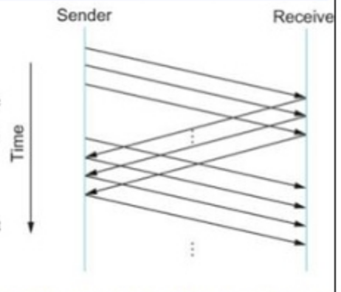
Sliding Window Protocol
Be optimistic:
send up to ws (window size) frames without waiting for (receiving) a positive acknowledgement
Performance of a sliding window protocol

Slide 28
Flow Control
What is flow control?
Why?
How?
Read Section 3.1.4

Slide 29
Flow Control
Flow control:
Flow control is about pacing a sender to avoid overrunning a slow receiver
In general, the receiver will control the sender
How?
Feedback based: the receiver controls the sender
Rate based: sender paces itself

Slide 30
Wrap Up
Learn and understand the Logical Link Layer (Role and services
Learn and understand framing.
Learn and understand error control.
Overview of Elementary data link protocols
Learn and understand the flow control.
Notes:
Video Module 4A-05

