Slide 1
Network Layer
Notes:
Video Module 5-01

Slide 2

Overview
Objectives
Get familiar with the Network Layer
Learn and understand Routing Policies (algorithms and protocols)
Learn how to Update Routing Tables (Routing policy)
Learn about the routing mechanism (IP) for Routing over the Internet
Learn about some IP helpers (IP)
Requirements
Read Intro, 5.1.1, 5.1.2, 5.1.3,
Read 5.2 Intro, Skim 5.2.1, Skim 5.2.2, Skim 5.2.3,
Read 5.2.4, Read 5.2.5,
Skim 5.5,
Read 5.6 up to 5.6.2
Read 5.6.4

Slide 3
Introduction
The network layer in the OSI Reference model
Functions/Services of the network Layer
Connectionless and connection oriented
Read Introduction and Sections 5.1.1-5.1.3
Notes:
Video Module 7-01

Slide 4
Where in the OSI Reference Model ?
Session Layer
Transport Layer
Network Layer
Link Layer
Physical Layer

Slide 5
Fundamental Functions of a Network Layer
Neat interface for the transport layer
Addressing
Routing
Congestion control
Some network protocols provide congestion control

Slide 6
Network Layer Protocols : two families
Connectionless
Each piece of information (message) is sent as an independent entity. No state information is kept on hosts, routers, or intermediary L3 switches.
Connection oriented
There exists a virtual circuit over which all pieces of information (messages) will transit. Intermediary nodes keep a state about the circuit.

Slide 7
Connectionless vs Connection-oriented
Circuit setup
Addressing
State information
Routing
Effect of routing failures
Congestion control

Slide 8
Routing
Routing policy:
updates the routing table
Routing mechanism:
decides how to route a packet depending on some policy (i.e, chooses the output line)
modifies
Routing
table
reads
Quite elementary

Slide 9
Routing Policy Algorithms
How to update the routing tables?
Routing algorithms
Distance vector routing
Link state routing
Flooding
Routing protocols
Routing Information Protocol (RIP)
Open Shortest Path First (OSPF)
Border Gateway Protocol (BGP)
Read Introduction and Sections 5.2.4-5.2.5
Read Sections 5.6.6 and 5.6.7
Notes:
Video Module 5-02

Slide 10
Routing Policy: Updating the Routing Tables
Manual
Using daemons on the routers (L3 switches):
A daemon is a piece of software continuously running: it uses some algorithm to find paths and some protocols to communicate with other routers to gather information and send out information.

Slide 11
Routing Policies (Algorithms) and Protocols
Routing policies (algorithms)
Distance vector routing (DVR)
Link state routing (LSR)
flooding
Routing protocols
Interior gateway protocols (IGP)
Routing Information Protocol (RIP)
Open Shortest Path First (OSPF)
Exterior gateway protocol (EGP)
BGP
Protocol | Policy/Algorithm
RIP | DVR
OSPF | LSR
BGP | Path Vector Protocol

Slide 12
Distance Vector Routing
A node periodically
tells to its neighbors only
its distance to EVERY NODE in the network
Example:
Initially (each node knows only about cost to its neighbors only):
A → vector = (0,1,4,inf),
B → vector = (1,0,1,1)
C → vector = (4,1,0,3)
D → vector = (inf,1,3,0)
In Round 1, each node sends its vector
After one round, every node will know the shortest path and the gateway
B
1
1
A
1
D
Routing Table (Gateways)
4
3
→ | A | B | C | D
A | 0 | 1(B) | 2(B) | 2(B)
B | 1(A) | 0 | 1(C) | 1(D)
C | 2(B) | 1(B) | 0 | 2(B)
D | 2(B) | 1(B) | 2(B) | 0
C

Slide 13
Distance Vector Routing (Problems!!!)
When ?
Links go down
What kind of problem ?
Count-to-infinity
Example
Initially
A (0,1,inf)
B (1,0,1)
C (inf,1,0)
Solution
path vector
Send the distance vector but with the path also
A
B
C
X
1
1
(0,1,inf)→
←(1,0,1)
(0,1,2)→
←(1,0,1)
X
(0,1,2)→
←(1,0,3)
(0,1, 4)→
←(1,0, 5)
(0,1, 6)→
←(1,0, 7)

Slide 14
Link-State Routing
A node
tells EVERY node (through flooding)
its distance to its immediate NEIGHBORS
How ?
Send link-state packets (LSP)
Using controlled flooding
Use Dijkstra’s algorithm or Bellman-Ford
B
1
1
A
1
D
4
4
C

Slide 15
Internal and External Protocols
Autonomous
Systems
Exterior Gateway
Protocol
Autonomous
Systems
LANs
Internet Backbone
Autonomous
Systems
Interior Gateway
Protocol
Autonomous
Systems

Slide 16
Routing Policy Protocols
How to update the routing tables?
Routing algorithms
Distance vector routing
Link state routing
Routing protocols
Interior
Routing Information Protocol (RIP)
Open Shortest Path First (OSPF)
Exterior
Border Gateway Protocol (BGP)
Read Introduction and Sections 5.2.4-5.2.5
Read Sections 5.6.6 and 5.6.7
Notes:
Video Module 5-03

Slide 17
RIP (RFC 1058) (Routing Information Protocol)
Interior gateway protocol
Distance vector algorithm
Uses split horizon to avoid count-to-infinity (Does not advertise a cost to a neighbor if it is a next hop for that destination)
Exchange each 30s
Time-out after 180 s.

Slide 18
OSPF (RFC 1247) (Open Shortest Path First)
Interior gateway protocol
Link state protocol
Uses directly IP (while RIP uses UDP)

Slide 19
BGP (RFC 1267) (Border Gateway Protocol)
Exterior gateway protocol
(Exception: BGP uses TCP !!!!)
Path Vector protocol (+ policy attributes)
Topology may be loop-free (BGP guarantees loop-freeness)

Slide 20
A Mechanism (IP)
What is a routing mechanism?
The Internet Protocol (IP) is a mechanism
How is an IP packet carried?
The IP header
IP Addresses
IP subnetting
Read Section 5.6 up to 5.6.1
Notes:
Video Module 5-04

Slide 21
Routing Mechanism
Takes the decision how to route
Examples:
Early Exit (known also as Hot Potato)
IP (Internet Protocol)
These mechanisms do NOT modify the routing tables. They may read them.
For example, the IP protocol implements on each Internet host a mechanism to route. We will study what it does to route

Slide 22
A Connectionless Network Layer: the Internet Protocol (IP)
The Internet Protocol is implemented on every:
host that is connected to Internet
router on a LAN connected to the Internet
router on the backbone
L3 switch on Internet
Application
Transport
Network IP
Link Layer

Slide 23
Fundamental Idea of IP
Routes between networks.
Why? It makes routing tables shorter

Slide 24
IP Packet
An IP packet is encapsulated in a frame ([Data] Link Layer)
Preamble
Dest
Source
Type
Payload
CRC
IP Packet
0x0800
Header
6
6
2
46-1500

Slide 25
IP Header
0
31
15 16
V
IHL
TOS
Total Length
16-bit identification
Flgs
13-bit frag. offset
TtL
Protocol
Header Checksum
32-bit source IP address
32-bit destination IP address
Options (Variable 0 ---> ??)
Data Payload (TCP segment,
or UDP Datagram, or ICMP ….)

Slide 26
IP Header Fields (1/2)
V : 4-bit number indicating the version
HL: 4-bit number indication the number of 32-bit words making the header. This number hints to whether the header contains options fields or not. If HL = 5, the header does not include any options.
TOS: Type Of Service. Indicates to the router the type of service this packet prefers. Specifically, it indicates the quality metrics to optimize: throughput, delay, cost….
Total Length: total number of bytes making the packet.
Identification: this 16-bit number identifies a packet (a fragment)
Flags: 3 bits (two of them (DF and MR) related to fragmentation and one unused)
Fragment Offset: 13 bit number indication the fragment number in a packet

Slide 27
IP Header Fields (2/2)
TTL: Time To Live. This 8-bit field determines the maximum number of hops the packet should travel. TTL is decremented at each router. If TTL reaches 0, the router drops the packet.
Protocol: this 8-bit number indicates the “type” of payload (=6 for TCP, =17 for UDP, and =1 for ICMP
Checksum: this 16-bit number is the checksum on the HEADER. The header is organized as 16 bit words. All the words are added such that whenever there is a carry C, that carry C is simply added to the running sum. When the sum S is computed, the checksum is set to ~S (NOT(S), i.e, one-complement of S).
Source: 32 bit bit Source address.
Destination: 32 bit bit Destination address.
Options: cover special features.

Slide 28
IP Addresses
What is a routing mechanism?
The Internet Protocol (IP) is a mechanism
How is an IP packet carried?
The IP header
IP Addresses
IP subnetting
Read Section 5.6.2
Notes:
Video Module 5-05

Slide 29
IP Address (Review)
32 bits
IPv4
8 bits
8 bits
8 bits
8 bits

Slide 30
IP(v4) Address Structure (1/2)
Recall: IP routes between networks
An IP address will have two pieces of information:
A Network ID (netid)
A Host ID (hostid)
What should be the value of n?
n bits
32-n bits
netid
hostid
32 bits
IP Address

Slide 31

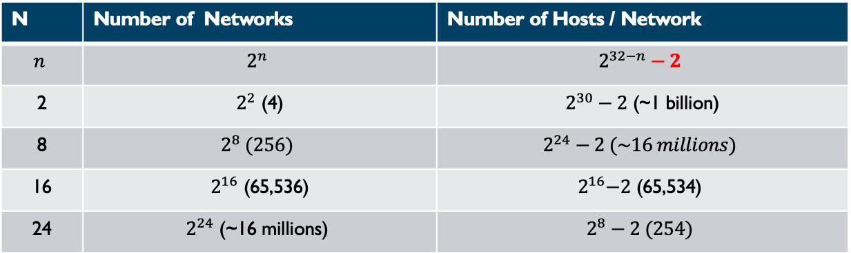
IPv4 Address Structure (2/2): What Should be the value of n?
How to choose n?
Let us try different different values on and see how many networks and hosts per network we can have.
N | Number of Networks | Number of Hosts / Network
$$n$$ | $$2^{n}$$ | $$2^{32−n}−2$$
2 | $2^{2}$ (4) | $2^{30}−2$ (~1 billion)
8 | $$2^{8} (256)$$ | $$2^{24}−2 (\sim 16 millions)$$
16 | $2^{16}$ (65,536) | $$2^{16}\text{−2}\text{ (65,53}\text{4}\text{)}$$
24 | $$2^{24}\text{ (\sim 16 }\text{millions}\text{)}$$ | $$2^{8}−2 (254)$$
n bits
32-n bits
netid
hostid
32 bits
IP Address

Slide 32
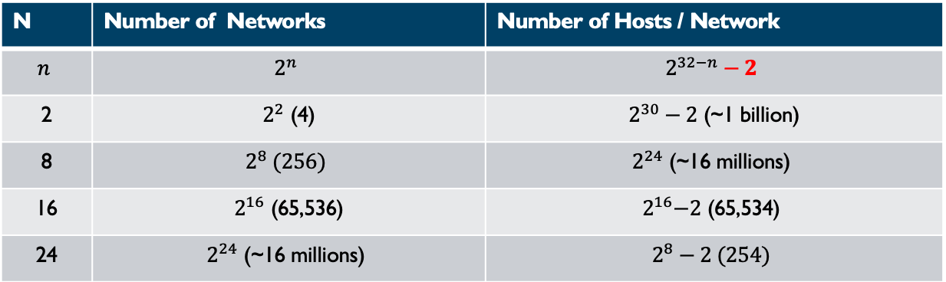
IPv4 Address Structure (2/2): What Should be the value of n?
How to choose n?
Let us try different different values on and see how many networks and hosts per network we can have.
N | Number of Networks | Number of Hosts / Network
$$n$$ | $$2^{n}$$ | $$2^{32−n}−2$$
2 | $2^{2}$ (4) | $2^{30}−2$ (~1 billion)
8 | $$2^{8} (256)$$ | $$2^{24}\text{ (\sim 16 }\text{millions}\text{)}$$
16 | $2^{16}$ (65,536) | $$2^{16}\text{−2}\text{ (65,53}\text{4}\text{)}$$
24 | $$2^{24}\text{ (\sim 16 }\text{millions}\text{)}$$ | $$2^{8}−2 (254)$$
n bits
32-n bits
netid
hostid
32 bits
IP Address

Slide 33
Internet Addresses : A Compromise … Classes
Having different classes of addresses
Class A
Class B
Class C
Class D
Class E
7bits
24 bits
0
netid
hostid
14 bits
16 bits
1
0
netid
hostid
21 bits
8 bits
1
1
0
netid
hostid
28 bits
1
1
1
0
Multicast group ID
27 bits
1
1
1
1
0
Future use

Slide 34
Addresses Range By Classes
Ranges for the dotted decimal notation: W.X.Y.Z
Class A : 0 - 127*
Class B : 128 - 191
Class C : 192 - 223
Class D : 224 - 239
Class E : 240 - 254

Slide 35
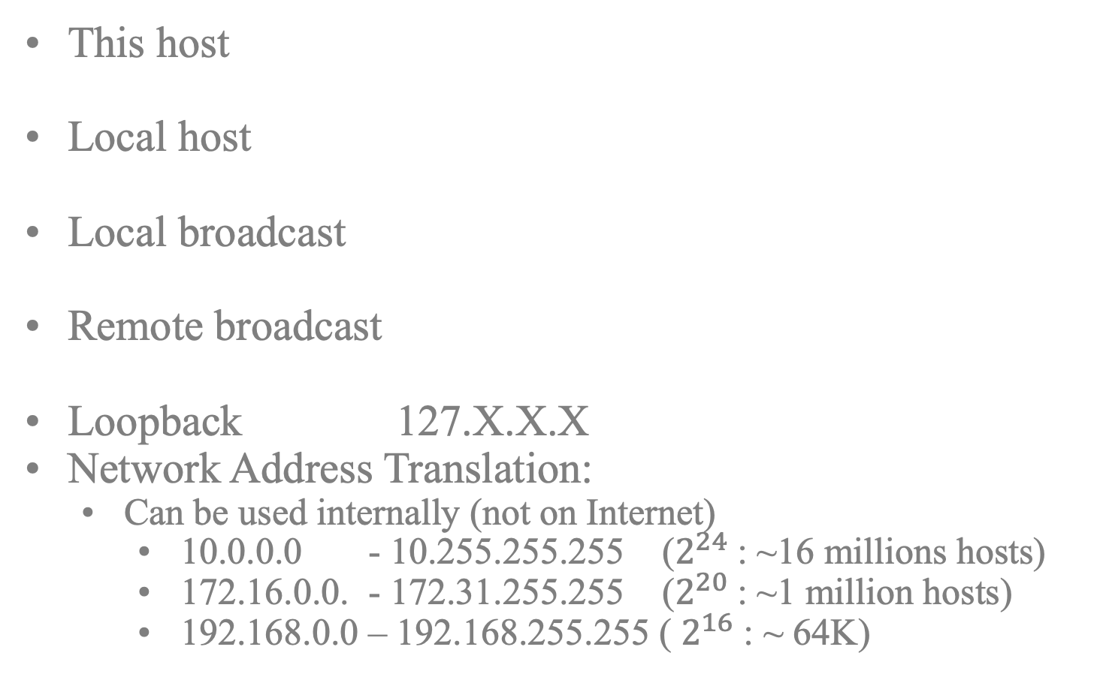
Special/Reserved Internet Addresses
32 bits
000000000000…..000000000000000000
This host
Local host
Local broadcast
Remote broadcast
Loopback 127.X.X.X
Network Address Translation:
Can be used internally (not on Internet)
10.0.0.0 - 10.255.255.255 ($2^{24}$: ~16 millions hosts)
172.16.0.0. - 172.31.255.255 ($2^{20}$: ~1 million hosts)
192.168.0.0 – 192.168.255.255 ( $2^{16}$ : ~ 64K)
00000….0000000
hostid
1111111111111…..11111111111111111
NetID
11111111111…..111111111

Slide 36
Internet Addresses (Cont’d)
Unicast addresses (Classes A, B, and C)
Multicast addresses (Class D)

Slide 37
Subnets
What is a subnet?
Why subnetting?
How is subnetting done?
A key tool: the subnet mask
Read Section 5.6.2
Notes:
Video Module 5-06

Slide 38
Subnetting
What is a subnet?
It is a network that is part of another larger network (the subnet uses a subset of the addressing space of the network).
Example:
Auburn is assigned the network with netid 131.204.0.0
The Auburn network is a class B network
Why subnetting ?
A class A (or even Class B) network has a large number of hosts (16M for Class A and 65,534 for a Class B)
In general, hosts on the same network will share a broadcast medium. 65,534 hosts are too many to share a medium.
How is it done ?
Notion of subnet mask

Slide 39
Subnetting (RFC 950)
14 bits
16 bits
Class B
1
0
netid
hostid
m bits 32-16-m bits
We divide the 16 bits addressing space
netid hostid
5 bits
11 bits
Example : Subnet AU network
131.204.0.0
netid hostid
Problem : How to know the number m of bits of the subnet ID?
In our example, the subnet ID has 16 bits + 5 bits = 21 bits…..
Answer:
use a subnet mask that is a binary number starting with 21 ones and finishing with 11 zeros
Here the subnet mask = 1111 1111 1111 1111 1111 1000 0000 0000
Subnet ID = IP Address & subnet Mask (Bitwise AND)

Slide 40
Subnet Mask
Example 1:
- What is the subnet ID of IP address 131.204.65.34 if the subnet mask is 255.255.255.0?
- 131.204.65.34 = 1000 0011 1100 1100 0100 0001 0010 0010
- 255.255.255.0 = 1111 1111 1111 1111 1111 1111 0000 0000
- Subnet ID = Bitwise IP&Mask
Bitwise IP&Mask = 1000 0011 1100 1100 0100 0001 0000 0000 = 131.204.65.0
- Subnet ID = 131.204.65.0
Example 2:
- What is the subnet ID of IP address 131.204.65.34 if the subnet mask is 255.255.255.240?
- 131.204.65.34 = 1000 0011 1100 1100 0100 0001 0010 0010
- 255.255.255.240 = 1111 1111 1111 1111 1111 1111 1111 0000
- Subnet ID = Bitwise IP&Mask
Bitwise IP&Mask = 1000 0011 1100 1100 0100 0001 0010 0000 = 131.204.65.32
Example 3:
- What is the subnet ID of IP address 131.204.65.34 if the subnet mask is 255.255.240.0?
- 131.204.65.34 = 1000 0011 1100 1100 0100 0001 0010 0010
- 255.255.240.0 = 1111 1111 1111 1111 1111 0000 0000 0000
- Subnet ID = Bitwise IP&Mask
Bitwise IP&Mask = 1000 0011 1100 1100 0100 0000 0000 0000 = 131.204.64.0

Slide 41
Checking Whether Two IP Addresses Are on the Same Subnet
How to know that two hosts with IP addresses IP₁ and IP₂, respectively
are one the same subnet?
Idea : IP₁ IP₂
& (Bitwise AND)
&
Subnetmask
Subnetmask
= SubnetID₁
= SubnetID₂
If subnet IDs equal then IP₁ and IP₂ are on the same subnet

Slide 42
Shorthand Subnet Mask Notation (/m)
Shorthand notation for subnet mask:
How to express an IP 131.204.65.34 with a subnet mask is 255.255.255.0?
Shorthand is 131.204.65.34/24
Why 24?
Subnet mask = 255.255.255.0 = 1111 1111 1111 1111 1111 1111 0000 0000
There are 24 ones in the subnet mask.
Example 1: How to express an IP 131.204.65.34 with a subnet mask is 255.255.255.240?
Subnet mask = 255.255.255.240 = 1111 1111 1111 1111 1111 1111 1111 0000
Shorthand is 131.204.65.34/28
Example 2: How to express an IP 131.204.65.34 with a subnet mask is 255.255..240.0?
Subnet mask = 255.255.240.0 = 11 1111 1111 1111 1111 0000 0000 0000
Shorthand is 131.204.65.34/20

Slide 43
Devices Connecting Machines
If two machines M1 and M2 have IP addresses with different subnet IDs, there is necessarily a router (or an L3 switch) on the path between M1 to M2.
The network interfaces of a router (L3 switch) have addresses that have different subnet IDs.

Slide 44
IP Routing
How to select the next router (hop)?
Routing table
How does IP use the routing table?
Read Section 5.6.2
Notes:
Video Module 5-07

Slide 45
IP Mechanism
Consider a machine M with IP address IP_{m} that is handed an IP packet P with a destination IP address IP_{d}. IP on Machine M will handle P as follows:
if (IP_{d} = IP_{m}) { // is the packet P for ”me” (Machine M)
hand Packet P to appropriate transport layer protocol (based on protocol #)
} else {
if (IP_{d} local to one of my interfaces) { // Is M on the same network as IP_{d}? (Local)
Get the MAC Address MAC_{d} of the interface having IP address IP_{d} (See ARP)
Ask data link layer to send Packet P to Machine with MAC address MAC_{d}.
} else { // M is on a different network than IP_{d}
Read Routing Table to find a router R to forward Packet P
Get MAC Address MAC_{R} of the router
Ask data link layer to send Packet P to Machine with MAC address MAC_{R}.
}

Slide 46
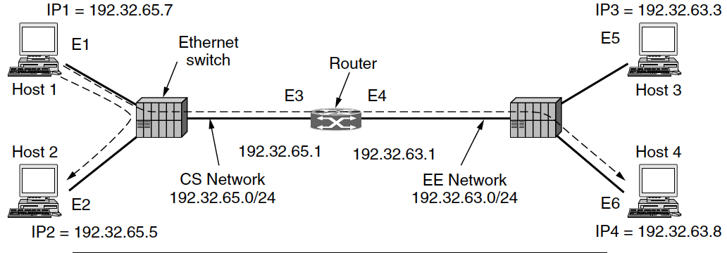
IP Mechanism Example 1 (Illustration)
Suppose that the transport layer (TCP or UDP) on Host 1 hands to IP an IP packet to send to Host 2. IP₁ = 192.32.65.7/24 and IP₂ = 192.32.65.5/24.
Subnet ID for IP₁ = 192.32.65.7 & 255.255.255.0 = 192.32.65.0
Subnet ID for IP₂ = 192.32.65.5 & 255.255.255.0 = 192.32.65.0
The subnet IDs are equal: Destination IP₂ is local
Host 1 will then get the MAC address of Host 2 (i.e., E₂), put the packet P in a frame, send this frame to MAC address E₂.

Slide 47
IP Mechanism Example 2 (Illustration)
Suppose that the transport layer (TCP or UDP) on Host 1 hands to IP an IP packet to send to Host 3. IP₁ = 192.32.65.7/24 and IP₃ = 192.32.63.3/24.
Subnet ID for IP₁ = 192.32.65.7 & 255.255.255.0 = 192.32.65.0
Subnet ID for IP₃ = 192.32.63.3 & 255.255.255.0 = 192.32.63.0
The subnet IDs are different: Destination is on a different network
Host 1 will read the routing table and find that the router has MAC address E₃.
Host 1 will then get the MAC address of Router (i.e., E₃), put the packet P in a frame, send this frame to MAC address E₃.

Slide 48
IP Routing : The Routing Table
Based on a routing table with entries having
Destination IP addr (host ID or net ID)
Subnet Mask
Next hop router IP address
flags (hostid or netid, next hop or connected interface…)
network interface
Destination IP | Subnet Mask | Router IP Address | Network Interface Card
131.204.0.0 | 255.255.0.0 | 134.89.200.54 | ………
0.0.0.0 |  | 200.134.67.24 | …….

Slide 49
IP Routing : Selecting the next Hop (Router)
1) Try to find a complete IP address match in the routing table
2) If 1) fails, then try to find the longest match with some network id. If the subnet ID of the destination matches with 131.204.0.0 and 131.204.65.0 then choose 131.204.65.0 in the routing table
if 1) and 2) fail search for default router (entry 0.0.0.0)

Slide 50
IP “Helpers”
ARP (Address Resolution Protocol) : RFC 826
DHCP (Dynamic Host Configuration Protocol) (RFC 1541)
ICMP (Internet Control Message Protocol) (RFC 792)
Read Section 5.6.4
Notes:
Video Module 5-08

Slide 51
ARP (Address Resolution Protocol) What?
ARP (Address Resolution Protocol) : RFC 826
Maps an IP address to a MAC address
Input: IP address IP_{a}
Output: MAC address of interface having IP address IP_{a}.
Transport Layer
Network Layer
What is Mac Address for IP_{a}? →
IP
ARP
← Here is Mac Address for IP_{a}
Link Layer
Physical Layer

Slide 52
ARP (Address Resolution Protocol) How?
When ARP receives a request (“What is the MAC Address for IP Address IP_{a}?)
ARP searches in its cache for an entry with IP_{a}
If there is an entry, it takes the associated MAC address and sends it back to IP.
If it does NOT find an entry, it performs these actions:
It broadcasts on the local network the message “Who has the IP address IPa?”
It waits for a response…
When it receives a response with the associated MAC address, it stores it in its cache and sends the MAC address to IP.

Slide 53
DHCP (Dynamic Host Configuration Protocol)
Every machine needs the following information to communicate over the Internet
IP address
Subnet mask
IP address of the DNS server (DNS maps host names to IP addresses)
IP address of the default gateway (Router to go to the Internet)
How to configure the machine with this information?
Manually?
Use a configuration file?
Use DHCP
Each machine should have a “reachable” DHCP server on the network
The DHCP client on the machine will (at startup in general):
discover the DHCP server
collect the IP address, subnet mask, IP address of DNS server, and the IP address of default gateway

Slide 54
ICMP (Internet Control Message Protocol)
This protocol helps when anomalies occur
TTL reaches 0 and the packet must be dropped
Routing error
An IP packet must be fragmented, but its fragmentation flag does not allow it…
When an anomaly occurs, ICMP
builds an ICMP message that contains the beginning of the “faulty” packet (first 64 bytes including the IP header and the transport layer header)
Sens back a message to the source of the “faulty” packet.

Slide 55
Wrap-Up
Get familiar with the Network Layer
Learn and understand Routing Policies (algorithms and protocols)
Learn how to Update Routing Tables (Routing policy)
Learn about the routing mechanism (IP) for Routing over the Internet
Learn about some IP helpers (IP)
Notes:
Video Module 5-09

