Slide 1
Transport Layer
Notes:
Video Module 6-01

Slide 2

Overview
Objectives
Learn and understand the transport layer (in general).
Learn and understand the Transmission Control Protocol (TCP).
Learn and understand the User Datagram Protocol (UDP).
Requirements
Read Sections 6.1.1-6.1.2, 6.2.1, 6.2.4, and 6.2.5.
Read Section 6.5 (pp552-581).
Read Section 6.4 (pp 541-543. Stop at RPC (excluded)).

Slide 3
Introduction
Transport layer in the OSI reference model
Services of the transport layer
Addressing,
Reliability
Flow control
Congestion control
Read Sections 6.1.1-6.1.2, 6.2.1, 6.2.4, and 6.2.5.

Slide 4
What is the Transport Layer ?
It provides a service (to define) to the session layer (in OSI)
It request service from the network layer
Session
Transport
Network
Link Layer

Slide 5
Why Do We need a Transport Layer ?
Because the network layer may be an unreliable (lousy) agent:
It may loose packets
It may reorder packets
It may duplicate packets
The network layer identifies HOSTS (interfaces more precisely) only!!!
Moreover, in general a connectionless network layer does not provide any flow or congestion control.

Slide 6
Transport layer Provides END-TO-END Services
Reliability
Addressing
Flow control
Congestion control
In addition, it may offer some Quality of Service (QoS) guarantees

Slide 7
END-TO-END !!!
Upper layers
Upper layers
Transport
Transport
Network
Network
Network
Link Layer
Link Layer
Link Layer
Network
Phone line
IEEE 802.3
Link Layer
ATM
Network
Link Layer
Network
Satellite link
Link Layer

Slide 8
Reliability
How to provide reliability ?
In general, reliability is done by:
Error Detection + Retransmission because of corrupting channel
Must number units of communications (TPDU, segments) if acks can be corrupted
Timeout at sender + Retransmissions because of lossy channel

Slide 9
A form of Addressing
An entity for the network layer may have multiple “connections”, how to differentiate them ?
The transport layer assigns different “numbers” to different connections on the same host

Slide 10
Flow Control
A fast sender should now overflow a slow RECEIVER.. How to avoid this ?
The receiver advertizes the size of its input buffers.
The sender limits the number of outstanding data units to the size advertized.

Slide 11
Congestion Control
A sender should not overflow the intermediary devices on the NETWORK. How ?
Use losses as indication of congestion (when devices overflow, they drop packets)
Use of variations if round trip time (when queues get longer, delay spent in devices increase)
Congestion control is a difficult problem still intensely studied by researchers.

Slide 12
Transport Protocols on The Internet
TCP: (Transmission Control Protocol RFC 793) offers a reliable connection-oriented in order byte stream
UDP : (User Datagram Protocol RFC 768) offers an unreliable connectionless byte stream.

Slide 13
Transmission Control Protocol (TCP RFC 793)
TCP in the TCP/IP Reference Model
Services provided by TCP
Addressing,`
TCP Header
Header fields related to addressing
Reliability
Flow control
Congestion control
Read Sections 6.2.1 and 6.5.4,
Notes:
Video Module 6-02

Slide 14
Where in TCP/IP Model ?
Application
Transport TCP
Network
Link Layer

Slide 15
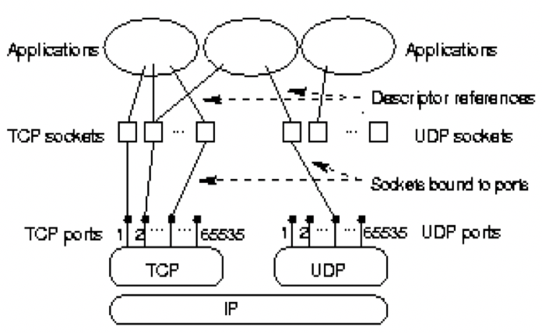
Addressing in TCP
TCP uses Ports
A port identifies a TCP (server or client).
At the application level, the TCP (server or client) is bound to a port number
The port number is a 16 bit number (0-65535)
How does a TCP server and client exchange port numbers?
Answer:
The port numbers are carried inside the TCP header
Where is the TCP header?

Slide 16
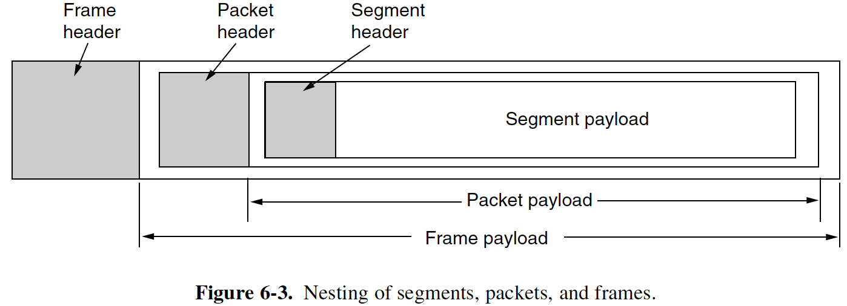

Where is a TCP Segment in a Frame? (Encapsulation)
A frame (Link Layer) encapsulates a packet (Network Layer)
A packet (Network Layer) encapsulates a segment (Transport Layer)
The segment (Transport Layer) encapsulated a message (Application Layer)

Slide 17
Relation to IP Header
0
31
15 16
IP
Header
V
HL
TOS
Total Length
16-bit identification
Flgs
13-bit frag. offset
TTL
Protocol
16-bit Hdr Checksum
32-bit source IP address
32-bit destination IP address
Options (Variable 0 ---> ??)
Data (TCP segment, or UDP Dtg,
or ICMP ….)

Slide 18
TCP Header
16-bit src port number
16-bit dst port number
16-bit Source port #
16-bit Destination port #
32-bit sequence number
32-bit acknowledgement number
4-bit HL
Flags
16-bit window size
16-bit checksum
16-bit urgent pointer
Options
Data (Application Message)

Slide 19
Transmission Control Protocol (TCP RFC 793)
TCP in the TCP/IP Reference Model
Services provided by TCP
Addressing,`
TCP Header
Header fields related to addressing
Reliability
Problem: IP offers just a best-effort service
Three phases for a connection
Opening,
data exchange,
closing
Sequence numbers
Recovering Corrupted/Lost Segments
Sliding windows
Flow control
Congestion control
Read Sections 6.5.4, 6.5.5, and 6.5.6
Notes:
Video Module 6-03

Slide 20
Service Offered by IP
Best effort service
it may loose packets
it may reorder packets
it may duplicate packets

Slide 21
Service Offered by TCP
Application
A connection-oriented
Reliable
Byte stream
Reliable byte stream
TCP
Looses,
Reorders,
Duplicates packets
Network (IP)
Link Layer

Slide 22
Phases of a TCP Connection
Opening
Full duplex data exchange
Closing

Slide 23
Function of Opening a Connection
Client informs server (creation of tcp control block)
Client and server exchange initial sequence numbers : (TCP numbers bytes)
Client and server “negotiate” maximum segment size (mss) and window size

Slide 24
Opening a Connection: Three-Way Handshake
Client
Server
SYN 1200:1200
mss 1024
SYN 34901:34901
ack 1201 mss 1024
Ack 34902
time

Slide 25
Closing a Connection
Client
Server
App. closes
FIN
EOF to app.
Ack of FIN
Data
FIN
Ack of FIN
time

Slide 26
Data Exchange: Sequence Numbers
A TCP Header includes two 32-bit sequence numbers:
A sequence number: it is the sequence number of the first byte in a segment
An ack. number a: it is an acknowledgment number a that means:
All bytes with sequence number up to a-1 were correctly received in order
The next expected byte is the byte with sequence number a.
Example 1:
Suppose that a TCP client receives a segment containing 5 bytes such that the sequence number is 1000.
The TCP client will respond with an acknowledgement number ……..
1000
1004
1005

Slide 27
Sequence/Ack Numbers in the TCP Header
A TCP Header includes two 32-bit sequence numbers:
A 32-bit sequence number: it is the sequence number of the first byte in a segment
A 32-bit ack. number a: it is an acknowledgment number a that means:
All bytes with sequence number up to a-1 were correctly received in order
The next expected byte is the byte with sequence number a.
16-bit Source port number
16-bit Destination port number
32-bit sequence number
32-bit sequence number
32-bit acknowledgement number
32-bit acknowledgement number
4-bit HL
Flags
16-bit window size
16-bit checksum
16-bit urgent pointer
Options
Data (Application Message)

Slide 28
Transmission Control Protocol (TCP RFC 793)
TCP in the TCP/IP Reference Model
Services provided by TCP
Addressing,`
TCP Header
Header fields related to addressing
Reliability
Problem: IP offers just a best-effort service
Three phases for a connection
Opening,
data exchange,
closing
Sequence numbers
Recovering Corrupted/Lost Segments
Sliding windows
Flow control
Congestion control
Read Section 3.1.4 (from data link layer… but think end to end)
Notes:
Video Module 6-04

Slide 29
Data Exchange
Data Exchange is bidirectional (both endpoints can send)
TCP must handle 3 functions :
Error detection and recovery
Flow control
Congestion control
TCP must adapt to :
kind of traffic (Bulk or interactive)
Network conditions

Slide 30
Service Offered by IP
Best effort service
it may loose packets
it may reorder packets
it may duplicate packets

Slide 31
What Can Happen to A Segment?
A segment can:
reach its destination unaltered
reach destination corrupted
reach the destination out of order
get lost before reaching the destination
get duplicated

Slide 32
How to Deal with Corrupted Segments?
Two questions:
How does TCP detect that a segment is corrupted?
Answer:
Use a checksum: it covers the TCP header and the payload (application message). Computed as shown in the module about the Data Link Layer. Compute the sum S of all 16-bit numbers (with carry wrap-around). Checksum = ~S.
How does TCP recover a corrupted segment?
TCP resends the segment.
16-bit Source port number
16-bit Destination port number
32-bit sequence number
32-bit acknowledgement number
4-bit HL
Flags
16-bit window size
16-bit checksum
16-bit checksum
16-bit urgent pointer
Options
Data (Application Message)

Slide 33
How to Deal with Out-of-Order Segments?
Consider a TCP sender which sent 3 segments (1000, 1006, and 1010)
The first segment with sequence number 1000 is received unaltered
The TCP receiver will acknowledged it with an acknowledgement number = 1006 (next expected byte)
The second segment gets lost
The receiver is unaware that the segment (1006) is lost
The third segment with sequence number 1010 is received unaltered.
Now, the receiver knows that something happened to the segment with sequence # 1006:
Segment (1006) is out-of-order or is lost.
The TCP receiver sends another acknowledgment identical to the previous: it is called a duplicate acknowledgement.
If the sender receives three duplicate (dupacks), it assumes the segment is lost.
TCP
Sender
X
Lost
1010
1006
1000
TCP
Receiver
Ack = 1006
Ack = 1006
Dupack

Slide 34
How to Deal with Lost Segments?
Consider a TCP sender which sent 2 segments (1000 and 1006) and does not send any other segment for some time
The first segment with sequence number 1000 is received unaltered
The TCP receiver will acknowledged it with an acknowledgement number = 1006 (next expected byte)
The second segment gets lost
The receiver is unaware that the segment (1006) is lost
No other segment is sent by the TCP sender.
How can the TCP sender or TCP receiver realize that Segment (1006) is lost?
Answer:
The TCP sender sets up a timer before sending a segment: if the TCP sender does not receive an ack for that segment within some time, it will timeout and resend the segment.
A timeout mechanism at the sender is the only solution.
TCP
Sender
X
Lost
1006
1000
TCP
Receiver
Ack = 1006

Slide 35
Notion Of Sliding Window
What is the problem with stop-and-wait protocol ?
Assume a network path with a bottleneck link being a 20 Mbps and propagation time of 50ms, what is the highest throughput that we can achieve with a 1250 bytes segment?
Solution : a window-based protocol
Keep sending new segments without waiting for acknowledgements.

Slide 36
Sliding Window (Maintained by the Sender)
Offered Window Wnd
(advertised by receiver or limited by network conditions)
34 35 36 37 38 39 40 41 42 43 44 45 46…...
Sent and
acked
Sent, not
acked
May be sent
if data available
Cannot be
sent
Sequence
number

Slide 37
Sliding Window (Maintained by the Sender)
Offered Window Wnd
(advertised by receiver or limited by network conditions)
34 35 36 37 38 39 40 41 42 43 44 45 46…...
Sent and
acked
Sent, not
acked
May be sent
if data available
Cannot be
sent
Sequence
number

Slide 38
Transmission Control Protocol (TCP RFC 793)
TCP in the TCP/IP Reference Model
Services provided by TCP
Addressing,`
TCP Header
Header fields related to addressing
Reliability
Problem: IP offers just a best-effort service
Three phases for a connection
Opening,
data exchange,
closing
Sequence numbers
Recovering Corrupted/Lost Segments
Sliding windows
Flow control
Congestion control
Read Introduction to 6.4
Notes:
Video Module 6-05

Slide 39
Flow Control /Congestion Control
Flow Control
Flow control is a strategy to insure that a fast sender does not overrun a slow receiver. A slow receiver is a receiver that processes incoming packets at a slower rate than the sending rate. If the receiver is overwhelmed, its input queue will fill up and packets will get dropped.
Congestion Control
Congestion control is a strategy to avoid that intermediary nodes are overrun. An intermediary node will get overrun if the incoming traffic rate is larger than the outgoing traffic rate.

Slide 40
Flow Control /Congestion Control in TCP
TCP achieves Flow Control and Congestion Control by adjusting the Offered Window Wnd
Flow control is achieved by the receiver which limits the sender’s offered window by advertising a window W_{a} side (it is the maximum size of the incoming buffer). The receiver tells (advertises to) the sender the maximum size of its offered window.
Congestion control is achieved by the sender which will try the guess the maximum size of the offered window to avoid overrunning the intermediary nodes. This maximum size of the offered window is a variable (at the sender) called cwnd : the size of the congestion window. cwnd is a variable maintained by the sender.
TCP set Wnd to min(W_{a}, cwnd)
Why not set Wnd to the smallest possible value?
Answer : the throughput and efficiency will be terribly low (recall stop-and-wait)
Offered Window Wnd
(advertised by receiver or limited by network conditions)
34 35 36 37 38 39 40 41 42 43 44 45 46…...
Sent and
acked
Sent, not
acked
May be sent
if data available
Cannot be
sent
Sequence #

Slide 41
Flow Control in TCP
The receiver monitors its available input buffer size
When acknowledging segments, the receiver advertises (for the sender) its available input buffer size.
16-bit Source port number
16-bit Destination port number
32-bit sequence number
32-bit acknowledgement number
4-bit HL
Flags
16-bit window size
16-bit window size
16-bit checksum
16-bit urgent pointer
Options
Data (Application Message)

Slide 42
Transmission Control Protocol (TCP RFC 793)
TCP in the TCP/IP Reference Model
Services provided by TCP
Addressing,`
TCP Header
Header fields related to addressing
Reliability
Problem: IP offers just a best-effort service
Three phases for a connection
Opening,
data exchange,
closing
Sequence numbers
Recovering Corrupted/Lost Segments
Sliding windows
Flow control
Congestion control (Part I)
Read Sections 6.5.10
Notes:
Video Module 6-06

Slide 43
END-TO-END makes Congestion Control Hard!
Upper layers
Upper layers
Transport
Transport
Network
Network
Network
Link Layer
Link Layer
Link Layer
Network
Phone line
IEEE 802.3
Link Layer
ATM
Network
Link Layer
Network
Satellite link
Link Layer

Slide 44
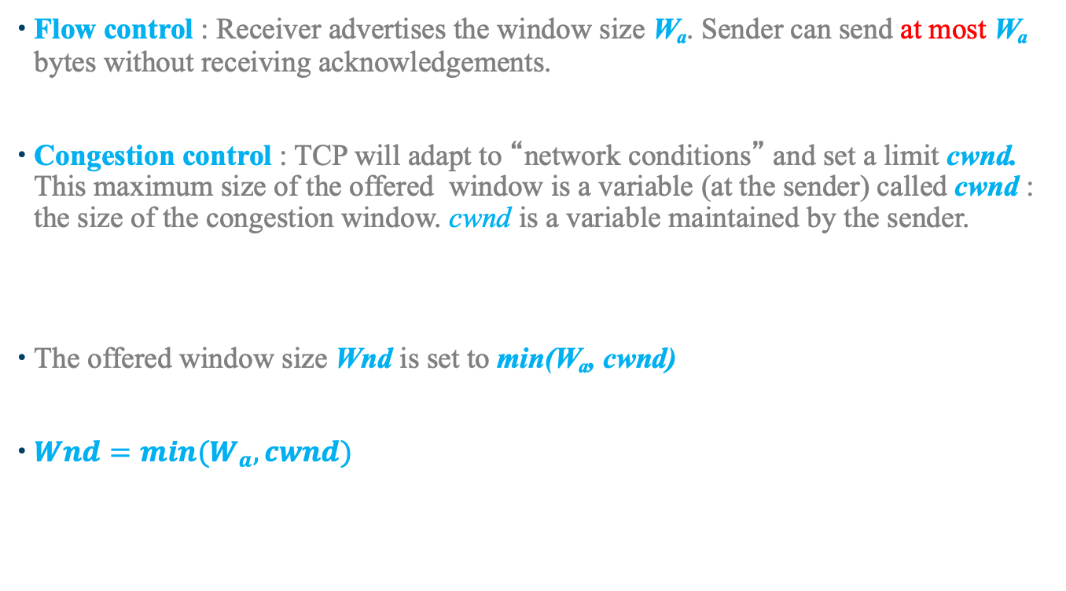
How Is the Window Size Wnd Set ?
Flow control : Receiver advertises the window size W_{a}. Sender can send at most W_{a} bytes without receiving acknowledgements.
Congestion control : TCP will adapt to “network conditions” and set a limit cwnd. This maximum size of the offered window is a variable (at the sender) called cwnd : the size of the congestion window. cwnd is a variable maintained by the sender.
The offered window size Wnd is set to min(W_{a}, cwnd)
$Wnd=min(W_{a},cwnd)$

Slide 45
Congestion Control: How Is cwnd Maintained?
Objective:
The objective is to maximize the throughput (efficiency).
Maximizing throughput calls to increase the window size Wnd, and therefore cwnd.
But, increasing cwnd increases the risk of overflowing the input buffer on some intermediary device.
In addition, the objective is fairness: users should achieve similar throughputs.
Question: How to achieve the highest and fair throughput without overflowing intermediary devices?
This problem is similar to the Weekly Pocket Money Demand: (How can a child get the most pocket money possible?)
Suppose that:
Parents set a fixed total weekly allowance B for ALL children
The allowance B is not known by the children
Each child does not know what, when, or whether siblings asked for or got each week.
Not all children ask for money each week.
If the child asks for an amount cwnd less than what parents still have, the parents grant it even if it is the total allowance B.
Now, if the child asks for more than the remaining available B, the parents SMACK the child and confiscate all money the child has.
What should be the strategy of the child to get the highest amount of pocket money and avoid getting smacked too often?

Slide 46
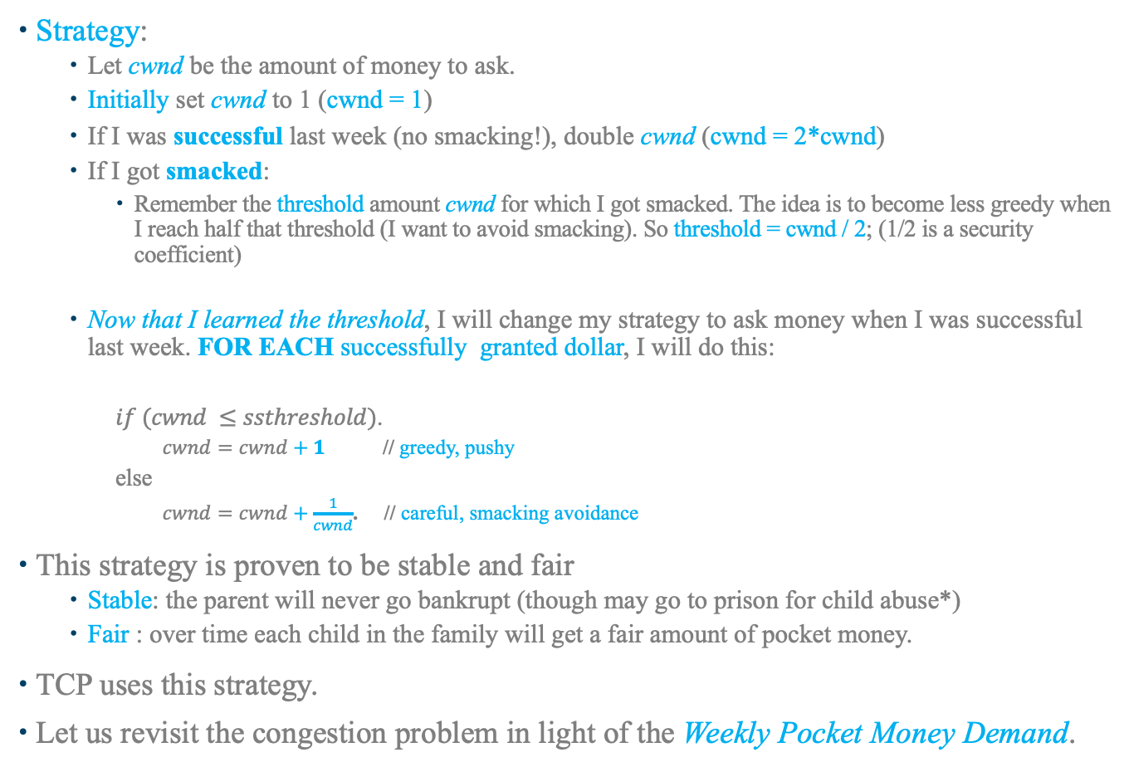
Strategy for the Weekly Pocket Money Demand Problem
Strategy:
Let cwnd be the amount of money to ask.
Initially set cwnd to 1 (cwnd = 1)
If I was successful last week (no smacking!), double cwnd (cwnd = 2*cwnd)
If I got smacked:
Remember the threshold amount cwnd for which I got smacked. The idea is to become less greedy when I reach half that threshold (I want to avoid smacking). So threshold = cwnd / 2; (1/2 is a security coefficient)
Now that I learned the threshold, I will change my strategy to ask money when I was successful last week. FOR EACH successfully granted dollar, I will do this:
$if (cwnd ≤ssthreshold)$.
$cwnd=cwnd+1$ // greedy, pushy
else
$cwnd=cwnd+\frac{1}{cwnd}$. // careful, smacking avoidance
This strategy is proven to be stable and fair
Stable: the parent will never go bankrupt (though may go to prison for child abuse*)
Fair : over time each child in the family will get a fair amount of pocket money.
TCP uses this strategy.
Let us revisit the congestion problem in light of the Weekly Pocket Money Demand.

Slide 47
Transmission Control Protocol (TCP RFC 793)
TCP in the TCP/IP Reference Model
Services provided by TCP
Addressing,`
TCP Header
Header fields related to addressing
Reliability
Problem: IP offers just a best-effort service
Three phases for a connection
Opening,
data exchange,
closing
Sequence numbers
Recovering Corrupted/Lost Segments
Sliding windows
Flow control
Congestion control (Part II)
Read Sections 6.5.10
Notes:
Video Module 6-07

Slide 48
Congestion Control: How Is cwnd Maintained?
Objective:
The objective is to maximize the throughput (efficiency).
Maximizing throughput requires to increase the window size Wnd, and therefore cwnd.
But, increasing cwnd increases the risk of overflowing the input buffer on some intermediary device.
In addition, the objective is fairness: users should achieve similar throughputs.
How to achieve getting the highest and fair throughput without overflowing intermediary devices?
Let us revisit the congestion problem.
Suppose that:
A bottleneck router/device has a fixed total available bandwith B.
The available bandwith B is not known by the users using the same bottleneck router/device
Each user does not know what, when, or whether the other users ask for or got each cycle.
Not all users use the router/device each cycle.
If the user asks for an amount less than what the router has, the router grants it all even if it is the total available B.
Now, if the user sends more packets than what the router can handle (input buffer full), the router drops the packet(s).
What should be the strategy of a user to get the highest bandwidth (throughput) and avoid packets drops?

Slide 49
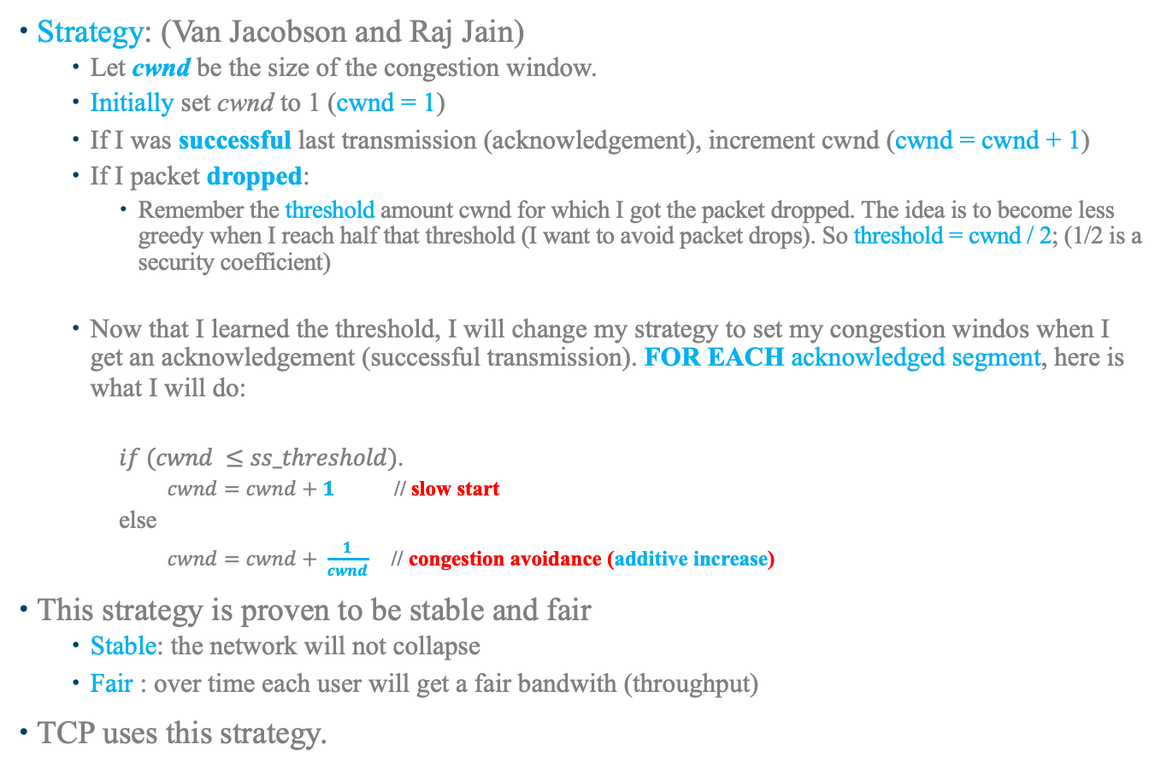
Strategy for the Congestion Control
Strategy: (Van Jacobson and Raj Jain)
Let cwnd be the size of the congestion window.
Initially set cwnd to 1 (cwnd = 1)
If I was successful last transmission (acknowledgement), increment cwnd (cwnd = cwnd + 1)
If I packet dropped:
Remember the threshold amount cwnd for which I got the packet dropped. The idea is to become less greedy when I reach half that threshold (I want to avoid packet drops). So threshold = cwnd / 2; (1/2 is a security coefficient)
Now that I learned the threshold, I will change my strategy to set my congestion windos when I get an acknowledgement (successful transmission). FOR EACH acknowledged segment, here is what I will do:
$if (cwnd ≤ss_threshold)$.
$cwnd=cwnd+1$ // slow start
else
$cwnd=cwnd+ \frac{1}{cwnd}$ // congestion avoidance (additive increase)
This strategy is proven to be stable and fair
Stable: the network will not collapse
Fair : over time each user will get a fair bandwith (throughput)
TCP uses this strategy.

Slide 50
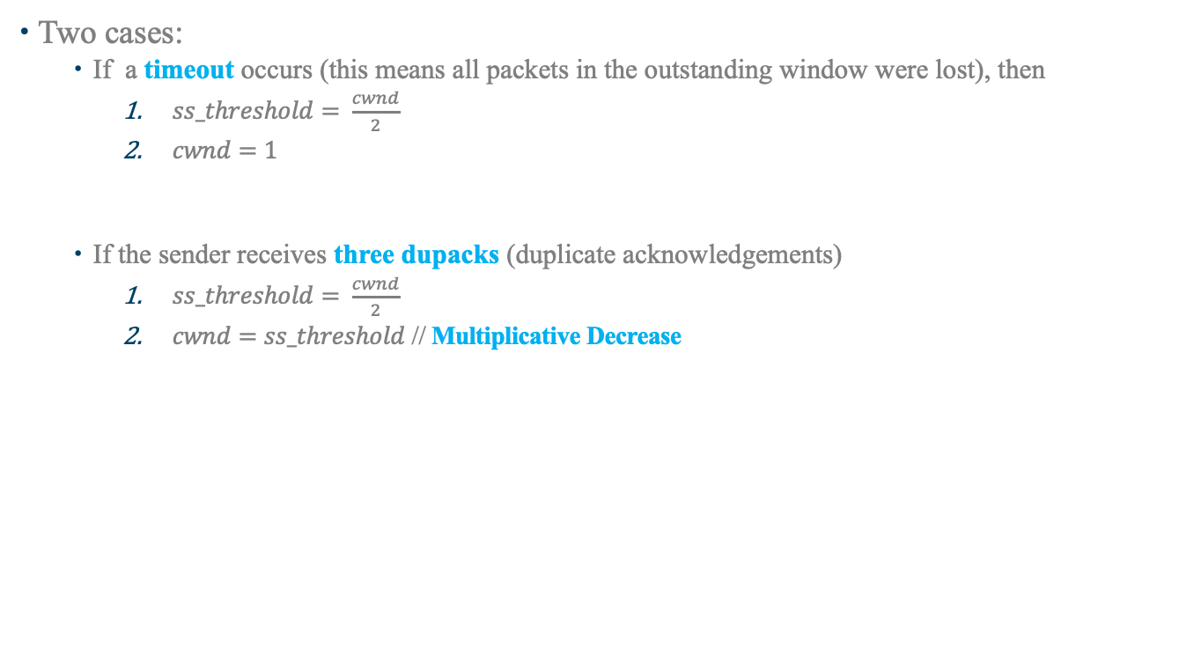
What If a Packet is lost ?
Two cases:
If a timeout occurs (this means all packets in the outstanding window were lost), then
$ss_threshold= \frac{cwnd}{2}$
$cwnd=1$
If the sender receives three dupacks (duplicate acknowledgements)
$ss_threshold= \frac{cwnd}{2}$
$cwnd=ss_threshold$ // Multiplicative Decrease

Slide 51
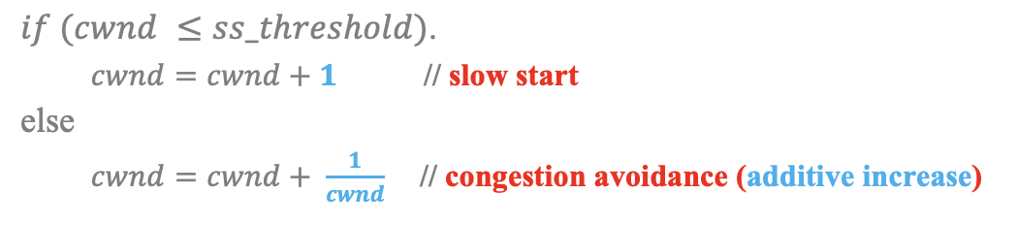
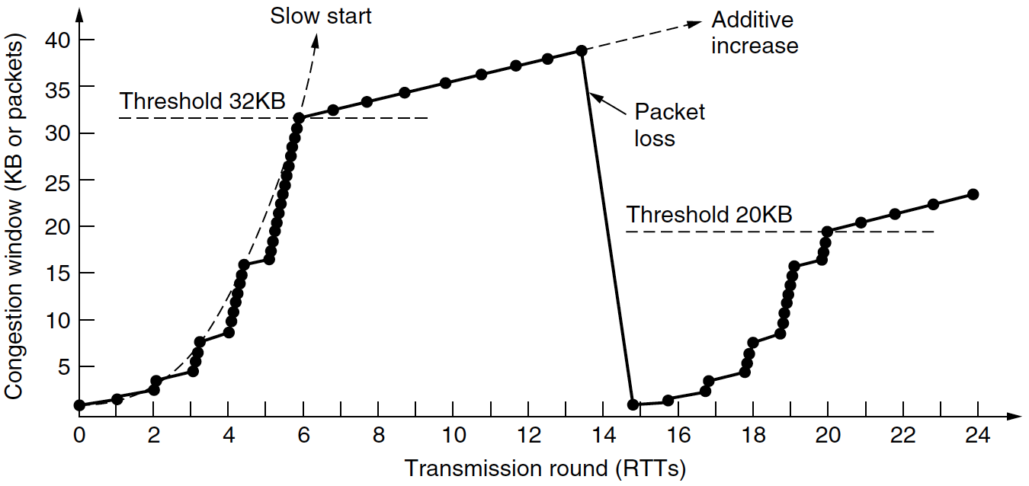
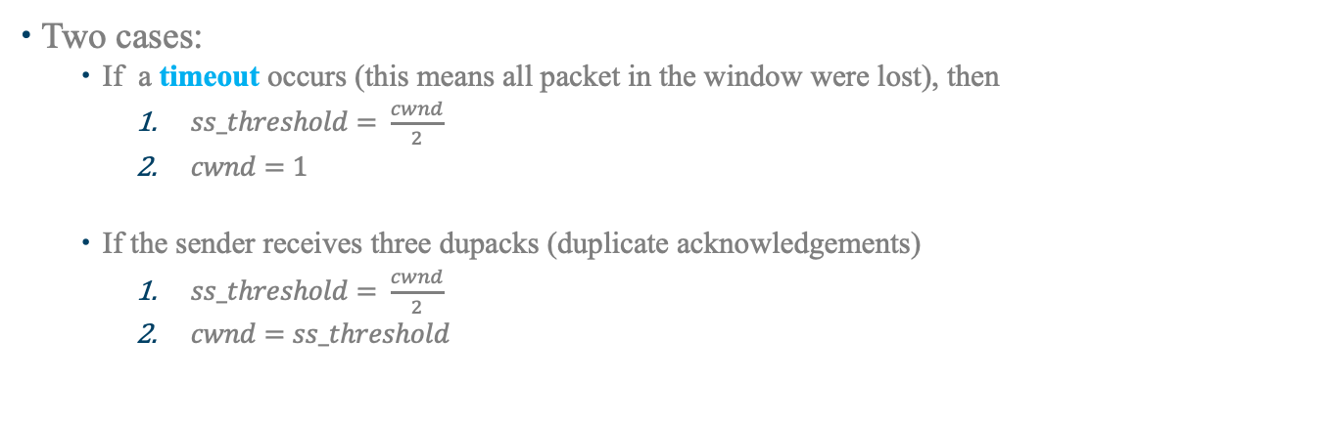
TCP Reno Congestion Window With Timeout
timeout
cwnd
Two cases:
If a timeout occurs (this means all packet in the window were lost), then
$ss_threshold= \frac{cwnd}{2}$
$cwnd=1$
If the sender receives three dupacks (duplicate acknowledgements)
$ss_threshold= \frac{cwnd}{2}$
$cwnd=ss_threshold$

Slide 52
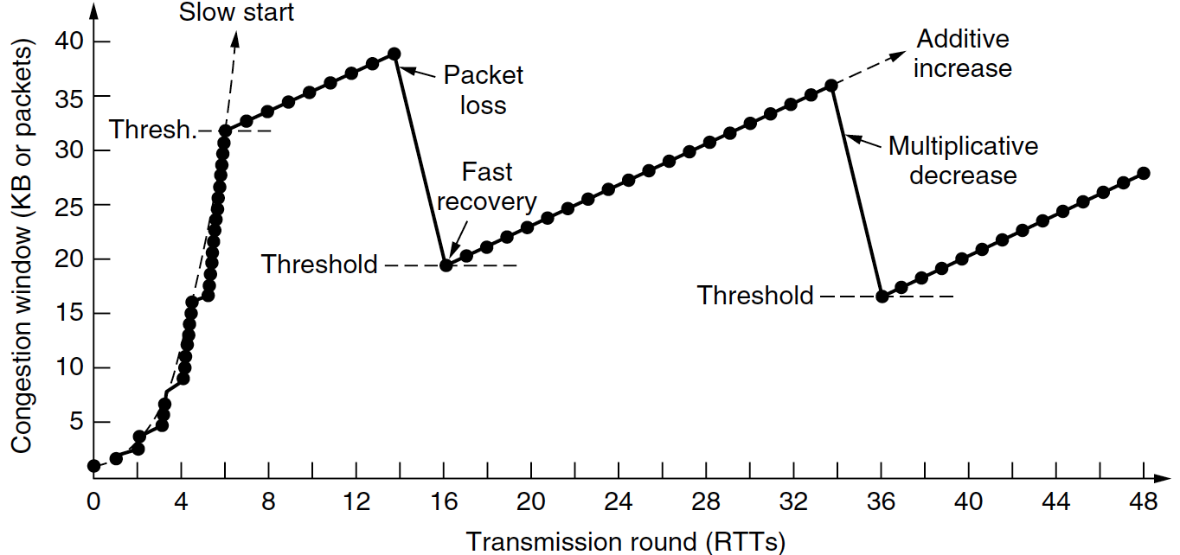
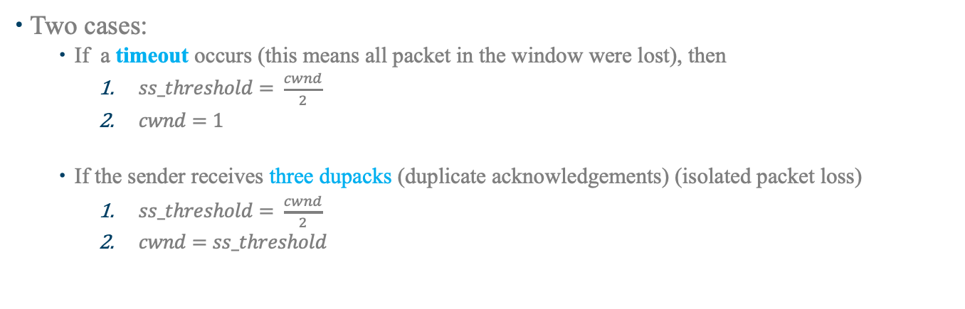
TCP Reno Congestion Window With Packet Loss
cwnd
Two cases:
If a timeout occurs (this means all packet in the window were lost), then
$ss_threshold= \frac{cwnd}{2}$
$cwnd=1$
If the sender receives three dupacks (duplicate acknowledgements) (isolated packet loss)
$ss_threshold= \frac{cwnd}{2}$
$cwnd=ss_threshold$

Slide 53
Congestion Control and the TCP Header
A TCP sender keeps track of the last sequence number sent and the highest acknowledgement received so far:
A 32-bit sequence number: it is the sequence number of the first byte in a segment
A 32-bit ack. number a: it is an acknowledgment number a that means:
All bytes with sequence number up to a-1 were correctly received in order
The next expected byte is the byte with sequence number a.
16-bit Source port number
16-bit Destination port number
32-bit sequence number
32-bit sequence number
32-bit acknowledgement number
32-bit acknowledgement number
4-bit HL
Flags
16-bit window size
16-bit checksum
16-bit urgent pointer
Options
Data (Application Message)

Slide 54
User Datagram Protocol (UDP RFC 768)
UDP in the TCP/IP Reference Model
Relation to IP
Services provided by UDP
Addressing
UDP Header
Header fields related to addressing
Reliability
Just detection
Header fields related to error detection
Read Introduction to 6.4, and Section 6.4.1
Notes:
Video Module 6-08

Slide 55
Where in TCP/IP Model ?
Application
Transport UDP
Network
Link Layer

Slide 56
Relation to IP Header
0
31
15 16
IP
Header
V
HL
TOS
Total Length
16-bit identification
Flgs
13-bit frag. offset
TTL
Protocol
16-bit Hdr Checksum
32-bit source IP address
32-bit destination IP address
Options (Variable 0 ---> ??)
Data (TCP segment, or UDP Dtg,
or ICMP ….)

Slide 57
UDP Functions/Services
Offers a SIMPLE user access to a Datagram Service (Raw socket is accessible only to super users (root access))
A checksum service to detect corrupted packets
No reliability (No retransmission, no timeout, no care about MTU...)

Slide 58
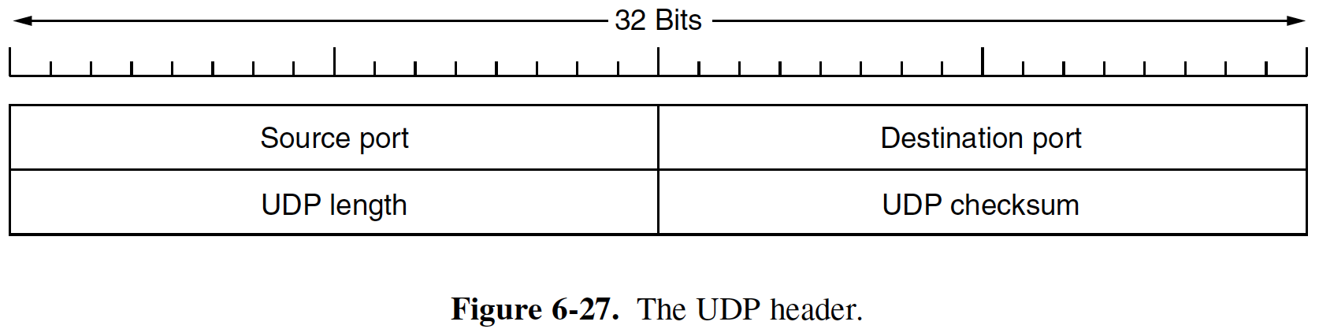
UDP Header
Source Port number (2 bytes)
Destination Port number (2 bytes)
Datagram length in bytes (header + payload)
Checksum (2 bytes)

Slide 59
Checksum Computation
Checksum concerns PSEUDO header + data
Pseudo header contains:
from the IP header
IP source
IP destination
Protocol number (17)
From the UDP header
Source port #
Destination port #
UDP length

Slide 60
Wrap Up
Learn and understand the transport layer (in general).
Addressing, reliability, flow control, congestion control, QoS
Learn and understand the Transmission Control Protocol (TCP).
Addressing (Port Numbers)
Reliability (sequence number, ack. Number, checksum)
Flow control (advertised window)
Congestion control (Slow-start and congestion avoidance strategies)
Learn and understand the User Datagram Protocol (UDP).
Addressing (Port Numbers)
Reliability (detection only, checksum)
Notes:
Video Module 6-09

