Slide 1
Application Layer
Some Internet Applications Protocols: DNS, SMTP, HTTP
Notes:
Video Module 7-01

Slide 2

Overview
Objectives
Learn and understand the application layer (in general).
Learn and understand the Domain Name System (DNS).
Learn and understand the email system.
Learn and understand the Web system.
Requirements
DNS: Read Section 7.1 introduction, Sections 7.1.1 and 7.1.3. Scan Section 7.1.2.
eMail: Read Section 7.2, Sections 7.2.1, 7.2.4-7.2.5. scan Sections 7.2.2-7.2.3
WWW: Read Introduction Section 7.3, Scan 7.3.1-7.3.2

Slide 3
Introduction
Application layer in the OSI reference model
Application layer in the TCP/IP reference model
A Client-Server Architecture
Typical Protocol Stack for Internet applications
Services of the application layer
Read Introduction to Chapter 7

Slide 4
Where in the OSI Reference Model?
User/Client
User/Server
Application
Protocol
Application
Interface
Interface
Presentation
Protocol
Presentation
Interface
Interface
Protocol
Session
Session
Interface
Interface
Protocol
Transport
Transport
Interface
Interface
Network
Network
Network
Network
Interface
Interface
Interface
Interface
Link
Link
Link
Link
Interface
Interface
Interface
Interface
Phys.
Phys
Phys.
Phys

Slide 5
How Do Lower Layers Appear to the Application Layer?
User/Client
User/Server
Application
Protocol
Application
message
message
Interface
Interface
message
message
message
message
message
message
message
message
message
message
message
message

Slide 6
Where in TCP/IP Model ?
Application
Transport
TCP
UDP
IP
Network
Link Layer

Slide 7
Using UDP as Transport
Client or Server
Application
Message (Request/Response)
UDP
Datagram
TCP
Transport
UDP Header
Message (Request/Response)
IP
Network
IP Header
UDP Header
Message (Request/Response)
Packet
Link Layer
LL Header
IP Header
UDP Header
Message (Request/Response)
LL Trailer
Frame

Slide 8
Using TCP as Transport
Client or Server
Application
Message (Request/Response)
TCP
Segment
Transport
TCP Header
Message (Request/Response)
IP
Network
IP Header
TCP Header
Message (Request/Response)
Packet
Link Layer
LL Header
IP Header
TCP Header
Message (Request/Response)
LL Trailer
Frame

Slide 9
TCP Or UDP?
Features | UDP | TCP
Service | Simple wrapper | Reliable in-order delivery
Connection Set Up | No set up | 3 way hand-shake
Data interface with application | “Chunks” / datagram | Byte stream
Reliability | Best effort / Detection only | Reliable with acknowlegements
Retransmission | No | Yes
Traffic control | None | Flow and congestion control
Overhead | 8 bytes header | 20+ bytes header
Data Exchange Form | Small (transactional) | Small to high

Slide 10
Functions of the Application Layer
Offer specialized service to the user
Offer services not offered by lower layers
Offer services offered by lower layers but not reliable or not trusted
Improve services offered by lower layers but incomplete/unsatisfactory.

Slide 11
Specialized Service To the User
Mapping host names to IP addresses
Email
Web browsing
Virtual chat room
File transfer
Remote terminal
…………

Slide 12
Specialized Services
Application | Application Protocol | Transport Protocol | Port # | RFC # Earliest
Host name → IP Address mapping | Domain Name System (DNS) | UDP | 53 | 1034/35
Electronic mail | Simple Mail Transfer Protocol (SMTP) | TCP | 25 | 821
 | (Delivery) Post Office Prot. V3 (POP3) | TCP | 110 | 1939
 | Internet Message Access Prot. (IMAP) | TCP | 143 | 3501
Remote unsecure login | Telnet | TCP | 23 | 854
Secure Shell (ssh) | ssh | TCP | 22 | 4251/54
File transfer | File Transfer Protocol | TCP | 20/21 | 354
 | Trivial File Transfer Protocol | UDP | 69 | 1350
World Wide Web | hypertext Transfer Protocol | TCP | 80 | 2068

Slide 13
Domain Name System (DNS RFCs 1034/35)
Domain Name System
What is it?
Why?
How?
DNS architecture (Domains)
DNS architecture (Zones)
Read Section 7.1 introduction, Section 7.1.1.
Scan Section 7.1.2
Notes:
Video Module 7-02

Slide 14
What ?
DNS is a service used to map host names into IP addresses for:
Devices on the Internet
Web URLs
Email addresses
Based on a Client-Server architecture:
Client on each host request IP address for some desired host name HN
Server responds with IP address for host name HN

Slide 15
Why ?
Human do not like to use IP addresses (numbers), prefer names…
Interconnected devices use IP addresses
Huge/tremendous number of hosts on the Internet

Slide 16
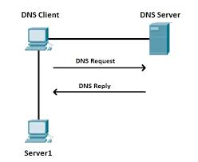
How ?
ssh Server1
What is the IP address of Server1?
Here is the IP address of Server1

Slide 17
How ?
ssh Server1
What is the IP address of Server1?
Here is the IP address of Server1

Slide 18
DNS Client (Sends Request)
DNS Client
DNS Client
Message (Request)
UDP
Datagram
TCP
Transport
UDP Header
Message (Request)
IP
Network
IP Header
UDP Header
Message (Request)
Packet
Link Layer
LL Header
IP Header
UDP Header
Message (Request)
LL Trailer
Frame

Slide 19
DNS Server (Receives Request)
DNS Server
Message (Request)
DNS Server (53)
Datagram
UDP
TCP
UDP Header
Message (Request)
Transport
IP
IP Header
UDP Header
Message (Request)
Network
Packet
Link Layer
LL Header
IP Header
UDP Header
Message (Request)
LL Trailer
Frame

Slide 20
DNS Server (Sends Back Response)
DNS Server
Message (Response)
DNS Server (53)
Datagram
UDP
TCP
UDP Header
Message (Response)
Transport
IP
IP Header
UDP Header
Message (Response)
Network
Packet
Link Layer
LL Header
IP Header
UDP Header
Message (Response)
LL Trailer
Frame

Slide 21
How Does the DNS Retrieve The Response?
Use a file with all machine names over the Internet and mapping?
Use a local server that contains the database related to all hosts on the Internet?
Use a distributed database system?

Slide 22
DNS Database (DNS RFCs 1034/35)
Domain Name System
What is it?
Why?
How?
DNS architecture (Internet Domain Name Space)
DNS Name Servers (Zones)
Read Section 7.1 introduction, Sections 7.1.1, and 7.1.3.
Scan Section 7.1.2
Notes:
Video Module 7-03

Slide 23
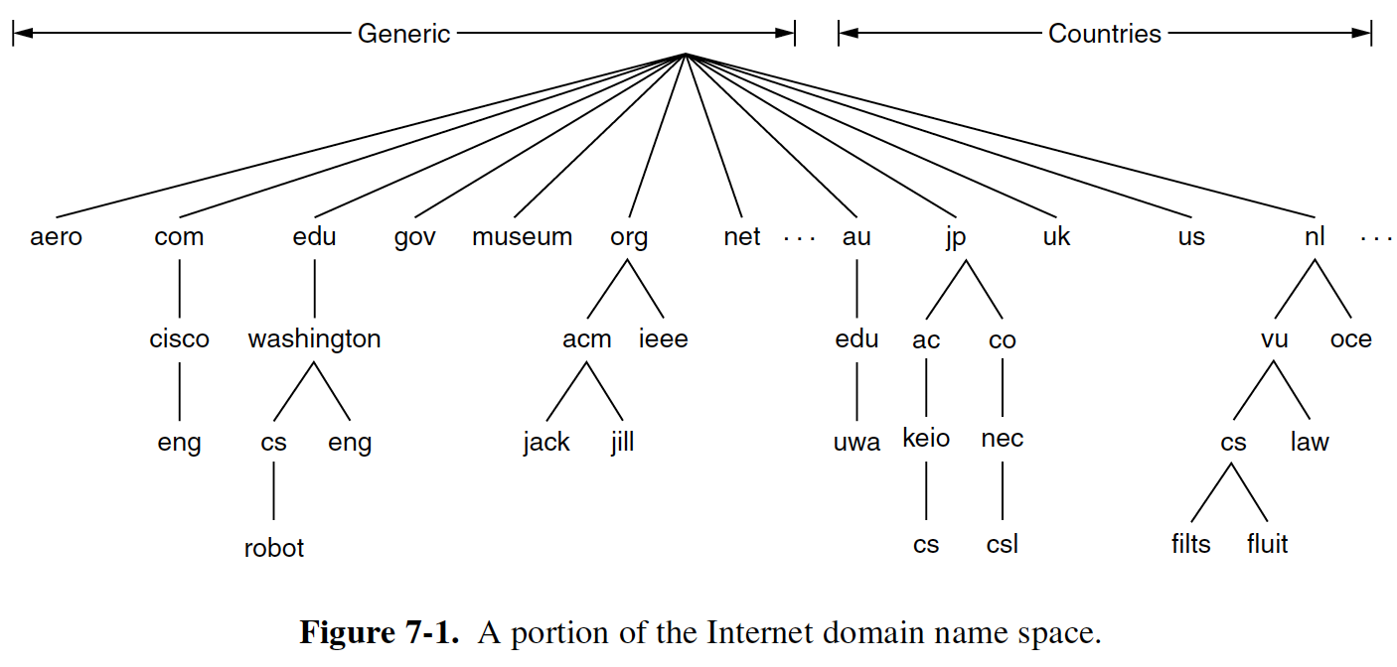
DNS: Internet Domain Space
Generic
root
Countries
Hierarchical addressing system
Root server administered by the Internet Corporation for Assigned Names and Numbers (ICANN)
Who administers the rest?
Key feature: an administrator (name server) are not limited to one node: they may cover a subtree.

Slide 24
DNS: Internet Domain Space
Generic
root
Countries
Hierarchical addressing system
Root server administered by the Internet Corporation for Assigned Names and Numbers (ICANN)
Who administers the rest?
Key feature: an administrator (name server) are not limited to one node: they may cover a subtree.

Slide 25
Name Servers
Generic
Countries
Zones are determined based on their users/organizations/politics/capabilities/resources
One primary name server ( ) per zone.

Slide 26


Name Servers (Examples)
Generic
root
Countries
N_{edu}
N_{org}
N_{nl}
N_{was}
N_{acm}
N_{cs}
N_{vu}
Hosts Names | Name Servers to Inquire
host.edu | root; N_{edu}
host.washington.edu | root; N_{edu}; N_{was}
host.eng.washington.edu | root; N_{edu}; N_{was}
host.cs.washington.edu | root; N_{edu}; N_{was}; N_{cs}
host.robot.cs.washington.edu | root; N_{edu}; N_{was}; N_{cs}
host.filts.cs.vu.nl | root; N_{nl}; N_{vu}
host.uwa.edu.au | ?

Slide 27
Name Servers (Examples)
Generic
Countries
N_{edu}
N_{nl}
N_{was}
N_{vu}
N_{cs}
Hosts Names | Name Servers to Inquire
host.edu | N_{edu}
host.washington.edu | N_{edu}; N_{was}
host.eng.washington.edu | N_{edu}; N_{was}
host.cs.washington.edu | N_{edu}; N_{was}; N_{cs}
host.robot.cs.washington.edu | N_{edu}; N_{was}; N_{cs}
host.filts.cs.vu.nl | N_{nl}; N_{vu}
host.uwa.edu.au | ?

Slide 28
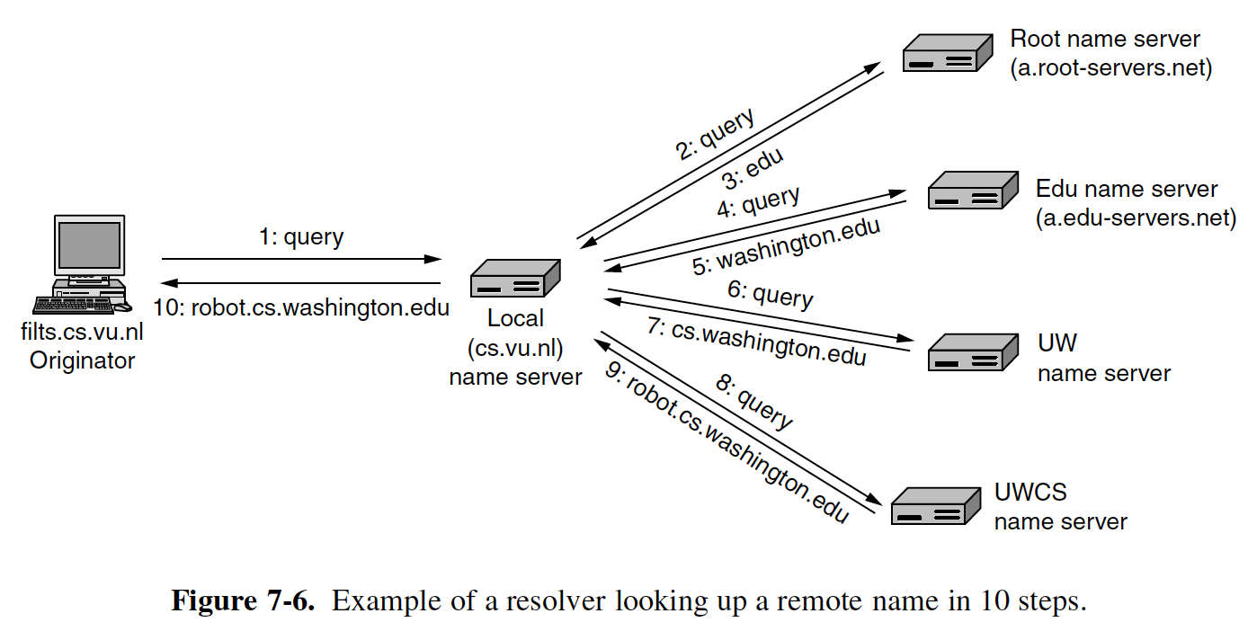
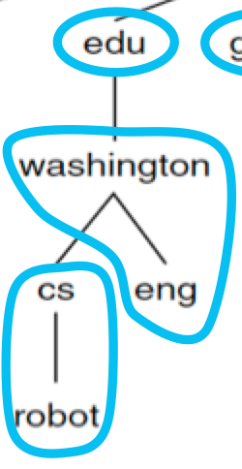
Name Resolution
Looking for IP address of robot.cs.washington.edu
IP address
Who administers the rest?

Slide 29
Name Resolution
Looking for IP address of robot.cs.washington.edu
IP address
Who administers the rest?

Slide 30
Some Name Resolution Issues
Iterative vs Recursive Queries:
Recursive: the name server calls itself the next level Name Server N_{next} rather than just providing the address of N_{nex} to the local name server.
Iterative: the local name server queries each level as it gets their IP addresses.
Caching:
all answers (partial and final) are cached for some duration (time to live). These cached answers can be used if requests come for the same domains. However, these cached answers are NOT authoritative.

Slide 31
eMail Multiple Protocols/RFCs
Electronic Mail
What is it? Why?
Obvious!
How?
Architecture
Submission (SMTP)
Transfer (SMTP)
Delivery (POP3; IMAP)
Read introduction Section 7.2, Section 7.2.1
Scan Sections 7.2.2-7.2.3
Read Sections 7.2.4-7.2.5
Notes:
Video Module 7-04

Slide 32
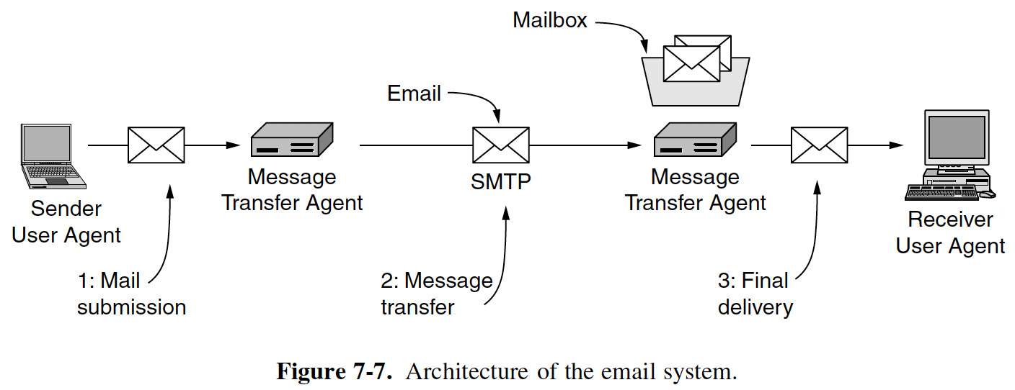

eMail Architecture
Generic
Countries
Four components
Sender User Agent and Receiver User Agent
Message Transfer Agent
Mailbox
Three operations
Submission
Transfer
Delivery

Slide 33
eMail Architecture
Generic
Countries
Four components
Sender User Agent and Receiver User Agent
Message Transfer Agent
Mailbox
Three operations
Submission
Transfer
Delivery

Slide 34
eMail Architecture: Application Protocols
Generic
Countries
POP3
or
IMAP
SMTP
SMTP
Application Protocols for Operations
Submission
Transfer
Delivery
→ SMTP (Simple Mail Transfer Protocol)
→ SMTP
POP3 (Post Office Protocol version 3)
or IMAP (Internet Message Access Protocol)

Slide 35
eMail Architecture: Transport Protocol
TCP
Generic
Countries
POP3
or
IMAP
SMTP
SMTP
SMTP, POP3, and IMAP use TCP

Slide 36
World Wide Web (www) HTTP (RFC 2068)
World Wide Web
What is it? Why?
Obvious!
How?
Client-Server Architecture
Read Section 7.3 introduction
Scan Sections 7.3.1-7.3.2
Notes:
Video Module 7-05

Slide 37
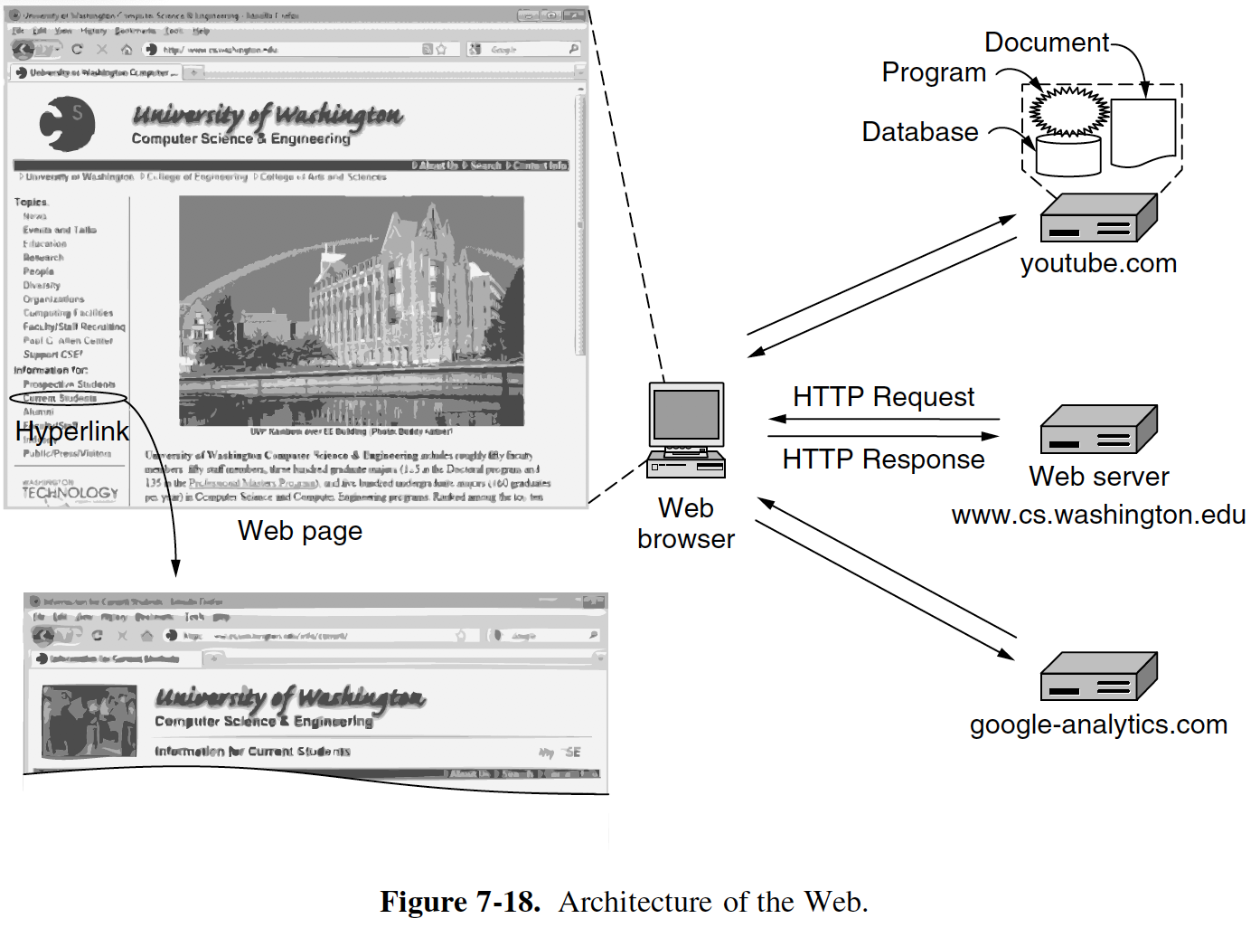
Architecture of the Web
Client
Servers

Slide 38
HTTP Client (Sends HTTP Request)
HTTP Client
HTTP Client
Message (HTTP Request)
TCP
Segment
TCP
Transport
TCP Header
Message (HTTP Request)
IP
Network
IP Header
UDP Header
Message (HTTP Request)
Packet
Link Layer
LL Header
IP Header
TCP Header
Message (HTTP Request)
LL Trailer
Frame

Slide 39
HTTP Server (Receives HTTP Request)
HTTP Server
Message (HTTP Request)
HTTP Server (80)
Segment
TCP
TCP
TCP Header
Message (HTTP Request)
Transport
IP
IP Header
TCP Header
Message (HTTP Request)
Network
Packet
Link Layer
LL Header
IP Header
TCP Header
Message (HTTP Request)
LL Trailer
Frame

Slide 40
HTTP Server (Sends Back Response (file))
HTTP Server
Message (Data: pictures, text,…)
HTTP Server (80)
Segment
TCP
TCP
TCP Header
Message (Data: pictures, ..)
Transport
IP
IP Header
TCP Header
Message (Data: pictures, …)
Network
Packet
Link Layer
LL Header
IP Header
TCP Header
Message (Data: pictures, …)
LL Trailer
Frame

Slide 41
Accessing a Page Without a Browser
What do I need to send a request to the server and receive a response?
Think about it…
I need some tool to open a TCP connection!
Telnet
netcat (windows, ubuntu)
nc on MacOS
Form a valid request that follows HTTP format
GET filename HTTP/1.1
host: hostname
Example: get RFC 2068 (Original RFC specifying HTTP 1.1)
Find the URL for RFC 2068
I found URL https://www.ietf.org/rfc/rfc2068.txt
Open a TCP connection to host www.ietf.org Port 80 (HTTP port)
(Used on MacOS nc -c www.ietf.org 80)
Type GET https://www.ietf.org/rfc/rfc2068.txt and hit enter
Type host: www.ietf.org and hit enter twice
You will get back the text of RFC 2068

Slide 42
Wrap Up
Learn and understand the application layer (in general).
On Internet, protocols at the application layer use either TCP or UDP at the transport layer.
Learn and understand the Domain Name System (DNS).
Mapping service host names → IP addresses
Name domains
DNS zones
Uses UDP
Learn and understand the email system.
Main components: user agent sender/receiver, transfer. mailbox
Primary operation: submission, transfer, delivery
SMTP, POP3, and IMAP all use TCP
Learn and understand the Web system.
Convenient method to ”browse” the content of the Internet
Key protocol: HTTP
HTTP uses TCP
If we can open a TCP connection, no need of a browser to browse, but…..
Notes:
Video Module 7-06

