Slide 1
Course Notes Set 12-a:
Combinatorial Interaction Testing
Computer Science and Software Engineering
Auburn University

Slide 2
Combinatorial Interaction Testing
Execution requires interactions with external entities, e.g., users, sensors, or other systems
System behaviors depend on the inputs from external entities
Example:
  A system may allow user configuration options, e.g., 160 binary options, 10 ternary, 5 4-setting, 5 6 choices ➔ 2¹⁶⁰ X 3¹⁰ X 4⁵ X 6⁵ ~ ∞
  Impossible to test all configurations
  Really?
  Filing tax return through Form 1040

Slide 3
Combinatorial Interaction Testing
Impossible to test all configurations or possibilities
The sampling of the configurations is called combinatorial interaction testing (CIT)
A system under test has to be modeled based on the interactions into factors
Goal: to generate a set of combinations of factors and their values that satisfy certain requirements

Slide 4
Combinatorial Interaction Testing
Requirement example
  Pairwise testing – all possible combinations between two factors appear at least once in the sample
  A simplified tax return example:
  Status: Single, married-jointly, married-separately
  Disabled: Yes, No
  Tax ranges: 0 – 20K, 20K-40K, 40K-∞
  Pairwise: S&D ➔ 6
  S&T ➔ 9

Slide 5
Combinatorial Interaction Testing
1
Parallel modeling
3
4
Testing
Analyzing
2
CIT sampling
How? (dynamic)
What? (static)

Slide 6
Combinatorial Interaction Testing
Modeling
  input space is represented in a set of factors
  Best to have a limited set of values for each factor
    Continuous input factors can be discretized, e.g., income value ➔ 0 – 20K, 20K-40K, 40K-∞
    Still too many values, use equivalence partitioning
  There may be constraints or dependency among factors
    Factor-1: TCP/IP = True ➔ Factor-2: Network-Enabled must be True
    Factor-2: Network-Enabled = False ➔ Factor-5: Remote-Printing cannot be True

Slide 7
Combinatorial Interaction Testing
  Seed models
    Must-include-seeds: certain combinations
    Must-avoid-seeds: already tested combinations
Sampling
  Computing an efficient combinatorial objects, called covering array, to satisfy a given coverage criterion

Slide 8
Combinatorial Interaction Testing
Covering Array
  t-way covering array: for each set of t factors, every possible combination appears at least once
  A, B, C: 0, 1 D, E: 0, 1, 2
  Total configurations: 2 X 2 X 2 X 3 X 3 = 72
  2-way covering array
Only 9 configurations are needed for 2-way covering array
t is called the coverage strength, 2 in this case
Study has shown that low strength coverage correlate to high statement and branch coverage
In practice, the needed t is much smaller than the number of factors. Typically, 2=< t =< 6, with t = 2 being the most typical case
  2-way covering array

Slide 9
A | B |  | B | C
0 | 0 |  | 0 | 0
0 | 1 |  | 0 | 1
1 | 0 |  | 1 | 0
1 | 1 |  | 1 | 1
A | B | C
0 | 0 | 0
0 | 1 | 0
1 | 0 | 1
1 | 1 | 1
0 | * | 1
1 | * | 0
Process one pair at a time
Only 6 configurations are needed

Slide 10
Combinatorial Interaction Testing
Variable-strength covering arrays
  A subset of factors must be tested more thoroughly
  Most factors can be tested with t-strength covering array (fixed strength), while a subset set can be tested with >t-strength (variable strength)

Slide 11
Combinatorial Interaction Testing
Test case-aware covering arrays:
  Covering arrays are designed for each system configuration
  Each configuration can be tested by multiple test cases and one test case may run under different configurations
  Some test cases can only be run when certain conditions are true or false – constraints
  E.g., testing remote printing … network must be enabled
  If not considered carefully, a set of test cases may not be executed

Slide 12
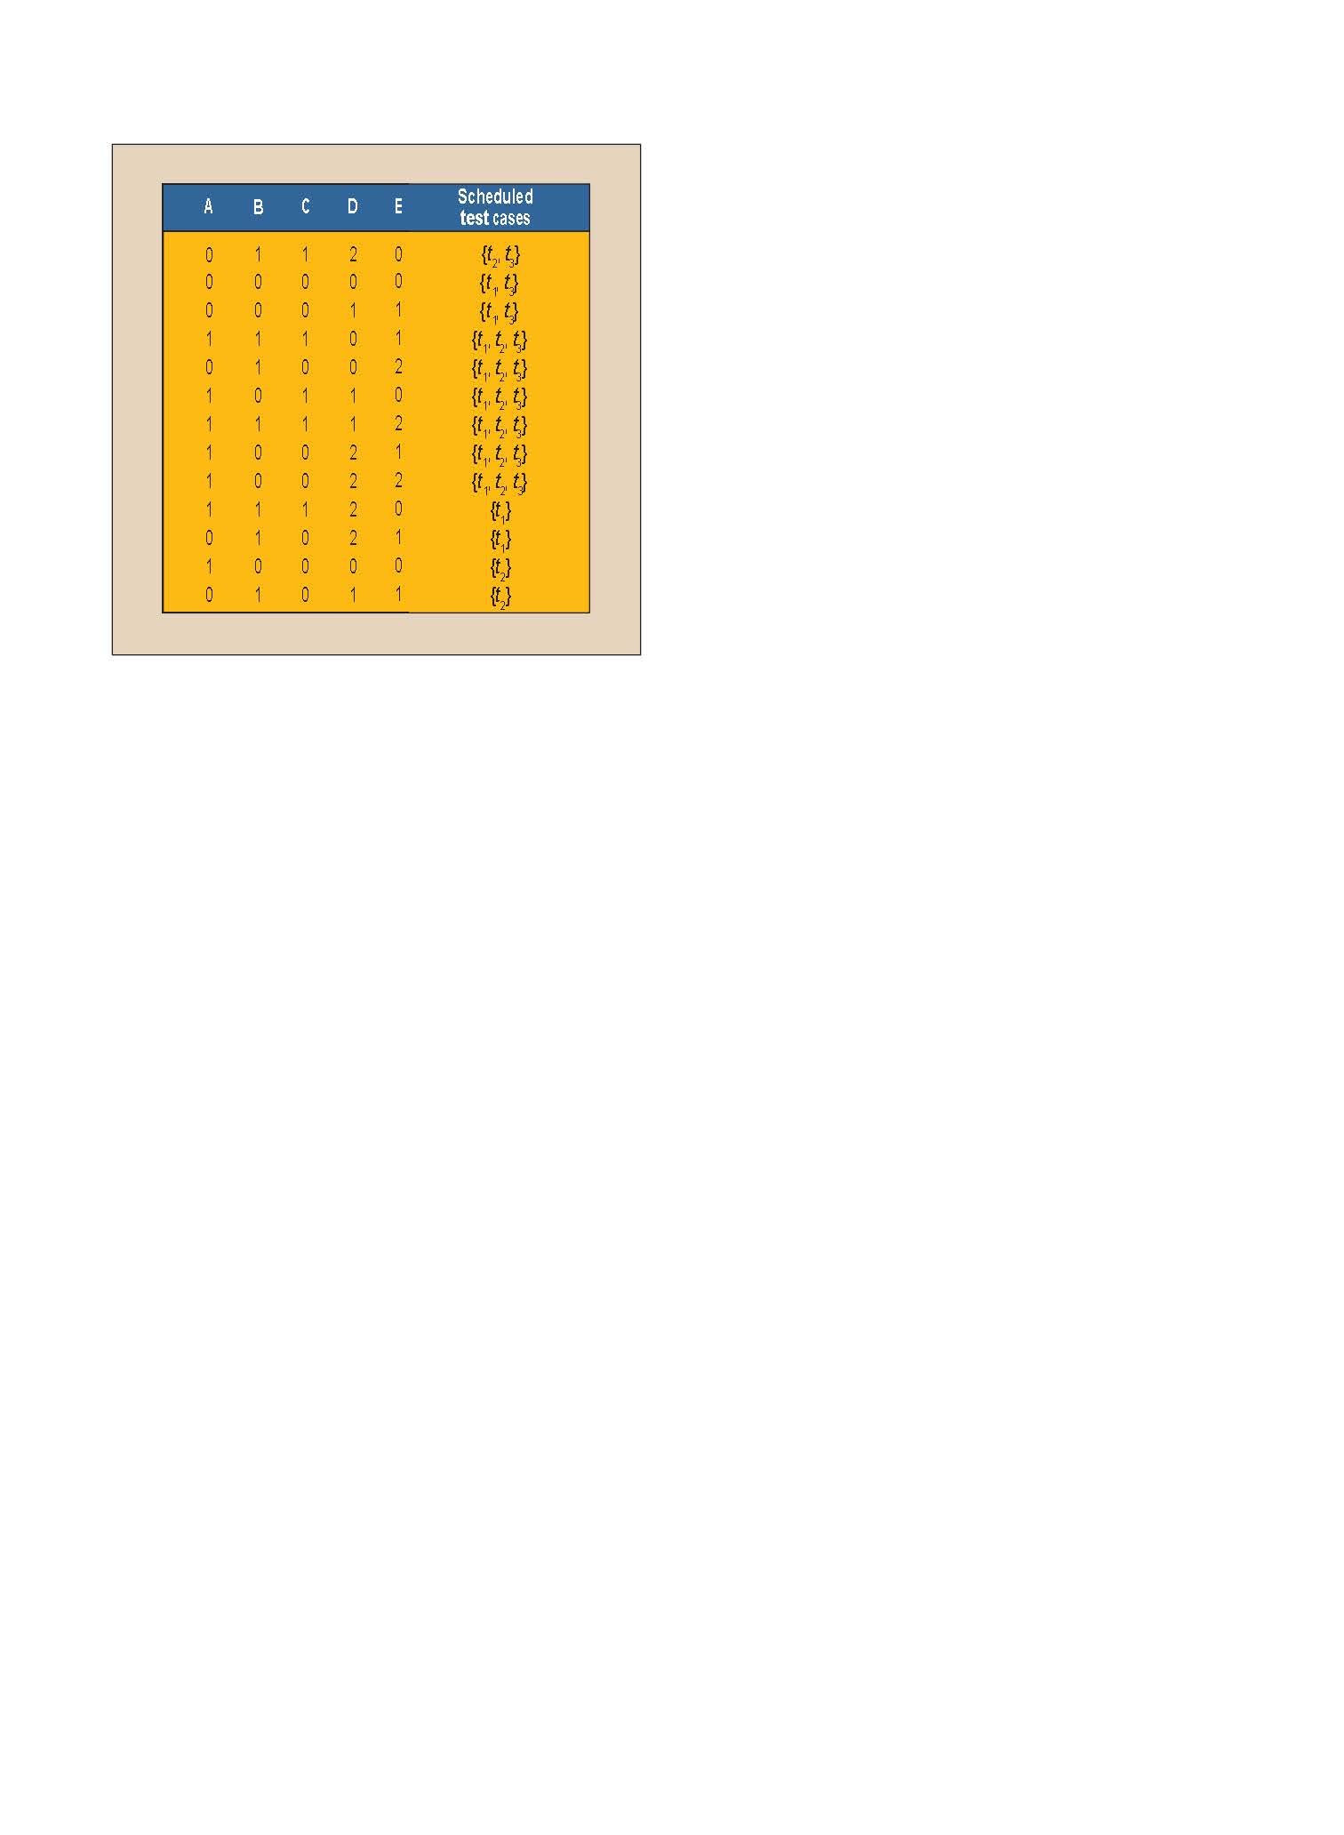
Combinatorial Interaction Testing
Test cases: t₁, t₂, t₃
  Constraints: t₁& t₂ cannot run under (A=0 Λ C=1); t₂ cannot run under (A=0 Λ B=0)
  Same example from earlier
Each test case must achieve 2-way covering array
13 configurations are needed now
28 executions are needed

Slide 13
Combinatorial Interaction Testing
Some issues to consider
  Cost-aware covering arrays
    Some configurations are more expensive to run, e.g., needs additional installation and compilation
    Needs to “order” test configurations
  Incremental Covering arrays
    Start form pre-defined seeds
    Start from (t-1)-way array as seed. Use the existing configurations and add only a small amount of new configurations to achieve t-way array
  Prioritization based on cost, execution frequency, etc.
This slide set is based on Moving Forward with Combinatorial Interaction Testing, by C. Yilmaz, S. Fouche, M. Cohen, A. Porter, G. Demiroz, and U. Koc, in Computer, February, 2014, Vol. 47, No.2, pp. 37 - 45

