Slide 1
Course Notes Set 12-b: Case Study: Penetration Testing Tools
Computer Science and Software Engineering
Auburn University

Slide 2
Penetration Testing for Web Services
Service-oriented architectures (SOA)
Interactions between system and users
Penetration
Attack - for a hacker to uncover and exploit any security vulnerabilities
By entering into input fields values that have malicious purposes, e.g., command injections
Products must be tested for vulnerability
Penetration tools available
How good are they?

Slide 3
Penetration Testing for Web Services
Traditional approaches are important: white box, black box, and gray box
White Box
Exhaustive source code analysis difficult (i.e., impossible)
Without runtime dynamic consideration
Black Box
Test specifications must be defined before development for coverage criteria
Gray Box
When faults are detected through black box, exam the code

Slide 4
Penetration Testing for Web Services
Black box is common for penetration testing to identify vulnerabilities
No knowledge about code is needed
Manual testing is hard
Test cases (inputs) must be broad representatives (or cover specification criteria)
Web scanners or web vulnerability scanners are the automatic tools that perform penetration testing
Many populous commercial web scanners
Most of them are “general purpose”
How good are they?
Important to know to have appropriate confidence level

Slide 5
Penetration Testing for Web Services
Three leading commercial scanners are studied – HP WebInspect, IBM Rational AppScan, and Acunetix Vulnerability Scanner
Plus one academically developed scanner
Randomly ordered scanners – VS1. VS2, VS3, VS4
Enlisted a team of four security experts. The faults they discover will serve as the baseline for performance comparison
The domain
25 web services, 101 operations
Average cyclomatic complexity is 9
Faults are injected

Slide 6
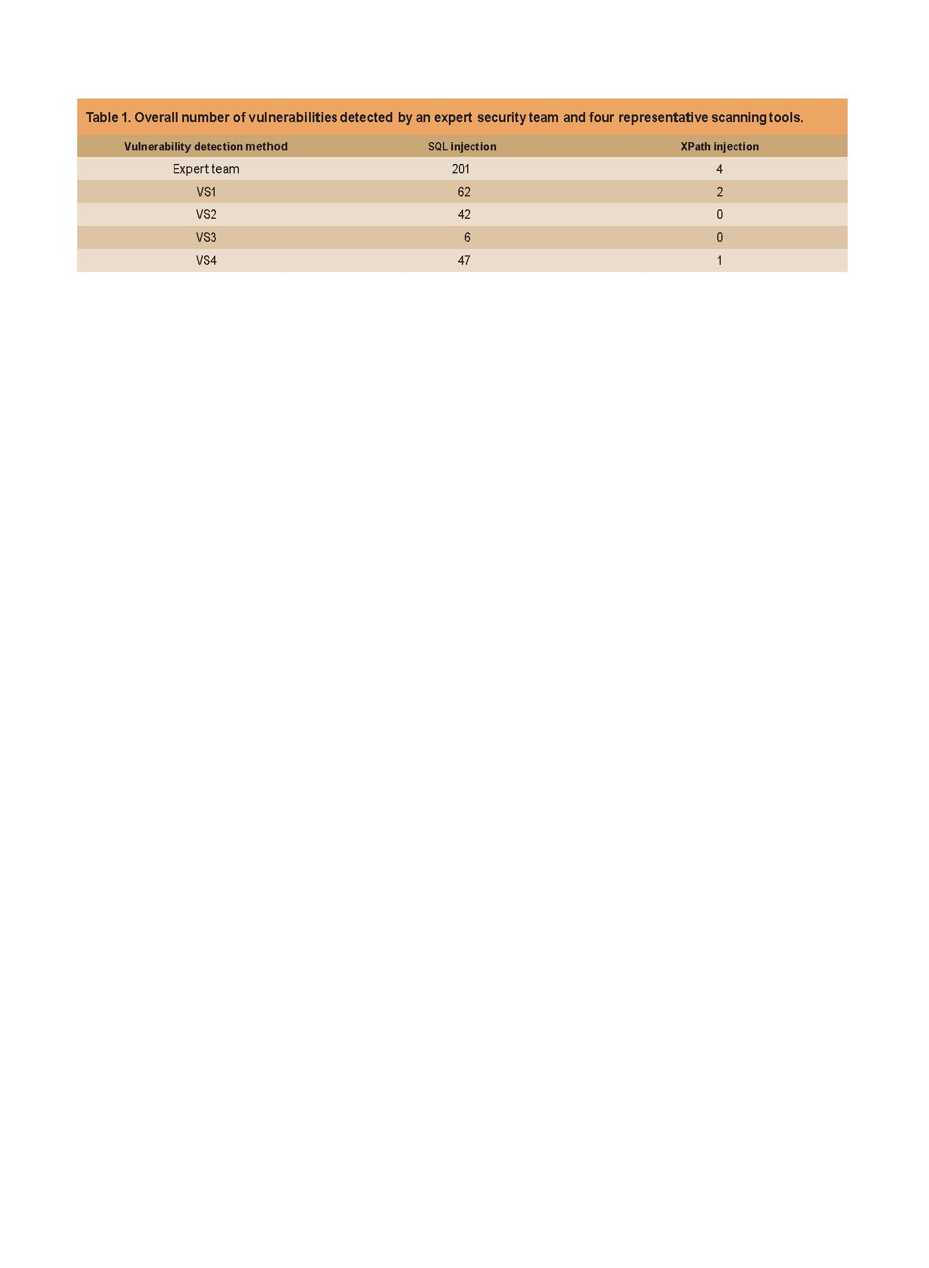
Most automatic scanners are not effective

Slide 7
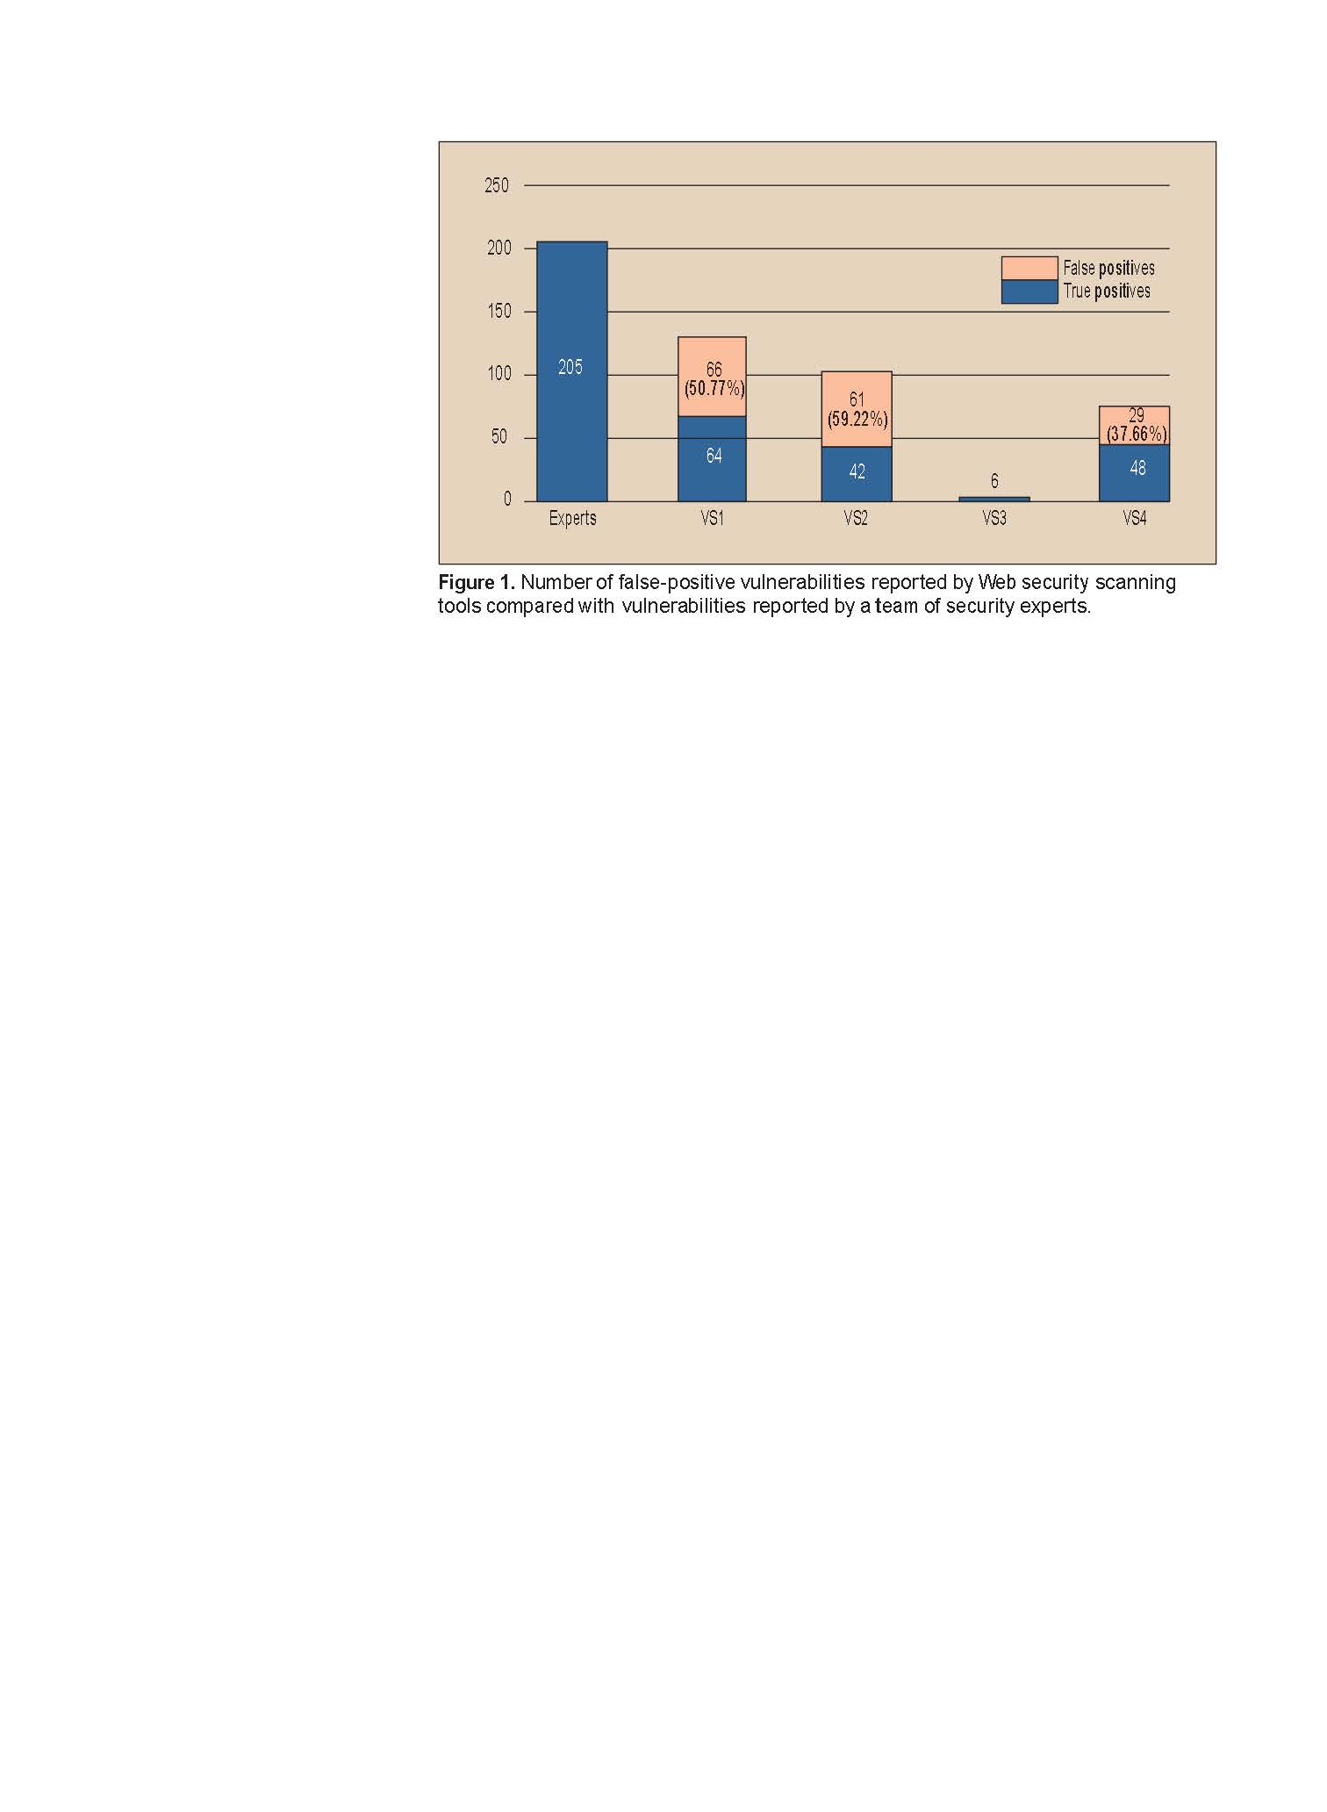
The nightmare of False-positives
Waste time to fix nonexistent vulnerabilities
Reduce development team’s confidence
Significant portion is false-positive

Slide 8
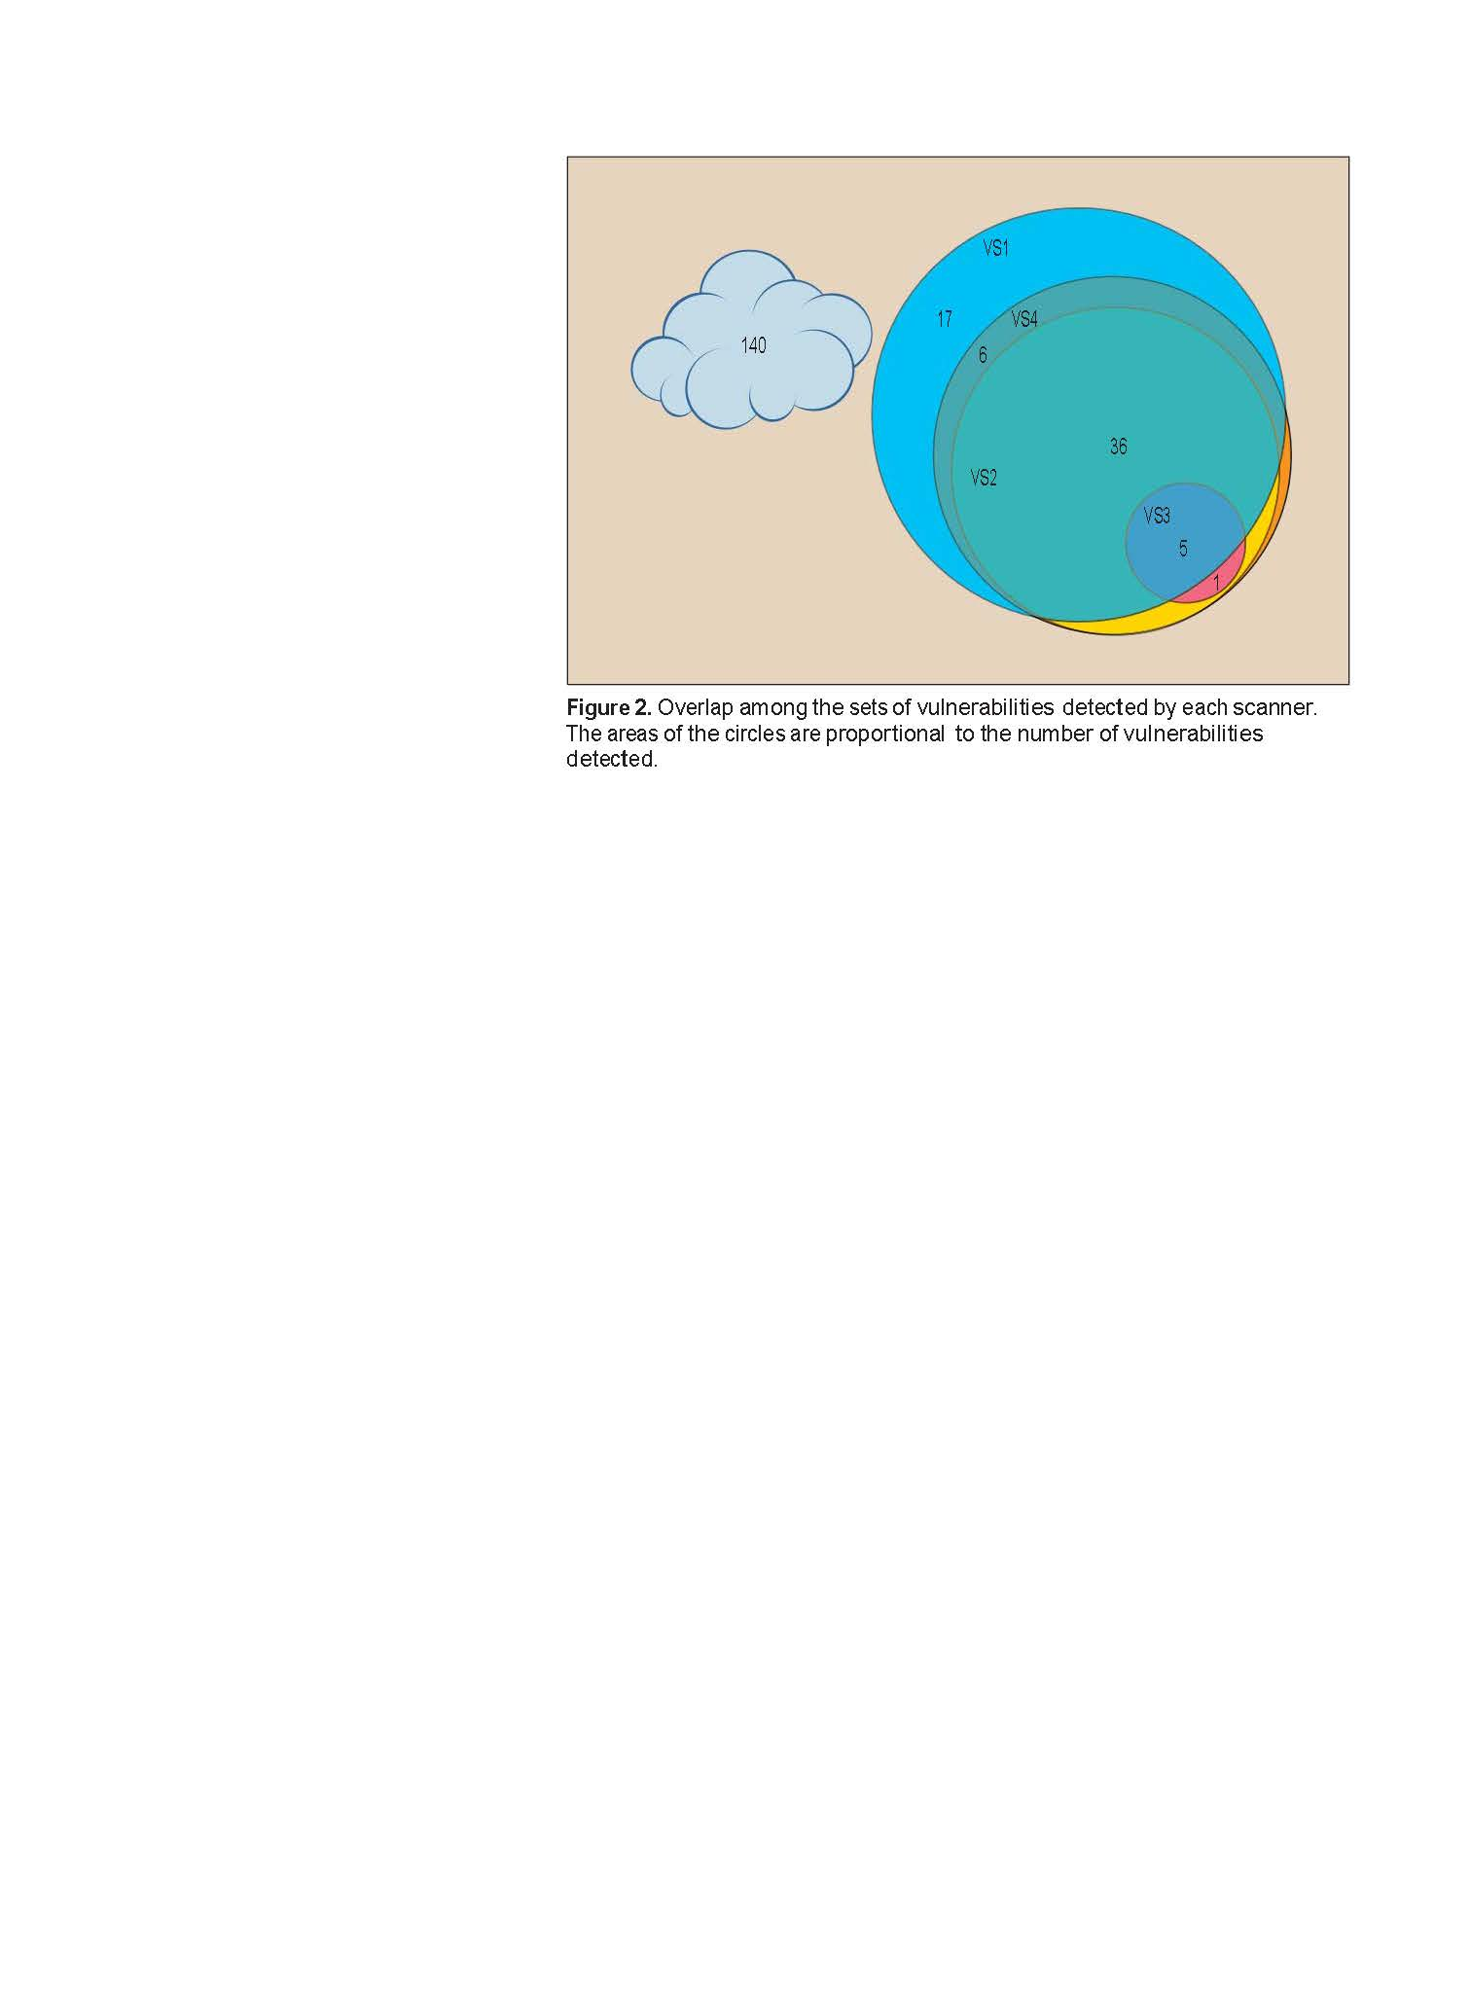

Slide 9
It may not be totally fair
Some faults cannot reached because they are after certain faults, therefore cannot be detected by automatic tools
The preceding faults must be removed first
Human experts use static review can reach all faults
Some faults can only be detected by correlating multiple requests (interactions). Single request/response is not enough ➔ Combinatorial Interaction Testing, t-way covering arrays
Large number of faults are left undetected

