Slide 1
The Physical Layer
Notes:
Video Module 3-01

Slide 2

Overview
Objectives
Learn and understand the physical layer in the OSI Reference Model
Learn and understand the effects of a medium on a signal.
Learn and understand the techniques to mitigate the above effects.
Learn and understand the relationships between bitrate, transmission time, propagation time.
Requirements
Know the OSI Reference Model
Read Sections 2.1.1 and 2.1.3
Read Section 2.3.1
Read 2.5.1-2.5.3
Read 2.4.4

Slide 3
Introduction
Physical layer in the OSI Reference model
Fundamental (adverse) effects of a medium on the signal
attenuation
delay
unfairness (signal of different frequencies are treated differently)
Fourier Theorem
Maximum Data Rate of a Channel
Read Sections 2.1.1-2.1.3

Slide 4
OSI Reference Model
User/Client
User/Server
Application
Protocol
Application
Interface
Interface
Presentation
Protocol
Presentation
Interface
Interface
Protocol
Session
Session
Interface
Interface
Protocol
Transport
Transport
Interface
Interface
Network
Network
Network
Network
Interface
Interface
Interface
Interface
Data Link
Data Link
Data Link
Data Link
Interface
Interface
Interface
Interface
Phys.
Phys
Phys.
Phys

Slide 5
Physical Layer
Offers service to data link layer
Transmission of raw bits
Deals with:
Electrical specs
Mechanical specs
Tries to deliver as many bits as possible per unit time without corruption or loss.

Slide 6
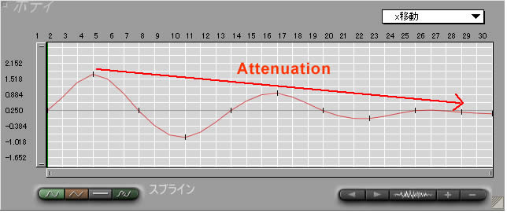
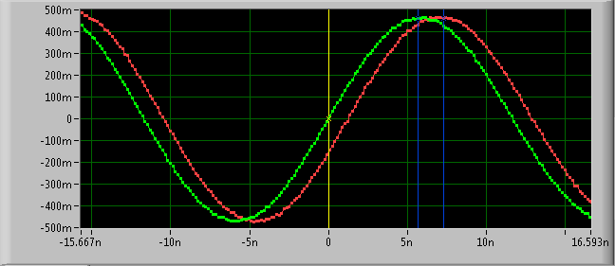


(Adverse) Impact/Effect of a Medium on a Signal
A medium :
attenuates a signal
Delays a signal
Is unfair to signals using different frequencies:
Signals of different frequencies experience DIFFERENT attenuations and delays
The unfairness produces DISTORSION, making it hard to recognize the original sent signal
In short, a medium is a kind of …..
……. a washing machine
→

Slide 7

Impact of a Washing Machine on a Garment
A Washing machine:
Shrinks (attenuates!) a garment
Delays a garment
Is unfair to garments using different fabrics
Washing with hot water shrinks wool much more than denim (fabric for jeans)
There is a limit on the capacity of a washing machine.

Slide 8
No More Laundry Talks …....
Let us formalize these ideas.

Slide 9
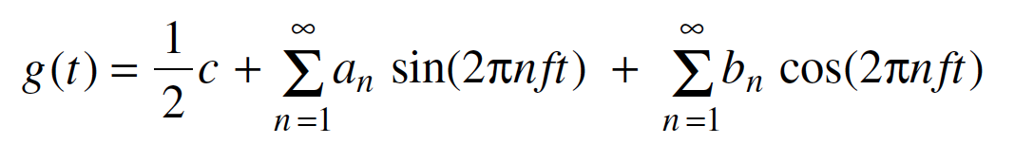
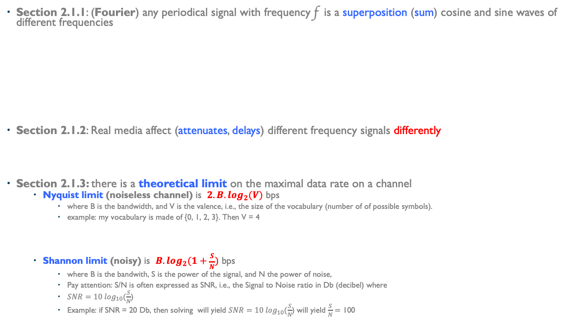
Fundamental Properties
Section 2.1.1: (Fourier) any periodical signal with frequency f is a superposition (sum) cosine and sine waves of different frequencies
Section 2.1.2: Real media affect (attenuates, delays) different frequency signals differently
Section 2.1.3: there is a theoretical limit on the maximal data rate on a channel
Nyquist limit (noiseless channel) is ${2.B.log}_{2}(V)$ bps
where B is the bandwidth, and V is the valence, i.e., the size of the vocabulary (number of of possible symbols).
example: my vocabulary is made of {0, 1, 2, 3}. Then V = 4
Shannon limit (noisy) is $B.\log_{2}(1+\frac{S}{N})$ bps
where B is the bandwith, S is the power of the signal, and N the power of noise,
Pay attention: S/N is often expressed as SNR, i.e., the Signal to Noise ratio in Db (decibel) where
$SNR=10 \log_{10}(\frac{S}{N}$)
Example: if SNR = 20 Db, then solving will yield $SNR=10 \log_{10}(\frac{S}{N}$) will yield $\frac{S}{N}=$ 100

Slide 10
Mitigating the Consequences of Fourier Theorem
Consequences of Fourier Theorem
Baseband transmission
Why do we need modems for long distance communications?
MODEM (MOdulates – DEModulate
Read Sections 2.2.1-2.2.3 and 2.2.5 (skip 2.2.4)
Notes:
Video Module 3-02

Slide 11
Consequences of Fourier
Square signals (baseband transmission) are badly affected by channels
because square signals are a mix of signals of different frequencies
Recall: signals of different frequencies are attenuated and delayed differently
→ square signals are distorted.
There is only limited ways to increase data rate and fight attenuation, delay, and discrimination (frequency unfairness) (2.5.1)
Use better media:
twisted pair,
coaxial cable,
fiber
Symbol rate (baud rate) versus bit rate:
If the vocabulary consists of 2^{n} symbols, Bit Rate = n Baud Rate
Use better encoding schemes:
NRZ,
NRZI,
Manchester

Slide 12
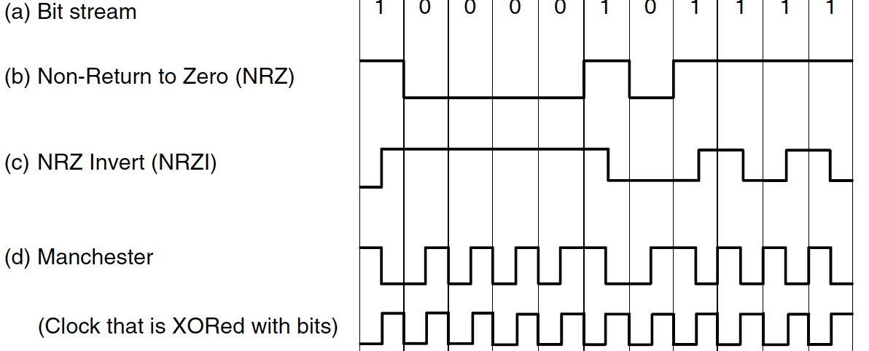
Better Encoding Schemes for Baseband Transmission
Encoding schemes:
NRZ,
NRZI,
Manchester

Slide 13
Better Encoding Schemes for Baseband Transmission
Encoding schemes:
NRZ,
NRZI,
Manchester

Slide 14
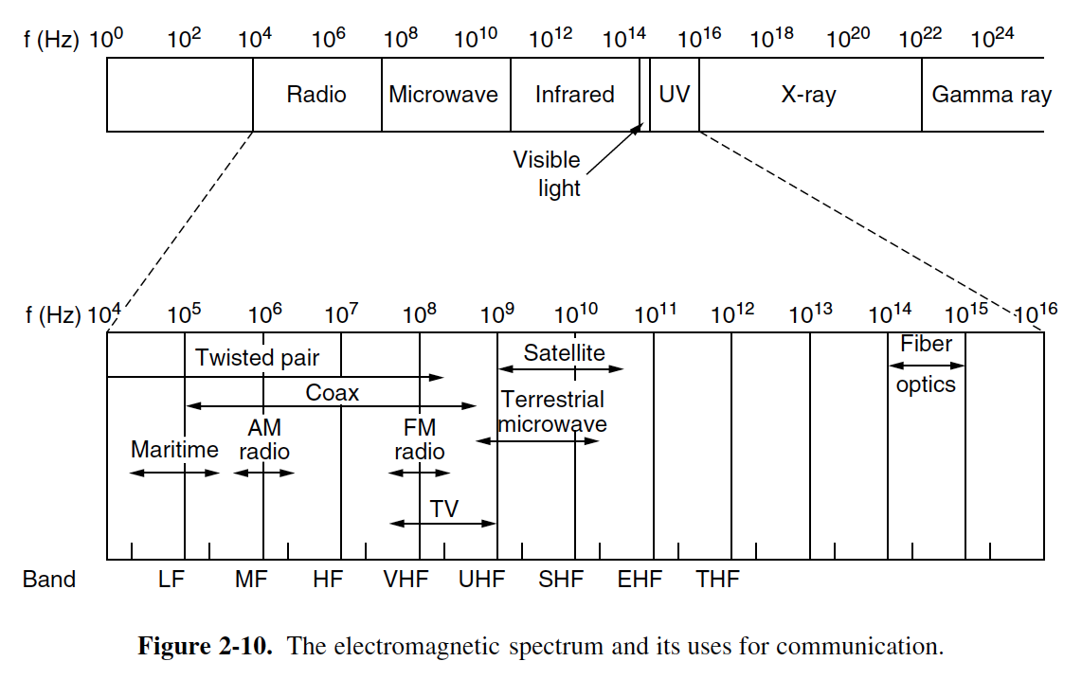
Better Media
Guided Transmission Media
Magnetic Media (2.2.1)
Twisted pairs (2.2.2)
Coaxial cable (2.2.3)
Fiber optics (2.2.5)
Wireless Transmission

Slide 15
Better Media
Guided Transmission Media
Magnetic Media (2.2.1)
Twisted pairs (2.2.2)
Coaxial cable (2.2.3)
Fiber optics (2.2.5)
Wireless Transmission

Slide 16
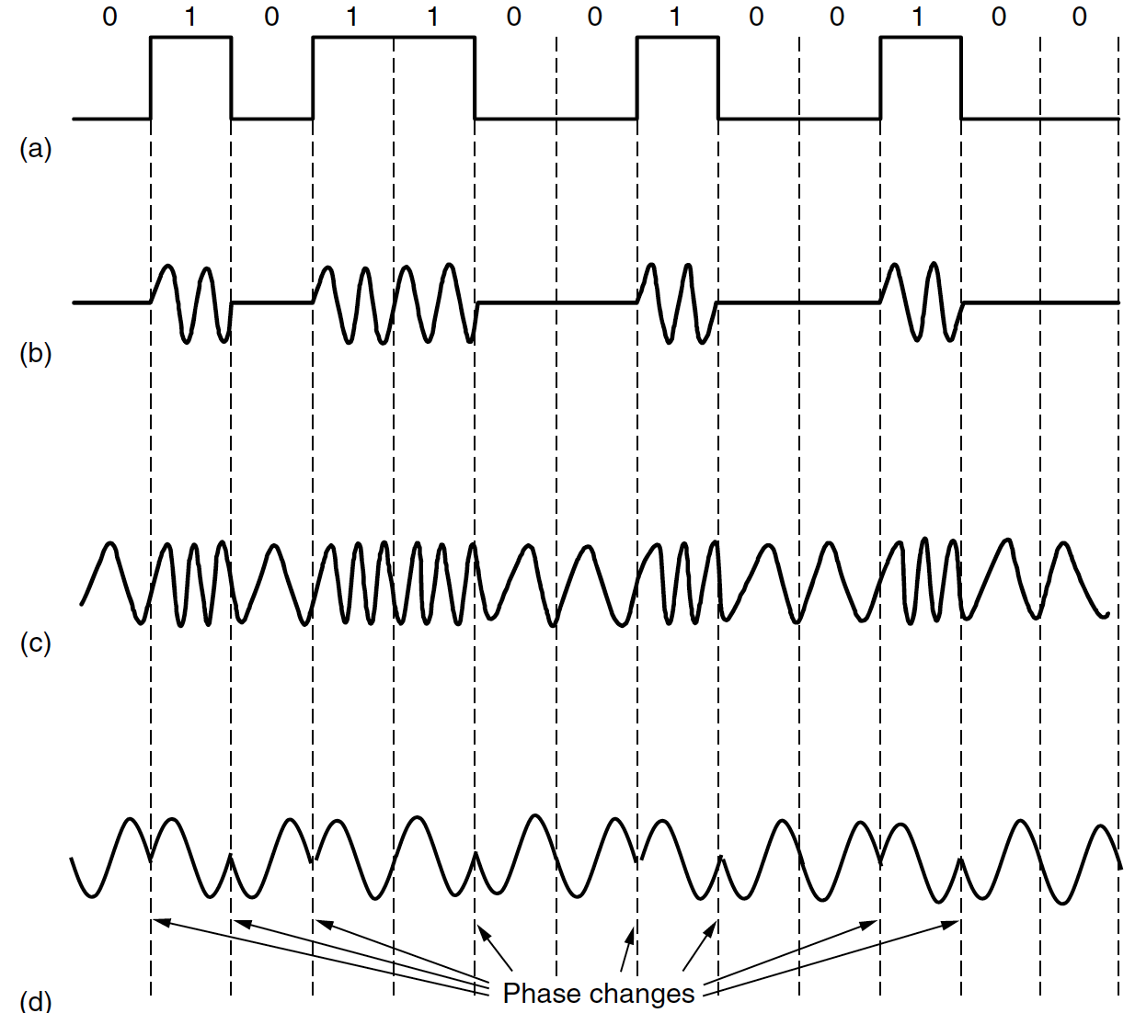
Baseband Cannot Be Used Long Distances→ Modulation
===➔ Modulation such that a signal is made of a limited number of frequencies (2.5.2).
ASK (Amplitude Shift Keying), FSK (Frequency SK), PSK (Phase SK)
ASK
FSK
PSK

Slide 17
Baseband Cannot Go On Long Distances→ Modulation
===➔ Modulation such that a signal is made of a limited number of frequencies (2.5.2).
ASK (Amplitude Shift Keying), FSK (Frequency SK), PSK (Phase SK)
ASK
FSK
PSK

Slide 18
Consequences of Maximal Capacity
Consequences of the Capacity Limit (bit rates)
Nyquist/Shannon Limits
How to share the channel?
Read Sections 2.5.1, 2.5.3-2.5.5
Notes:
Video Module 3-03

Slide 19
Consequences of the Capacity Limit
Multiple users must share the medium
How to share?
Frequency division multiplexing (FDM) (2.5.3)
Time division multiplexing (TDM) (Section 2.5.4)
Code Division Multiplexing (2.5.5)

Slide 20
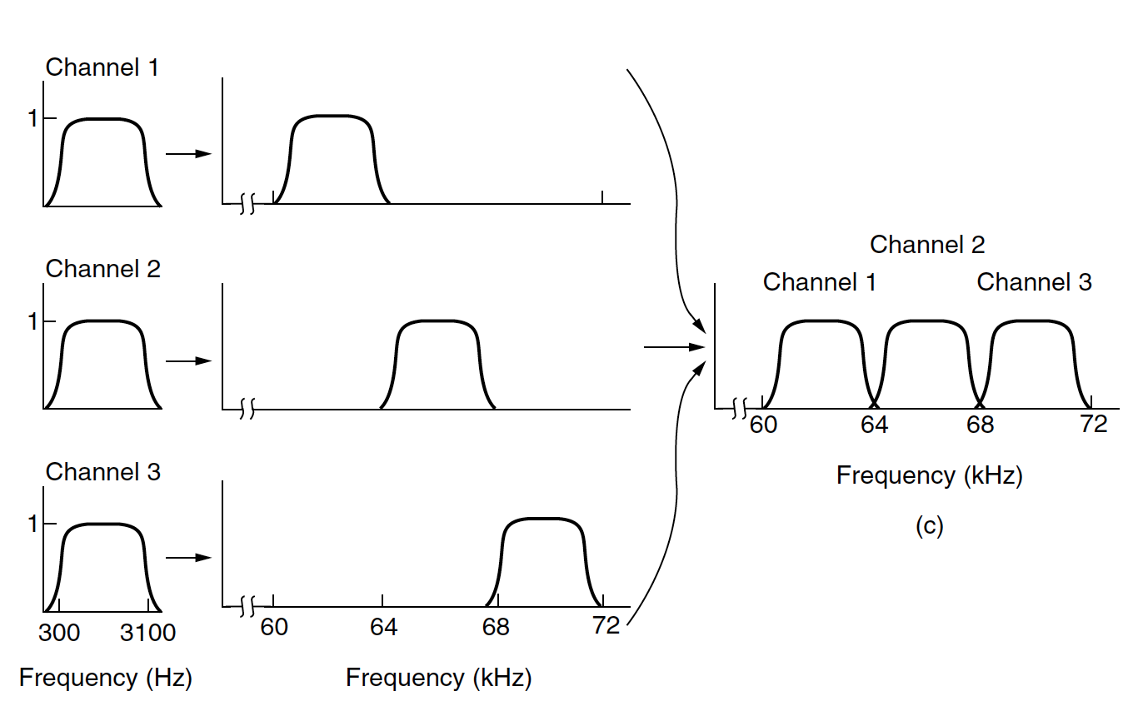
Frequency Division Multiplexing (FDM)
A medium is divided in multiple channels
Each channel is carried on different frequency bands.

Slide 21
Frequency Division Multiplexing (FDM)
A medium is divided in multiple channels
Each channel is carried on different frequency bands.

Slide 22
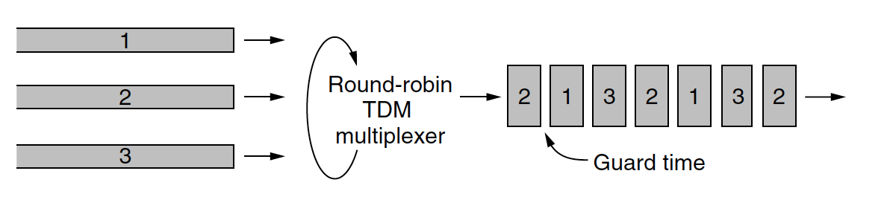
Time Division Multiplexing (TDM)
A medium is used in turns (round robin) by multiple users.

Slide 23
Time Division Multiplexing (TDM)
A medium is used in turns (round robin) by multiple users.

Slide 24
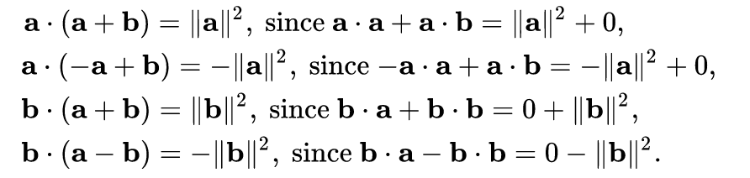
Code Division Multiplexing Access (CDMA)
Different stations A and B are assigned codes (chip sequences) a and b for each bit such that a and b are orthogonal → a. b = 0
Example:
To send 0 (resp.1) using the chip a, Station A sends –a (resp. a).
To send 0 (resp.1) using the chip b, Station B sends –b (resp. b).
Suppose that Station A sends 1 (a) and Station B sends 1 (b). A receiver will see the superposition of both signals, i.e. S = a + b.
How can a receiver know what Station A sent?
To extract a from S, a receiver must multiply S by ….
Suppose that Station A sends 0 (-a) and Station B sends 1 (b). A receiver will see the superposition of both signals, i.e. S = -a + b.
How can a receiver know what Station A sent?
To extract a from S, a receiver must multiply S by ….

Slide 25
Code Division Multiplexing Access (CDMA)
Different stations A and B are assigned codes (chip sequences) a and b for each bit such that a and b are orthogonal → a. b = 0
Example:
To send 0 (resp.1) using the chip a, Station A sends –a (resp. a).
To send 0 (resp.1) using the chip b, Station B sends –b (resp. b).
Suppose that Station A sends 1 (a) and Station B sends 1 (b). A receiver will see the superposition of both signals, i.e. S = a + b.
How can a receiver know what Station A sent?
To extract a from S, a receiver must multiply S by ….
Suppose that Station A sends 0 (-a) and Station B sends 1 (b). A receiver will see the superposition of both signals, i.e. S = -a + b.
How can a receiver know what Station A sent?
To extract a from S, a receiver must multiply S by ….

Slide 26
Delay
Delay components
Transmission time
Propagation time
Queueing delay
Notes:
Video Module 3-04

Slide 27
Delay
Upper Layer Feeder
Feeding rate larger than bit rate
Queueing Time
Receiver
Sender
Bandwidth (bit rate)
Speed of signal)
Transmission Time
Propagation Time
Loading Time
Transmission Time
Travel Time
Propagation Time (Tp)

Slide 28
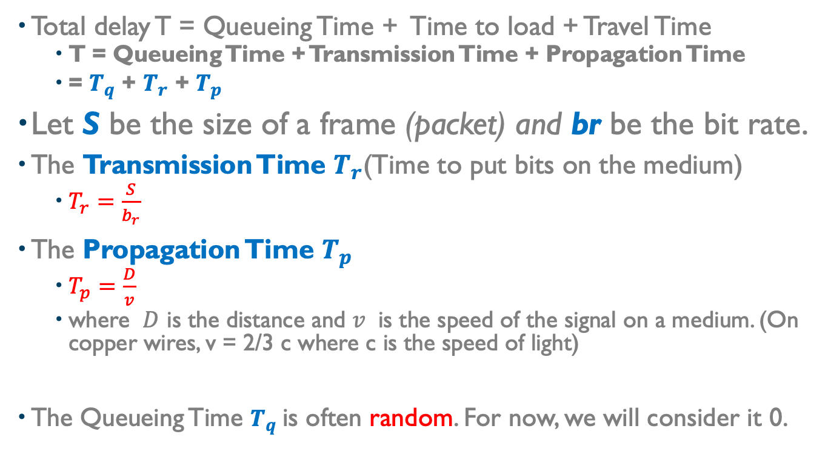
Delay (Cont’d)
Total delay T = Queueing Time + Time to load + Travel Time
T = Queueing Time + Transmission Time + Propagation Time
= $T_{q}$ + $T_{r}$ + $T_{p}$
Let S be the size of a frame (packet) and br be the bit rate.
The Transmission Time $T_{r}$(Time to put bits on the medium)
$T_{r}=\frac{S}{b_{r}}$
The Propagation Time $T_{p}$
$T_{p}=\frac{D}{v}$
where $D$ is the distance and $v$ is the speed of the signal on a medium. (On copper wires, v = 2/3 c where c is the speed of light)
The Queueing Time $T_{q}$is often random. For now, we will consider it 0.

Slide 29
Delay : units, constants, conventions (to know)…
The speed of light c is 299,792,458 m/s. Throughout this course use this approximation: c = 3 10⁸ m/s = 3 10⁵ km/s.
The speed on copper is about 2/3 the speed of light (2 10⁵ km/s )
The bit rate is often expressed in Kbits/s (Kilobit = 10³ bits), Mbits/s (Megabit = 10⁶ bits), or Gbits/s (Gigabit = 10⁹ bits).
Important, when expressing a bit rate
Kilo = 10³
Mega = 10⁶
Giga = 10⁹
Important, when expressing data size (storage, packet size…)
Kilo = 2¹⁰
Mega = 2²⁰
Giga = 2³⁰
Time units
milliseconds (ms) (10⁻³ s)
microseconds (μs) (10⁻⁶ s)
nanoseconds (ns) (10⁻⁹ s)

Slide 30
Wrap Up
Learn and understand the physical layer in the OSI Reference Model
Learn and understand the effects of a medium on a signal.
Learn and understand the techniques to mitigate the above effects.
Learn and understand the relationships between bit rate, transmission time, propagation time.
Notes:
Video Module 3-05

