Slide 1
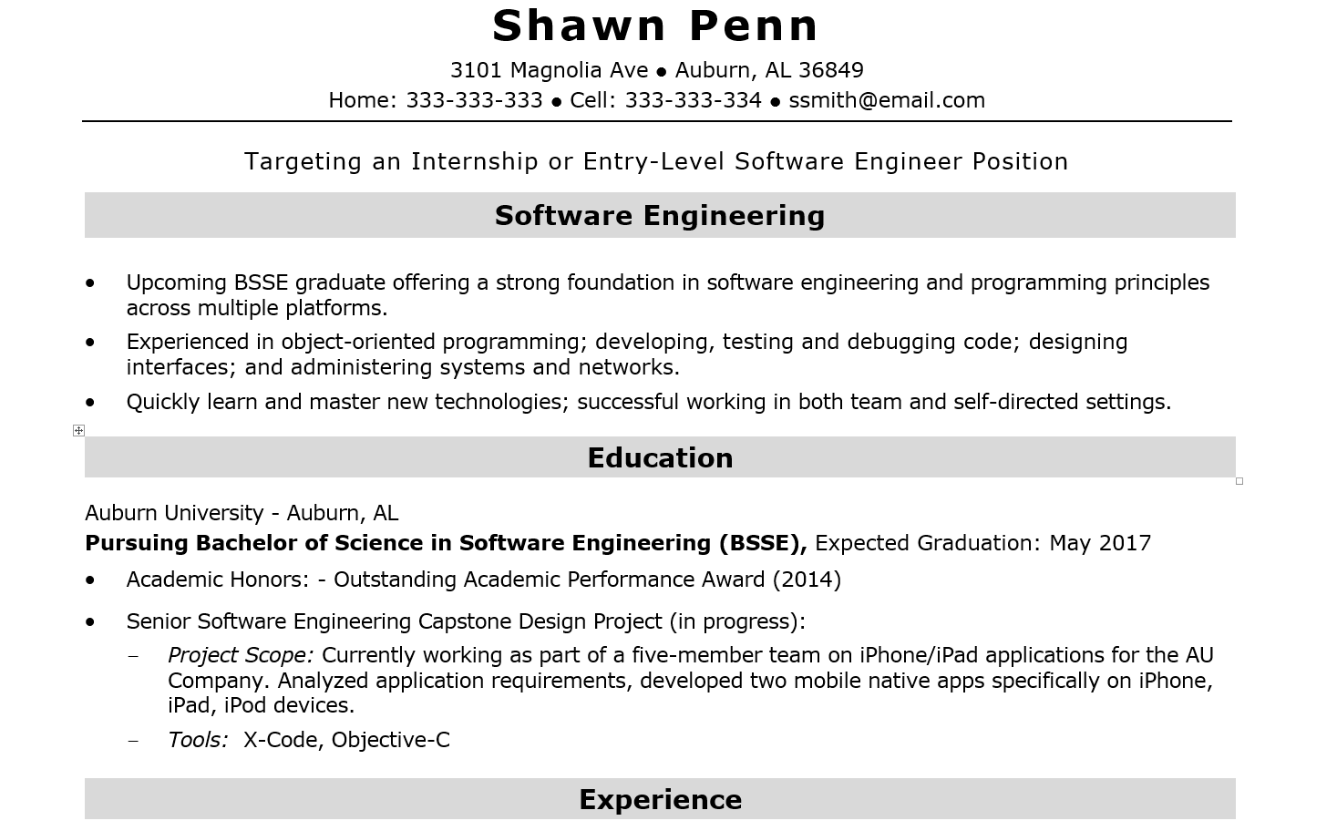
COMP3500 and Your Resume
1-1
Notes:
Strengthen your resume in the last semester.
1

Slide 2
1-2
Notes:
From COMP2710 Projects to COMP4710 Projects
2

