Slide 1

Of the Layer stack
and the chained factory

Slide 2
Karel Chanivecky
2021 BCIT Computer Systems Technology Diploma graduate (Datacomm option)
Embedded Software Engineer. Fortinet inc. (Since 2021)
Lvl II Electrician Apprentice. ESC Automation (2018 – 2019)
Music player (Guitar, Harmonica, Hand drums, etc.)
Bicycle restorer. Specially 70’s/80’s road bikes

Slide 3



My boss tells me…
Proprietary Protocol
Slightly different proprietary protocol
XML
JSON
Stream
App Icon by Aficons studio
Stream
TLS / No TLS

Slide 4

What’s in it
App Icon by Aficons studio
API(Protocol message, handlers)
API Message Serialization
Secondary protocol (e.g., HTTP)
Encryption
Buffering
Handshake (perhaps at several levels)
Peer management (e.g., DoS detection)
Load balancing
Error Handling
Plug Icon by IconLib
TOO MUCH!!!
Socket
APP
We just wanted to add chocolate to the cart

Slide 5
Don’t do this
addCartItem(item) {
const addItemMessage = new AddItemMessage(item);
const serializedMessage = serialize(addItemMessage);
const encryptedMessage = encrypt(serializedMessage);
tcpSocket.send(encryptedMessage);
}

Slide 6
Don’t do this
while (true) {
const totalData = []
while (totalData < whatIsNeeded) {
const newData = socket.read(); totalData.append(newData);
}
const encryptedMessage = totalData.join();
const serializedMessage = decrypt(encryptedMessage);
const message = deserialize(serializedMessage);
switch (message.type) {
case ADD_ITEM: ….
….
}
}

Slide 7
What does my manager want?
Do not get bogged down in the details. Code to an interface
Flexibility to build up the stack according to project priorities
Modules should only care about other modules with a similar hierarchical level
serverManager = new ServerManager(factoryForConnectionWithTLSandJSONandBLABLABLAandWhatNot )
try:
serverManager.getServer(). addCartItem(swissChocolate)
except BoomError:
print(“WHY YOU!”)
// inside server connection.send(new AddCartItemMessage(item))
Our program only needs a handle to a connection object

Slide 8
A better way

Slide 9
Considerations
On connection, build the stack
Each layer should be as transparent as possible to the next
Account for different types of stack. Event driven or stream driven.
Account for the type of data that each layer consumes. Perhaps some layers consume text, and some bytes
If any layer fails to build, the whole stack must be destroyed
Account for handshake failures
Account for resource exhaustion
Account for implementation errors
After built, errors should bubble up to the highest level of the stack
Disconnection
Invalid syntax at any level
The application should only have a handle to the top-most layer
Destroying the top layer, should trigger a destruction of the following layers

Slide 10
Types of stacks
Event driven
Stream driven
Browser WebSocket API
const ws = new WebSocket(…) ws.onmessage = event => console.log(event.data)
Express HTTP server
app.get('/', (req, res) => res.send('Hello World!’));
IPC. Sockets, pipes, files, fifos, etc, etc
res = read(fd, buffer, byte_count);

Slide 11

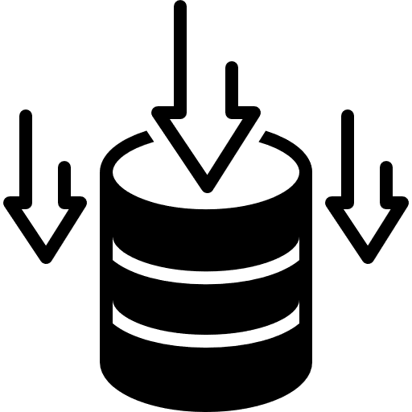

Stream to event
Ear Icon by Kerismaker Studio
Data Storage Icon by WEBTECHOPS LLP
Wait for data
Accumulate until we
have a complete
message
Emit message
or
error

Slide 12
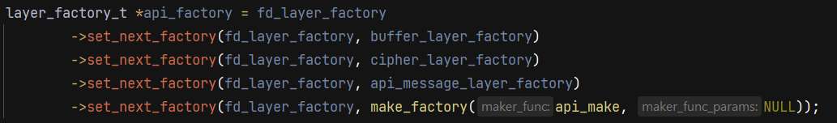
Chained Factory
Based on Abstract Factory and Chain of Command patterns
A linked list of abstract factories
The head points to the bottom-most layer’s factory. After building, the top-most layer is returned

Slide 13
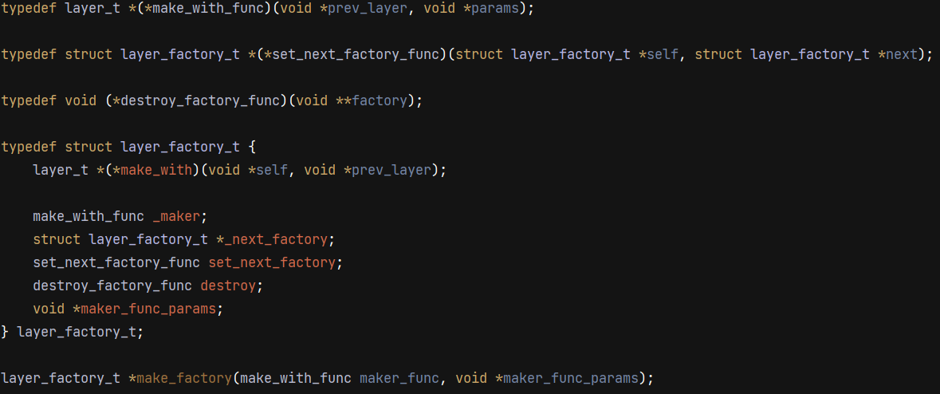
Chained Abstract Factory Object

Slide 14
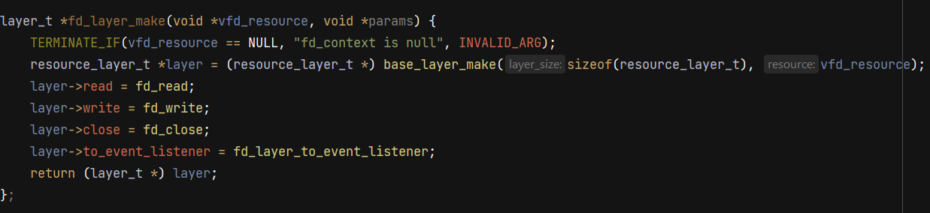
Concrete layer factory

Slide 15
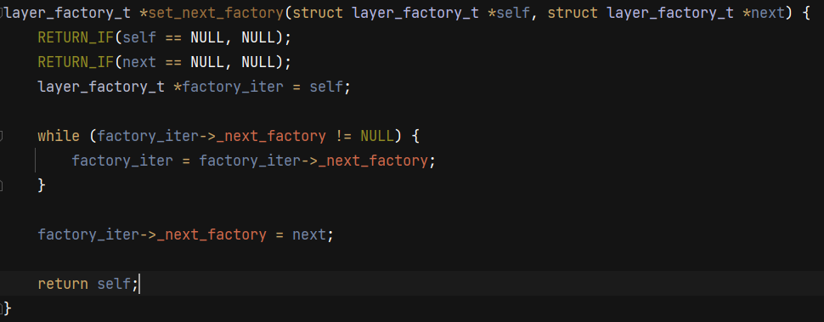
Making the chain

Slide 16
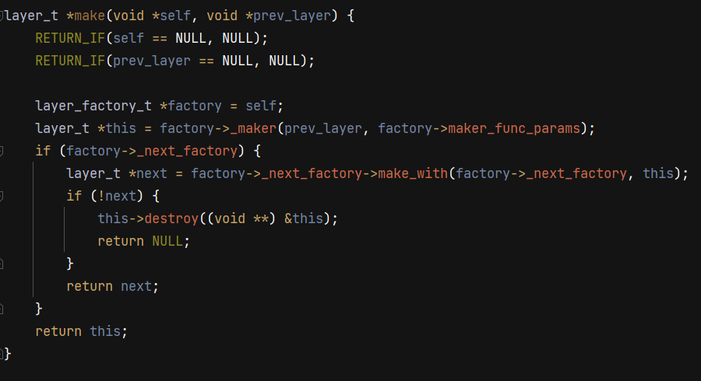
The chain reaction

Slide 17
Demo of sample application
https://github.com/KarelChanivecky/BCIT_demo_layered_application_patterns

