Slide 1

Markus Bilz, Karlsruhe, DE
Notes:
I’m Markus I’d like to tell you a story; my story.
It’s was in summer 2003, I was 8 years back ten.
I spent the summer at my cousin’s house. People say it was a beautiful summer, I actually don’t know, as I’ve stayed indoors all weeks long. At this time The Rasmus with “In the shadows” was very popular. I was watching it on MTV in endless iterations and people were up-voting this song again and again.
Recently Philipp pointed me to blog post by Rcharlie, a blogger and scientist who did data analysis on spotify using R. I liked the idea; the problem was that I didn’t speak R. So I took general idea for this talk and combined it with tools I knew and come up with my own workflow.
“In the shadows” actually has some serious background; telling the story of somebody suffering from cancer. One of the saddest I know. Of course I wanted to know how it would rank, compared to other The Rasmus songs.

Slide 2
What makes up a good sad song?
Notes:
But first things first… I had to find out what makes up a sad song…
[discussion about possible ideas]
I was also doing some brainstorming on a Friday night. After three minute I finished my extensive research and came up with this...

Slide 3

Notes:
[instruments]

Slide 4

By RIAA (RIAA) [Public domain], via Wikimedia Commons
Notes:
[lyrics]

Slide 5

Notes:
[in the case of “The Rasmus” we need definitely need black feathers in our hair]

Slide 6
things, that make music
+
lyrics
Notes:
Let’s more generalize it…
What we need are lyrics and things, that make music; ordinary people call this instruments ;-)
The only problem is...

Slide 7
<?>
+
lyrics
Notes:
… that I know nothing about instruments. So I decided to swap it for something else and stick with the lyrics to do the calculus and to do the final ranking.

Slide 8

cc-by City.and.Color flickr.com
Notes:
From previous projects I knew, that websites like spotify have a “back door” to access data, that is not available to every Tom, Dick and Harry.
Most websites do this, ….

Slide 9
human web
programmable web
Notes:
… they offer an interface for humans and software...
The human web as we know it:
-You point your web browser to some URL
-You are served a web page.
- Your browser renders the response, that’s been send by the server, nicely.
The programmable web is just the same.
The main difference is that instead of arranging its data in attractive html pages with banner adds and cute cat memes., the programmable web serves stark, brutal xml or json (or data so to speak).
It’s build for software programs not for humans.
We can access the programmable web trough something that is called an API.

Slide 10
spotify.com
api.spotify.com
Notes:
Just recall spotify.com is the human web and api.spotify.com is the programmable web.

Slide 11
API

Slide 12

(c) amazon.com
Notes:
Just imagine this box to be an application either running on a server or on your desktop.
Imagine this box would your application, returning the geometric shapes you put into the box, but with a different color.
But you’re only allowed two input specific shapes and your geometry/input has to meet some specific criteria. So the blue cover works as an interface.
In a web context, an API structures requests and responses.
So let’s speak about the why first.

Slide 13
why?
Notes:
So why do we need API’s at all? This is in fact the million dollar question because for those who understand the potential of APIs, there could be millions of more dollars to be made, or saved.
API’s let you write applications, that use other applications. API’s enable to develop software fast and efficient.
Let’s have look at 2 real life examples.

Slide 14
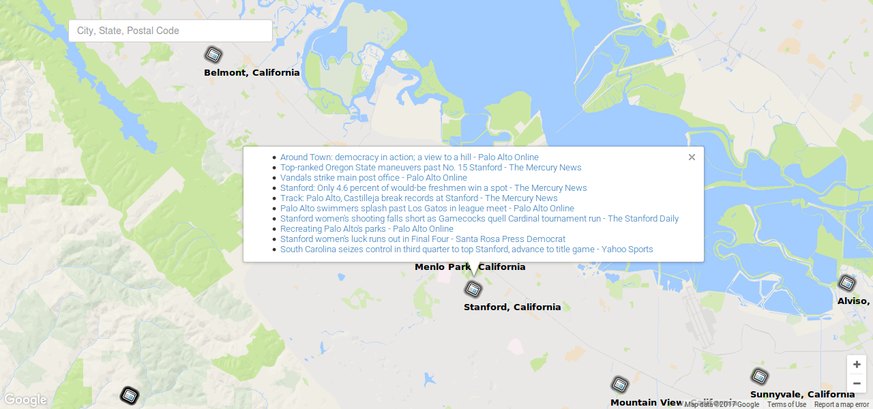
http://www.cs50.net Markus Bilz

Slide 15

http://www.thewildernessdowntown.com/#

Slide 16


Notes:
There are different ways how web APIs can be build the most popular are “SOAP” and “REST”. Lately REST is gaining more and more popularity and all the cool kids of the Internet are using it like google, facebook and yahoo. REST is simpler to use and very fast.
We won’t cover Soap during this talk, as all the API’s we use, are based on REST principles.
To better understand what Rest is and how REST works, we first have to understand what HTTP is and how it works. HTTP is used in the human web and most REST-services use it. For now just regard HTTP and REST as building blocks.
Let’s get started.

Slide 17
HTTP
Notes:
HTTP, was designed to schlep project notes around a physics lab.
HTTP is a document-based protocol, in which the client puts a document in an envelope and sends it to the server. The server returns the favor by putting a response document in an envelope and and send it to the client.
There are strict standards, how the envelope has to look like, but not what goes inside.
[Explain concept with real envelops and printed cat memes…]
So HTTP really has no features to speak of. It’s simplicity is it’s strength.
You basically tell it, what you want and it gives it to you

Slide 18
GET
POST
PUT
PATCH
DELETE
HEAD
OPTIONS
...

Slide 19
GET
POST
PUT
PATCH
DELETE
HEAD
OPTIONS
...
Notes:
GET: retrieve some data
Post: Post some data to a server.

Slide 20
GET

Slide 21
request
GET / HTTP/2.0
Host: www.google.de
...
Notes:
HTTP method: This indicates how the client our web browser is trying to “GET” information from the server
path: URI or URL without host name
request headers: “Informational stickers” slapped onto the envelope. e. g. HOST
entity-body:
This is the document inside of the envelope.

Slide 22
response
HTTP/2.0 200 OK
Content-Type: text/html
...
Notes:
So multiple things go on here...
HTTP response code: Tells the client whether its request went well or poorly and how the client should regard this envelope and its content.
response headers: Just as with the request headers, these are informational stickers such as date, server and so on ...
entity body: again this is the inside of the envelope. It’s the fulfillment of our get request.
The rest is just an envelope with stickers on it, telling the web browser how to deal with it. The most important sticker of these is the content-type, which gives the media type of the entity body. Our web browser, now knows to render Google’s web page as HTML and not as image/jpg or application/xml

Slide 23
POST

Slide 24
request
POST /login.php HTTP/1.1
Host: www.facebook.com
…
Email=mail@markusbilz.com&pass=12345

Slide 25
REST

Slide 26
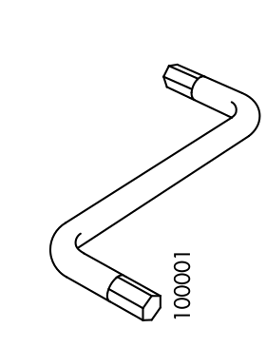

REST
HTTP
(c) ikea.com
Notes:
Think of REST as an instruction of how a RESTful API looks like and HTTP as your tool.

Slide 27
valence
+
lyrics
Notes:
But why am I telling you all of this. Well as it turns out, Spotify provides a so called valence score for tracks. So valence can fill the shoes of the instruments.
According to the documentation, valence is a measure from 0.0 to 1.0 describing the musical positiveness conveyed by a track. Tracks with high valence sound more positive (e.g. happy, cheerful, euphoric), while tracks with low valence sound more negative (e.g. sad, depressed, angry).
So how can we access the valence scores within the API

Slide 28
REST
It’s just an architectural style
It relies on a stateless, client-server protocol, almost always HTTP
Treats server objects as resources, that can be created or destroyed.
Can be used by almost any programming language
Notes:
REST defines a set of architectural principles by which you can use to design a web service. Roy Fielding came up with the idea for REST in his dissertation.
Speaking about the resources: We could have a person resource (Markus) on our server and a Service providing contact information (To retrieve that we would use HTTP verb GET)
What’s being returned is the representation e.g. my phone number in some format but not the person itself. You can have multiple representations of one resource.
REST makes use of HTTP protocol verbs such as POST or GET (The same person who worked on the HTTP specification worked on REST)

Slide 29
REST principles
Uniform interface
Stateless
Client-server
Cacheable
Layered system
Code on demand
Notes:
There are 6 guideline constraints that define a RESTful service
I know all of these sound very intuitive ;-) So hey Markus, what do they mean?
Uniform interface
The uniform interface is a fundamental constraint to the design. You find complicated definitions only, but basically it’s saying we use the HTTP spec with URI’s being our resource name and the HTTP verbs as the actions we gonna take on the resources. Instead of url defining a directory structure, in restful services you often get to a point where it represents data.
Stateless:The server does not need to remember the client’s state. Or in other words, the client provides enough context or information, that the server needs to make a response. Any session state is held on the client.
Client-server: We have disconnected system of a client and a server. The client access a service, that’s provided by the server. A uniform interface is the link between the two. Basically the concerns, processing the data on hand and serving data on the other hand is seperated.
Cacheable
As on the World Wide Web clients and intermediaries can cache responses. Caching responses helps to reduce client-server interactions. Cache-control is set to public in Spotify headers that means it could be cached.
Layered system
I client can not tell whether its connected to the server directly or to an intermediary. This greatly improves scalability.
Code on demand
Optional. Server can temporarily extend the functionality of a client by transferring executable code. Such as javascript.

Slide 30
API endpoints
GET https://api.spotify.com/v1/search
GET https://api.spotify.com/v1/artists/{id}
GET https://api.spotify.com/v1/artists/{id}/albums
GET https://api.spotify.com/v1/albums/{id}/tracks
GET https://api.spotify.com/v1/audio-features/{id}
Notes:
Querying spotify REST API’s to obtain the valence score is a multistep process. The id within the curly brackets is a short version of the spotify URI.
[URIs identify and URLs locate; however, locators are also identifiers, so every URL is also a URI, but there are URIs which are not URLs.]

Slide 31
request
def spotify_get_artist(artist_name):
params = {'q': artist_name, 'type': 'artist'}
headers = {'Accept': 'application/json'}
r = requests.get('https://api.spotify.com/v1/search',
params=params, headers=headers)
return r
def main():
artist = spotify_get_artist(‘The Rasmus’)
Notes:
This is how an API call might look like. The actual implements looks a bit different.
But what I am doing is, I make some HTTP request, I specify the endpoint, specify the data, that goes into the headers and the parameters e.g. ?q=’The Rasmus’

Slide 32

Notes:
Some API’s require so called Access Tokens. Similar to a key. The Spotify API requires Access Tokens for some endpoints only. There are different ways how you can pass the access token to Spotify, either through the headers or as part of the body. We can request the Access Token by doing a post request with our client-ID and some secret key. More on this in the source code.
So how do the responses look like?

Slide 33
{'limit': 20, 'previous': None, 'total': 29, 'next': 'https://api.spotify.com/v1/artists/76ptJV8617638xrpeoUtzl/albums?offset=20&limit=20&album_type=album', 'href': 'https://api.spotify.com/v1/artists/76ptJV8617638xrpeoUtzl/albums?offset=0&limit=20&album_type=album', 'offset': 0, 'items': [{'uri': 'spotify:album:4bq4FZttZXQcC4oEsEQ6d4', 'album_type': 'album', 'external_urls': {'spotify': 'https://open.spotify.com/album/4bq4FZttZXQcC4oEsEQ6d4'}, 'name': 'The Rasmus (Spotify version)', 'type': 'album', 'id': '4bq4FZttZXQcC4oEsEQ6d4', 'images': [{'url': 'https://i.scdn.co/image/7c7f9ef611f5e862abbabd11154e085cad35144e', 'width': 640, 'height': 640}, {'url': 'https://i.scdn.co/image/ee9f7260fd267b200bd122bf5e55a1729b47a5de', 'width': 300, 'height': 300}, {'url': 'https://i.scdn.co/image/525b08b66e6712c4881ec8621a0d0b0aa5495bef', 'width': 64, 'height': 64}], 'artists': [{'external_urls': {'spotify': 'https://open.spotify.com/artist/76ptJV8617638xrpeoUtzl'}, 'type': 'artist', 'href': 'https://api.spotify.com/v1/artists/76ptJV8617638xrpeoUtzl', 'uri': 'spotify:artist:76ptJV8617638xrpeoUtzl', 'id': '76ptJV8617638xrpeoUtzl', 'name': 'The Rasmus'}], 'available_markets': ['AR', 'AT', 'BE', 'BR', 'CH', 'CL', 'CO', 'DE', 'DK', 'EE', 'FI', 'GT', 'HN', 'LT', 'LU', 'LV', 'NI', 'NL', 'NO', 'PA', 'SE', 'SV'], 'href': 'https://api.spotify.com/v1/albums/4bq4FZttZXQcC4oEsEQ6d4'}, {'uri': 'spotify:album:1Z3SGq8fwdzgxHs3ktno1i', 'album_type': 'album', 'external_urls': {'spotify': 'https://open.spotify.com/album/1Z3SGq8fwdzgxHs3ktno1i'}, 'name': 'The Rasmus (Tour Edition)', 'type': 'album', 'id': '1Z3SGq8fwdzgxHs3ktno1i', 'images': [{'url': 'https://i.scdn.co/image/2edddbfac94b9de08ff78097fc21d65d029926cd', 'width': 640, 'height': 640}, {'url': 'https://i.scdn.co/image/20e5ce868d48a7a001029e1aba6f9885d9b819c5', 'width': 300, 'height': 300}, {'url': 'https://i.scdn.co/image/748331fc3959de3758a88a2909112a3b3c955d6d', 'width': 64, 'height': 64}], 'artists': [{'external_urls': {'spotify': 'https://open.spotify.com/artist/76ptJV8617638xrpeoUtzl'}, 'type': 'artist', 'href': 'https://api.spotify.com/v1/artists/76ptJV8617638xrpeoUtzl', 'uri': 'spotify:artist:76ptJV8617638xrpeoUtzl', 'id': '76ptJV8617638xrpeoUtzl', 'name': 'The Rasmus'}], 'available_markets': ['AT', 'CH', 'DE', 'EE', 'FI', 'LT', 'LV', 'NL'], 'href': 'https://api.spotify.com/v1/albums/1Z3SGq8fwdzgxHs3ktno1i'}, {'uri': 'spotify:album:1CyhVFWTyQD9T0J0L6gtbq', 'album_type': 'album', 'external_urls': {'spotify': 'https://open.spotify.com/album/1CyhVFWTyQD9T0J0L6gtbq'}, 'name': 'The Rasmus', 'type': 'album', 'id': '1CyhVFWTyQD9T0J0L6gtbq', 'images': [{'url': 'https://i.scdn.co/image/a337e7b7222b199cf2e1dc177ed0fab871f5afe2', 'width': 640, 'height': 640}, {'url': 'https://i.scdn.co/image/5c6a1a31415e80c4638193c803a4f8b67811e741', 'width': 300, 'height': 300}, {'url': 'https://i.scdn.co/image/4bfd6a127fa2812017be3dc5507140e6ac79d2cc', 'width': 64, 'height': 64}], 'artists': [{'external_urls': {'spotify': 'https://open.spotify.com/artist/76ptJV8617638xrpeoUtzl'}, 'type': 'artist', 'href': 'https://api.spotify.com/v1/artists/76ptJV8617638xrpeoUtzl', 'uri': 'spotify:artist:76ptJV8617638xrpeoUtzl', 'id': '76ptJV8617638xrpeoUtzl', 'name': 'The Rasmus'}], 'available_markets': ['CA', 'US'], 'href': 'https://api.spotify.com/v1/albums/1CyhVFWTyQD9T0J0L6gtbq'}, {'uri': 'spotify:album:3DOIu3Foeaftlxh3yGCecl', 'album_type': 'album', 'external_urls': {'spotify': 'https://open.spotify.com/album/3DOIu3Foeaftlxh3yGCecl'}, 'name': 'The Rasmus', 'type': 'album', 'id': '3DOIu3Foeaftlxh3yGCecl', 'images': [{'url': 'https://i.scdn.co/image/fe0801ba68dc3ef7831ea16e53c60a2fae20b5c7', 'width': 640, 'height': 640}, {'url': 'https://i.scdn.co/image/a1d279610742d8273ed6631af8693053033e54c7', 'width': 300, 'height': 300}, {'url': 'https://i.scdn.co/image/f46166ac1455588e6d97a2ecfaa1fd7db2d0f096', 'width': 64, 'height': 64}], 'artists': [{'external_urls': {'spotify': 'https://open.spotify.com/artist/76ptJV8617638xrpeoUtzl'}, 'type': 'artist', 'href': 'https://api.spotify.com/v1/artists/76ptJV8617638xrpeoUtzl', 'uri': 'spotify:artist:76ptJV8617638xrpeoUtzl', 'id': '76ptJV8617638xrpeoUtzl', 'name': 'The Rasmus'}], 'available_markets': ['MX'], 'href': 'https://api.spotify.com/v1/albums/3DOIu3Foeaftlxh3yGCecl'}, {'uri': 'spotify:album:6RucKPmd7vxFkwToX3gh9q', 'album_type': 'album', 'external_urls': {'spotify': 'https://open.spotify.com/album/6RucKPmd7vxFkwToX3gh9q'}, 'name': 'The Rasmus', 'type': 'album', 'id': '6RucKPmd7vxFkwToX3gh9q', 'images': [{'url': 'https://i.scdn.co/image/b5035e4bacb66511423d5bf6c8f6b6e8c09f636c', 'width': 640, 'height': 640}, {'url': 'https://i.scdn.co/image/d189c658559e4485838ca19ee31a3caec5ef715e', 'width': 300, 'height': 300}, {'url': 'https://i.scdn.co/image/8bddfe719acb8561fc456fe5e5514f55435aa491', 'width': 64, 'height': 64}], 'artists': [{'external_urls': {'spotify': 'https://open.spotify.com/artist/76ptJV8617638xrpeoUtzl'}, 'type': 'artist', 'href': 'https://api.spotify.com/v1/artists/76ptJV8617638xrpeoUtzl', 'uri': 'spotify:artist:76ptJV8617638xrpeoUtzl', 'id': '76ptJV8617638xrpeoUtzl', 'name': 'The Rasmus'}], 'available_markets': ['CZ', 'HU', 'PL'], 'href': 'https://api.spotify.com/v1/albums/6RucKPmd7vxFkwToX3gh9q'}, {'uri': 'spotify:album:1PBeNnE5mqhg52rLJpO4hU', 'album_type': 'album', 'external_urls': {'spotify': 'https://open.spotify.com/album/1PBeNnE5mqhg52rLJpO4hU'}, 'name': 'Best Of 2001-2009 (International Version)', 'type': 'album', 'id': '1PBeNnE5mqhg52rLJpO4hU', 'images': [{'url': 'https://i.scdn.co/image/40cb093a7a237f4190a63c4d452d2ed75d172034', 'width': 640, 'height': 640}, {'url': 'https://i.scdn.co/image/658f96792696765f0b5e356b6b264d332f16c85e', 'width': 300, 'height': 300}, {'url': 'https://i.scdn.co/image/7db5eb883b8ad8151162b617dabce4efd2236626', 'width': 64, 'height': 64}], 'artists': [{'external_urls': {'spotify': 'https://open.spotify.com/artist/76ptJV8617638xrpeoUtzl'}, 'type': 'artist', 'href': 'https://api.spotify.com/v1/artists/76ptJV8617638xrpeoUtzl', 'uri': 'spotify:artist:76ptJV8617638xrpeoUtzl', 'id': '76ptJV8617638xrpeoUtzl', 'name': 'The Rasmus'}], 'available_markets': ['AR', 'AT', 'AU', 'BE', 'BG', 'BO', 'BR', 'CH', 'CL', 'CO', 'CR', 'CY', 'CZ', 'DO', 'EC', 'GT', 'HN', 'HU', 'ID', 'JP', 'LU', 'MY', 'NI', 'NL', 'NZ', 'PA', 'PE', 'PL', 'PT', 'PY', 'SG', 'SK', 'SV', 'TW'], 'href': 'https://api.spotify.com/v1/albums/1PBeNnE5mqhg52rLJpO4hU'}, {'uri': 'spotify:album:1zdDRIAhA0BoWCkmChzNRV', 'album_type': 'album', 'external_urls': {'spotify': 'https://open.spotify.com/album/1zdDRIAhA0BoWCkmChzNRV'}, 'name': 'Best Of 2001-2009', 'type': 'album', 'id': '1zdDRIAhA0BoWCkmChzNRV', 'images': [{'url': 'https://i.scdn.co/image/13a5fb48dc835a87812430593751552991dc4b78', 'width': 640, 'height': 636}
Notes:
Just kidding, let’s look at a simpler example...

Slide 34
JSON response
{
‘animals’:[’pangolin’,’narwhal’,‘unicorn’],
‘total_cuteness’: 1.4,
}
Notes:
Some REST-full webservices return XML or JSON.
JSON stands for javascript object notation. It’s really simple to write and parse.
JSON is a String so to speak, that is nothing but a tightly constrained JavaScript program.
But JSON is not tied to javascript at all.
There is also XML, as mentioned previously. I won’t cover it in my talk, as all API’s we will use, reply with JSON.

Slide 35
valence
+
lyrics
Notes:
Once we have searched for all the valence scores, we can work on analyzing the lyrics.

Slide 36
Do you master finding lyrics?
Notes:
How would try to find lyrics?
[discussion to find different approaches]

Slide 37


Slide 38
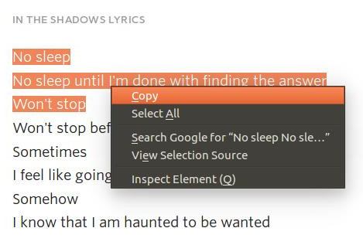

Slide 39

et voilà, that’s
Notes:
Web scraping, is probably not the most preferred way of accessing data, but probably the most powerful. The entire Internet can become your data base.
Let’s have a look at two real life examples.

Slide 40

https://camelcamelcamel.com
(c) amazon.com
Notes:
Did you know that awake chocolate was 25 % cheaper on 21 February?
Price tracking websites like camelcamelcamel could use web scraping.

Slide 41
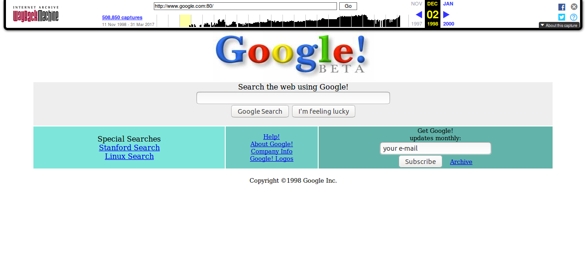
https://archive.org
Notes:
Can you remember how the Google web page looked in Dec. 1999, if not you can visit archive.org?
Archive.org is a webcrawler using webscraping technology per excellance.

Slide 42
mash-ups
search engines
e-mail address harvesting
break web pages
exploit security leaks
...
Notes:
You can use webscraping to create mashup or to power search engines such as google.
E-Mail address harvesting or breaking web pages via automated sql or javascript injection is also a possible use case.

Slide 43
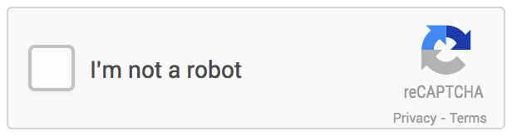
Notes:
Some websites try hard to prevent web scraping.
A bot visiting your website just causes traffic and doesn’t earn you a penny.
Two of the many techniques are IP blocking or solving captchas.

Slide 44
response = self._get(lyric_url, None, web=True)
soup = BeautifulSoup(response.text, 'html.parser')
lyric_text = soup.find("lyrics").get_text()
>>> lyric_text = 'No sleep. No sleep until I'm done […]'
Notes:
Make some HTTP request, use some HTTP parser and write the content of a div with the class “lyrics” to lyric_text. lyric_text looks like this. I get the lyric_url by making an API call to the API of Genius.com
[show things in Firefox, developer console]

Slide 45
What do they mean?
Notes:
[Let’s gather some ideas for analyzing the lyrics text.
Notice them down.]

Slide 46
No sleep until I’m done finding the answer.
['No', 'sleep', 'until', 'I', 'm', 'done', 'with', 'finding', 'the', 'answer']
Notes:
Doing some divide conquer, I’ve split the lyrics_text into smaller chunks containing only the words.
I use the regular expression tokenizer, which is part of the natural language processing toolkit.

Slide 47
274214 | giraffe-- height | sadness-0 | fear-0 | anger-0 | trust-0 | ... | pos-N
882290 | giraffe-- height | sadness-0 | fear-0 | anger-0 | trust-0 | ... | pos-N
230158 | motive--motion | sadness-0 | fear-0 | anger-0 | trust-1 | ... | pos-Adj
965873 | motive--motion | sadness-0 | fear-0 | anger-0 | trust-0 | ... | pos-Adj
105133 | unsuccessful--failure | sadness-0 | fear-1 | anger-0 | trust-0 | ... | pos-Adj
968727 | unsuccessful--failure | sadness-2 | fear-0 | anger-1 | trust-0 | ... | pos-Adj
... |  | ... | ... | ... | ... | ... | ...
Copyright (C) 2011 National Research Council Canada (NRC)
Notes:
Some Canadian researchers have created a dictionary for Emotions. The dictionary contains 14,000 words
The active vocabulary of a average German ranges from 12,000 to 16,000 words.
All in all I head a list with 8247 sad words.
0 indicates that the target word has no association with affect category, 2 or 3 indicate a strong association.
Funny discoveries: kindergarden was marked sad, while some annotators marked murder as neutral. I guess they weren’t raised by Mary Poppins...

Slide 48

(c) amazon.com
Notes:
If you wonder how they collected all the data. They used an service called amazon mechanical turk, where you can upload micro tasks, which are solved by humans for a few pennies.
They asked 5 different people for every word and removed out layers. I did some clean up work as well.

Slide 49
No sleep. No sleep until I'm done with finding the answer
Won't stop. Won’t stop before I find a cure for this cancer.
Sometimes I feel like going down I'm so disconnected.
Somehow. I know that I am haunted to be wanted.
['No', 'sleep', 'No', 'sleep', 'until', 'I', 'm', 'done', 'with', 'finding', 'the', 'answer', 'Won', 't', 'stop', 'Won', 't', 'stop', 'before', 'I', 'find', 'a', 'cure', 'for', 'this', 'cancer', 'Sometimes', 'I', 'feel', 'like', 'going', 'down', 'I', 'm', 'so', 'disconnected']
Notes:
The lyrics text is being split in so called tokens or individual words. I run those tokens against a the dictionary with sad words. If words match, I increase an index.
Method is simple and fast, but does not support pluralization or other languages but English. Alternatives methods could involve using a naive Bayesian classifier or some other ML models.

Slide 50
Notes:
This is the kind of equation you make, if you wanna keep maths simple. Just calculate the mean of the data, you’ve found...

Slide 51
track_name valence lyrics total
128 Live Forever 0.9154 0.188034 0.551717
150 Live Forever 0.9154 0.188034 0.551717
117 Live Forever 0.9084 0.188034 0.548217
74 No Fear 0.6300 0.455446 0.542723
91 No Fear 0.6300 0.455446 0.542723
57 No Fear 0.6300 0.455446 0.542723
139 Live Forever 0.8940 0.188034 0.541017
200 No Fear 0.6110 0.455446 0.533223
166 No Fear 0.6050 0.455446 0.530223
235 Funeral Song 0.9327 0.122137 0.527419
101 Funeral Song 0.9319 0.122137 0.527019
67 Funeral Song 0.9319 0.122137 0.527019
.. ... ... ... ...
215 In The Shadows 0.2460 0.142857 0.194429
73 In The Shadows - Radio Edit 0.2330 0.146226 0.189613
227 In The Shadows - Radio Edit 0.2300 0.146226 0.188113
225 F-F-F-Falling - Scream Remix 0.2720 0.000000 0.136000
[246 rows x 4 columns]
Notes:
Tada! Here are the final scores for The Rasmus.
discoveries:
Some songs list multiple times, as they appeared on multiple albums… The Rasmus is obviously good at merchandising...
[Listen to e.g. No Fear on spotify to validate valence, show lyrics on Genius, to prove why every second word is sad.]
Most surprisingly the song I thought was their saddest song, is actually one of their happiest songs.
All in all our dataset contains as much as 246 songs!

Slide 52
self.spotify_get_artist("_")
Notes:
I was happy, once I head the results for “The Rasmus”.
I’ve done some testing in preparation for this talk, so I decided to ask my family for their favorite artists and I’d do the analysis for them.
So I asked my mom first. She couldn’t think of an artist, so I said, it’s fine and I used an empty String as a keyword.
Guess what, what I came up with...

Slide 53
RuntimeException()
Notes:
...I got this. I said to my mom, mom that’s great, exceptions are the holly grail of sad songs.
So still the program can’t do magic. It can only query one artist at a time. By the way it only handles English songs properly.
I didn’t want to let myself pull down, so I asked my brother Alex, who was more into music...

Slide 54

Notes:
“So I gave him a call.
I said, hey Alex do you have a minute? He said yes, but only one.
I said, excellent!”
We searched 296 Billy Talent songs. After two minutes we ended the phone call, after 5 more minutes we got the results. It only took me 422 Sec, that’s 7 min to get the result.
We can clearly see, the script is lightning fast. This is due to the 1100 http requests, that are required.
[query spotify_artist for artist name and artist uri...
0.12149310111999512
query spotify_albums...0.23218989372253418
query spotify_tracks...0.580808401107788
query spotify_audio_features...34.88614773750305
query genius.com... 422.20317482948303]

Slide 55
{demo}
Notes:
[Run script for artist with only few songs to keep the time minimal. Scott McKenzie]
Explain code especially API endpoints while waiting for the final result. Explain that it takes (1+11+246+246+246+246) = 996 HTTP-requests and with every new track we have to make 4 new HTTP-requests. (3 API calls, one website call)
Explain why API’s are the preferred over webscraping.

Slide 56
Questions?
Notes:
Are there any more questions?

Slide 57
https://github.com/KarelZe
Slides shared with ❤ under cc-by 4.0
Notes:
All the source code and this presentation is available on GitHub. Feel free to search for your saddest song. So Happy searching!

