Slide 1
Output
Probabilities
Classical Transformer
Softmax
Linear
Add & Norm
Feed Forward
Add & Norm
Mat Mul
Linear
Multi-Head
Self-Attention
Add & Norm
Softmax
Concatenate
K
Q
V
L×
Feed Forward
Scale
Scaled Dot-Product Attention
L×
Add & Norm
Add & Norm
Mat Mul
Masked
Multi-Head
Self-Attention
Linear
Linear
Linear
Multi-Head
Self-Attention
Q
K
V
K
V
Q
K
Q
V
K
Q
V
Positional Embedding
Positional Embedding
+
+
Input Embedding
Output Embedding
inputs
targets

Slide 2
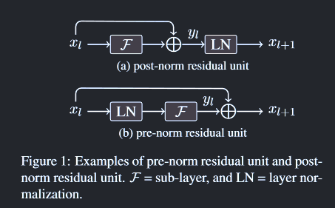
Post norm
b
Sublayer
+
Layer
b
Pre norm
$\boldsymbol{X}$
Layer Norm
Sublayer
+
$\boldsymbol{X}$
b
Sublayer
Layer
+
b

Slide 3
https://brushingupscience.com/2016/02/02/design-using-hsl-colour-space/
Figure 1
Quote Rule
Tick Rule
Tick Rule
Trade Size Rule
Misc
Ask
Quote Rule
Quote Rule
Tick Rule
7/10
Tick Rule
Mid
Tick Rule
Depth Rule
3/10
Quote Rule
Quote Rule
Bid
Quote Rule
Tick Rule
Tick Rule

Slide 4
https://brushingupscience.com/2016/02/02/design-using-hsl-colour-space/
p (prev)
x
p
x
p
Tick Rule
a~
m
b~
x
Quote Rule
p~
Trade Size Rule

Slide 5
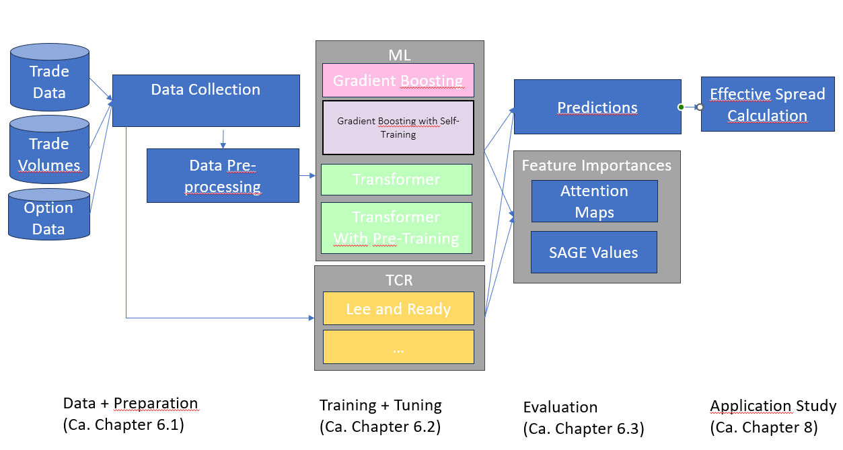
Research Framework
Data and Data Preparation
Training and Tuning
Evaluation
Machine Learning
Evaluation Metric
LiveVol
Trade Data
Gradient Boosting
Accuracy
ISE Open/Close
Trade Profile
Gradient Boosting
With Self-Training
Data Collection
Data Pre-Processing
Feature Importance
Transformer
SAGE Values
OptionMetrics
Option Data
Attention Maps
Transformer
With Pre-Training
Classical Rules
Application Study
Lee & Ready
Effective Spread
Calculation
V
…

Slide 6
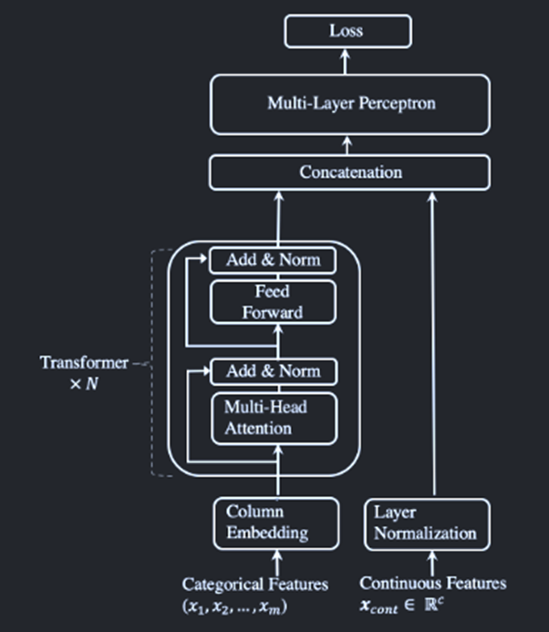
Output
Probabilities
TabTransformer
Softmax
Linear
Feed Forward
Concatenate
Add & Norm
Norm
Feed Forward
N×
Add & Norm
Multi-Head
Self-Attention
K
Q
V
Input Embedding
categorical inputs
continuous inputs

Slide 7


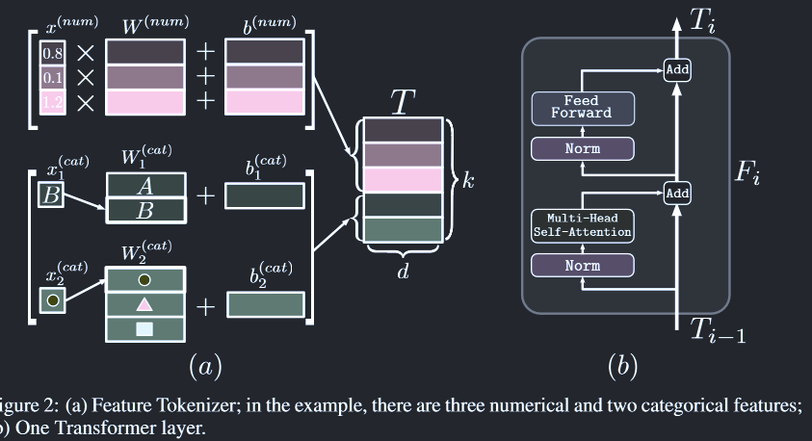
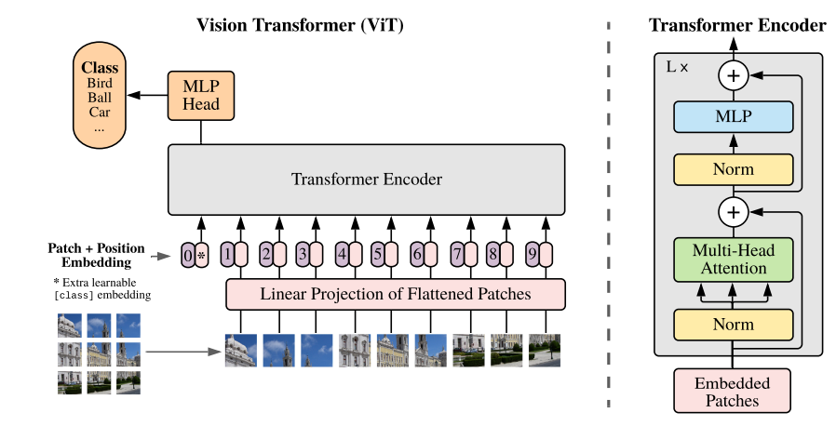
FTTransformer
output probabilities
Softmax
Linear
Norm
Add
Feed Forward
Layer Norm
L×
Add
Multi-Head
Self-Attention
K
Q
V
Layer Norm
Input Embedding
categorical and continuous inputs

Slide 8
FTTransformer
the
$\mathtt{[MASK]}$
the
original
chef
chef
chef
original
cooked
$\mathtt{[MASK]}$
ate
replaced
the
the
the
original
meal
meal
meal
original
Generator
Discriminator
categorical and continuous inputs

Slide 9
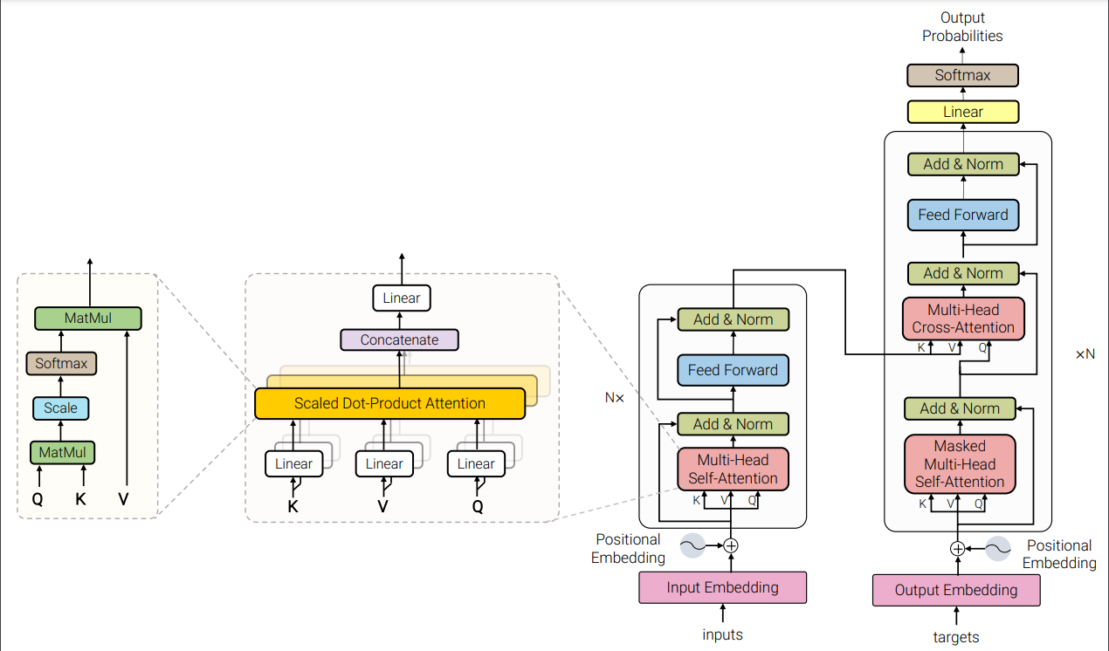

Slide 10
