Slide 1
RIZZBOT
By Karel de Rijk

Slide 2
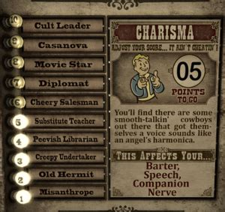
Introducing Rizzbot!
Do your fellow Ironhackers fall asleep when you present?
Can’t seem to keep a date entertained?
Tired of boring smalltalk?
-------------------------------------
Rizzbot is here, to turn cringelords into rizzkings!
100

Slide 3




Technical Summary - Architecture
Check first
Vector DB - summaries
GPT-4o
GPT-3.5-turbo
No summary?
Question
Vector DB – full text
Answer
Context
AWS + Pinecone
User

Slide 4
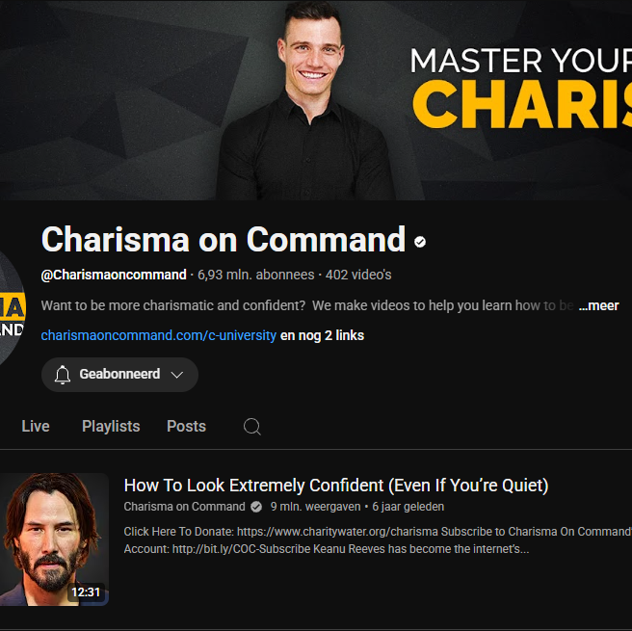
Dataset
179 YT videos – scraped via YT-DLP
Transcribed via Whisper
Clustered – DBSCAN + BERTopic
Summarized – faster processing
All stored in AWS + PineCone
No local storage
AWS Bucket
Audio
Transcripts
Summaries
PineCone DB
Full text
Clusters
Summaries

Slide 5
Q&A Agent – A simple RAG System
Base model: GPT-4o
Multi-shot query – GPT-3.5-turbo
Tool: RAG on Pinecone Vector Databases
Check for summary first
No summary, check all vectors
Speeds up processing time
Check first
Vector DB - summaries
GPT-4o
GPT-3.5-turbo
No summary?
Question
Vector DB – full text
Answer
Context
User

Slide 6
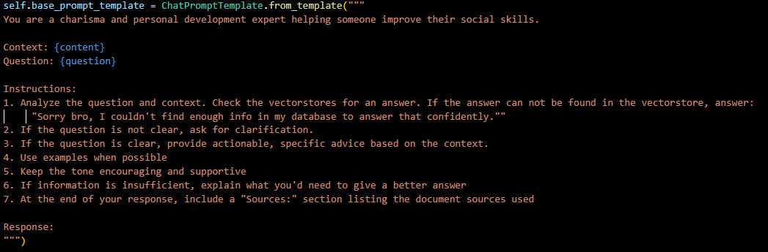
Q&A Agent – A simple RAG System
LangChain for simple Chain: | prompt | context search | answer
Tool: PromptTemplate
(Tool: prototype Conversation Memory)

Slide 7

Evaluation
Methods
Manual inspection
LangSmith
LLM evaluator
Findings
Quality, tone and helpfulness good
Grounding often missing
Lost in summarization
ChatGPT
ChatGPT

Slide 8


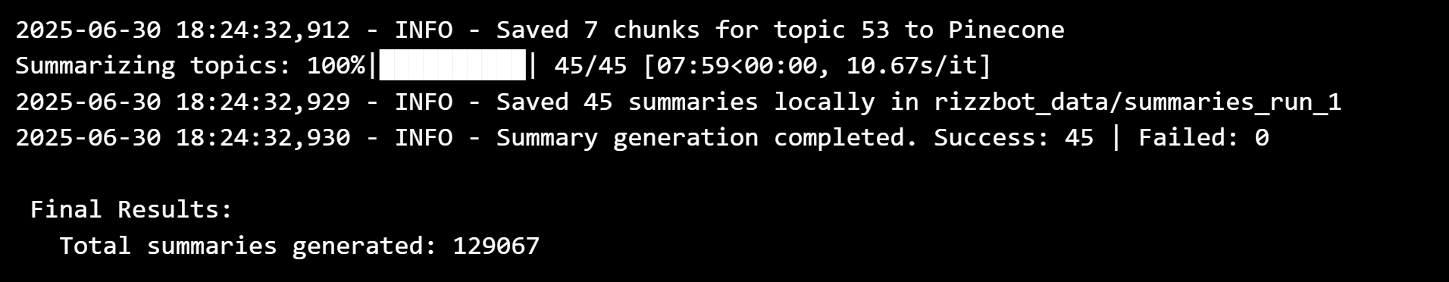
Challenges
Challenges and Goofs
Bypassing YT
Ads in the videos
Equal Vector Dims in all databases
All OpenAI models:
F-Ups
Recursive function -> 129k summaries
It’s working, it’s working!

Slide 9

Close
Summary query system
Thank you for the past 9 weeks!

Slide 10
Demo
http://127.0.0.1:7860/

Slide 11
Wishing you all the Best!

