Slide 1
Galaxy
Presenter Name

Slide 2

Introduction
With PowerPoint, you can create presentations and share your work with others, wherever they are. Type the text you want here to get started. You can also add images, art, and videos on this template. Save to OneDrive and access your presentations from your computer, tablet, or phone.

Slide 3
Topic one
Subtitle

Slide 4

The way to get started is to quit talking and begin doing.
Walt Disney

Slide 5
Template slide
Subtitle
Subtitle
Add text, images, art, and videos.
Add transitions, animations, and motion.
Save to OneDrive, to get to your presentations from your computer, tablet, or phone.
Open the Design Ideas pane for instant slide makeovers.
When we have design ideas, we’ll show them to you right there.

Slide 6
Template slide
Subtitle
Subtitle
Add text, images, art, and videos.
Add transitions, animations, and motion.
Save to OneDrive, to get to your presentations from your computer, tablet, or phone.
Open the Design Ideas pane for instant slide makeovers.
When we have design ideas, we’ll show them to you right there.

Slide 7
Template slide
Subtitle
Subtitle
Add text, images, art, and videos.
Add transitions, animations, and motion.
Save to OneDrive, to get to your presentations from your computer, tablet, or phone.
Open the Design Ideas pane for instant slide makeovers.
When we have design ideas, we’ll show them to you right there.

Slide 8
Template slide
Subtitle
Subtitle
Add text, images, art, and videos.
Add transitions, animations, and motion.
Save to OneDrive, to get to your presentations from your computer, tablet, or phone.
Open the Design Ideas pane for instant slide makeovers.
When we have design ideas, we’ll show them to you right there.

Slide 9
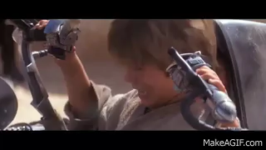
Challenges and Goofs
Biggest Ls
Ads in the videos
Equal Vector Dims in all databases
Accidentally generated 129k summaries
It’s working, it’s working!

Slide 10




Thank you
Presenter name
Email address
Website

