Slide 1
ANALYZING RETAIL DATA TO DERIVE INSIGHTS
INNOBYTE SERVICES INTERNSHIP TASK
PRESENTED BY
Karemu Greshma Ratnam
IS/AI/A6629

Slide 2
CONTENTS
Objective
Introduction
Data Exploration
Handling Values
Tools and Libraries used
Complete View of Dashboard
Loading Data Into Power BI
Descriptive Statstics
Key Performance Indicators(KPI)
Pie Charts
Line and Bar Charts
Conclusion
Recommendation for Improving Sales

Slide 3
OBJECTIVE
Analyzing retail sales data provides valuable insights into customer behavior, popular products, and sales trends.
This presentation will delve into the analysis of retail sales data to uncover hidden patterns, identify emerging trends, and reveal customer preferences.
By examining sales data, we will uncover insights on customer demographics, purchasing habits, and loyalty patterns, as well as identify top-selling products and categories.
Additionally, we will explore seasonal and geographic trends, and examine the impact of promotions, pricing, and marketing strategies on sales.
This analysis will provide retailers with actionable insights to inform business decisions, optimize product offerings, and improve customer satisfaction.

Slide 4
INTRODUCTION
In today's competitive retail landscape, understanding customer behavior, product popularity, and sales trends is crucial for making informed business decisions. Retail sales data holds the key to unlocking these insights, providing valuable information on sales performance, product demand, and profitability. Our analysis of retail sales data will delve into the following key metrics
Sales: Total revenue generated by each location
Quantity: Number of units sold by each location
Profit: Gross profit margin by each location
Discount: Discount rates applied by each location
Online orders
Ship-from-store orders

Slide 5
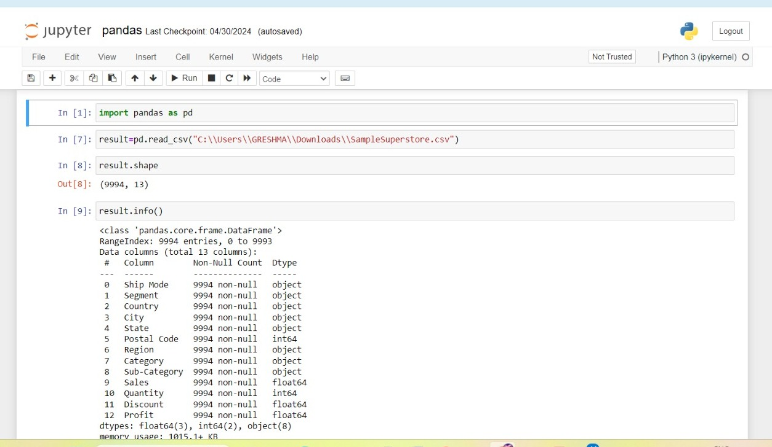
DATA EXPLORATION
Loading and Preparing the Retail Sales Data
A screenshot of Jupyter Notebook showing the data loaded into a Pandas Data Frame, with a brief summary of the data such as the number of rows, columns, and data types.
``

Slide 6
To begin our analysis, we loaded the retail sales data into a Python Jupyter Notebook using the Pandas library. We then examined the data to gain an understanding of its structure and content.
Data Summary:
* Number of rows: [9994]
* Number of columns: [13]
* Data types:
[Postal code ,Quantity are int]
[Sales, Discount and Profit are float]
[Remaining are objects]

Slide 7
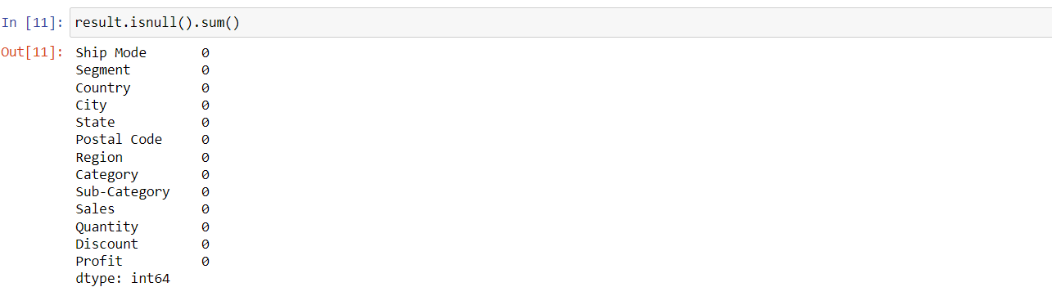
HANDLING NULL VALUES
Problem: Null values in our data can lead to incorrect analysis and insights.
Solution: We used the pandas library in Python to handle null values in our data.
Code:
import pandas as pd
# Load the data
df = pd.read_csv('data.csv')
print(df.isnull().sum())
We successfully handled null values in our data using pandas and found no null values in our dataset. This ensures that our analysis and insights are accurate and reliable.

Slide 8


TOOLS AND LIBRARIES USED
For this project, we leveraged the following tools and libraries:
Python Pandas Library in Jupyter Note book : A powerful and popular library for data manipulation and analysis in Python.
Pandas provides data structures and functions to efficiently handle structured data, including tabular data such as spreadsheets and SQL tables. Connect to various data source.
Pandas is a powerful library for data manipulation and analysis in Python. In a Jupyter Notebook, we can use Pandas to:
Load and manipulate data from various sources, such as CSV files, Excel files, and databases
Perform data cleaning and preprocessing
Power BI: A business analytics service by Microsoft that allows users to create interactive visualizations and business intelligence reports.
Connect to various data sources
Create interactive dashboards and reports
Visualize data using a range of visualization options
Share insights with others.

Slide 9
DATA VISUALIZATION USING POWER BI
What is Power BI?
Power BI is a business analytics service by Microsoft that allows users to create interactive and visualized reports, dashboards, and datasets. It's a powerful tool for data analysis, reporting, and visualization.
Benefits of Power BI:
Easy data visualization: Quickly create interactive and dynamic dashboards to visualize your data.
Data storytelling: Use Power BI to create compelling stories with your data to drive business decisions.

Slide 10
Collaboration: Easily share your reports and dashboards with others, allowing for real-time collaboration.
Real-time updates: Power BI automatically updates your reports and dashboards with new data, ensuring you always have the most up-to-date insights.
Creating a Superstore Sales Data Dashboard:
With Power BI, we can create a comprehensive dashboard that provides insights into our retail sales data.
We can visualize sales trends, customer behavior, and product performance across different locations and ship modes. T
his dashboard will enable us to make data-driven decisions and optimize our business operations

Slide 11
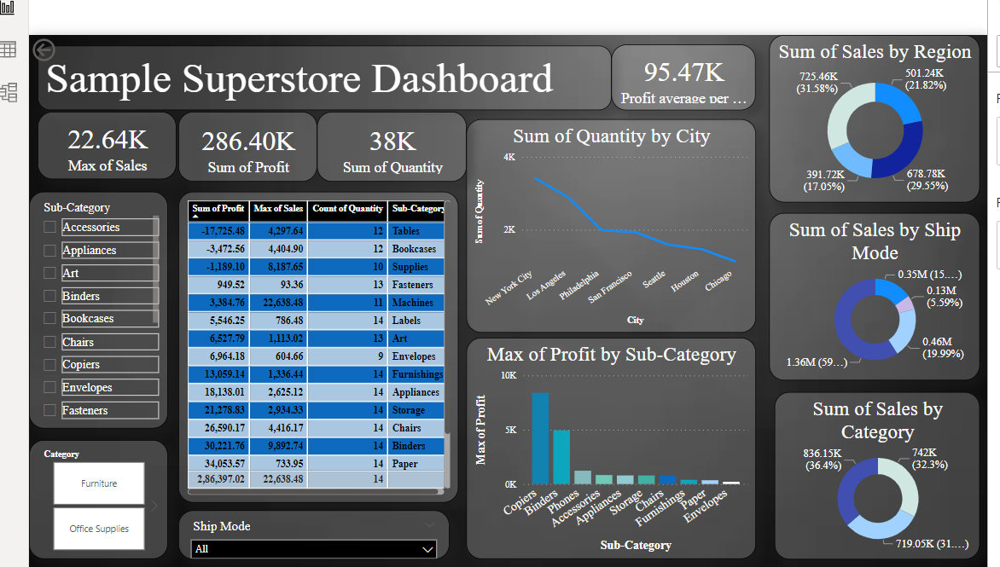
COMPLETE VIEW OF SAMPLE SUPERSTORE SALES DASHBOARD

Slide 12
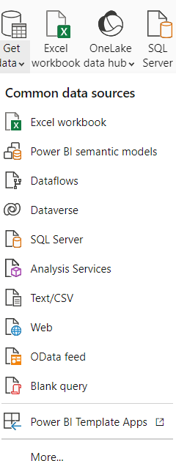
LOADING DATA INTO POWER BI
Loading Retail Sales Data into Power BI
To load our retail sales data into Power BI, we'll start by clicking on the "Get Data" button in the Power BI ribbon.
Step 1: Get Data
* Click on the "Get Data" button in the Power BI ribbon
* Select "Excel" as the data source
Step 2: Select Excel Workbook
* Browse to the location of the Excel workbook
* Select the workbook and click "Open"
Step 3: Import Data

Slide 13
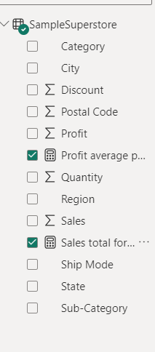
DESCRIPTIVE STATASTICS
To gain deeper insights into our sales data, we
created new measures using
DAX in Power BI. Specifically, we created:
Total Sales for Category: This measure calculates the total sales for each category, providing a clear overview of sales performance across different product categories.
Profit Average per Sub-Category: This measure calculates the average profit for each sub-category, allowing us to identify areas where we can improve profitability.
DAX Formula:
Total Sales for Category: SUM(Sales[Amount]) by Category[Category Name]
Profit Average per Sub-Category: AVERAGE(Sales[Profit]) by Sub-Category[Sub-Category Name]

Slide 14
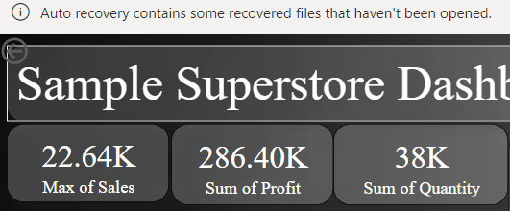
“KEY PERFORMANCE INDICATORS(KPI)”
Card 1:sales
Card name:max of sales
Value-22.64k
Card 2: Profit
Card name: sum of profit
Value-286.40k
Card3: Quantity
Card name :Sum of Quantity
Value:38k
The business has a relatively high sales volume, but the profit margin is relatively low.
The business may need to focus on improving its pricing strategy or reducing costs to increase profitability.

Slide 15
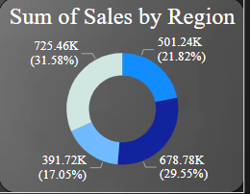
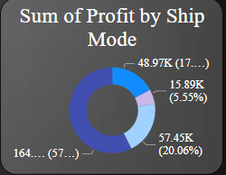
PIE CHARTS
Sum of Sales by Region :
A pie chart showing the distribution of sales by region, with the Western region taking up 31.58% of the total.
The Western region's attributed to a strong customer base, effective marketing strategies, or a favorable business environment.
Western Region -31.58%, Eastern Region -29.55%
Central Region -21.82%, Southern Region1 -17.05%
Sum of Sales by Region :
A pie chart showing the distribution of profit by shipping mode, with Standard Mode taking up 57.6% of the total profit.The significant profit share of Standard Mode (57.6%) indicates that this mode is the most profitable for the organization. This could be due to lower operating costs, higher demand for standard shipping, or a combination of both.
Standard -57.29%, First Class -17.1%
Second class - 20.06%, Same day -5.59% ,

Slide 16
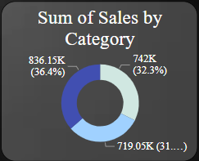
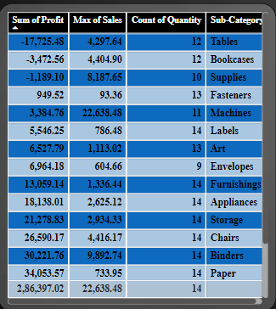
Sum of Sales by Category:
Technology Leads the Way
Visual: A pie chart showing the distribution of sales by category, with Technology taking up 36.4%,of the total sales. The dominant share of Technology sales (36.4%) indicates that this category is the largest contributor to the organization's revenue.
Technology -36.4%, Furniture -32.3%
Office Supplies -31.3%
Table visualization:
Profit, Sales, and Quantity by Sub-Category.
This table provides a detailed breakdown of the total profit, maximum sales, and count of quantity by sub-category.

Slide 17
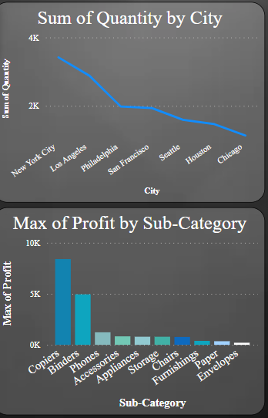
Visualization Charts
LINE CHART SHOWING SUM OF QUANTITY BY CITY:
This chart provides a visual representation of the total quantity of sales by city, highlighting that New York is the largest market with the highest total quantity.
This could be due to various factors such as strong demand, competitive advantage, or strategic focus on this area. On the other hand, Chicago has the lowest total quantity, indicating that this market may be less competitive or less demanding.
Bar Chart on maximum of Profit by Sub-Category:
A bar chart showing the maximum profit by sub-category, with the x-axis representing the sub-category and the y-axis representing the maximum profit.
This chart provides a visual representation of the maximum profit achieved by each sub-category, highlighting that Technology - This could be due to various factors such as high demand, competitive advantage, or strategic focus on this area.

Slide 18
CONCLUSION
After analyzing our sales data, I identified the following key insights and
findings:
The sales are more in the Western region, which suggests that this region may be a key market for the business.
The profit is high through standard mode, which suggests that the business may be able to maintain its profitability by focusing on standard products and services.
Continue to focus on expanding sales in the Western region and exploring new opportunities in this market.
Highest Total Quantity in New York City: The highest total quantity of sales is in New York City.
Highest Profit in Sub-Category Copiers: The sub-category with the highest profit is Copiers.
Sales High in Western Region: The Western region has the highest sales value.
Profit High through Standard Mode: The profit margin is highest through the Standard mode.
Total Sales High in Technology Category: The Technology category has the highest total sales.

Slide 19
Recommendation for Improving Sales
Improving our profit margins through more effective pricing and cost management
Product Line Expansion: We recommend expanding our product line to include more products in the copiers sub-category, as it has shown high demand and profitability.
Targeted Marketing Campaigns: We recommend targeting our marketing campaigns towards the Western region, as it has shown a high level of sales activity and demand for our products.
Increased Inventory in New York City: We recommend increasing our inventory levels in New York City, as it has shown the highest total quantity of sales.
Optimization of Sales Process: We recommend optimizing our sales process to ensure that we are maximizing our profit margins through standard mode.
Regional Focus: While we will focus on the Western region due to its high sales activity, we must also prioritize the Southern region, which has shown lower sales activity. We will identify the reasons for this and develop strategies to address these challenges.
Customer Feedback: To improve customer satisfaction, we will implement feedback forms and surveys to gather insights on customer needs and pain points. This will help us identify areas for improvement and develop targeted marketing campaigns.

Slide 20
THANK YOU

