Slide 1
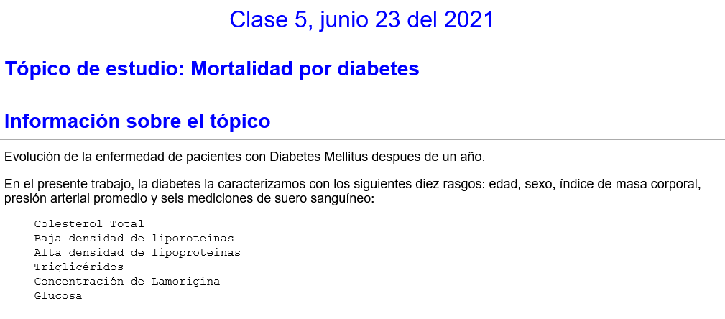

Slide 2
Clase 5, junio 23 del 2021
Códigos para desarrollar aplicaciones de inteligencia artificial
Backends, Frontends

Slide 3
Backends
. Plankalkül (1945)
. Fortran (1957) : 1969, 1984 (PDI)
. Lisp (1958): 1986 (AI)
. COBOL(1959)
Lenguaje ensamblador : (1981, EM, Difractómetro)
. Basic (1964) : 1985 (PDI)
Logo (1967) : 1985 (PDI)
Pascal (1970)
. C (1972): 1989 (Magnetómetro)
. Python (1991) : 2017 (2011)
. CUDA (2007) : 2010

Slide 4
Sistemas de Aprendizaje (Machine Learning)
Algunas librerias para crear modelos de estos sistemas
. Python
. Scikit-Learn
. Keras
. TensorFlow
. Pytorch
. CNTK
. MXNet (Apache)
. Gluon
. PyText (Facebook)
. Microsoft, Azure
. Amazon, AWS
. IBM Watson Studio

Slide 5

Python is a programming language that lets you work quickly and integrate systems more effectively.
Python Software Foundation
The mission of the Python Software Foundation is to promote, protect, and advance the Python programming language, and to support and facilitate the growth of a diverse and international community of Python programmers.

Slide 6

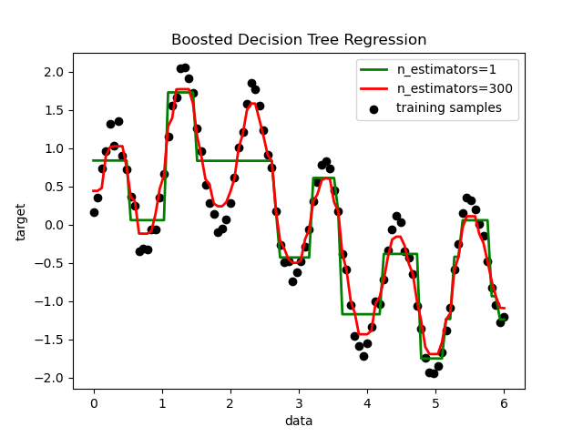
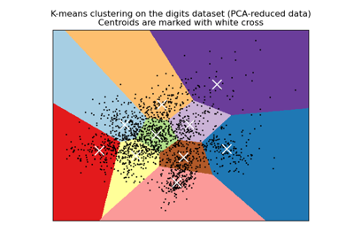
scikit-learn
Machine Learning in Python
Simple and efficient tools for predictive data analysis
Accessible to everybody, and reusable in various contexts
Built on NumPy, SciPy, and matplotlib
Open source, commercially usable - BSD license
https://scikit-learn.org/stable/

Slide 7

Keras
Simple. Flexible. Powerful.
State-of-the-art research.
Keras is used by CERN, NASA, NIH, and many more scientific organizations around the world (and yes, Keras is used at the LHC). Keras has the low-level flexibility to implement arbitrary research ideas while offering optional high-level convenience features to speed up experimentation cycles.
Backend: Tensorflow, Theano, CNTK, MXNet

Slide 8
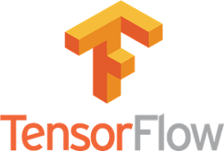
TensorFlow
An end-to-end open source machine learning platform
TensorFlow makes it easy for beginners and experts to create machine learning models for desktop, mobile, web, and cloud. See the sections below to get started.
For Mobile & IoT
Run inference with TensorFlow Lite on mobile and embedded devices like Android, iOS, Edge TPU, and Raspberry Pi.

Slide 9

Pytorch
PyTorch Mobile
End-to-end workflow from Training to Deployment for iOS and Android mobile devices
End-to-end Machine Learning Framework
PyTorch enables fast, flexible experimentation and efficient production through a user-friendly front-end, distributed training, and ecosystem of tools and libraries.

Slide 10
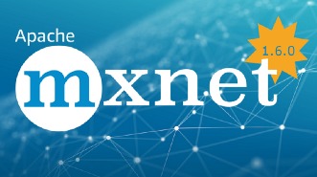
mxnet
About The Apache Foundation
A FLEXIBLE AND EFFICIENT LIBRARY FOR DEEP LEARNING
A truly open source deep learning framework suited for flexible research prototyping and production.
A hybrid front-end seamlessly transitions between Gluon eager imperative mode and symbolic mode to provide both flexibility and speed.

Slide 11
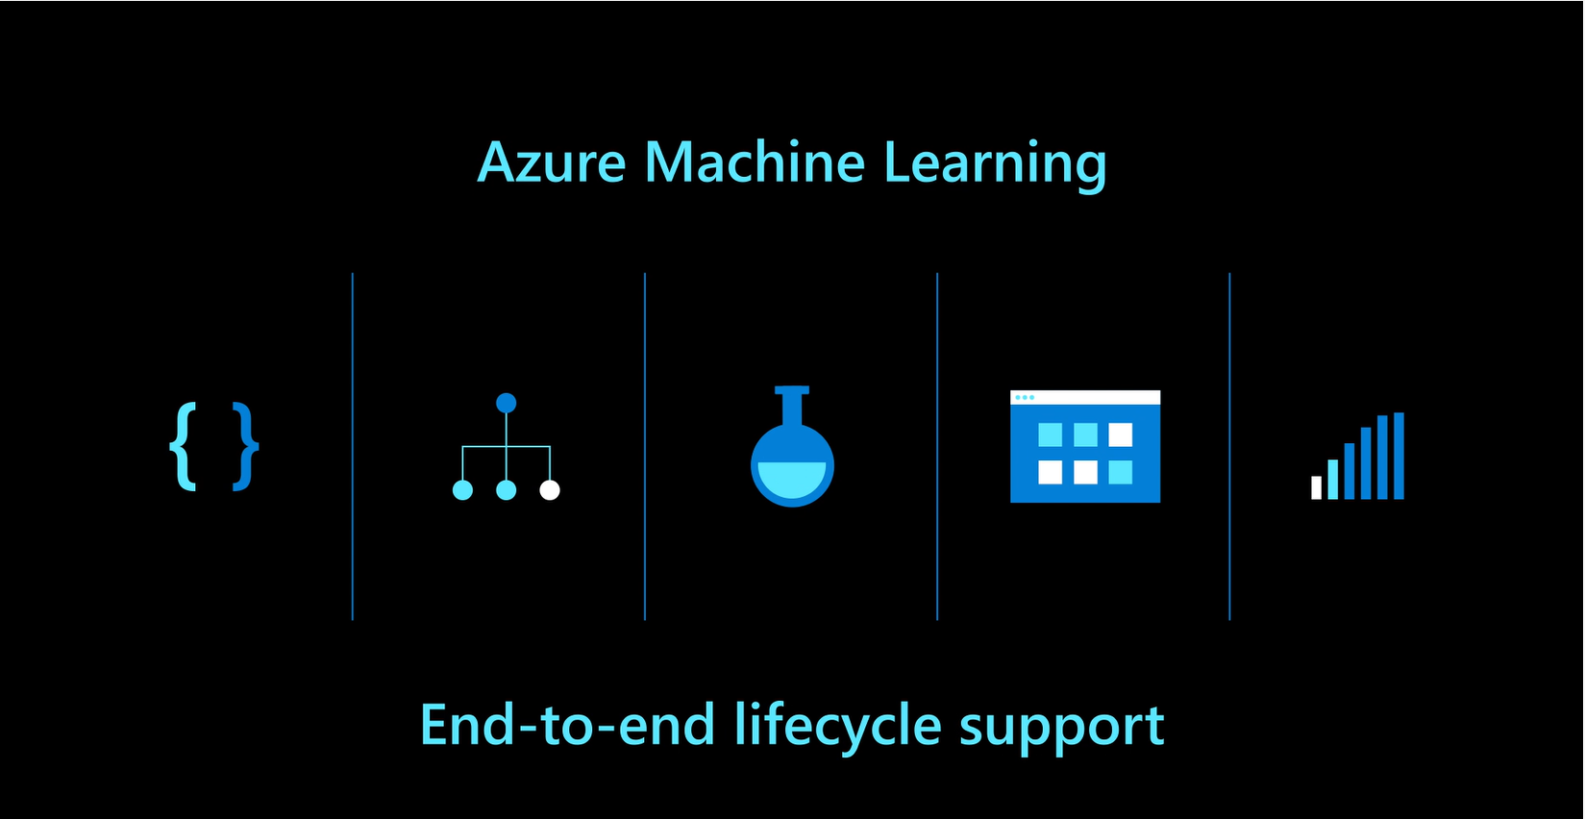

Azure
Notes:
11

Slide 12

Machine Learning for Free on AWS
Free offers and services you need to build, deploy, and run machine learning applications in the cloud
Free Product Offer: Amazon SageMaker
A fully managed platform to build, train, and deploy machine learning models
250 hours per month of t2.medium notebook usage for the first two months
50 hours per month of m4.xlarge for training for the first two months
125 hours per month of m4.xlarge for hosting for the first two months

Slide 13
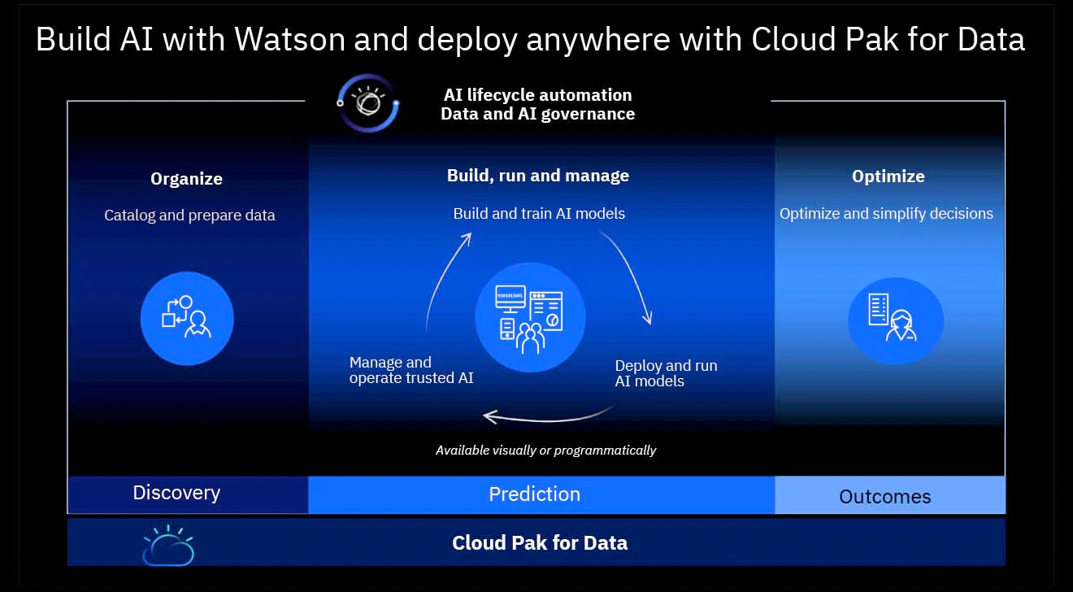
IBM Watson Studio
Build, run and manage AI models. Prepare data and build models anywhere using open source code or visual modeling. Predict and optimize your outcomes.
https://www.ibm.com/cloud/watson-studio

Slide 14

Introducing Gluon: a new library for machine learning
from AWS and Microsoft
Gluon is available in Apache MXNet today, a forthcoming Microsoft Cognitive Toolkit release, and in more frameworks over time.
Based on the the Gluon API specification, the new Gluon library in Apache MXNet provides a clear, concise, and simple API for deep learning. It makes it easy to prototype, build, and train deep learning models without sacrificing training speed

Slide 15

Facebook
Open-sourcing PyText for faster NLP development
The first AI model that translates 100 languages without relying on English data
October 19, 2020
Mining hundreds of millions of sentences for thousands of language directions

