Slide 1
Algorithm Final Project
cadb0094
B04505009 劉錫臻
B04505034 呂冠蓉

Slide 2


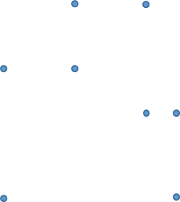

Polygon derivative
f(x,y)=1 for x, y in polygon, f(x,y)=0 for x, y not in polygon
Calculate $\frac{∂f}{∂x}$
Calculate $\frac{∂^{2}f }{∂y∂x}$
-1
1
1
-1
-1
1
-1
1
1
-1
1
-1
https://www.boost.org/doc/libs/1_70_0/libs/polygon/doc/GTL_boostcon2009.pdf

Slide 3
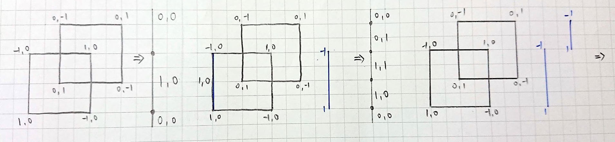
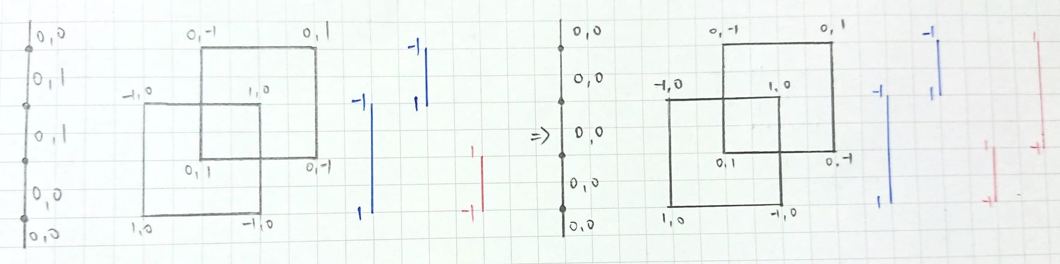
Merge(OR operation)

Slide 4
Clip
Use the truth table below to decide whether to select the area.
A Clip B
(A,B) | Boolean
(0,0) | false
(0,1) | false
(1,0) | true
(1,1) | false

Slide 5
Split Vertical/Horizontal
Find the concave vertex
Split the polygon with vertical/horizontal lines

Slide 6
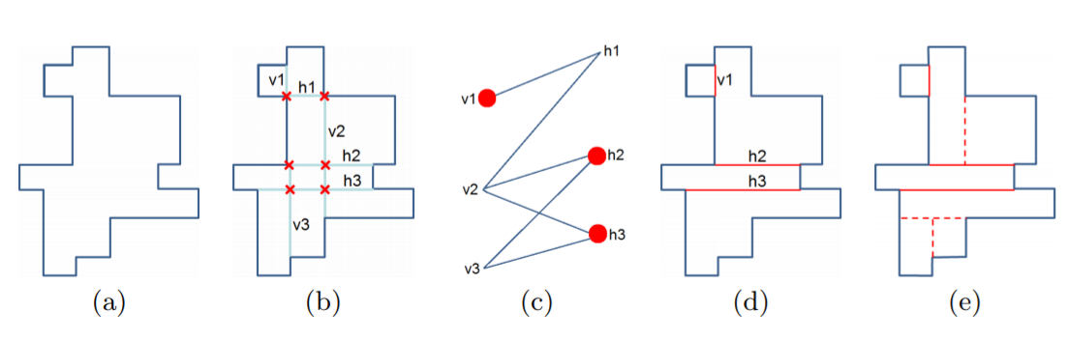
Split Optimal
Find concave vertex
Find maximum independent set
Split polygon on else concave vertex arbitrary
http://library.utia.cas.cz/separaty/2012/ZOI/suk-rectangular%20decomposition%20of%20binary%20images.pdf

Slide 7
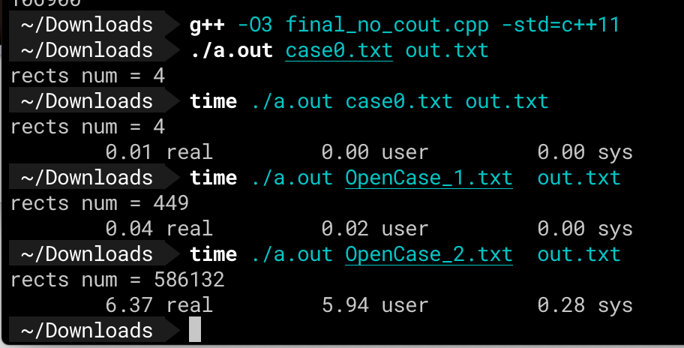
Result
Run on 2015 MacBook Pro 13’ with 2.9GHz Intel Core i5
Case | Rectangles Num | Time(s)
Small case on proj_slide | 4 | 0.01
OpenCase_1 | 449 | 0.04
OpenCase_2 | 586132 | 6.37

Slide 8
Teamwork
Research and discuss algorithm → b04505009、b04505034
Pair Coding → b04505009(driver)、b04505034(observer)
Slide → b04505034(main)、b04505009(support)

