Slide 1

Loan

Slide 2
Objective
understand loan attributes
01
understand consumer attributes
02
Analysis
03
Recommend a solution
04

Slide 3
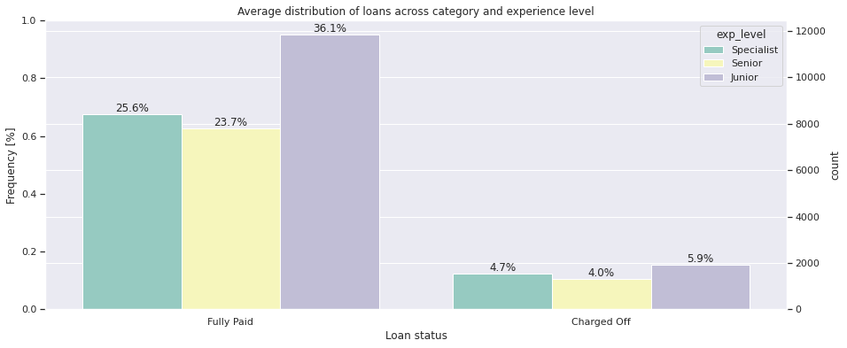
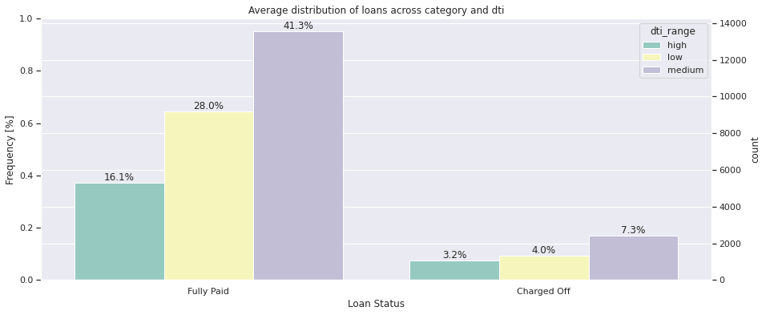
Analysis
Average distribution of loans across category and experience level.
Average distribution of loans across category and dti

Slide 4
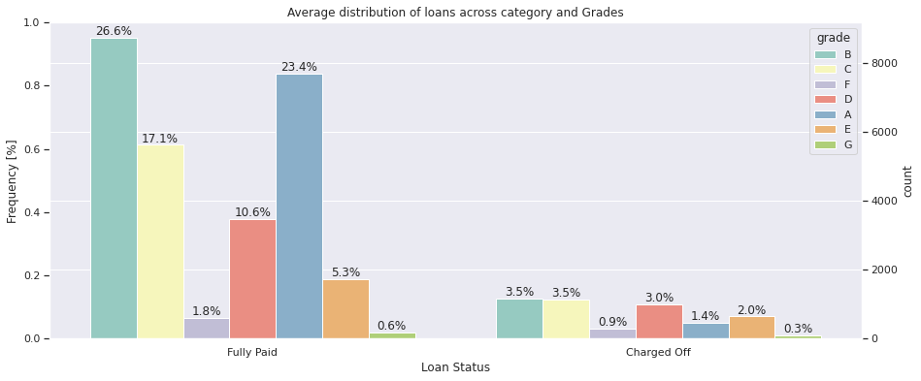
Analysis
People lying in medium dti range have high chances of default People who have high loan to annual income ratio are at high risk of defaulting

Slide 5
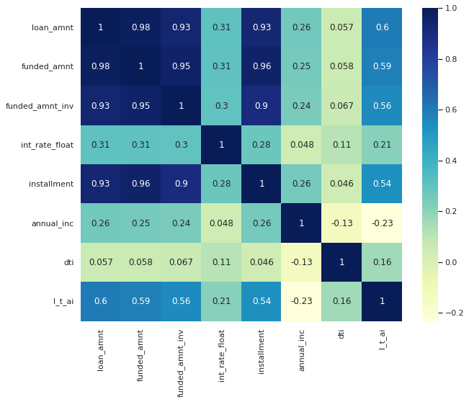
Analysis
Correlation of all datasets

Slide 6
Recommendation
Based on my findings the DTI has an impact in all aspects of loan
High levels of defaulters can be seen based on LC grade and DTI
Loans should be dispersed based on a persons income.

Slide 7


