Slide 1
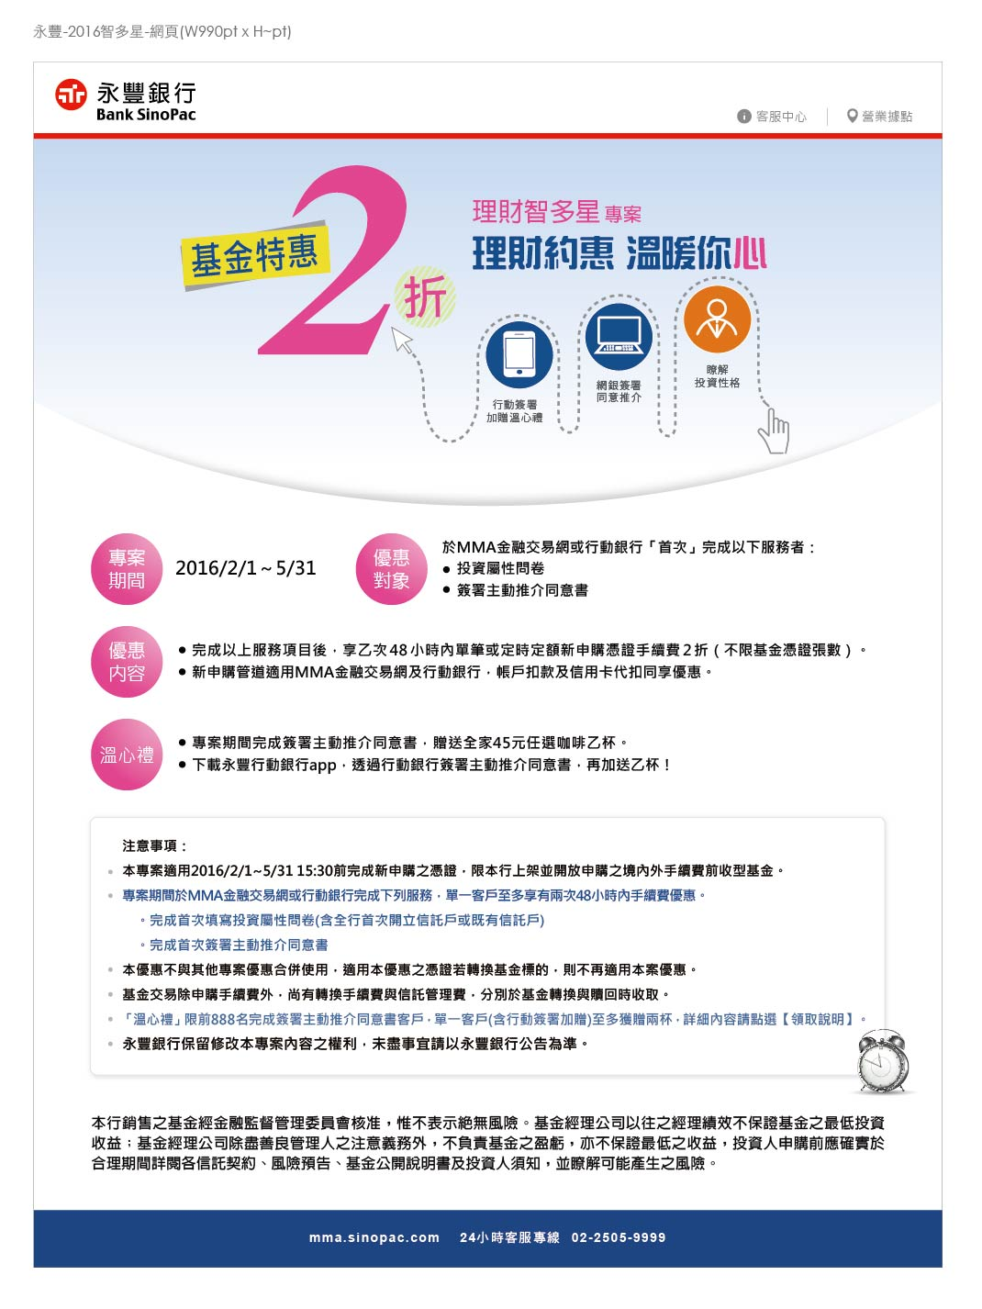
https://bank.sinopac.com/bsp/index/index.asp
https://bank.sinopac.com/MMA8/bank/service/service-index.html
https://mma.sinopac.com/MMA7txt/CustomerService/BranchService/mma_branch.html
顯示領取說明的文字
https://mma.sinopac.com/MemberPortal/Member/NextWebLogin.aspx

