Slide 1
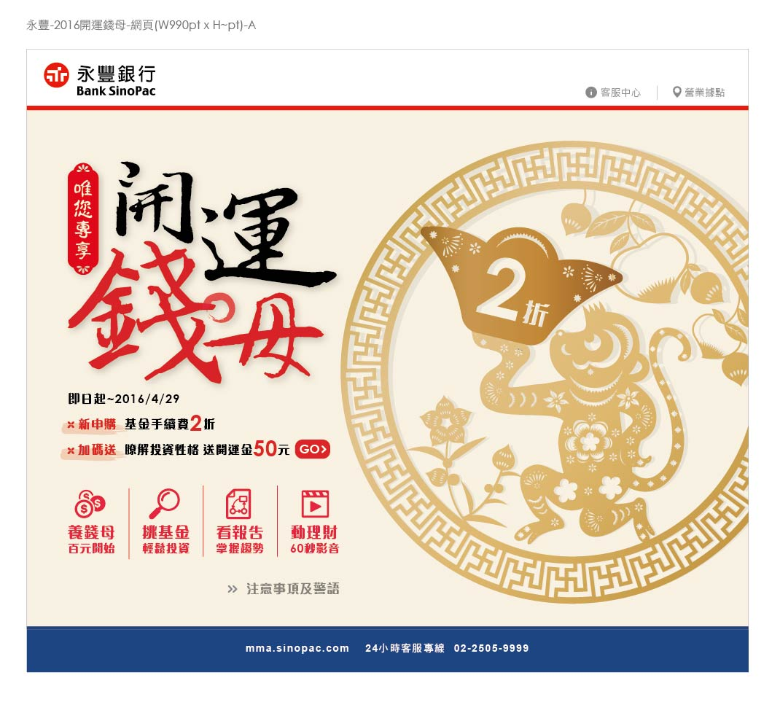
https://bank.sinopac.com/MMA8/bank/service/service-index.html
https://mma.sinopac.com/MemberPortal/Member/NextWebLogin.aspx
https://mma.sinopac.com/MMA7txt/CustomerService/BranchService/mma_branch.html
https://mma.sinopac.com/Fund/FundQueries/RiskTest_First.aspx?kyc=Fund
左區四個icon的網址連結：
養錢母https://mma.sinopac.com/MemberPortal/CustomerService/ContentFrame.aspx?url=promote/100/fund.html
挑基金http://mmafund.sinopac.com/main.asp?sUrl=$W$SINOPACFOCUSFUND]DJHTM{T}2
看報告https://mma.sinopac.com/mma/Plan/InvestmentReport.aspx
動理財https://goo.gl/Xqy39L

