Slide 1
Starting
Topic: marine plastic pollution
Why?
Interested in surface plastic/floating plastic size
Identified a sub-topic area each and went off to find datasources & articles
Sources of plastic pollution
Shipping and plastic pollution
Where the plastic pollution is, and size
How the plastic pollution is being distributed
Notes:
Our topic is on Plastic Pollution

Slide 2
Problems/ What we found
Majority of pollution was under the surface
Conflicting claims about plastic pollution
90% plastic waste comes from shipping
90% plastic waste comes from 10 rivers
Datasets from articles were
Already prepared/cleaned
Already explored in articles
Non-relevant data removed meaning no scope to explore beyond the article’s discussion itself
We had many references, but no hypothesis…

Slide 3
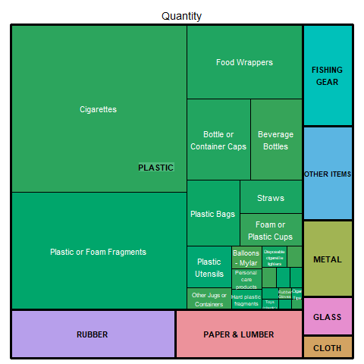
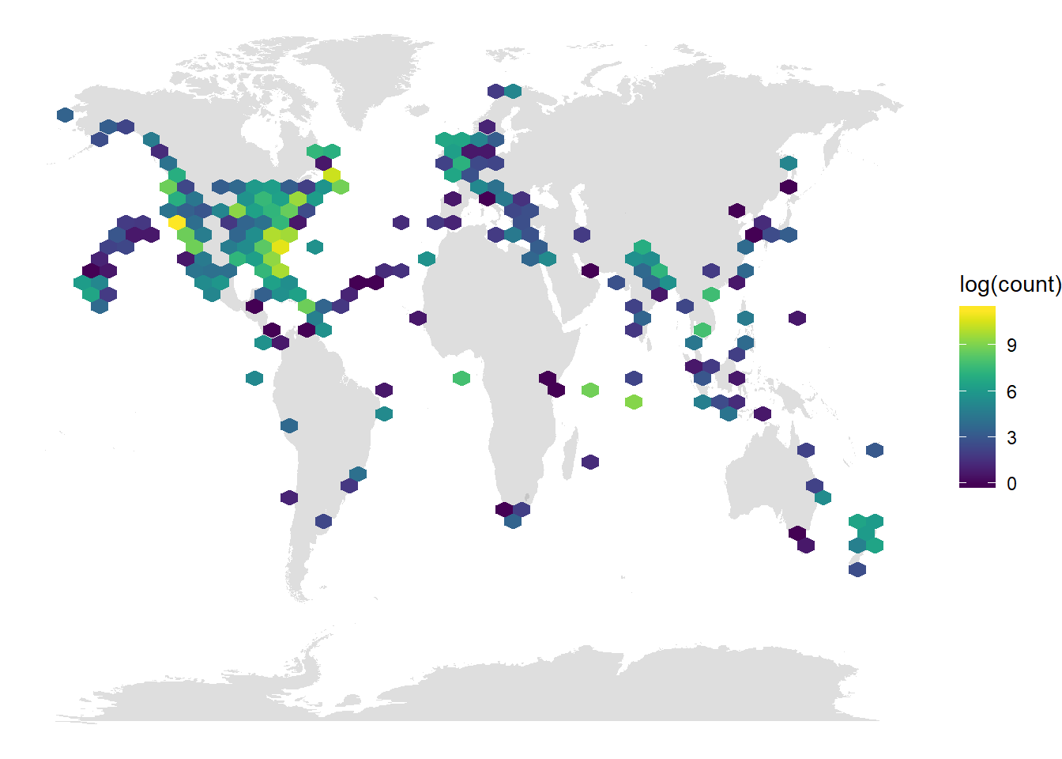
Turning Point
We found a raw dataset of plastic debris identified in locations
Narrowed focus & developed hypothesis
If the % of plastic pollution remains constant over time

Slide 4
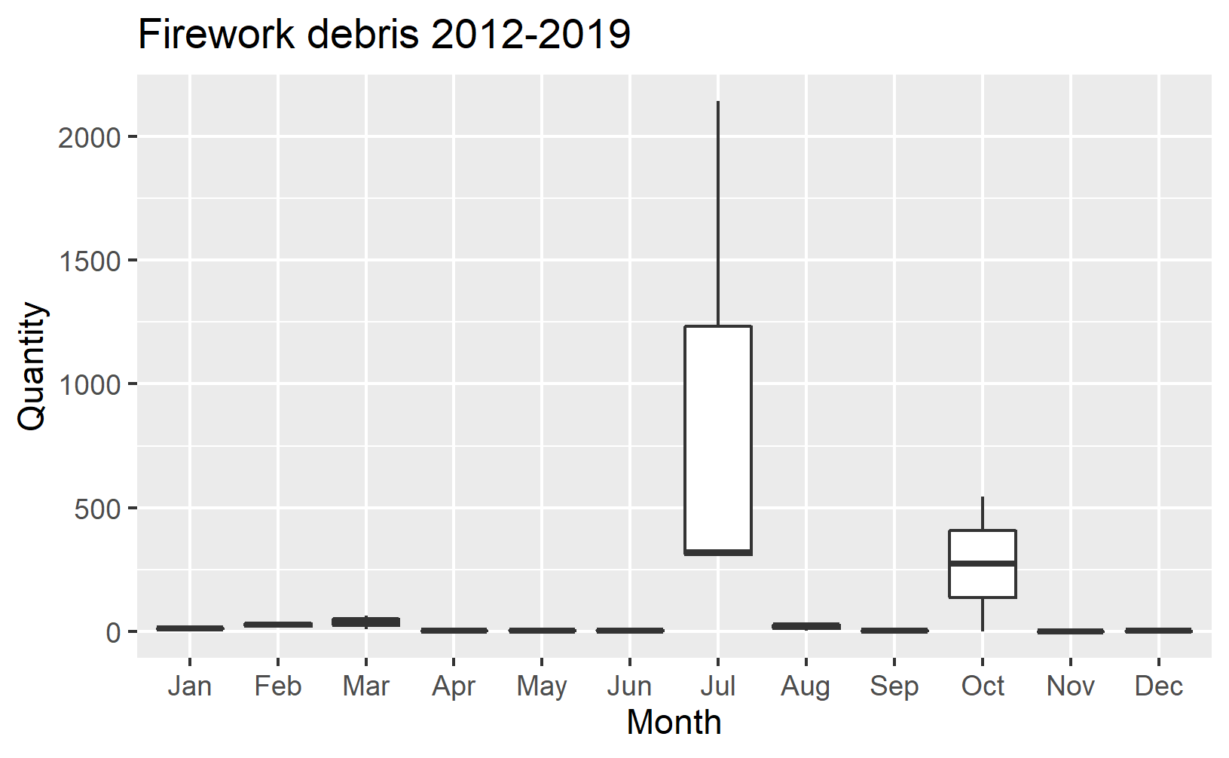
What We’ve Done
Data needed cleaning
Some things classified as rubber gloves, weren’t rubber at all
Some long/lat positions seemed incorrect
Found some interesting stories
Cigarette butts decrease over time
Possibly indicative of less smokers or more vaping?
Fireworks are collected most in July and in N.America
Possibly indicative of 4 Jul celebrations?

Slide 5
What we’re doing next
Exploring the ideas of
Event driven pollution
e.g. fireworks after 4th July
Location driven pollution
e.g. fireworks recorded in North America and no where else
Item-pairing
E.g.
Building a model to predict…
Time Series?

