Slide 1
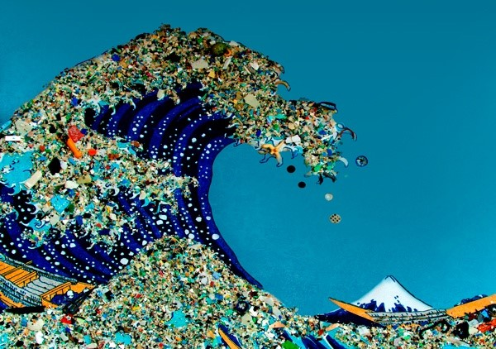
Marine Plastic Pollution
Art: “Plastic Ocean” by Bonnie Monteleone
Alex, Georgios, Karen, Roshi, and Stuart
Group 2

Slide 2
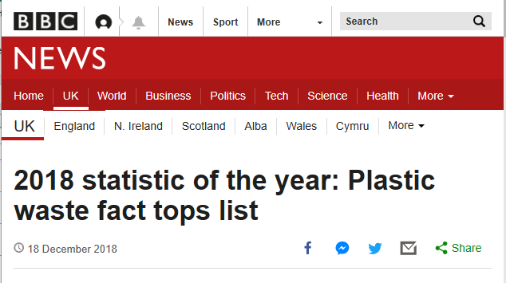
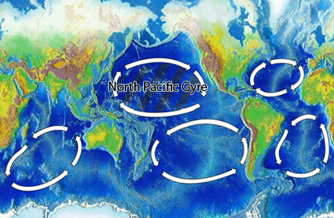
From The Beginning
Marine plastic pollution is a serious global issue
Plastics make up 60-80% of the marine litter
Dramatic increase in plastic production
Marine animals ingest it
Source: BBC NEWS (2018)
Initial Project Aims Investigate plastic ‘islands’
First Steps:
Identified sub-topic areas to investigate
Sources of plastic pollution
Shipping and plastic pollution
Where the plastic islands were and their sizes
How the plastic pollution is distributed
Source: https://en.wikipedia.org/wiki/Ocean_gyre
Notes:
Our topic is on Marine Plastic Pollution.
Our initial assumptions were that plastic mainly floated in ‘islands’ in the ocean (e.g. the pacific garbage patch) and that over time, the pollution which started out as macro-plastics, would break up into micro-plastics which became ingested by marine animals.
Our idea was that if we could model the size and position of the islands, it could be used to monitor and help direct clean-up to those areas, since plastic is easier to remove while it is in macro form rather than micro form.
We had big ideas…

Slide 3

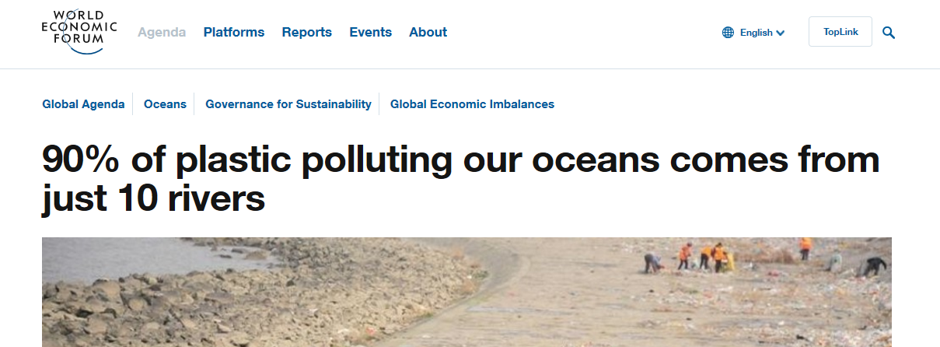
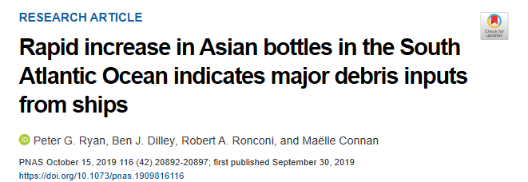
What We Found
Problems
Conflicting information
Pollution under the surface
Sources of pollution uncertain
Datasets from articles
Already prepared and cleaned
Already explored in articles
Non-relevant data removed, meaning little scope to explore beyond the article’s discussion itself
Source: PNAS (2019)
Source: World Economic Forum (2018)
We had many references, but no hypothesis…
Notes:
When we collated our research from the initial run, we found that a lot of our original assumptions were wrong, conflicting with each other, or did not give us room to explore what was already presented.
There were some extensive studies done by various academic and interest research groups, but because of the size and reach of the problem, most studies could only make projections on their research. Conducting ocean-wide surveys are costly.
Without collecting data for ourselves, which we did not want to do, we could not go very far with our initial idea…

Slide 4
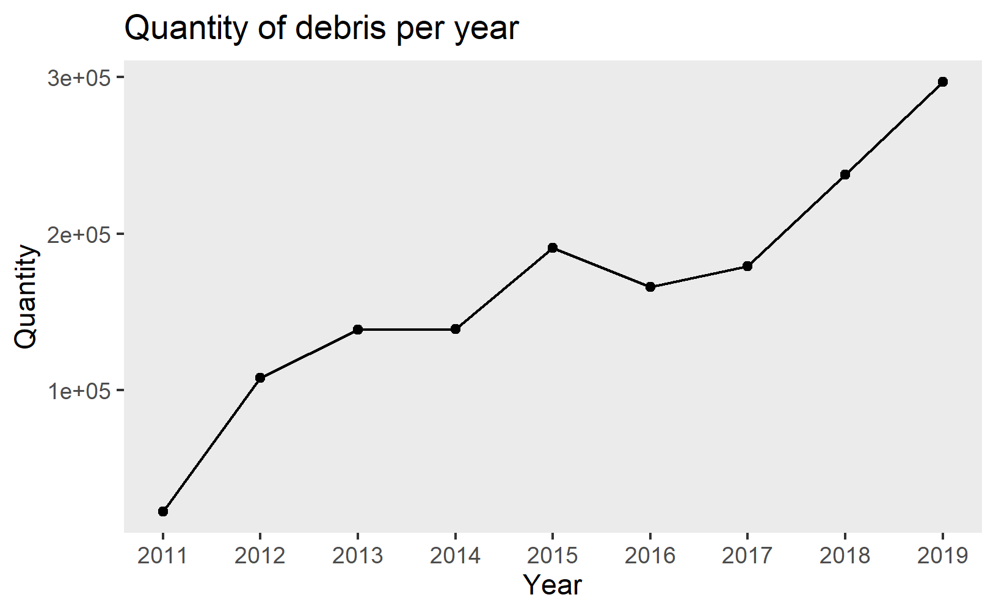
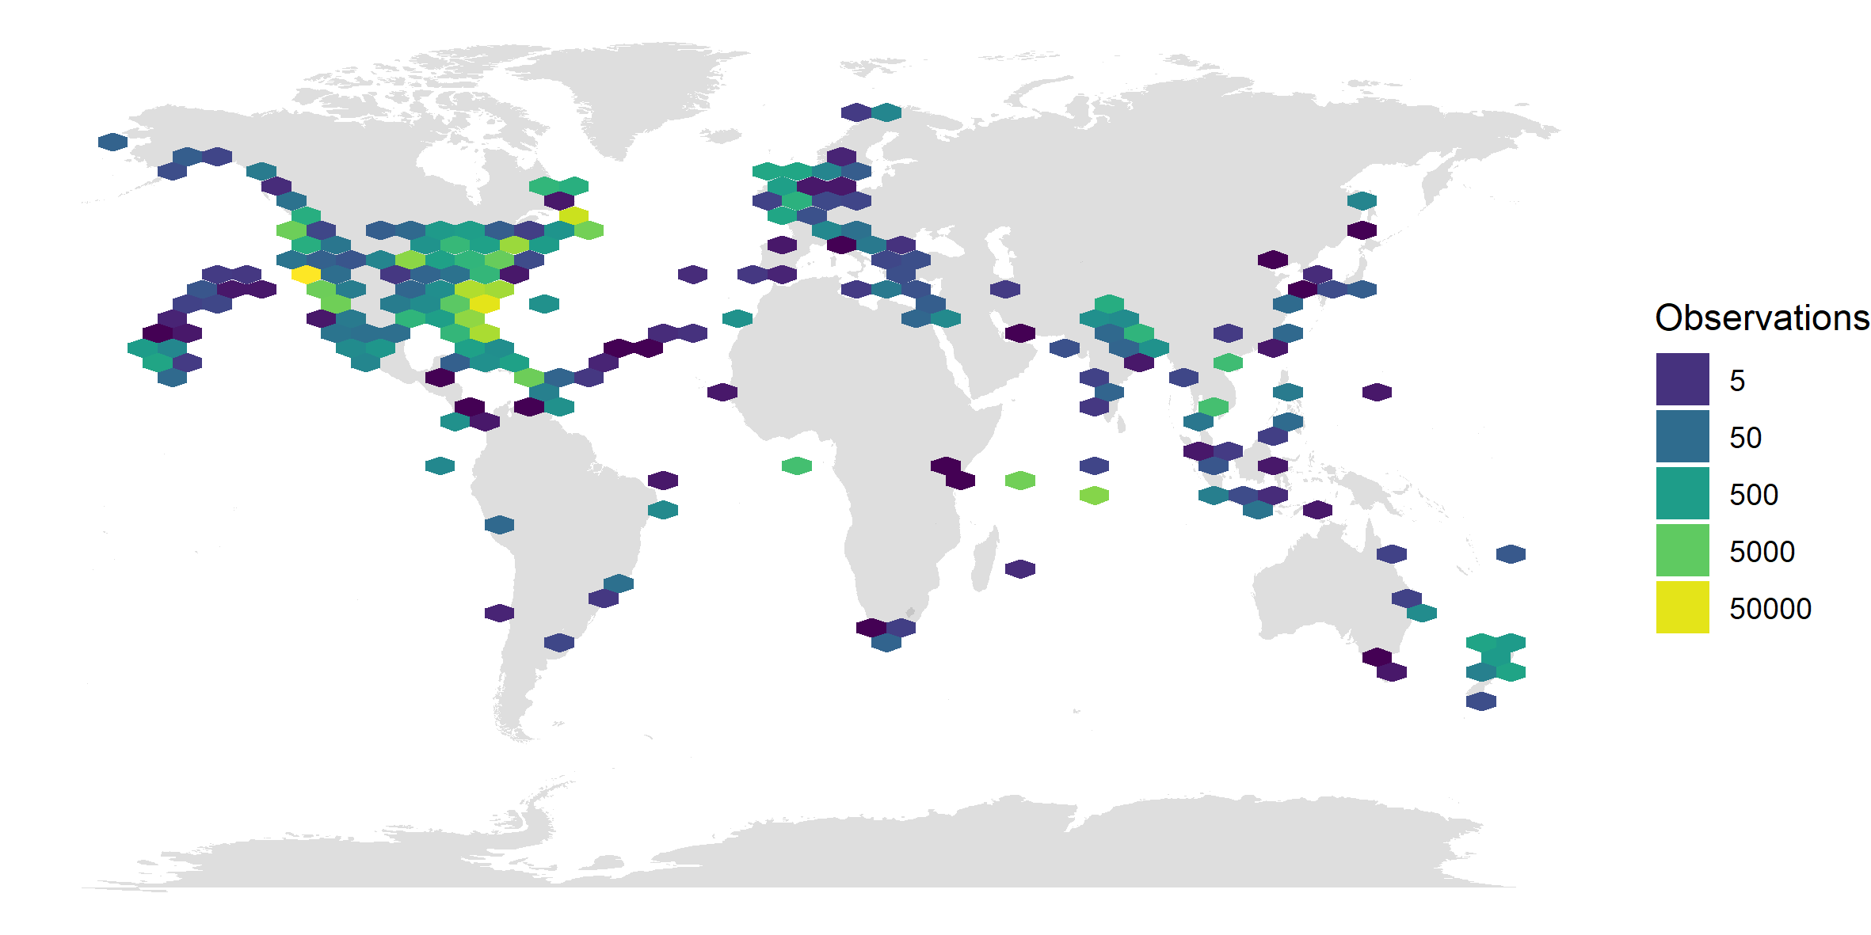
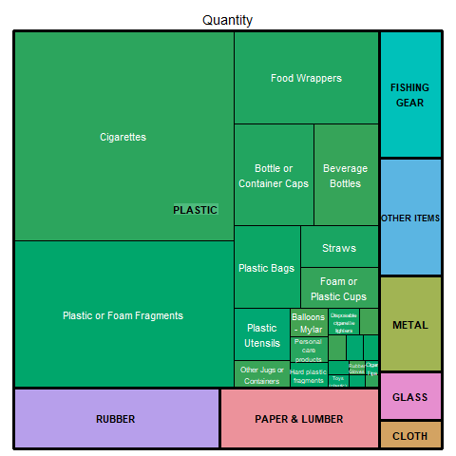
Turning Point
Found a raw dataset of plastic debris collected in locations over time
Narrowed focus and developed a hypothesis
“Plastic pollution composition remains constant over time”
Notes:
The dataset is a log of pollution picked up at water edges, recorded and classified by volunteers. There are features of time, geographical location, quantity, free-text descriptions and material classification.
One thing we identified, was that the quantity of plastics collected increased over time, but we recognise this is not necessarily reflective of plastic pollution increasing over time – it could simply be that more volunteers are recording the pollution, or with increased frequency.
But we could explore if the composition of pollution remained largely similar, despite changes in raw volume.

Slide 5
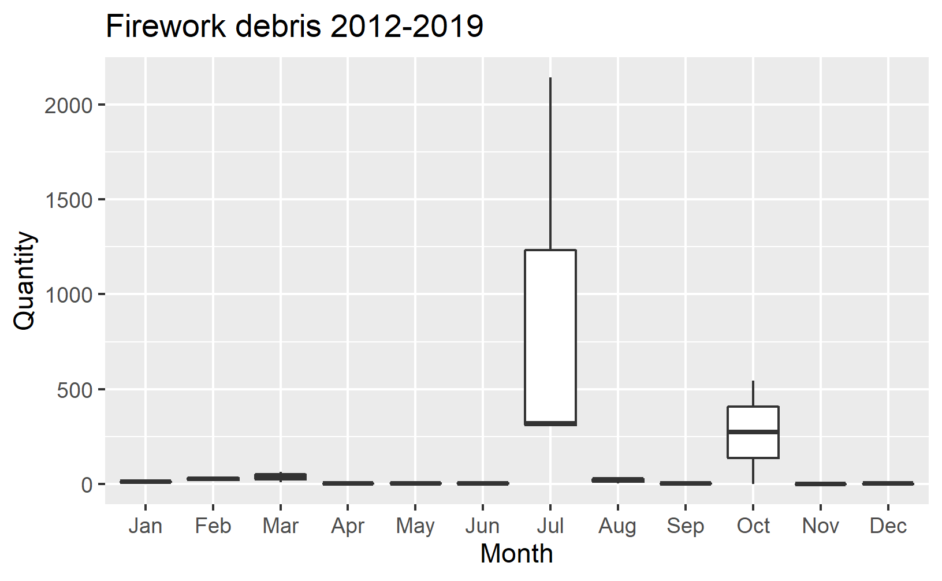
What We Have Done
Data needed cleaning
Some things classified as rubber gloves, were not rubber at all
Some long/lat positions seemed incorrect
Found some interesting stories
Cigarette butts decrease over time
Possibly indicative of less smokers or more vaping?
Fireworks are collected most in July and in North America
Possibly indicative of 4 July celebrations?
Notes:
We conducted some initial exploratory analysis, shared it with the group, discussed it, developed some new ideas, explored the ideas and repeat.
Through exploration and the help of data visualisation techniques, we found some patterns we had not expected.

Slide 6
What We Are Doing Next
Exploring the ideas of
Event driven pollution
(e.g. fireworks after 4th July?)
Location driven pollution
(e.g. are fireworks recorded in North America and no where else?)
Item pairing
(e.g. are 6-pack beer rings observed at the same time as fireworks? )
Building a model to predict the proportion of plastics given Month and Location
A lot of writing, reviewing and editing…

