Slide 1
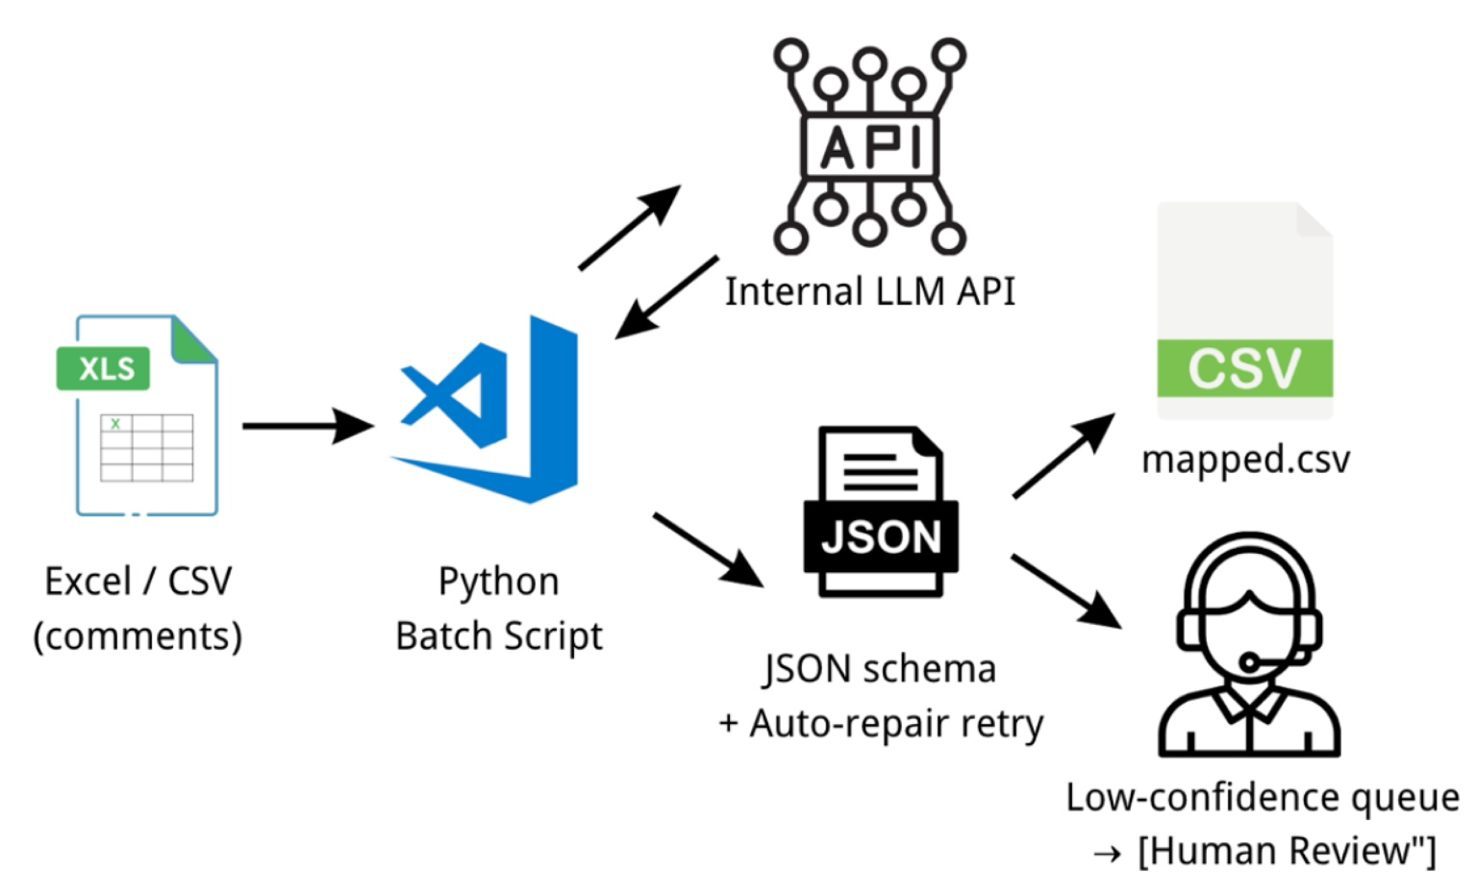
NPS Category Mapping (Pain Point → MVP)
Turn manual “Comment → Channel → Major → Minor” into controlled, auditable automation.
Pain Today
Who Benefits
Manual tagging (2–4 min/record), inconsistent across people/time,
hard to audit;
analysts lose time for insights.
NPS/VoC, Complaints, Service Quality; any rule-based repetitive mapping (ticket routing, CS topics, feedback labels)
MVP (Controlled Automation)
Value / Expected Outcome
Time & Capacity: ~80% effort reduction (≈1–2 h saved per ~125 items); batch runs in 5–10 min.
Consistency & Accuracy: One official taxonomy + JSON-only output with enum checks; low-confidence only goes to human review.
Auditability & Compliance: Rationale & signals per record, full logs (model/prompt/version/request ID), PII masking.

