Slide 1

Eulerian Video Magnifacation
Feb 22, 2016
Luis Alberto Díaz de León

Slide 2
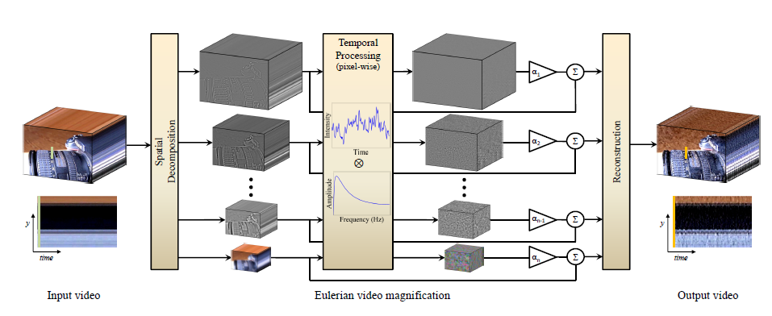
Notes:
This represents how the algorithm works

Slide 3
reproduceresults.m
amplify_spatial_lpyr_temporal_iir
(vidFile,
resultsDir,
alpha,
lambda_c,
r1,
r2,
chromAttenuation)
amplify_spatial_lpyr_temporal_butter
(vidFile,
outDir,
alpha,
lambda_c,
fl,
fh,
samplingRate,
chromAttenuation)
Notes:
Challenge: Remove Sampling Rate from the input, it can be calculated later

Slide 4
amplify_spatial_lpyr_temporal_iir.m
Spatial Filtering: Laplacian pyramid
Temporal Filt: substraction of two IIR lowpass filters
y1[n] = r1*x[n] + (1-r1)*y1[n-1]
y2[n] = r2*x[n] + (1-r2)*y2[n-1]
(r1 > r2)
y[n] = y1[n] - y2[n]
Notes:
Function deffinition

Slide 5
amplify_spatial_lpyr_temporal_iir.m
vid = VideoReader(vidFile); %Read Video
vidHeight = vid.Height;
vidWidth = vid.Width;
fr = vid.FrameRate;
len = vid.NumberOfFrames;
startIndex = 1;
endIndex = len-10;
Notes:
Challenge: do not remove ten frames from endIndex, this makes the output video smaller causing confusion and difficult to compare with original.

Slide 6
amplify_spatial_lpyr_temporal_iir.m
frame= struct('cdata', zeros(vidHeight, vidWidth, nChannels, 'uint8'), 'colormap', []);
frame.cdata = read(vid, startIndex);
.
.
[pyr,pind] = buildLpyr(frame(:,:,1),'auto');
pyr = repmat(pyr,[1 3]);
[pyr(:,2),~] = buildLpyr(frame(:,:,2),'auto');
[pyr(:,3),~] = buildLpyr(frame(:,:,3),'auto');
Notes:
nChannels =3 (RGB)
Handles first frame at the baggining to make a three-dimentional matrix
Challenge: calculate pyr size prior to the pyramid calculation to make a footprint and save RGB in one single loop

Slide 7
amplify_spatial_lpyr_temporal_iir.m
lowpass1 = (1-r1)*lowpass1 + r1*pyr;
lowpass2 = (1-r2)*lowpass2 + r2*pyr;
filtered = (lowpass1 - lowpass2);
Notes:
Temporal filtering

Slide 8
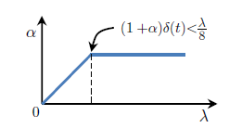
amplify_spatial_lpyr_temporal_iir.m
delta = lambda_c/8/(1+alpha);
lambda = (vidHeight^2 + vidWidth^2).^0.5/3;
%inside loop
currAlpha = lambda/delta/8 - 1;
lambda = lambda/2;
Notes:
Challenge: /3 Experimental Constant
currAlpha = currAlpha*exaggeration_factor;

Slide 9
amplify_spatial_lpyr_temporal_iir.m
If (currAlpha > alpha)
% representative lambda exceeds lambda_c
filtered(indices,:) = alpha*filtered(indices,:);
else
filtered(indices,:) = currAlpha*filtered(indices,:);

Slide 10
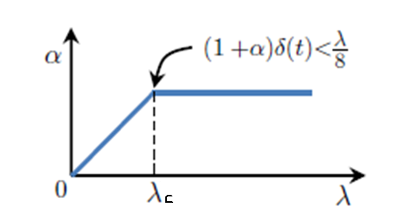
amplify_spatial_lpyr_temporal_iir.m
The lambda_c used in the code, is the one shown in the figure below. It is used initialy in the source code to compute Delta.
Other part of code calculates lambda, on each one of the parts of the pyramid.
The Delta calculated with lambda_c and the lambda are then used to calculate the current alpha.
If current alpha exceeds the alpha from the input parameter, that means that lambda is greated than lambda_c, si the alpha in the input parameters is used to amplify. Otherwise means that lambda is smaller than lambda_c, so the alpha calculated is used to attenuate the pyramid part.

