Slide 1

Intel RealSense Technology

Slide 2


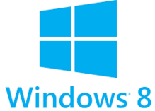

Development Requirements
4th Generation (or later) Intel® Core™ processor.
Windows* 8.1, 64-bit.
USB 3.0 (OS does not detect camera
connected via USB2).
Camera Driver, RealSense SDK .
Visual Studio 2010-2015 with SP1
No Linux support from Intel

Slide 3
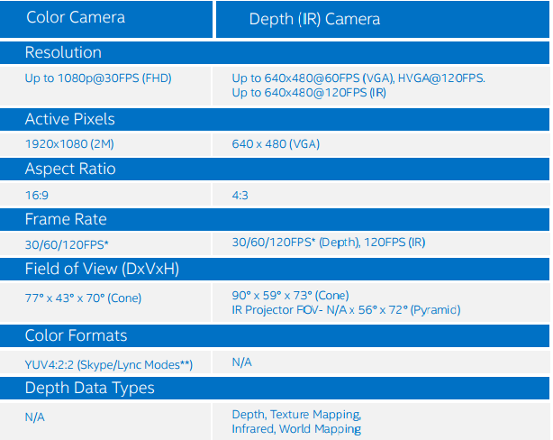


Imaging Component Overview
Capture Volumes(FOV)
Notes:
Capture volume constraints limit the practical range of motion of the user and the physical space within
which users can interact successfully.
very different mindset than designing for traditional platforms
Mid-air gesture input is very different from mouse input or touch input.
Intuitive. Approachable and immediately usable
Consistent. Users should perform similar operations in different parts of your application in similar ways.
Designed with the user in mind. Make sure you know who your audience is before choosing the users you work with.
Comfortable
Reliable and Recoverable. It only takes a small number of false positives to discourage a user from your application. Focus on simplicity where possible to minimize errors.

Slide 4
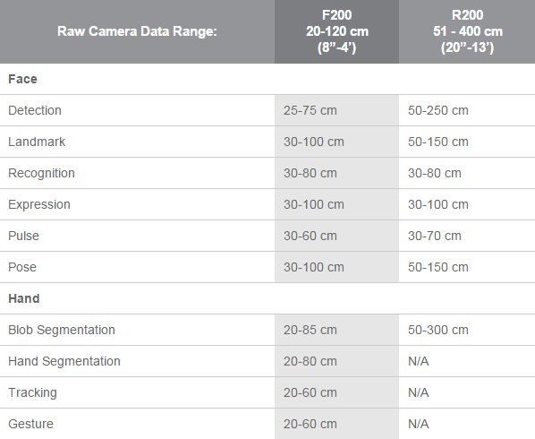
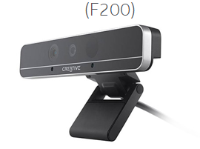
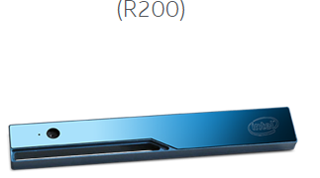
Real Sense Data ranges

Slide 5
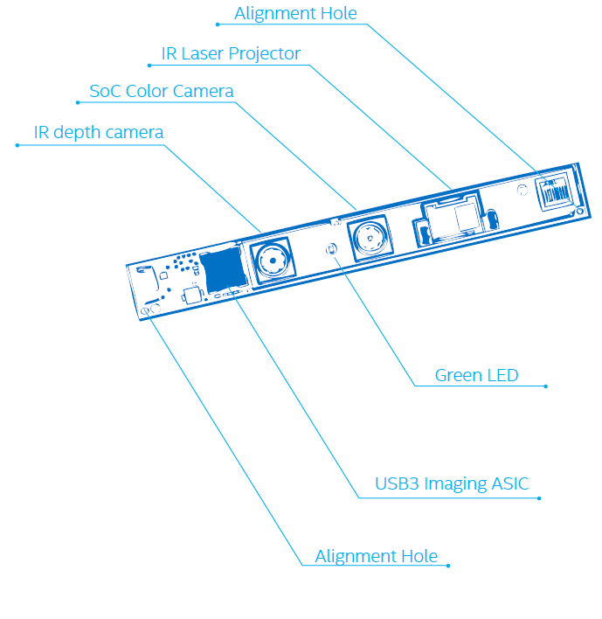
Imaging Component Overview

Slide 6
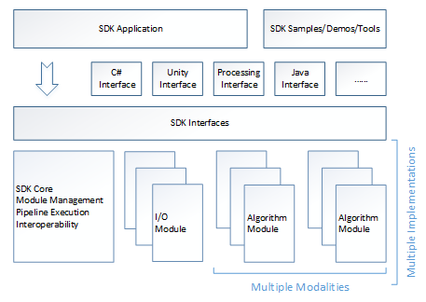
SDK Architecture
Configure Environment
Native C++ Interfaces
Camera Device
Notes:
The SDK standardizes the interfaces of the I/O and the algorithm modules so that the applications can access the functionalities without being concerned with the underlying implementations. Multiple implementations of SDK interfaces may coexist.
SDK core: One of its jobs is to manage the two types of modules: input/output modules and
capability modules,
Another job the SDK core performs is organizing the execution pipeline. It is possible to have multiple modules
contained within the pipeline at the same time, so it is essential that the pipeline have a manager. If you want to use
more than one camera or other input device in your application, you may require multiple pipelines, each with its own
manager.

Slide 7
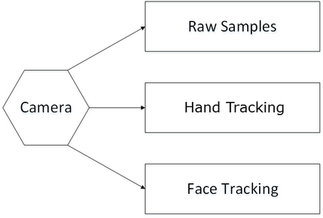
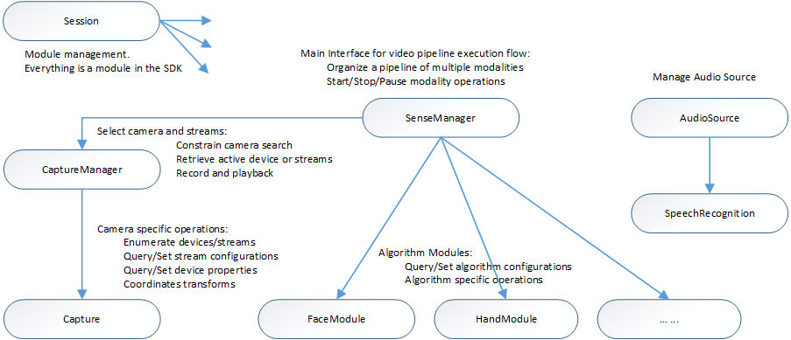
SDK Interfaces
*SenseManager predefined use cases.
Notes:
Session interface manages the following modules: I/O modules, algorithm modules, and any other SDK interface implementations.
For predefined usages such as hand tracking and face tracking, you can use the SenseManager interface.
Each session maintains its own context for I/O and algorithm models and is not aware of other sessions.

Slide 8
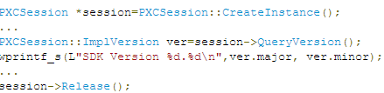
Code Sample
An SDK session is the class that holds context for
Modules.
Within an SDK session,
there are multiple I/O and algorithm modules
that implement certain SDK interfaces.
The Release() function should be used in an object, instead of the delete keyword.

Slide 9
Design Principles
Contextually appropriate.
Intuitive.
Consistent.
Designed with the user in mind.
Comfortable.
Reliable and Recoverable.
* Mid-air gesture input is very different from mouse input or touch input.
Notes:
very different mindset than designing for traditional platforms
Mid-air gesture input is very different from mouse input or touch input. Don’t model your app on existing user interfaces
Contextually appropriate. Are you designing a game? A medical application? A corporate content-sharing application?
Make sure that the interactions you provide match the context.
Intuitive. Approachable and immediately usable
Consistent. Users should perform similar operations in different parts of your application in similar ways.
Designed with the user in mind. Make sure you know who your audience is before choosing the users you work with.
Comfortable
Reliable and Recoverable. It only takes a small number of false positives to discourage a user from your application. Focus on simplicity where possible to minimize errors.

