Slide 1
E145 Technology Entrepreneurship Session 19 Course Summary
Professor Chuck Eesley
Stanford University
Copyright © 2010 by the Board of Trustees of the Leland Stanford Junior University and Stanford Technology Ventures Program (STVP). This document may be reproduced for educational purposes only.

Slide 2
Congrats on Significant Deliverables
Readings, class participation, and a team exercise
Three team case analysis emails (+ 3 other preps)
An individual case analysis email
OAP positioning statement, website, presentation, and written analysis
OEP presentation and written analysis
Extra credit opportunities (ETL seminars, investing, and today’s lessons learned)
Personal Business Plan …

Slide 3

So What Lies Ahead?

Slide 4
Recall Our Course Objectives
Understand entrepreneurial leadership as a vital process in technology-intensive enterprises (+ dispel common myths and misconceptions).
For students of all majors, teach skills important for 21st-century technology leaders.
Stimulate continuous learning and personal reflection regarding entrepreneurship and your future.

Slide 5
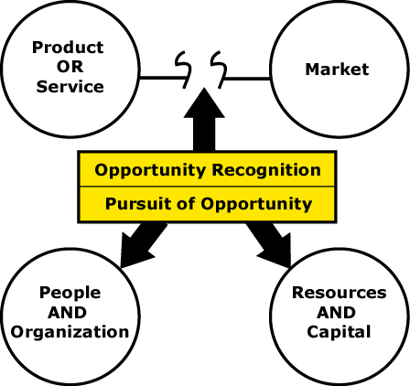
Examining the Tech Entrepreneurship Process
Yahoo!
AIR
“BioFuelBox”
IMVU
WebTV
“OAP”
SolidWorks
Barbara A.
Wily Technologies
“OEP”
© 2003 Mark P. Rice, Babson

Slide 6
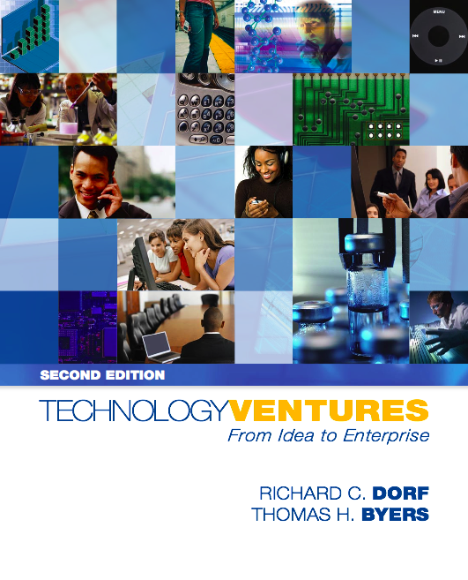


Major Concepts and Frameworks
Sahlman's “concept of fit” model: People - Opportunity - Context - Deal
Dorf and Byers’ “from opportunity to profitability” model: Vision – Strategy - Execution
Komisar's 3 Q's every VC wants to know: Big market + winning strategy + excellent team
Kaplan's Silicon Valley game: Entrepreneurs trade stock for ideas, talent, and capital
Moore’s technology adoption cycle and chasm model: Adapting the marketing strategy over time
Blank’s customer development model: Follow a process in parallel to product development
Byers’ ABCs of human and financial resources: Basics of effective orgs and venture financings
Bottom Line: Does the “Top 10 Elements” document seem familiar and logical?

Slide 7

Learning Technology Entrepreneurship
Basic terminology and concepts through the texts, lectures, and workshops.
Critical thinking via case studies.
Teamwork via the OAP and OEP assignments.
Career planning via the personal business plan.

Slide 8
Becoming a “T-Shaped” Person
Breadth of Knowledge about Design,
Entrepreneurship, Innovation, and Leadership
Depth of
Knowledge
in a
Particular
Discipline
Source: David and Tom Kelley

Slide 9
Change and Globalization
Creativity
Opportunity Evaluation
Decision Making
Teamwork
Persuasion and Influence
Communication
Ethics
Basics of Business

Slide 10








The Planet Needs Entrepreneurial Thinking
Environment & Sustainability
Security & Economic Stability
Digital & Physical Infrastructure
Human Health & Education

Slide 11
Next Steps in Entrepreneurship Education
Visit http://stvp.stanford.edu for more courses
Attend ETL lectures in person or access them on the web at http://etl.stanford.edu
Watch videos and podcasts at Entrepreneurship Corner at http://ecorner.stanford.edu
Join any of the innovation-related student clubs (e.g., BASES, ASES, SWE, etc.); participate in business plan competitions and challenges
Attend campus and Silicon Valley events regarding entrepreneurship (e.g., subscribe to BASES Digest at http://bases.stanford.edu)

Slide 12
Mayfield Fellows Program 2010 (Application Deadline: February 1)
Winter
Outstanding Undergrads & Coterms Apply To Be
“Mayfield Fellows”
Spring
Students Learn Structure & Methods of Start-ups;
Students Seek Paid Assignments
at Start-up Companies
Autumn
Students Bring Back Experiences and Learn From Them As a Group
3 Courses + Paid Summer Internship
+ Mentors
Summer
Students Leverage the Power of Real World, Hands-On Experience
http://mfp.stanford.edu

Slide 13
Importance of Course Evaluations (both via Axess and directly)

Slide 14
“If you don’t like the news, then go make some of your own.”
Scoop Nisker

