Slide 1
Entrepreneurial Sales & Marketing E145
Professor Chuck Eesley
“Companies that create the future do more than satisfy customers, they constantly amaze them.”
~ Hamel and Prahalad
Copyright © 2012 by the Board of Trustees of the Leland Stanford Junior University and Stanford Technology Ventures Program (STVP). This document may be reproduced for educational purposes only.
Note: Special thanks to my colleagues: Steve Blank and Tom Kosnik.

Slide 2
Agenda and Objectives
Entrepreneurial Marketing
- Either making it or selling it
Go-to-market strategies

Slide 3
“Market Analysis” Versus “Marketing”
Step #1 Opportunity recognition & market analysis
Identify a Market Need
Examine the Competitive Dynamics of the Industry
Determine Size and Growth Potential of the Market
Step #2 Marketing as a strategy to create demand
Develop a Unique Positioning
Develop Marketing Objectives
Build a Set of Go-to-Market Strategies (e.g., Pricing, Promotion, Distribution)
Support through Sales and Great Execution

Slide 4
Some Definitions
Total Available Market
TAM = how big is the universe
Served Available Market
Target Market
SAM = how many can I reach
with my sales channel
Target Market (for a startup) = who will be the most likely buyers

Slide 5
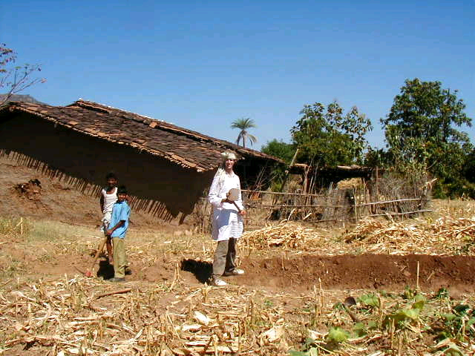
Oghna, India

Slide 6
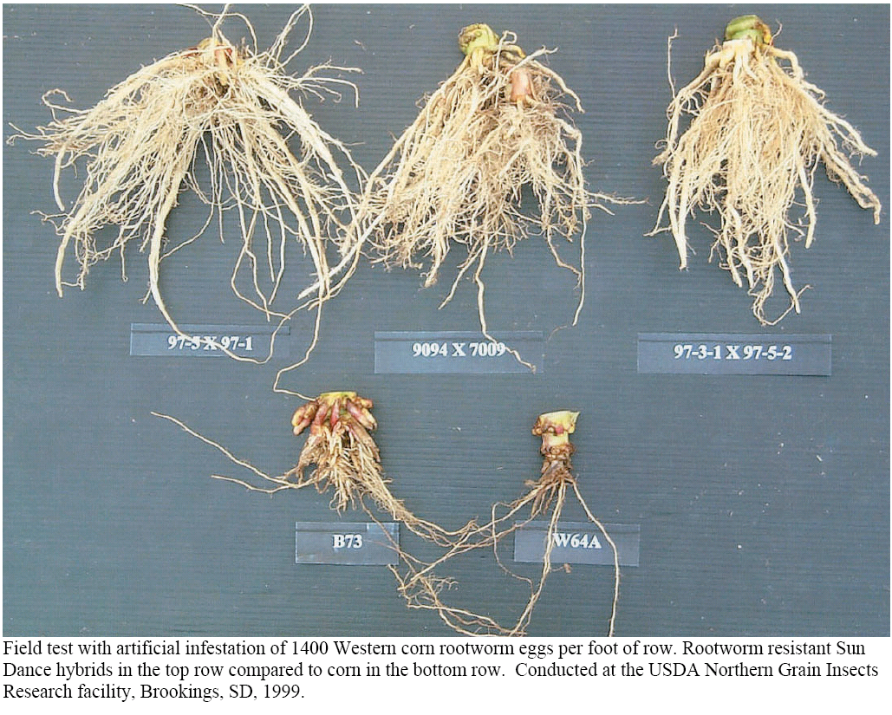
Corn Rootworm Product

Slide 7
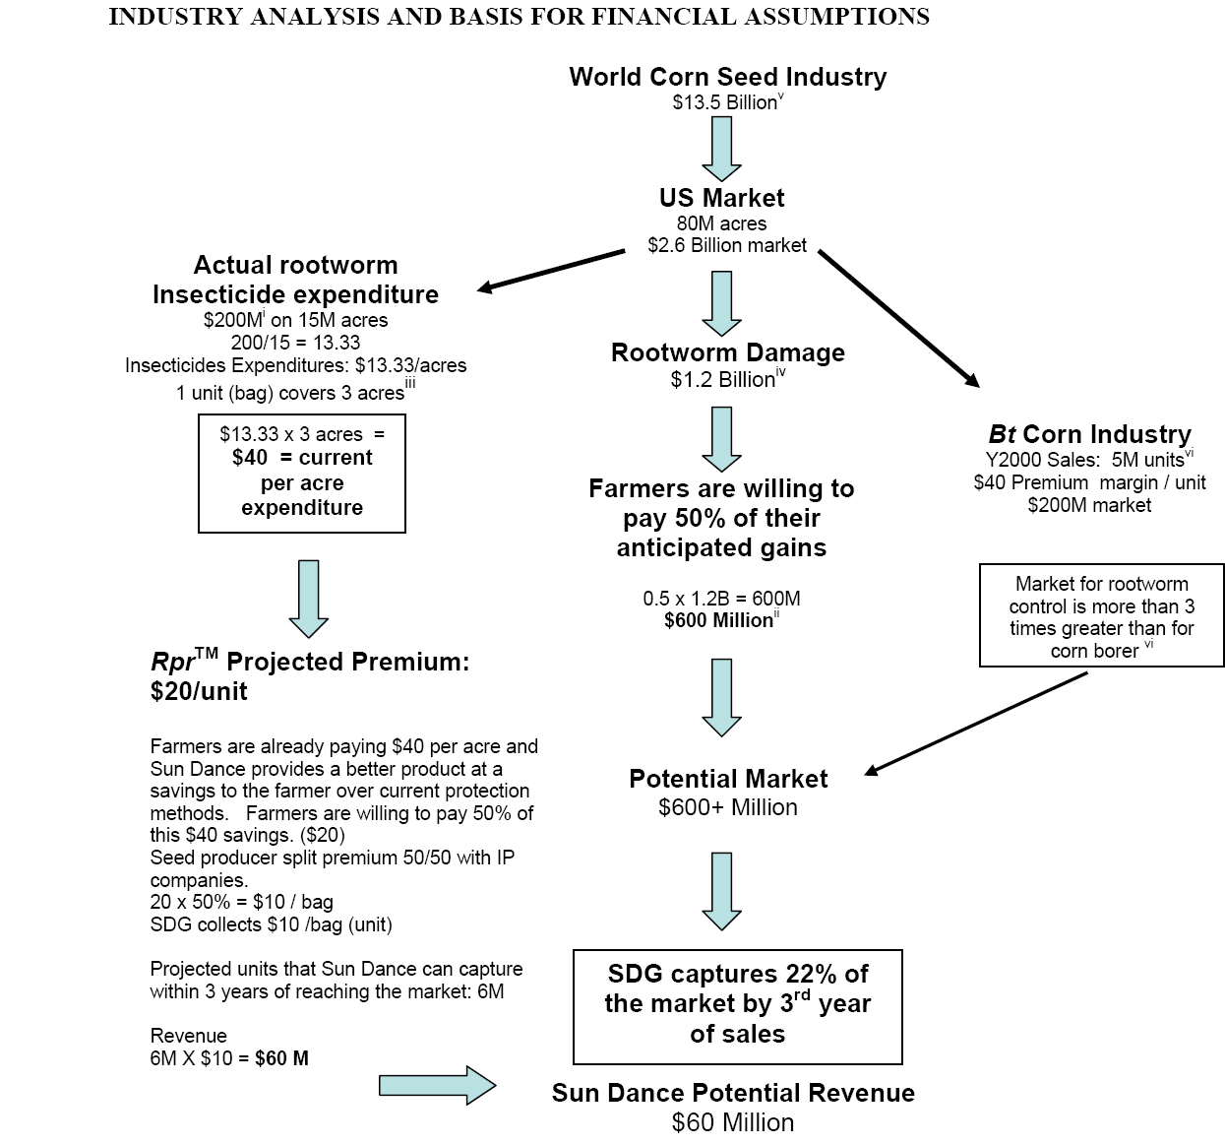

Slide 8
What makes marketing and sales so challenging in a high-growth venture?

Slide 9
Popular Model … Geoff Moore’s “Technology Adoption Life Cycle”
Pragmatists
Stick with the herd!
Conservatives
Move only when necessary!
Visionaries
Skeptics
Move ahead of the herd!
No way!
Techies
Try it!
Innovators
Early
Early Majority
Late Majority
Laggards
Adopters
The Chasm
Source: Moore, Geoffrey (2002) Crossing The Chasm

Slide 10
So How Does a Startup Cross the Chasm?
Put Your Eggs in One Basket … Target Market Segments.
Then Deliver a 100% Solution To Them … A Whole Product.
Source: Moore, Geoffrey (2002) Crossing The Chasm

Slide 11
Ways to Segment Markets
For “B2C” … consumers
Age
Gender
Income bracket
Brand loyalty
For “B2B” … businesses
Industry type
Number of employees
Geography
Order size
Total Available Market
Served Available Market
Target Market
Notes:
Geographic (region)
Demographic (gender)
Psychographic (lifestyle)
Behavioral (brand loyalty)
Other variables?

Slide 12
An Example of the Power of Segmentation: Pedigree Petfoods in UK
Dog’s Role Segment Brand Price/100 gr.
Dog as a family member Premium Chum 8.7 pence
Dog as a companion Moderate Pal and Bounce 6.4 & 7.9 pence
Dog as an animal Economy Chappie 6.3 pence
Dog as a substitute child? Super Premium
Reference: A. Ryans

Slide 13
Segmentation and the UK Dog Food Market: Pedigree’s Super Premium Strategy
Target Market? Intense relationships, own smaller dogs, older and urban females
Benefits? Very best product that can be bought, reassurance, confidence, leads to an enhanced relationship
Name? Mr. Dog (later Caesar)
Product? Very high quality ingredients, wide variety of flavors, special packaging
Price? 17.7 to 30.7 pence per 100 grams
Advertising? Dog bringing newspaper, slippers, etc.
Results: Fours years later, it had a 10% share of the total dog food market. The total super premium segment of the market was about 15% -- about 10% coming from dog food brands and about 5% coming from fresh foods. In addition, Pedigree's premium brand retained its market share.

Slide 14
What is the Single Most Important Concept in a Marketing Strategy?
Positioning (a.k.a. the “Elevator Pitch”)

Slide 15
Geoff Moore’s Positioning Template
Sentence #1 … Kawasaki’s horizontal axis For (target customer) who (statement of the need or opportunity), the (product/service name) is a (product/service category) that (statement of benefit).
Sentence #2 … Kawasaki’s vertical axis
Unlike (primary competitive alternative), our product (statement of primary differentiation).
Source: Geoff Moore and Guy Kawasaki

Slide 16
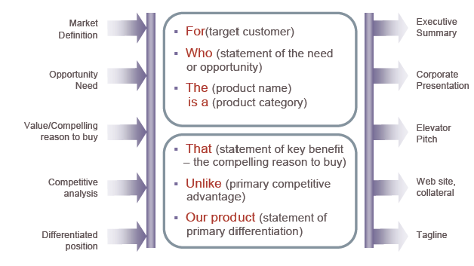
Positioning Happens Before Demand Creation
Demand
Creation

Slide 17
Positioning Should Drive Go-to-Market Strategies
Promotion and Communication (including branding)
Pricing and Business Model (including viral marketing)
Sales and Distribution (including affiliate marketing)

Slide 18
Entrepreneurial Sales & Marketing E145
Professor Chuck Eesley
“Companies that create the future do more than satisfy customers, they constantly amaze them.”
~ Hamel and Prahalad
Copyright © 2012 by the Board of Trustees of the Leland Stanford Junior University and Stanford Technology Ventures Program (STVP). This document may be reproduced for educational purposes only.
Note: Special thanks to my colleagues: Steve Blank and Tom Kosnik.

Slide 19
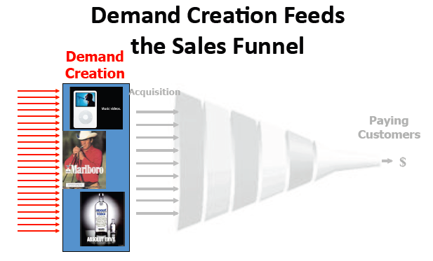

Slide 20
How Do I Get People to Buy?
Having a clear value proposition – why should a customer buy from you?
Demand Creation Experiments
Influencers
Bowling pin strategy

Slide 21
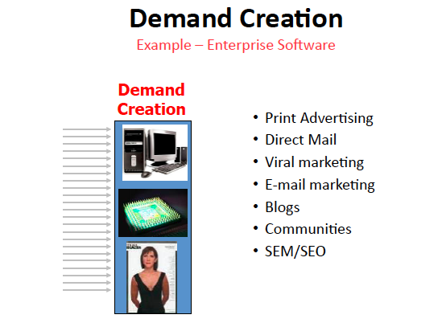

Slide 22
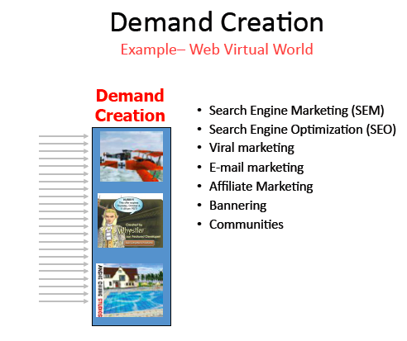

Slide 23
Demand Creation on the Web
Search engine marketing (SEM)
Search engine optimization (SEO) – free traffic by optimizing the website
Viral marketing
Affiliate management
Bannering

Slide 24
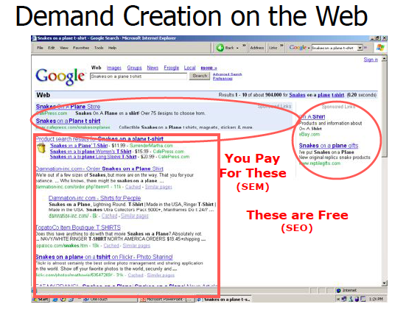

Slide 25
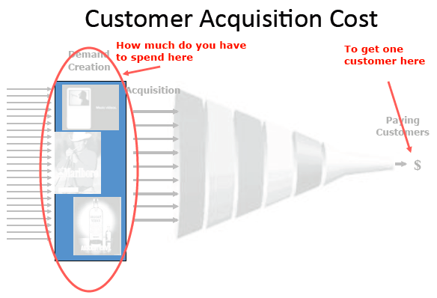

Slide 26
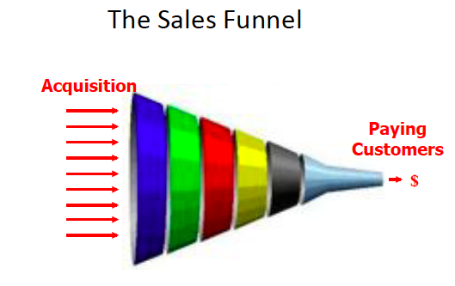

Slide 27
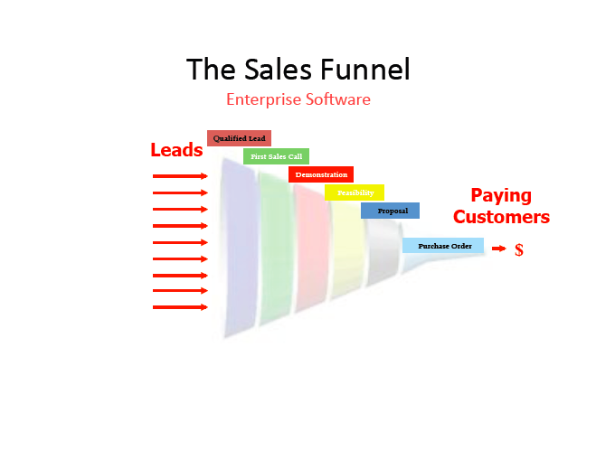

Slide 28
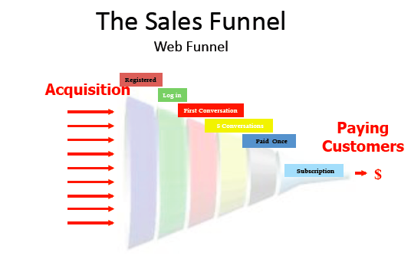

Slide 29
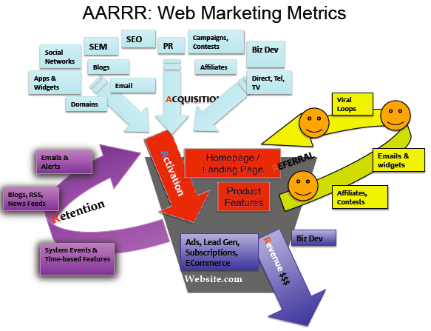
David McClure

Slide 30
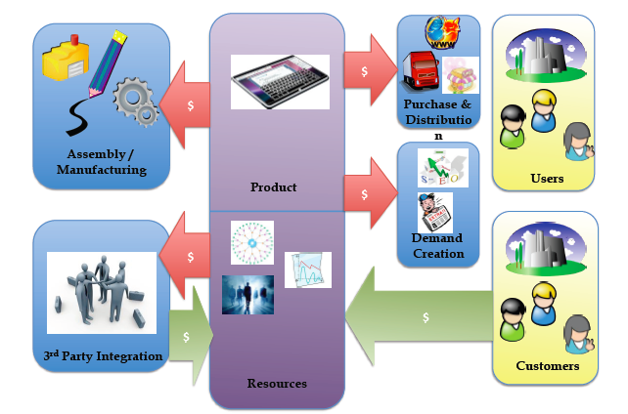

Slide 31
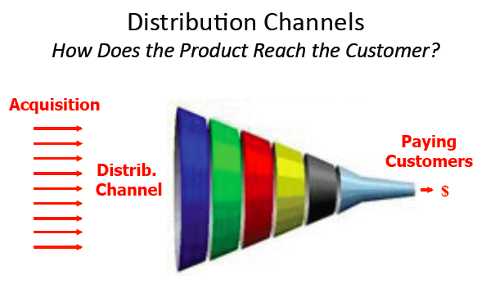

Slide 32
Where do People Buy my Product?
Sales Channels
Understanding the sales process and decision makers in the customer organization
Must experiment with sales channels/tactics

Slide 33
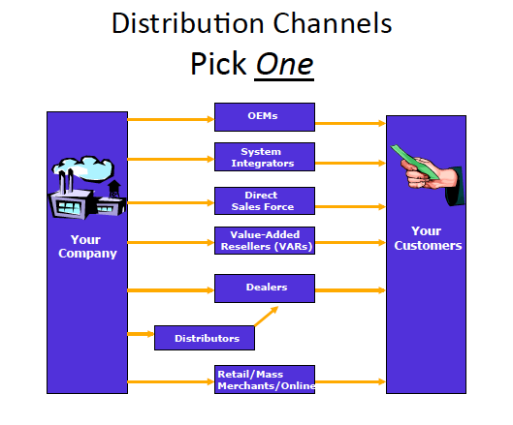

Slide 34




Example Business Model
ODM Hardware
$350
$399
$150
$399
$399
Customer Acquisition Cost:
($41)
Demand Creation
SEO/SEM
Blogs
Forums
Bookstore promotion
Sales force
Viral marketing
Website
yourcompany.com
Software
(in-house)
$200
$399
Notes:
Who are your users? Are they your customers?
How do they find out about your product?
How do they get access to your product?
How do you produce your product?

Slide 35
What do I track?
E145 Accounting Workshop

Slide 36
E-commerce: Sales Funnel
…
PR
Affiliates
SEO
Online Ads
Registration
Customer Acquisition Cost
Marketing Cost
Viral Coefficient
Customer Lifetime Value
Use/Evaluate
Pay
E145 Accounting Workshop

Slide 37
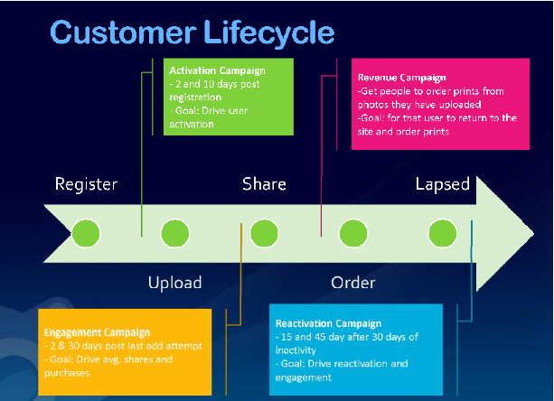
E145 Accounting Workshop
Source: Josh Koppelman Blog

Slide 38
Entrepreneurial Sales & Marketing E145
Professor Chuck Eesley
“Companies that create the future do more than satisfy customers, they constantly amaze them.”
~ Hamel and Prahalad
Copyright © 2012 by the Board of Trustees of the Leland Stanford Junior University and Stanford Technology Ventures Program (STVP). This document may be reproduced for educational purposes only.
Note: Special thanks to my colleagues: Steve Blank and Tom Kosnik.

Slide 39

Ambitious Startups Face a “Double Chasm” as They Go Global

Slide 40
The Double-Chasm Challenge
The Market Chasm – based on the early majority’s perceptions of the innovation’s risks
The Cultural Chasm – based on …
Lack of experience of the venture’s leaders in each new country’s local culture
Lack of trust among adopters in each new country in the “foreign” company and its leaders.

Slide 41
Going Global’s 5 Key Questions
Why should we care about going global?
Who can help us go global?
When should we think about going global?
Where should we focus?
How can we become global entrepreneurs on a shoestring budget?
Source: Professor Kosnik (Stanford)

Slide 42
What did we cover?
Transition from opportunity assessment to opportunity execution
Entrepreneurial Marketing
Market analysis, customer development → positioning → go-to market strategy “marketing”
Going Global

