Slide 1
E145 2011 Venture Finance Workshop
Professor Chuck Eesley
Copyright ©2011 by the Board of Trustees of the Leland Stanford Junior University and Stanford Technology Ventures Program (STVP). This document may be reproduced for educational purposes only.

Slide 2

How Tech E’s Finance Their Ventures … The “Essentials”
A. Amount of Cash Needed and Purpose
B. Sources of Capital
C. Deal Structure

Slide 3
Agenda
Introduction to Miriam Rivera and Clint Corver
Economics of VC, Flavors of VCs
Suggested pitching playbook, VC drivers
Break
Ways Startup Companies Raise Capital (Miriam Rivera and Clint Corver)
Expectations
Board composition
Process
Pros/Cons

Slide 4

Miriam Rivera
Co-founder and managing partner at Ulu Ventures and focuses on seed-stage investments in technology-enabled services, educational technology, and legal informatics.
Co-founder and co-president of Stanford Angels & Entrepreneurs a Stanford University alumni organization
Vice President/Deputy General Counsel at Google where she led the company’s corporate, commercial, Asia Pacific, Latin America, employment, real estate and technical operations practices. She helped to grow Google from $80 million in revenue to over $10 billion.
Miriam received an AB in Sociology, an AM in Spanish from Stanford University, as well as a JD/MBA from Stanford Law School and Stanford Graduate School of Business.

Slide 5
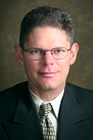
Clint Korver
Co-founding partner at Ulu Ventures
Co-founder and co-president of Stanford Angels & Entrepreneurs
alumni organization helping to build and connect Stanford’s entrepreneurial community.
Co-founded and led four companies including Outcome Software, where he raised $10 million in venture capital to build web-based decision tools for large enterprises and was granted multiple patents in web-based decision analytics.
Co-founded Decision Quality International which trained over 1000 Fortune 500 executives
Co-founded and led the consumer internet company, DecisionStreet and the analytics consulting firm, The Decision Company.
PhD and MS degree from Stanford University in Management Science and Engineering with an emphasis in decision analysis and a BA with honors in mathematics from Grinnell College where he currently serves as Vice Chair of the Board of Trustees.

Slide 6
AngelList.co Offer
Top startup from E145 (both sections) will receive angel funding
I choose who the winner will be.
Several meetings with angels will be set up
Yours to lose …

Slide 7
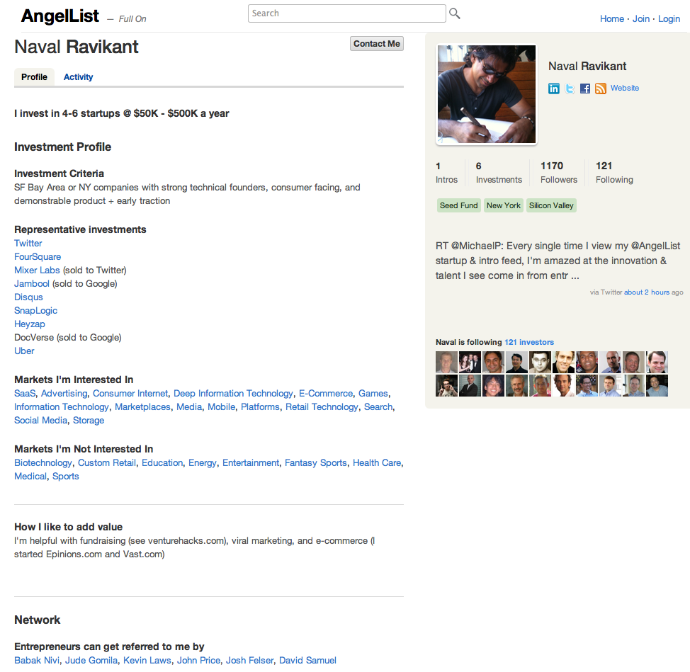

Slide 8
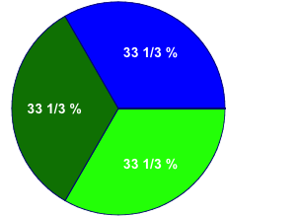
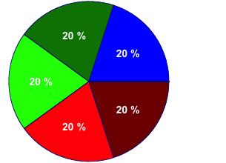
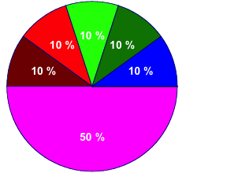
A Multi-Stage Venture Finance Example
Time
I
II
III
IV
V
10%
20%
33.3%
50%
1mm shares for each founder
Σ=3mm shares @ $0.001 ea.
Value=$3k
+1mm shares each for CEO & employees
Σ= 5mm shares @ $0.01 each
Value=$50k
+5mm shares for first VC firm
Σ=10mm shares @ $1.00 each
Value=$10mm
Use of $: R&D
Post-money value = $10mm
Pre-money value = ?
Note: not to scale

Slide 9
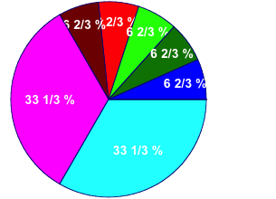
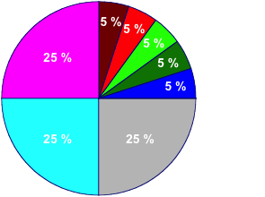
A Multi-Stage Venture Finance Example
I
II
III
Time
IV
V
10%
20%
33.3%
1mm shares for each founder
Σ=3mm shares @ $0.001 ea.
Value=$3k
1mm shares each for CEO & employees
Σ= 5mm shares @ $0.01 each
Value=$50k
5mm shares for first VC firm
Σ=10mm shares @ $1.00 each
Value=$10mm
Use of $: R&D
+5mm shares for second round VCs
Σ=15mm shares @ $5 each
Value=$75mm
Use of $: Mktg.
+5mm shares for sale to public in IPO
Σ = 20mm shares @ $15.00 each
Value=$300mm
Use of $: Operations
Note: not to scale

Slide 10
Economics of VC Firm
Management Fees (typically 2-2.5% of AUM)
Charge a management fee to cover the costs of managing the committed capital.
Carried Interest (typically 20-25%)
"Carried interest" is the term used to denote the profit split of proceeds to the general partner.
Example $100m fund
4x return and 2 and 20%
$2m per year in management fee
(($100m x 4) - $100m) * 20% = $60m in carried interest

Slide 11
Splitting the Pie
VC revenue averages $5 million per VC-backed company
Founding team averages $9 million per VC-backed company (most from small probability of great success)
Economically rational founding team would sell at time of VC funding for $900,000 to avoid the undiversified risk.
Entrep. Exit value (millions) | 0 to 1 | 1 to 10 | 10 to 50 | 50 to 100 | 100 to 200 | 200 to 500 | 500 to 1000 | 1000 and up
Percent of Co’s. | 67 | 20 | 9 | 2.4 | 1.3 | 0.5 | 0.1 | 0.03

Slide 12
Flavors of VCs
VC’s segment in a number of ways
Sector
Healthcare versus IT versus clean energy
Size
Small fund (<$100M) to large fund (>$1B+)
Geography
US, EU, India, Israel
Stage
Seed/early – two guys and an idea/demo
Mid-Stage – initial revenue traction
Late-Stage – near breakeven – expansion/mezzanine capital

Slide 13
Structure of Firm
General Partners
6-8 active deals at a time
Principals/Associate
Drive deal flow, deal process, and portfolio company development
Finance, Marketing, and HR Staff
Decision Making
Typically unanimous
Individual partners champion deals to group
Deal team diligences prospect and builds investment case
Partnership acts as a check and balance to ensure careful decision making

Slide 14
What do VC’s want
This depends on stage – let’s focus on early stage
Team
Domain expertise with core technical strength and knowledge of given market opportunity
History of collaboration and success
A willingness to allow VC’s to help build the team
Market
Emerging and fast growing market
Bad markets make for bad companies
Business model
How will you make money, how will you sell
Technology
Defensible technology/IP that can be protected to form competitive barriers over time

Slide 15
How to Raise Money?

Slide 16
Suggested Playbook
Be committed….
Hire a great Valley lawyer
Figure out what stage and sector you are
Identify 4-5 firms that focus on this stage
Identify which partner you think is most relevant
Get an introduction to that partner
Prepare a 1-2 page overview to send him/her
Prepare a 10-15 slide presentation to give in a 30-45 minute timeframe if they ask you to present
Only goal of the first meeting is to get a second meeting.

Slide 17
Your Pitch: 10 Slides
What we do
Who we are
How we plan to make money
What we are asking for (how much money)
Demo
Secret Sauce/Technology
Market Analysis
Competitive Assessment
Go to Market
Business Model/Financials/Targeted Milestones
The audience must know in first minute what you do
or they will tune out

Slide 18
Your Pitch: 7 Slides
What we do
Who we are
Business Model/How we plan to make money
Demo
Secret Sauce/Technology
Market Analysis
Competitive Assessment
Go to Market/Targeted Milestones/What we are asking for (how much money)
Financials
The audience must know in first minute what you do
or they will tune out

Slide 19
Pat your head and rub your tummy…Hard to Do!
Pat your head
Spec out 1.0 and focus on a customer need
Narrow the focus to broaden the appeal
Rub your tummy
Paint a picture and product roadmap that is a company not a feature

Slide 20
What to Expect
12-16 week process
First meeting to close
1st mtg → diligence → partner meeting → TS negotiation → close
Prepare Investor Package
Presentation
Financial Plan
Personal references
Customer references
Market references
Cap Table
Market research
Product documentation
Competitive Analysis
Investors will seek:
20-50% of the company
Valuation function of targeted raise, ownership, and stage,
Preferred Equity securities, with key terms:
BoD seat
Liquidation Preference
Anti-dilution Protection
Participation
Pro Rata rights
Protective Provisions
Vesting terms for founders and employees

Slide 21
What to Consider
Is the idea sufficiently baked?
Optimal time is 6 months of iteration
Pick your co-founders very carefully
Test fit with VC
Personality, values, knowledge of market
Optimize for best deal not best price
Consider the downstream effects of the financing
High-post moneys can by Pyrrhic victories if company misfires
Angel financing can be a mixed blessing – be careful

Slide 22
Approaching VC’s
Investing is a people business, and getting a meeting is all about “who you know”
Best way to approach a VC is some form of introduction
If you don’t know a VC, find someone who knows you who does and get them to introduce you
Entrepreneur, professor, attorney…
Sending a plan to info@vcfirmname.com is a waste of time

Slide 23
Tips
Don’t take rejection personally, the odds are against you.
Every VC is “interested” – force them to do work to test their level of interest.
Don’t waste time trying to change the mind of someone who says “no”.
Don’t shop to multiple partners in a firm if the first rejects you.
Don’t ignore the junior partners – they can really help.
There are lots of VC firms, focus on a firm that has some connection to you.

Slide 24
Drivers of VC Returns
1.) Human Capital
Sequence # of fund
Start-up experience (early stage) (Zarutskie)
2.) Focus (Lerner et al. )
Industry / stage
3.) Organization (Wasserman 2007; Schoar and Lerner)
Partner to $$ ratio
Partner to non-partner ratio
4.) Less growth across funds
5.) Public market (experienced VCs react quicker)
Overall (VC, not PE):
Returns are highly skewed (a few rock stars make $$$)
Returns are highly correlated with general stock market
Risk-adjusted returns are not different from Dow Jones 5000
(Hall and Woodward 2007)

Slide 25
VC characteristics and performance (on average)
Prior VC experience improves the # of IPO/Acquisitons.
Performance doubles when the VC has prior VC experience and experience managing a start-up
For seed stage: MBA hurts performance (unless it’s an Ivy MBA then no difference) Overall an Ivy degree doesn’t help
Science & Engineering degrees help performance
Individual VC characteristics matter more in seed stage funds than for later stage funds. (Zarutskie 2007)

Slide 26
Drivers of Obtaining VC
1.) Work history (Burton, et al. 2002; Higgins and Gulati 1996)
2.) Social network (Shane and Stuart 2002 – 134 MIT spin-offs)
3.) Size of founding team
4.) Timing
Public markets
Persistence (~9-12 months to raise VC)
Tactics
Casual dating
Timing around milestones/proofpoints
Fostering competition
Scrutinizing interesting
Network verification, call backs, etc.

Slide 27
Message to Entrepreneurs:
– Selecting Your Financial Partners
Seek True Value Added
Operating Experience
Rolodex/Network
Awesome Portfolio (in your space)
Cool Limiteds (in your space)
Entrepreneurs “pay” in terms of lower valuations for affiliating with higher status VC firms (Hsu, 2004)
Keep Realistic Expectations
Time to Market
Revenue growth
Valuations

