Slide 1
Data for Good
Scary AI & Other Dangers with Big Data
Jeannette M. Wing on Sept. 14, 2018

Slide 2
Data Science Institute
Vision
To uphold Columbia University’s leadership in Data Science
Mission 1
To advance the state of the art in data science
Mission 2
To transform all fields, professions & sectors with data science
Mission 3
To ensure the responsible use of data to benefit society

Slide 3
FATES
Fairness
Accountability
Transparency
Ethics
Safety and Security

Slide 4
FATES
Fairness: Building models to make unbiased decisions.
Accountability: Knowing who or what to blame for a judgment.
Transparency: Being open and clear to the end user about how an outcome is made.
Ethics: Paying attention to ethical use and collection of data as well as ethical decisions made by the automated systems we built.
Safety and Security: Ensuring that the systems we build are safe (do no harm) and secure (guard against malicious behavior).

Slide 5
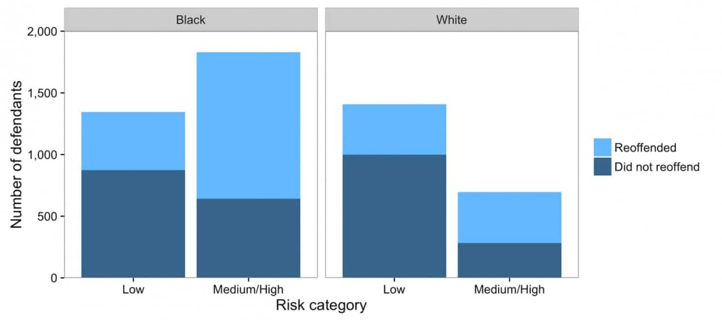
Which is fair?
Risk Score (Blacks) ≈ 2* Risk Score (Whites)
Risk Score (Blacks) = Fraction of Blacks who reoffend

Slide 6
Who is to blame?
Ads for high-paying jobs were shown more to men than to women on Google.
Advertisers (because they targeted males on purpose)
Google (because it programed the system that is prone to such results)
All males!!! (because they are more likely to click on these ads than females are)
All females!!! (because they are more likely to click on other ads causing advertisers of high-paying jobs to win fewer ad slots)
Some combination of the above.

Slide 7
Which is the most transparent?
You to your husband/wife/best friend
You to yourself
You to a smart machine

Slide 8
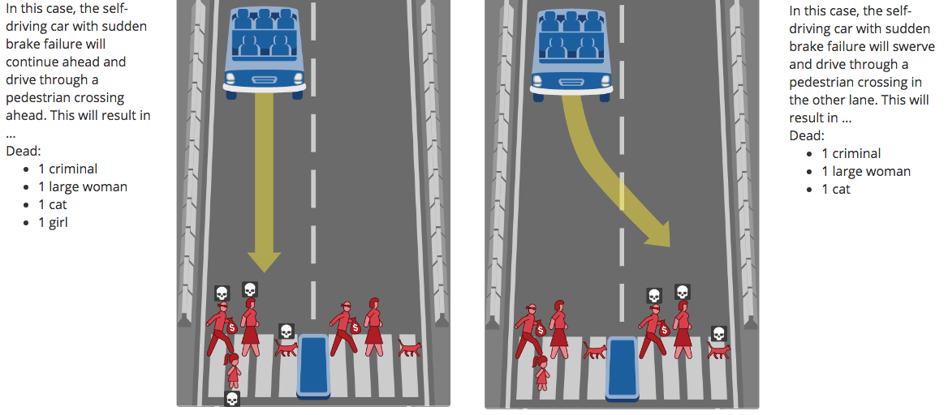
Which is more ethical?

Slide 9
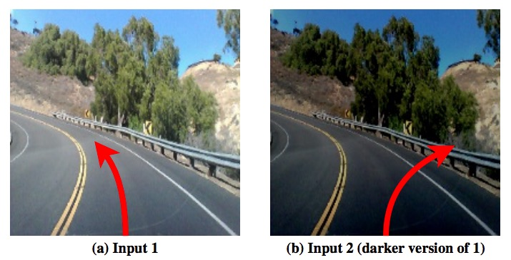
How safe are self-driving techniques right now?
An erroneous behavior found by DeepXplore in Nvidia DAVE-2 self-driving car platform.

Slide 10
FATES
Fairness
Accountability
Transparency
Ethics
Safety & Security
COMPAS & Recidivism (Washington Post)
Who to take responsibilities (RUB)
Johari Windows (WikiPedia)
Moral Machine (MIT)
Nvidia DAVE-2 (DeepXplore)
Notes:
Wing’s FATES: http://datascience.columbia.edu/FATES-Elaborated
Fairness: https://www.washingtonpost.com/news/monkey-cage/wp/2016/10/17/can-an-algorithm-be-racist-our-analysis-is-more-cautious-than-propublicas/?noredirect=on&utm_term=.92a828300581
Accountability: https://yale.qualtrics.com/jfe/form/SV_3TQAqDCjCWM1sSF?Q_JFE=qdg
Transparency: https://en.wikipedia.org/wiki/Johari_window
Ethics: http://moralmachine.mit.edu/
Safety and Security: https://arxiv.org/abs/1705.06640

