Slide 1
Group Discussion: Machine Learning Use Case
A structured approach to identifying ML opportunities

Slide 2
1. Problem / Use Case
- Predicting electricity demand
  Observed electricity shortages/blackouts
  Industrial developments (ZES)
  Infrastructure developments (Houses, Roads, Stadiums, Airport, )
  Population growth at acceleration.

Slide 3
2. Data
Variables: Data on electricity consumption and other control indicators (i.e., master plans,
Sources: REG, IREMBO data hub
Type: Tabular, text, images, audio, logs, etc.
Domain: infrastructure, industry and services

Slide 4
3. ML Task Type
Decide the type of ML task:
  Supervised: regression

Slide 5
4. Expected Output
Model or system delivery:
- Early detection of electricity demands/shortage
- Improved decision-making or prediction accuracy

Slide 6
5. Discussion Summary
Summarize your group’s findings:
• Identified problem
• Data sources
• ML task type
• Expected outcomes

Slide 7
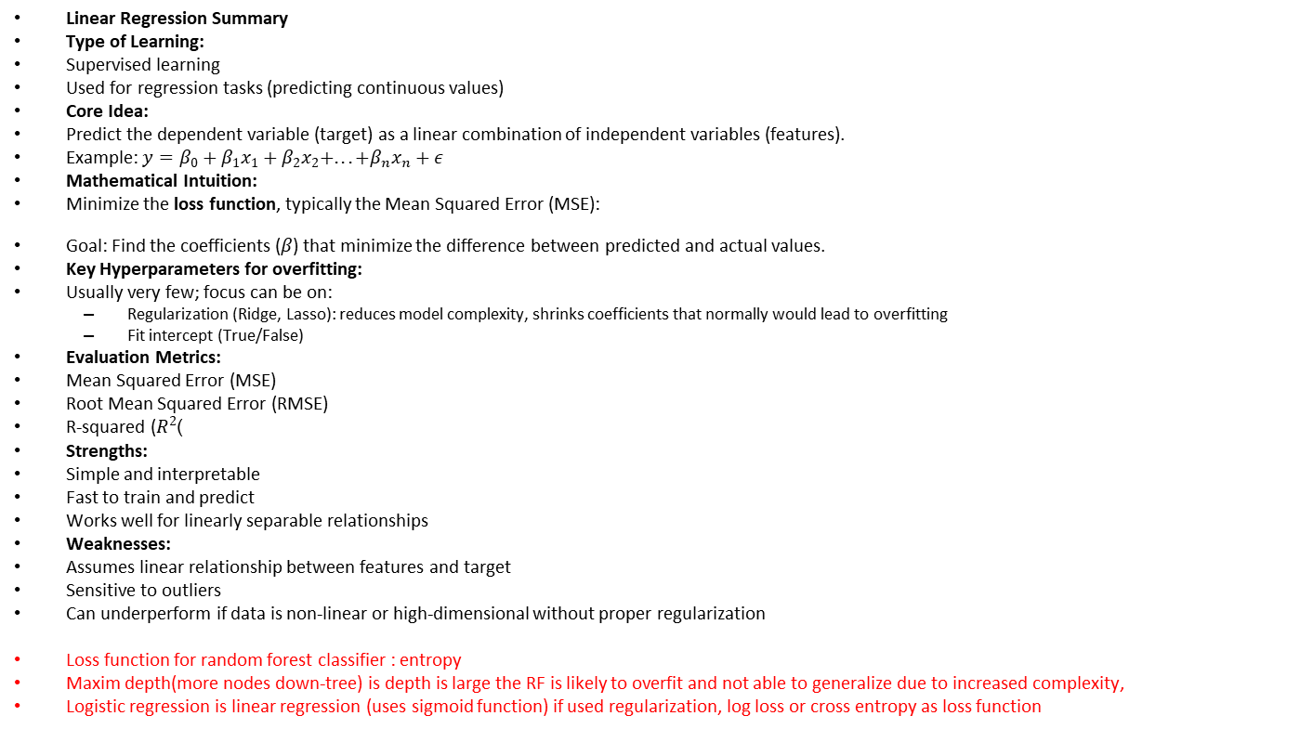
5. Discussion Summary
Linear Regression Summary
Type of Learning:
Supervised learning
Used for regression tasks (predicting continuous values)
Core Idea:
Predict the dependent variable (target) as a linear combination of independent variables (features).
Example: $y=β_{0}+β_{1}x_{1}+β_{2}x_{2}+...+β_{n}x_{n}+ε$
Mathematical Intuition:
Minimize the loss function, typically the Mean Squared Error (MSE):
Goal: Find the coefficients ($β$) that minimize the difference between predicted and actual values.
Key Hyperparameters for overfitting:
Usually very few; focus can be on:
  Regularization (Ridge, Lasso): reduces model complexity, shrinks coefficients that normally would lead to overfitting
  Fit intercept (True/False)
Evaluation Metrics:
Mean Squared Error (MSE)
Root Mean Squared Error (RMSE)
R-squared ($R^{2}$)
Strengths:
Simple and interpretable
Fast to train and predict
Works well for linearly separable relationships
Weaknesses:
Assumes linear relationship between features and target
Sensitive to outliers
Can underperform if data is non-linear or high-dimensional without proper regularization
Loss function for random forest classifier : entropy
Maxim depth(more nodes down-tree) is depth is large the RF is likely to overfit and not able to generalize due to increased complexity,
Logistic regression is linear regression (uses sigmoid function) if used regularization, log loss or cross entropy as loss function

