Slide 1


Fibromyalgia Review
Kari Bernhardt BSN RN CEN DNP-S
University of Mary
NUR 620: Care of Women & Children
Dr. Brittany Kudrna

Slide 2
What is Fibromyalgia?
Fibromyalgia syndrome (FMS) is included under rheumatologic conditions
  characterized by pain, fatigue, nonrestorative sleep, depression, headaches, and GI complaints
  waxing and waning symptom intensity
Affects 5 million Americans
  most commonly women
  ages 40-50yr old
Result of central dysregulation of unknow cause
  Enhanced sensitivity to stimuli and augmented sensory input (heat, cold, pressure)
  Abnormal pain processing that is hyperexcitable
  Central Sensitization (brain responds to pain at a lower threshold over wider areas originally involved)
  Abnormal levels of serotonin and norepinephrine
  HPA axis dysfunction that is related to stress
(Bradley, 2009; Buttaro, 2021; McCance & Huether, 2019; CDC, 2020)
Notes:
8-9X more common in women
Rarely presents in childhood
2% of all primary care visits
10% of internal medicine referrals
20% of Rheumatology referrals
Patients with FM display enhanced sensitivity to a wide array of stimuli such as heat and cold as well as mechanical and ischemic pressure. FM is characterized by an augmentation of sensory input that is mediated by CNS events similar to those associated with neuropathic pain conditions. Evidence also support abnormal levels of serotonin and norepinephrine which are key neurotransmitters in endogenous pain inhibitory pathways.
For unclear reasons some pain becomes ”louder” at the level of the spinal cord and brain – termed central sensitization
The brain responds with pain recognition at a lower threshold and over a wider areas than that originally involved

Slide 3
Disease Presentation
Core symptoms:
Generalized pain
Fatigue
Sleep disturbances
Present for at least three months and not explained by other medical condition
(Buttaro, 2021; Goldenberg, 2020a)
Notes:
The core symptoms of FM are generalized pain, fatigue, and sleep disturbances present for at least three months and not explained by any other medical condition.
Widespread musculoskeletal pain is accompanied by other somatic symptoms particularly nonrestorative sleep, cognitive difficulties, Auditory/vestibular/ocular complaints, chronic rhinitis, migraines, palpitations, irritable bowel syndrome, perceived joint swelling, and mood disorders. Physical examination reveals tenderness in multiple soft tissue anatomic location
“No matter hoe much sleep I get, I feel like I got run over by a truck”
“I feels as if I hurt all over”

Slide 4
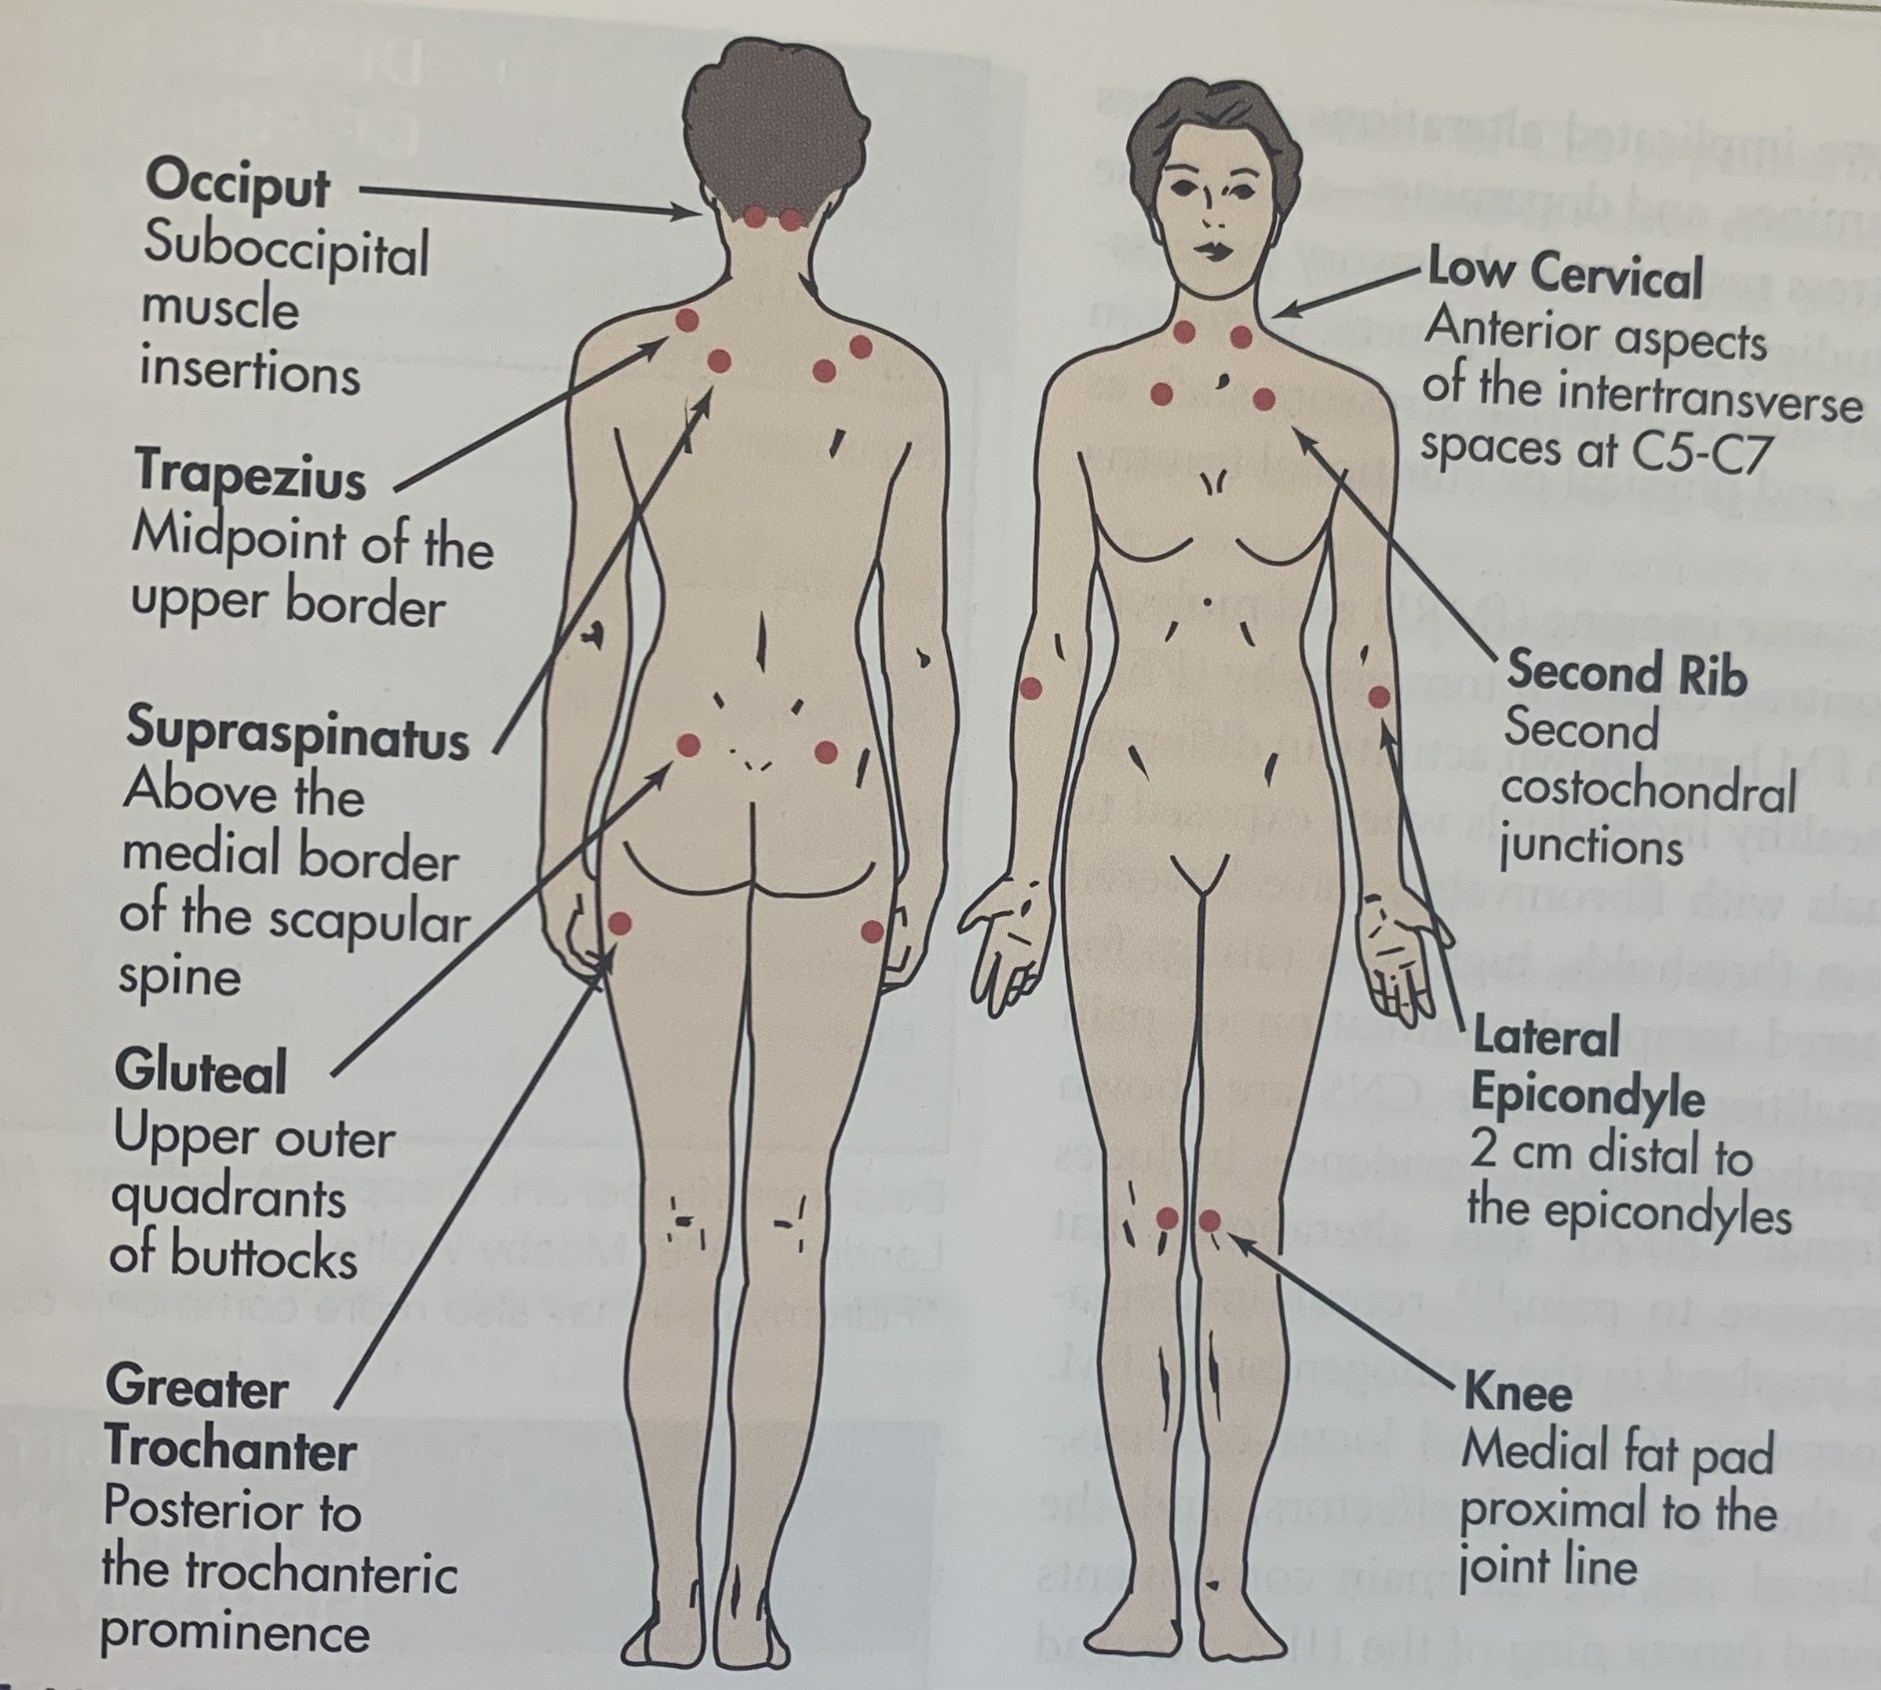
Disease Evaluation
Differential Diagnoses
  Myofascial pain syndrome
  Chronic fatigue syndrome
  Hypothyroidism
  Depression/anxiety
  Rheumatoid arthritis
  Systemic lupus
Red Flags
  Major depression (higher death rates from suicide)
  Chest pain not of musculoskeletal nature (angina)
History & Physical
  OLDCARTS
  Focused MSK exam
  Fibromyalgia Impact Questionnaire
(Buttaro, 2021; Goldenberg, 2020a; McCance & Huether, 2019;Wood, 2008)
Notes:
Differentials: Because the nonspecific symptoms of FM can mimic many other conditions.. Consideration of differential diagnosis is important
Red Flags:
chest pain not of msk nature (angina), dyspnea, severe, persistent, unrelenting pain
major depression (higher death rates from suicide)
History and Physical: an in-depth history and physical examination is necessary to reduce the need for extensive and expensive objective tests
OLDCARTs = consider FM with any musculoskeletal pain not explained by a clearly defined anatomic lesion, diffuse pain= aggravated by cold and humid weather, poor sleep, and physical or mental stress; improved by warm and dry weather, moderate physical activity, adequate sleep, and relaxation sleep
Questionnaire= assessment of physical activity and functional impairment (self administered composed of 10 items completed in 10 minutes)

Slide 5
Diagnostics & Diagnosis
No gold standard test – only used when clinically indicated
  Labs
  Imaging
  Sleep studies
Manual Tender Point Survey
  Digital palpation to 18 sites
  (+) w/ pain in at least 4-5 regions, present for 3 months
    Diagnosis valid regardless of other diagnoses
(Buttaro, 2021; Chakrabarty & Zoorob, 2007)
Notes:
Fibromyalgia can be difficult to diagnose because there’s no gold standard test like an X-ray or blood work. It is not a diagnosis of exclusion and should be identified by its own characteristics. Diagnostic testing have limited role
Manual Tender Point Survey (describes pressure application technique and precise identification of site)– moderate and consistent degree of pressure used in digital palpation using the thumb of the dominant hand on tender points (18 sites); this amount of pressure does not produce significant tenderness or pain with patient without fibromyalgia
meet widespread pain index/symptoms severity scale score, at least four or five regions, present for 3 months, dx is valid regardless of other diagnoses (does not exclude other dx)

Slide 6

Treatment
Goals: Control pain, enhance sleep, maintain function
Management:
Pharmacologic
Cognitive behavioral
Exercise
(Buttaro, 2021)
Notes:
Goal: empower patients to control their own pain, to enhance sleep, and maintain function
Management
Pharmacologic:
low dose tricyclic (amitriptyline 10mg 2-3hr before bedtime/ Cyclobenzaprine 5-10mg at bedtime)
SSRI – Prozac 20mg
SNRI – Cymbalta and savella
Others proven helpful – gabapentintin, lyrica, trazodone, ambien, acetaminophen, NSAIDs
Opioids – lacks evidence of efficacy; only use when other pharm and non-pharm have not worked
Cognitive Behavioral – coping skills, relaxation techniques, and guided imagery (multiple studies with proven efficacy)
Exercise – aerobic exercise can improve pain and has antidepressant effects; start low and go slow (stretching and yoga)
Alternative therapies – acupuncture, massage therapy, trigger point injections

Slide 7

Patient Management
Educations
    Improve patient understanding of disease and creation of partnership
Follow-up
  Ongoing management
  Educating and disease monitoring
Referral
  Refer patient who do not response to initial therapies
  Referral options
    Rheumatologist
    Pain management clinics
    Psychologist
    Physical therapist
    Chiropractor
(Arnold et al., 2021. Buttaro, 2020)
Notes:
Education: Education is imperative for improved patient understanding of fibromyalgia and the development of individual strategies to cope wit the pain, fatigue, and chronic nature of the syndrome. Educations should include management of expectation, how the patient and clinician will work together to create a partnership

Slide 8
Questions
What type of exercises/physical activity would you recommend for someone with fibromyalgia?
What are key findings that differentiate the diagnosis of fibromyalgia compared to chronic pain syndrome? Do treatments differ?
What is the suicide rate for individuals diagnosed with fibromyalgia?
Is fibromyalgia more common men or women? What age is fibromyalgia commonly diagnosed at?
Do you think there is stigma attached to the diagnosis of FM, and people are still thought to be "wimps," "depressed," or they "need to quit being lazy?'
Notes:
Many patients are reluctant to exercise for fear that it’ll aggravate symptoms; research does show that regular moderate exercise lessens pain and improves function
Regular aerobic exercise improves pain, function, and overall quality of life; start low and go slow to avoid flaring up … do not do too much on good days – this will cause more bad days
Flexibility exercises – reduce stiffness and improve range of motion
Strengthening exercises - supports joints and reduce fatigue
Aerobic - walking, biking, swimming
The symptoms overlap and both are hard to dx/differentiate but they can co-exist and fibro can lead to chronic pain syndrome; treatments are similar (anti-inflammatories, antidepressants; behavioral therapy; biofeedback; alternative therapies like acupuncture and yoga)
Fibromyalgia - often arises without a cause; x-rays wont should tissue or nerve damage which might be seen with chronic pain syndrome; widespread msk pain WITH fatigue, cognitive difficulties and others s/s (HA, depression, RLS)
Chronic pain – usually an identifiable trigger like arthritis or an injury; remains active for 12 weeks can be mild or serve, episodic or continuous, a minor inconvenience or complete debilitating
Suicide Rate –higher rates of psychiatric illness; women with chronic pain are 8-10 times higher risk for suicide than the general population
More common in women diagnosed in their 40s-50s
high anxiety, maladaptive coping strategies, altered pain behavior response, higher rates of depression, as well as alterations of the CNS and the hormonal effects of the menstrual cycle.
Almost 28% of physicians who treat fibromyalgia patients don’t take it as a legitimate disease.
As you have stated patients often spend years looking for the correct diagnosis for their symptoms. Often fibromyalgia is benign in nature and patients may feel the symptoms they are experiencing are “in their head”

Slide 9
References
Arnold, L. M., Clauw, D. J., Dunegan, L., & Turk, D. C. (2012). A framework for fibromyalgia management for primary care providers. Mayo Clinic Proceedings, 87(5), 488–496. https://doi.org/10.1016/j.mayocp.2012.02.010
Bradley, L. A. (2009). Pathophysiology of Fibromyalgia. The American Journal of Medicine, 122(12), S22–S30.doi:10.1016/j.amjmed.2009.09.008
Buttaro, T. M., Polgar-Bailey, P., Sandberg-Cook, J., Trybulski, J., & Distler, J. (2021). Primary care interprofessional collaborative practice (6th ed.). Elsevier.
Centers for Disease Control and Prevention. (2020, August 4). Fibromyalgia. https://www.cdc.gov/arthritis/basics/fibromyalgia.htm
Chakrabarty, S., & Zoorob, R. (2007, July 15). Fibromyalgia. American Family Physician. https://www.aafp.org/afp/2007/0715/p247.html
Goebel, A., Krock, E., Gentry, C., Israel, M. R., Jurczak, A., Urbina, C., Sandor, K., Vastani, N., Maurer, M., Cuhadar, U., Sensi, S., Nomura, Y., Menezes, J., Baharpoor, A., Brieskorn, L., Sandström, A., Tour, J., Kadetoff, D., Haglund, L.,...Andersson, D. A. (2021). Passive transfer of fibromyalgia symptoms from patients to mice. Journal of Clinical Investigation, 131(13). https://doi.org/10.1172/jci144201
Goldenberg, D. L. (2020a). Clinical manifestations and diagnosis of fibromyalgia in adults (P. H. Schur & P. L. Romain, Eds.). UpToDate. https://www.uptodate.com/contents/clinical-manifestations-and-diagnosis-of-fibromyalgia-in-adults
Goldenberg, D. L. (2020b). Treatment of fibromyalgia in adults not responsive to initial therapies (P. H. Schur & P. L. Romain, Eds.). UpToDate. https://www.uptodate.com/contents/treatment-of-fibromyalgia-in-adults-not-responsive-to-initial-therapies
McCance, K. L., & Huether, S. E. (2019). Pathophysiology: The biological basis for disease in adults and children (8th ed.). Elsevier .
Wood, P. B. (2008, January). Symptoms, diagnosis, and treatment of fibromyalgia [PDF]. American Medical Association Journal of Ethics. https://journalofethics.ama-assn.org/sites/journalofethics.ama-assn.org/files/2018-06/cprl1-0801.pdf

