Slide 1

MICROSOFT FABRIC · DATA SECURITY
Customer-Managed Keys
in Microsoft Fabric
What It Actually Does (and Doesn't)
A 60-minute session for data engineers — with a live demo
Karianne Kies

Slide 2


Slide 3




THE NEWS HOOK
Everyone's nervous about who can reach your data
One month ago, the EU proposed the Cloud and AI Development Act, or CADA, to reduce reliance on foreign tech giants.
2
New datacenters in Europe
Four Sovereignty Levels
Will CMK in Fabric help us obey the rules?
The act aims to triple the number of data centers inside Europe over the next 5 to 7 years.
Level 1 is a self-assessed cybersecurity baseline. Level 4 demands full EU ownership, EU-cleared staff, and third-party audits.
And in which cases?
Sources: European Commission, Cloud and AI Development Act proposal (3 Jun 2026) · EU Cloud Sovereignty Framework / SEAL · ENISA, EUCS cloud services scheme.
Customer-Managed Keys in Microsoft Fabric

Slide 4





AGENDA
Where we're headed in 60 minutes
Encryption in Fabric by default
01
BYOK vs CMK
02
Why your data is already protected
Two mechanisms, one strategy — the core confusion
What CMK actually does
03
Live demo
04
Ownership, control, the kill switch
Enable CMK on a workspace + revoke a key
What CMK does NOT do
05
Do you actually need it?
06
The honest payoff of the title
A practical decision frame
Customer-Managed Keys in Microsoft Fabric
3

Slide 5



THE BASELINE
Fabric already encrypts everything
Data encryption is the process of converting readable information into an unreadable code to prevent unauthorized access. Only users with the correct digital key can decode and view the original data.
Data at Rest (Stored Data)
Myth
Fabric automatically scrambles all stored data using AES-256 encryption, keeping it safe by default with Microsoft-managed keys.
"CMK is what finally encrypts my data."
Not true. Your data was already encrypted by default
Data in Transit (Moving Data)
All information moving across networks is funneled through secure TLS tunnels, preventing unauthorized interception during transit.
Customer-Managed Keys in Microsoft Fabric
4
Notes:
AES-256 stands for Advanced Encryption Standard with a 256-bit key length AES-256 secures the data content itself like a locked vault, whereas TLS secures the entire communication channel to protect the journey, hide metadata, and verify that you are connecting to the legitimate Microsoft server.

Slide 6

THE CORE DISTINCTION
BYOK vs CMK: two mechanisms
They don't compete — they complement. Different levels, different data.
 | BYOK | CMK (workspace)
What it protects | Power BI semantic models | Other Fabric items (Warehouse, Notebooks, SQL DB…)
Level | Capacity level | Workspace level
Origin | Power BI Premium feature | Fabric feature
Generally available | February 2020 | October 2025
Key storage | Azure Key Vault | Azure Key Vault or Managed HSM
Configured via | PowerShell admin cmdlets | Fabric portal (workspace settings)
Hold this boundary in mind: CMK does not cover semantic models.
Customer-Managed Keys in Microsoft Fabric
5

Slide 7



A COMMON QUESTION
Wait — why aren't they both “BYOK”?
Technically CMK is a form of “bring your own key.” The different names are history, not hard tech.
Different eras,
different teams
The industry shifted
Different names aid clarity
“BYOK” was Power BI's 2020 name. “CMK” is the term Azure uses across all its services. Fabric followed the Azure convention.
“CMK” became the de-facto standard term. “BYOK” now more often means importing a key you generated yourself.
With two mechanisms side by side, distinct names disambiguate which layer you mean. Same name would be chaos.
The irony: In Microsoft’s Fabric updates blog, they used the title “Workspace Customer-Managed Keys for BYOK in Microsoft Fabric (Preview)” Both terms in one title. The distinction is organizational and historical, not a hard technical line.
Customer-Managed Keys in Microsoft Fabric
6

Slide 8

WHAT IT ACTUALLY DOES
Three things CMK gives you
Key lifecycle & rotation
Granular access control
Auditability
You create, own and rotate keys in Azure Key Vault or Managed HSM.
Key Vault Crypto Service Encryption User role can get, wrap & unwrap only, never full key access.
Key Vault logs every use, a concrete, demonstrable audit trail.
The kill switch: revoke the key in Key Vault and access to the workspace is blocked within ~1 hour. Disable CMK and the workspace simply reverts to Microsoft-managed keys.
Covered today: All data in OneLake : via Lakehouse, Warehouse, Notebooks, SQL Database and 10+ more items (GA); Eventhouse (preview).
Recent win: CMK now works in BYOK-enabled capacities — no separate capacities needed (preview).
Customer-Managed Keys in Microsoft Fabric
7

Slide 9

FOR MAXIMUM ASSURANCE
Two independent axes (and what MHSM is)
AXIS 1 · Mechanism →
What is Managed HSM?
AXIS 2 · Key storage
BYOK + Key Vault
CMK + Key Vault
A dedicated, single-tenant pool of hardware security modules vs Key Vault, where keys are software-protected (Standard) or HSM-protected but shared across tenants (Premium).
Dedicated & single-tenant
FIPS 140-3 Level 3 validated
Hardware-backed key isolation
Semantic models, standard vault
Fabric items, standard vault
BYOK + Managed HSM
CMK + Managed HSM
Semantic models, hardware HSM
Fabric items, hardware HSM
Choose MHSM when strict compliance demands hardware-backed, FIPS-validated key storage.
All four combinations are valid. MHSM is a property of key storage — not a third option beside BYOK and CMK.
Customer-Managed Keys in Microsoft Fabric
8

Slide 10


THE TRUST MODEL
But does the key live inside Microsoft?
Yes, the hardware is Microsoft's
But the key is out of their reach
Runs in Microsoft datacenters
Microsoft patches & maintains the machines
“Managed” means they manage the hardware
You don't host a physical device
On an HSM-backed tier, keys are generated & kept inside FIPS-validated hardware — they never leave in plaintext
Microsoft operators have no data-plane access to your key material
Each Key Vault or Managed HSM is yours alone — MHSM adds a customer-owned security domain for extra isolation
You can revoke at any time
The accurate framing: the key sits in Microsoft's hardware, but is designed so Microsoft can't operationally reach it and you can pull the plug. CMK shifts the trust model; it doesn't remove Microsoft from the chain, the exact gap EUCS’s “high” tier tests for, and that gap narrows most on an HSM-backed tier.
Customer-Managed Keys in Microsoft Fabric
9

Slide 11
~12 MINUTES
Enabling CMK on a workspace
1
Start point A workspace on MMK — our baseline
2
The key in Azure Key Vault Your resource, your RBAC — tie back to the envelope
LIVE
DEMO
3
Enable CMK Workspace settings → select the key (the core action)
4
Show the boundary An unsupported item is blocked in a CMK workspace
5
The kill switch Revoke the key → blocked state (shown live, revoked in advance)
Customer-Managed Keys in Microsoft Fabric
10

Slide 12
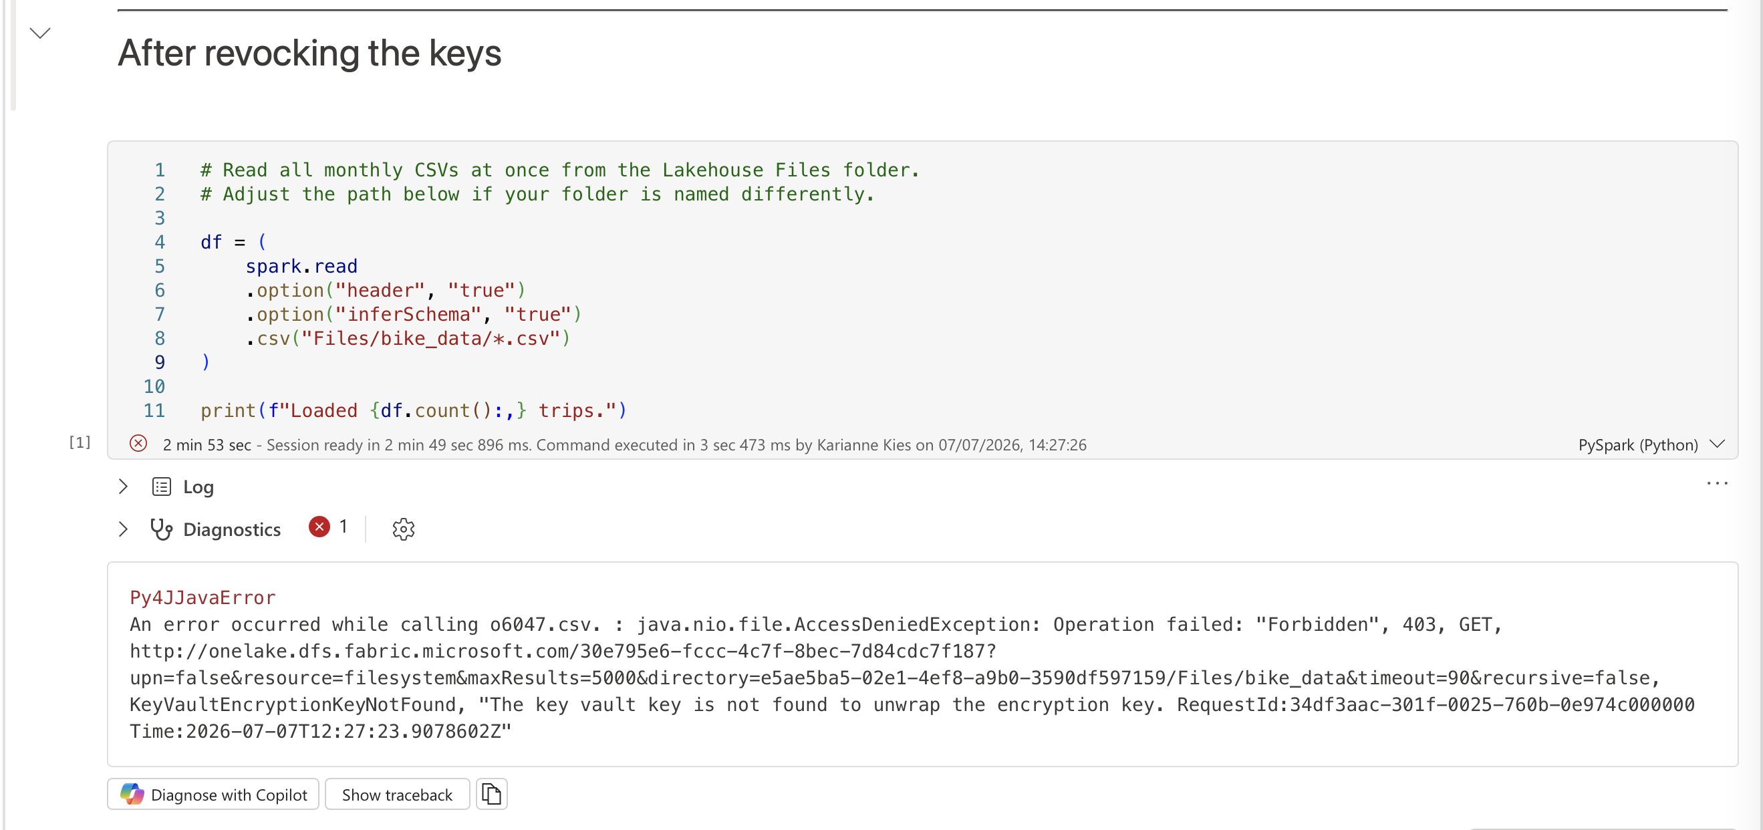
THE KILL SWITCH, CONFIRMED
This is what “blocked” actually looks like
Workspace A, revoked days earlier — a live notebook run against Fabric, not a recording.
KeyVaultEncryptionKeyNotFound — “the key vault key is not found to unwrap the encryption key.”
Customer-Managed Keys in Microsoft Fabric
11

Slide 13
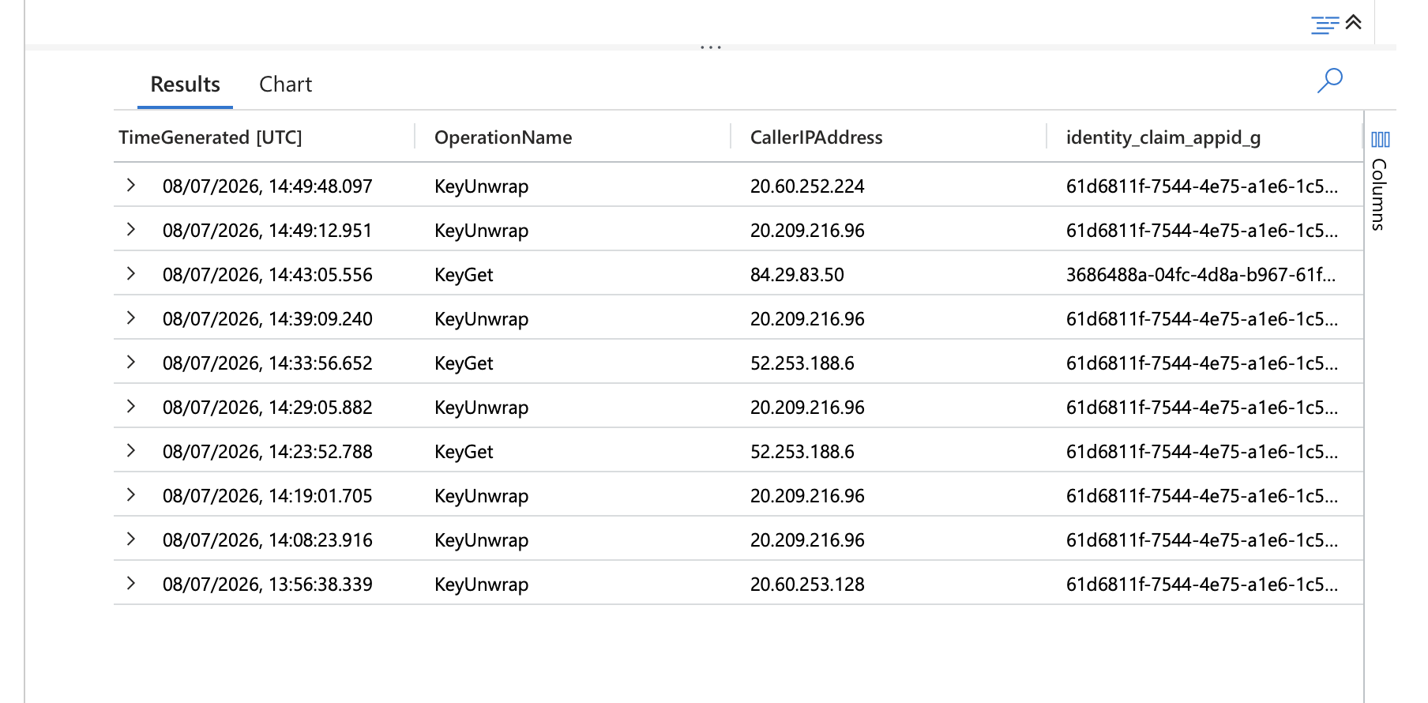
PROOF OF USE, NOT PROOF OF WHO
The log confirms use — not who, or which workspace
KQL QUERY USED IN LOG ANALYTICS
AzureDiagnostics
| where ResourceProvider == "MICROSOFT.KEYVAULT"
| where OperationName in ("KeyGet", "KeyUnwrap", "KeyWrap")
| project TimeGenerated, OperationName, CallerIPAddress, identity_claim_appid_g
| order by TimeGenerated desc
Every automated KeyUnwrap/KeyGet call shares the same identity_claim_appid_g:
61d6811f-7544-4e75… — Fabric’s shared “Fabric Platform CMK” app. It proves the key was used, not by which workspace or user.
Customer-Managed Keys in Microsoft Fabric
12

Slide 14

WHAT IT DOES NOT DO
The honest limits
No semantic models
Not all data
CMK does not cover Power BI semantic models. That still needs BYOK. The #1 confusion.
Lakehouse column names, table format and table compression fall outside CMK.
Workspace constraints
Operational edges
Can't enable CMK on a workspace with unsupported items; only supported items can be created in one.
SQL Database won't auto-revalidate the key — manual step.
Myth: “With CMK, Microsoft can't touch my data.” Reality: the key lives in Microsoft's hardware (even MHSM), but built so they can't operationally reach it and a lost or revoked key means inaccessible data. CMK shifts an operational burden onto your team.
Customer-Managed Keys in Microsoft Fabric
13

Slide 15


BEFORE YOU TRY IT
It needs a real (paid) capacity
The 60-day trial won't work
F2 pay-as-you-go
€0.42
CMK is supported on all F SKUs — but trial capacities can't be used for CMK encryption. You need a real F-SKU (from F2).
per hour
Billed per second, 1-minute minimum. Pause anytime — no time limit, no compute charge while paused.
The demo budget plan
Spin up an F2 (pick an available region — e.g. Sweden Central), stage two workspaces, pause between practice runs
Set an Azure budget alert (e.g. €10) via Cost Management as a safety net
Show it live during the talk; delete the capacity + Key Vault afterward
under
€5
total
Customer-Managed Keys in Microsoft Fabric
14

Slide 16
REAL USE CASES
Where it earns its operational cost
1
Incident response
2
Vendor & tenant offboarding
Suspected breach? Revoke the key and every read/write fails within the hour, even for Microsoft's own operators. False alarm? Restore access, nothing lost.
Give each customer or contractor its own workspace and key. When the relationship ends, revoke that one key, guaranteed cutoff, no hunting for copies.
3
M&A and divestiture
4
Provable control for regulators
Selling a business unit or splitting a joint venture? A dedicated key per workspace proves, at separation, the other side can no longer read that data.
Finance (DORA), government (EUCS “high”), healthcare: auditors increasingly want to see that you, not Microsoft, hold the keys, and that revocation actually works.
The common thread: none of this is about everyday performance, it's about having a credible, technical answer ready for the one day you need to cut off access permanently and provably.
Customer-Managed Keys in Microsoft Fabric
15

Slide 17
THE DECISION
Do you actually need CMK?
For most teams: MMK is fine
Three-question checklist
1
Do you have the regulatory requirement?
Default Microsoft-managed encryption already meets the bar for the majority of workloads.
A real mandate — not a nice-to-have
2
Do you have an F-SKU capacity?
CMK pays off when…
Paid, dedicated — no trial
your organization has a clear scenario for using CMKs
3
Do you have a team to run Key Vault?
Availability, rotation, revocation discipline
No clear “yes” to all three? You probably don't need CMK.
Customer-Managed Keys in Microsoft Fabric
16

Slide 18

IN SHORT
Does & Doesn't
DOES: give you ownership, rotation, auditability and a revocation kill switch for Fabric workspace data.
DOESN'T: cover semantic models, protect every byte, remove Microsoft from the chain, or run on a trial.
Thank you
Docs: learn.microsoft.com/fabric/security/workspace-customer-managed-keys
Back to Brussels: you now know exactly what CMK promises about control and where that promise runs out.

Slide 19
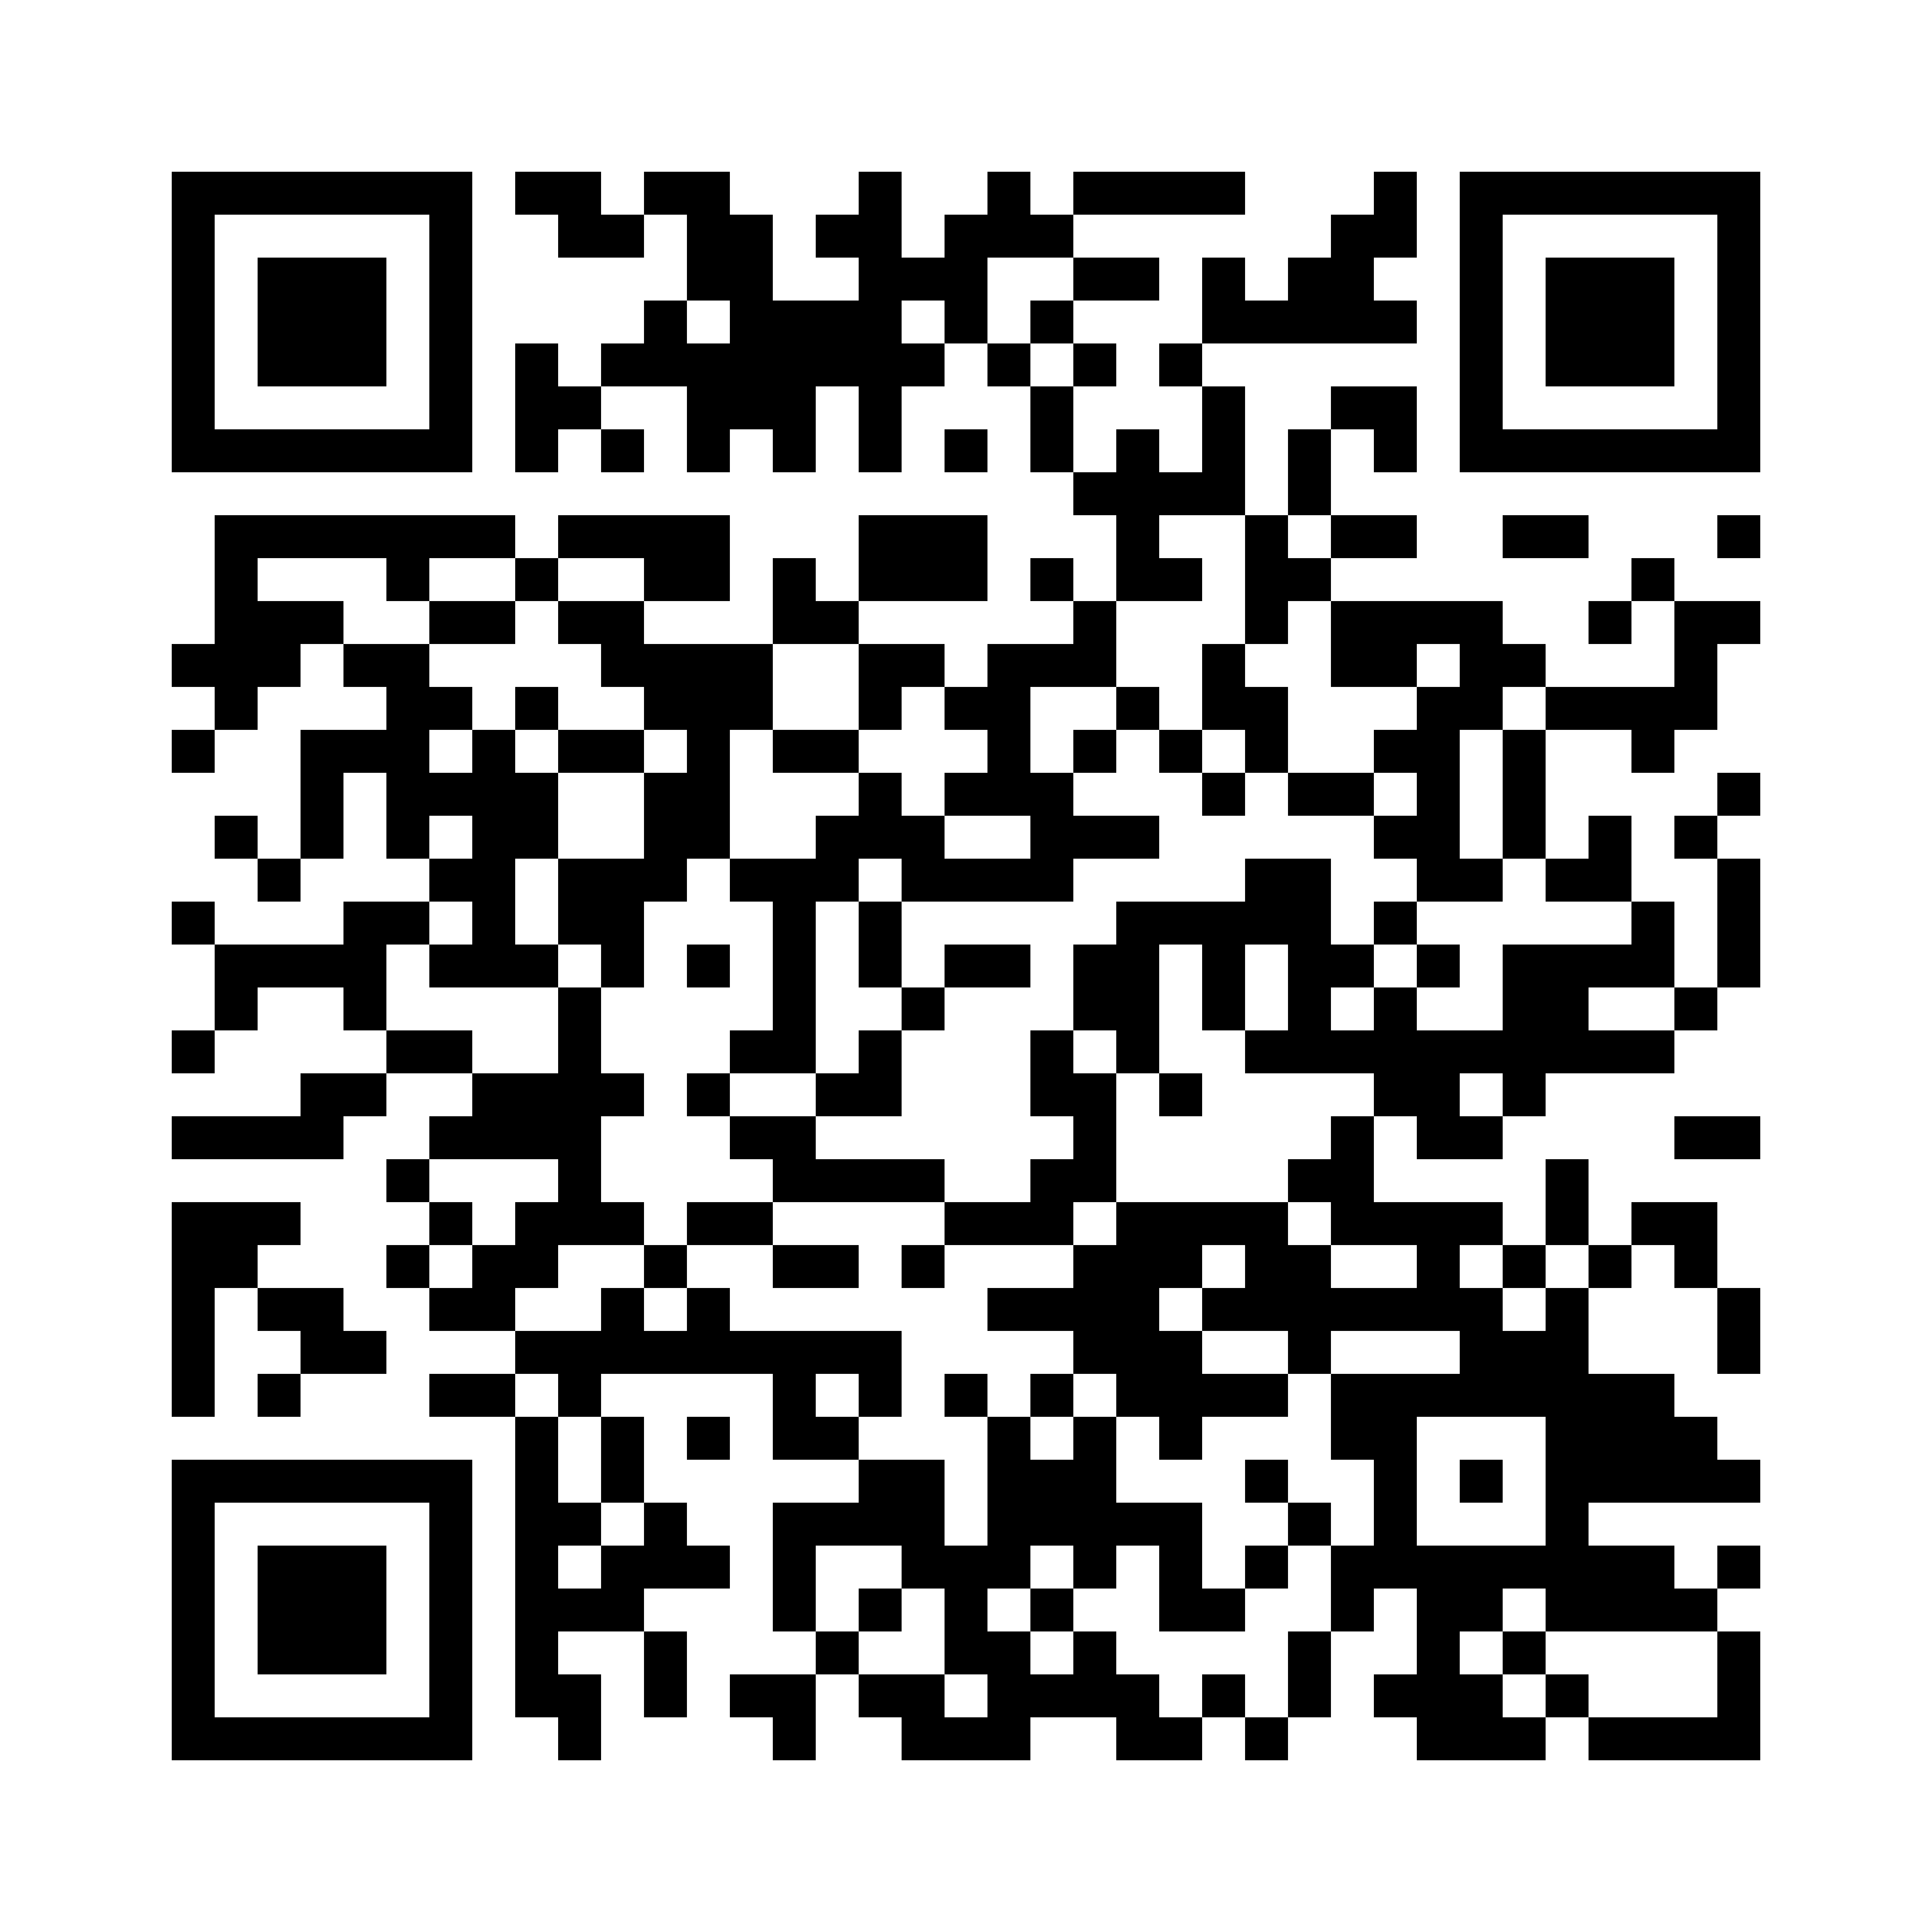

THANK YOU
Two quick things before you go
Give me feedback
Find all material of today on my GitHub
Scan to tell me what worked (and what didn't).
Scan for the demo notebook, setup guide, and scripts.
Customer-Managed Keys in Microsoft Fabric
18

