Slide 1
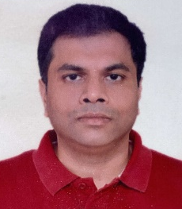
Sumit Agarwal
Cloud Architect
Career
CapGemini, Pune, India
Exela Technologies, Pune, India
Entytle India Pvt Ltd, Pune India
Prodash Technologies, Pune, India
Infosys Technologies, Pune, India
Skills
Languages – Java, PHP
Versioning Tool – GitLab, CodeCommit
IDE – Eclipse, visual Code
Cloud – AWS, Azure
DevOps Tool - TerraForm
Grade:
D2
City:
Pune
Email:
sumit.b.agarwal@capgemini.com
Mobile:
+91-7030359319
Sumit is an Agile Product guy with more than 20 years of experience on enterprise level products and larger applications & systems, such as Windchill (by PTC, in PLM domain), eGain Service 7 (by eGain Communications, in CRM domain) and DMR (by Exela Technologies). He takes pride in hands on coding and mentoring the large delivery teams covering all the facets like gap analysis, architectural & solution design, estimation, planning, implementations, monitoring, support etc. He has deep understanding of New-Age Technologies with hands-on expertise on Cloud Computing & Full Stack. A firm believer of Agile methodology, and a certified SCRUM Master.
8+ years exp in designing and developing SaaS applications
6+ years exp as cloud architect
Implemented SCRUM and DevOps practices on unit level
Handled large team upto 30 resources
Application Implementation for large clients with 80K users

