Slide 1


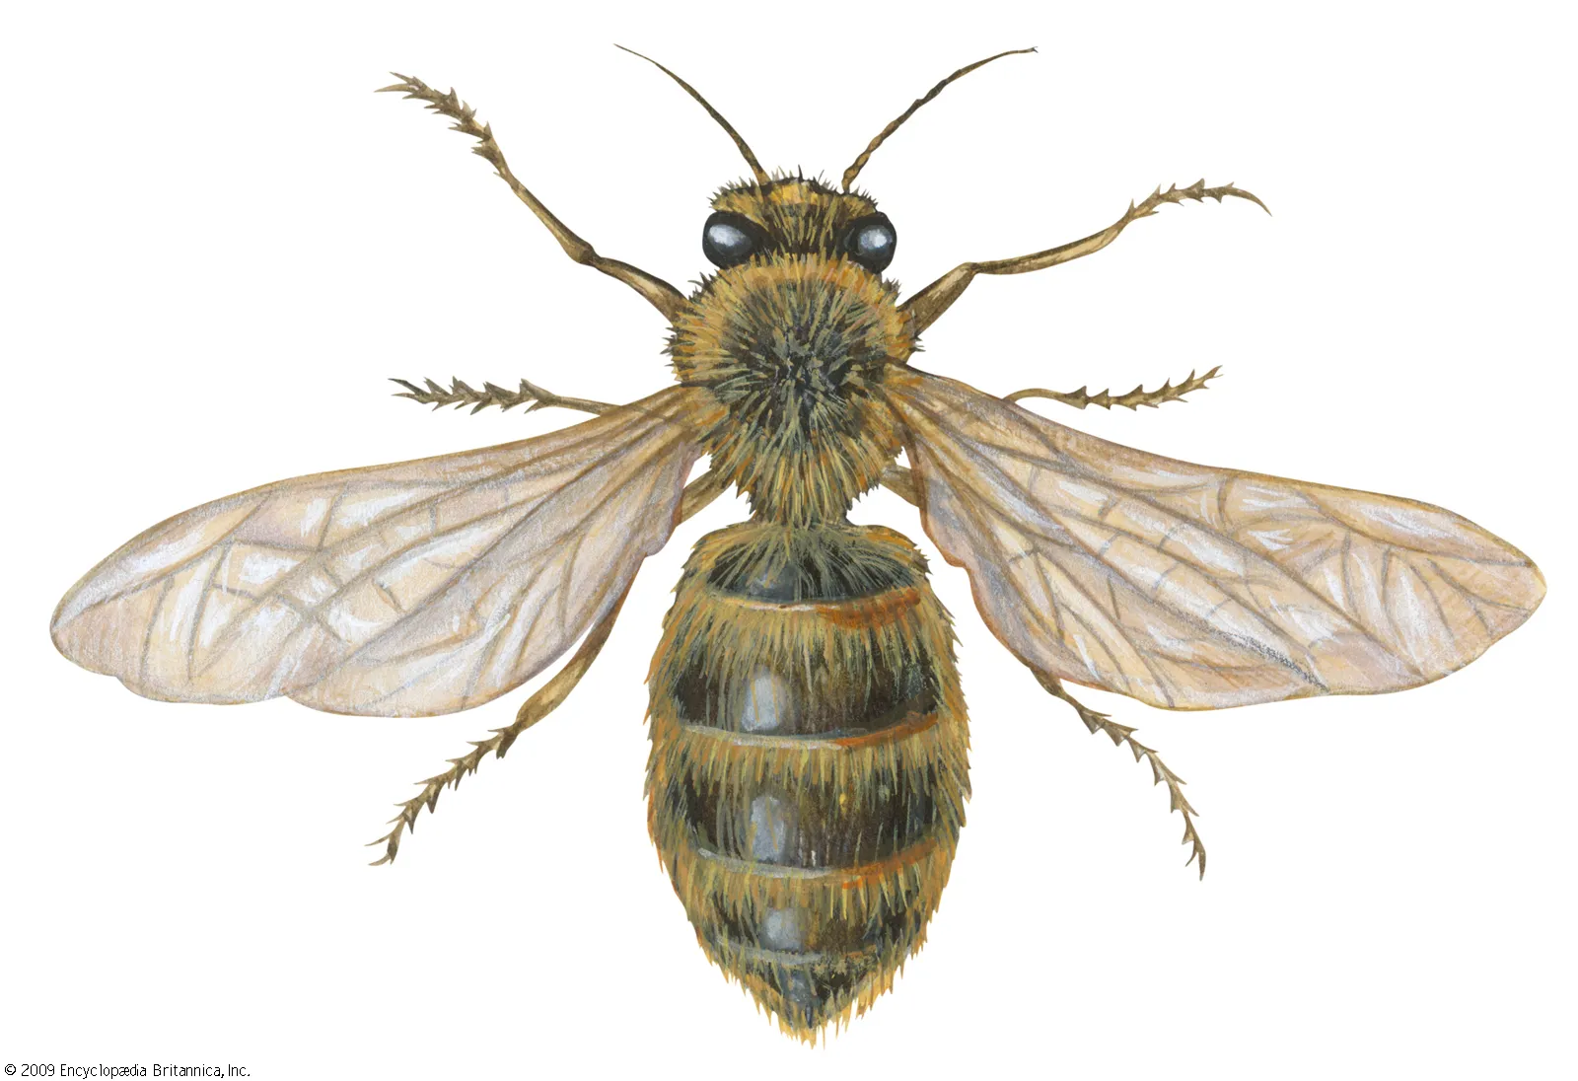


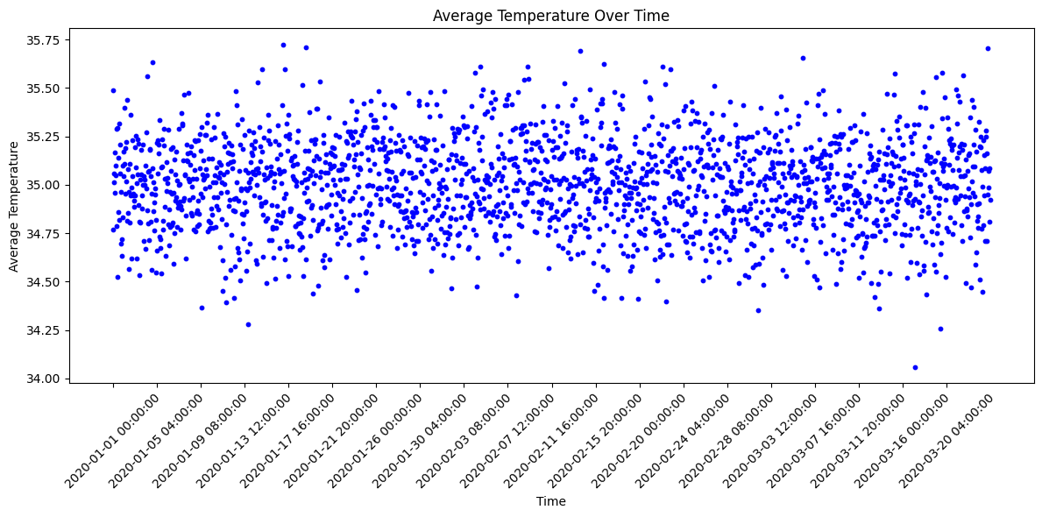
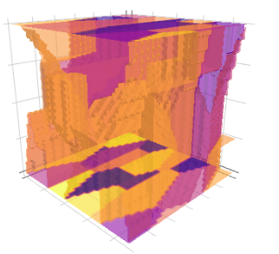

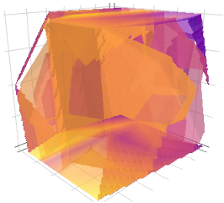
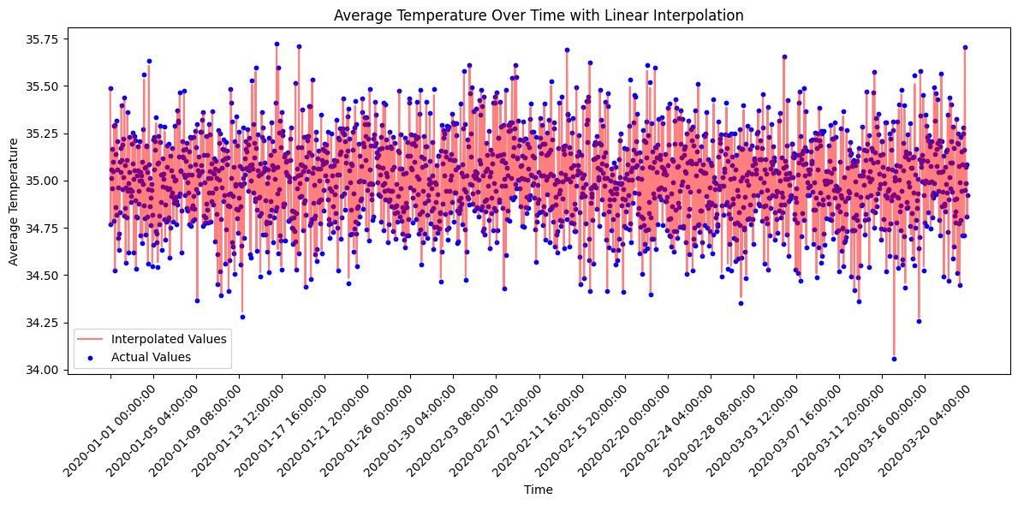
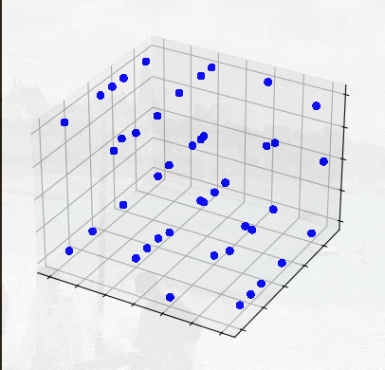



A Preliminary Study on 3D temperature Simulation and Visualization for Beehives
KENNETT PUERTO, RYNE MERRITT (Undergraduate Research Assistants)
Dr. THOMAS WEBSTER, Dr. CHI SHEN (College of Agriculture, Community, and the Sciences)
To gain a better understanding of colony behaviors, it is essential to acquire a comprehensive knowledge of various aspects. This knowledge spans a wide range of factors, including moisture levels, foraging times, colony size, and colony temperature. This work will focus on the visualization and simulation of colony temperature
We decided that a linear interpolation method gave better feedback and prediction for the empty space that was between the sensors. We should be able to predict what happened in between the empty space.
We have two 3D isograph which show us the temperature inside of a beehive. The left one is using linear interpolation. The right one is nearest neighbor interpolation. The temperature shown was collected through emulated data. From a series of 3x5x2 grid of sensors.
We could link our model to a weather API and predict the temperature on our environment with it. This is just a start to what can be a great machine learning model and monitoring system for the care of bees. This could also work as the foundation for better building apiaries as we could determine what work better for temperature insulation.
$$f\left(x,y,z\right)=Σ_{i}a_{i}f\left(x_{\dot{i}},y_{i},z_{i}\right)$$
$$a_{i}=\frac{1}{ⅆ_{i}}$$
$$ⅆ_{i}=\sqrt{{\left(x−x_{i}\right)}^{2}+{\left(y−y_{i}\right)}^{2}+{\left(z−z_{\dot{l}}\right)}^{2}}$$

