Slide 1

KariGhar
Connecting Labourers with Recruiters

Slide 2
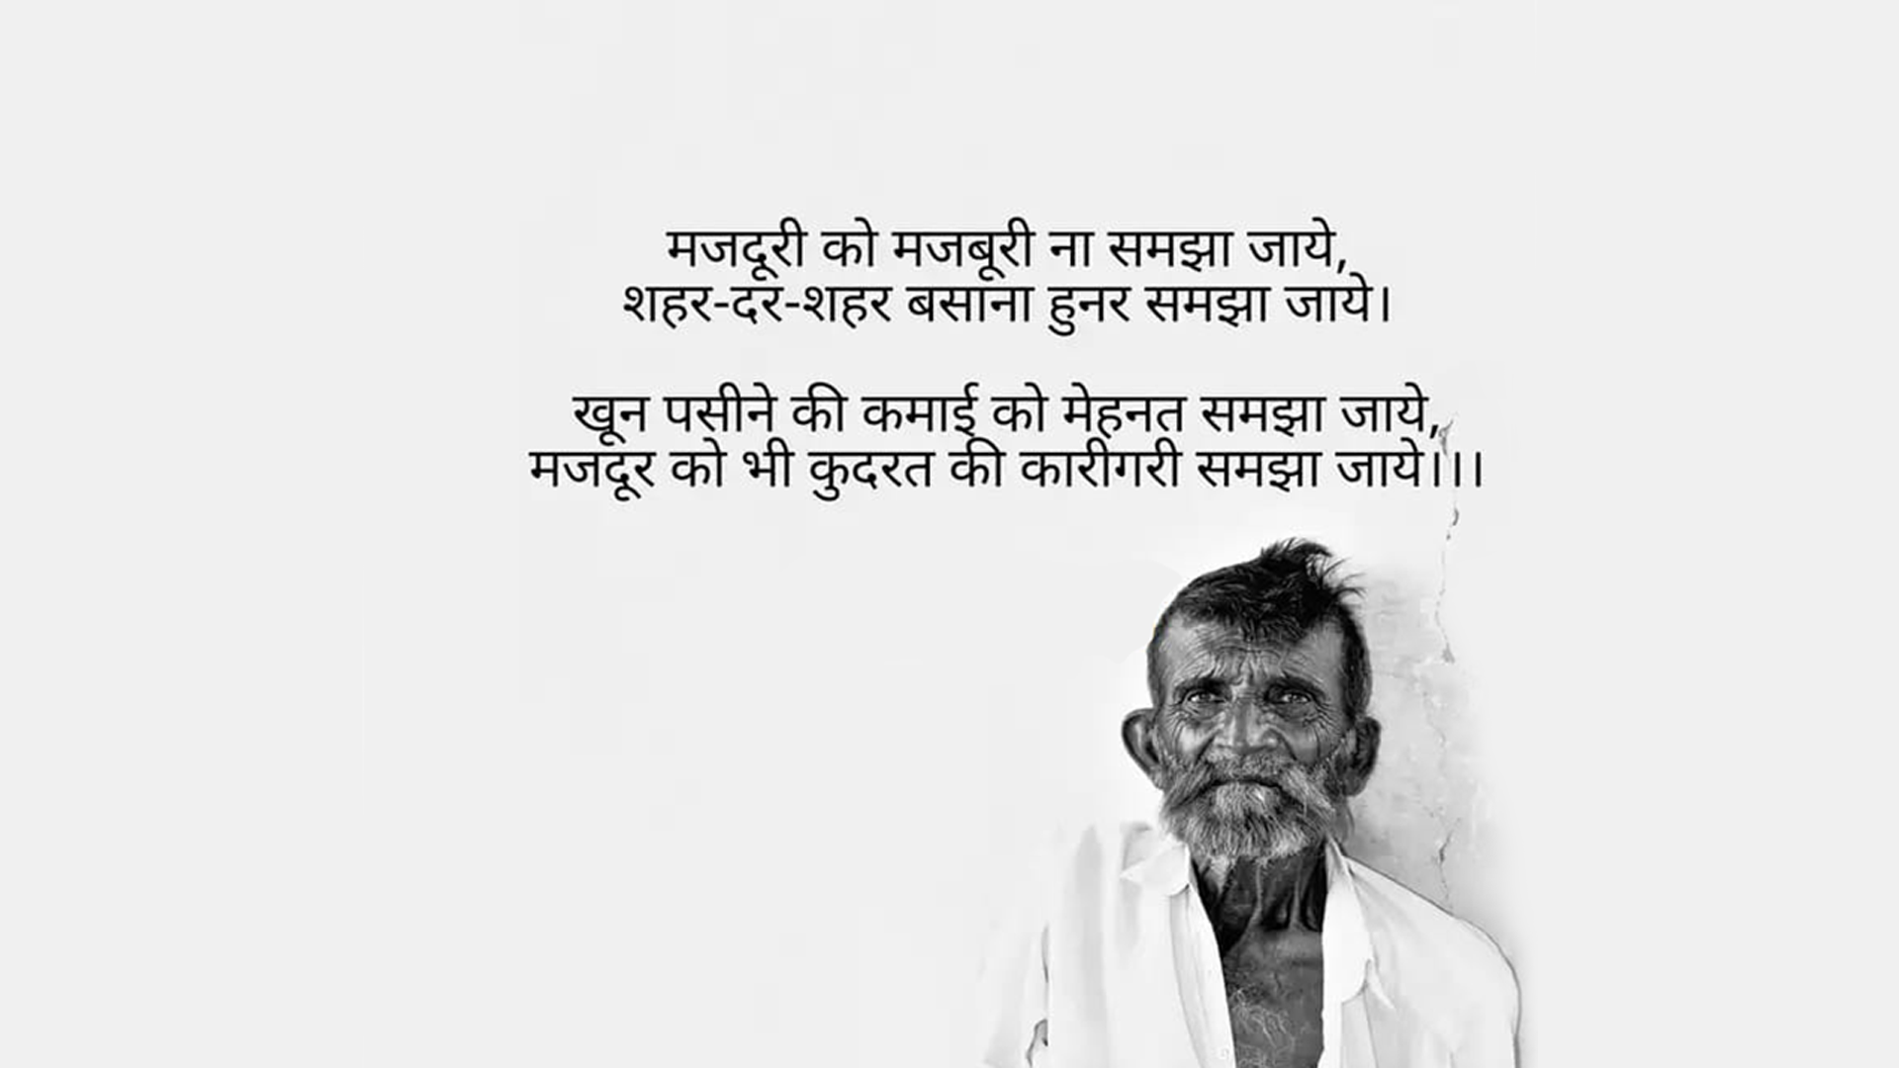

Slide 3

Overview
As we consider the present scenario, there are around 501 million workers in India, second largest after China and approximately 27% are engaged in industrial sector.
The Largest Problem which the construction industry in respect of the labours face is the security of jobs.

Slide 4
Problems
The problems faced by contract labourers within the industry and society are discussed in these slides

Slide 5
Problems
Contract labourers face various problems within the industry and society, such problems are listed below.
1. The exploitation of contract labourers is one of the
biggest concerns of the government.
2. Working hours are frequently longer as pay is
based on output and task completion.

Slide 6
Problems
3. Contract labourers are generally from the poorer
sections of society and will be denied the benefits
that regular employees receive.
4. Contract labourers have little bargaining power,
no social security, and are frequently employed in
hazardous industries with limited facilities and
security.

Slide 7


Slide 8


Slide 9

Solution
KariGhar is a platform that fulfils the requirements of labour in search for work opportunities in their skilled areas without being exploited by the contractor.

Slide 10
We are India’s Only Platform to do so.

Slide 11
Features
The features of our business and platform are discussed in these slides

Slide 12
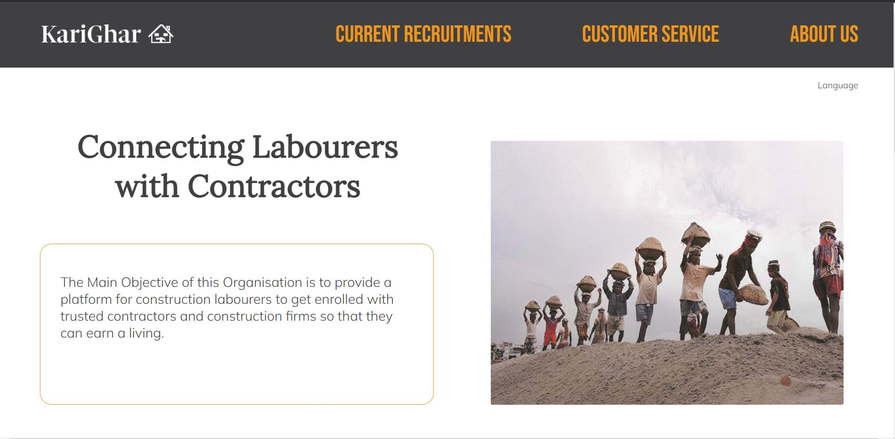
URL : karighar.cf

Slide 13
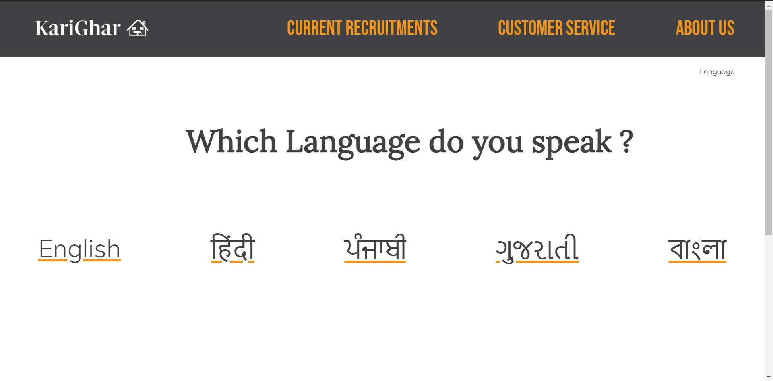

Slide 14

Simple UI Design
The user interface will be simple and available in all recognised local languages so that it can be easily used by the majority of workers. Karighar will provide a list of available jobs and notify workers through SMS according to the category filled at the time of profile building.

Slide 15




Target Audience
Factory Owners
Labourers
Contractors

Slide 16
Marketing
Our marketing approach is discussed in the following slides

Slide 17

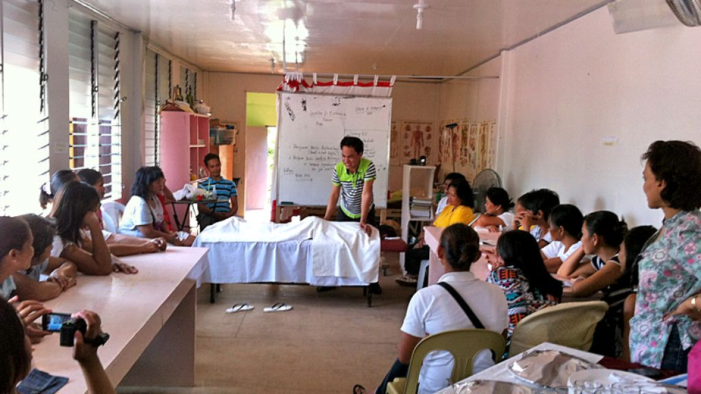
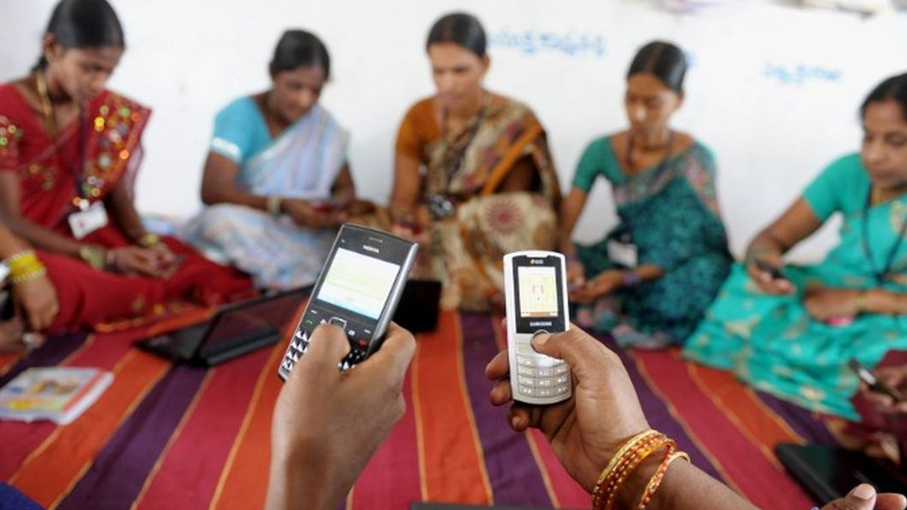
Marketing
At the initial stage, the main work would be to collaborate with all the labour unions and make them aware through various education seminar and programmes to provide information about KariGhar to labourers.

Slide 18
Sustainable
Development Goals
Our Sustainable Development Goals are
discussed in the following slides.

Slide 19

Decent Work and Economic Growth
Sustainable Development Goal 8 is about
"decent work and economic growth" and is one of the 17 Sustainable Development Goals which were established by the United Nations General Assembly in 2015.
SDG 8 aims at ensuring the economic sector of every country provides the necessary need for its citizen to have a good life irrespective of their background, race or culture.

Slide 20

Industry, Innovation and infrastructure
Sustainable Development Goal 9 is about "industry, innovation and infrastructure" and is one of the 17 Sustainable Development Goals.
SDG 9 aims to build resilient infrastructure, promote sustainable industrialization and foster innovation.

Slide 21
Revenue
Model
Our Revenue model and earning process is discussed and illustrated in the following slides.

Slide 22
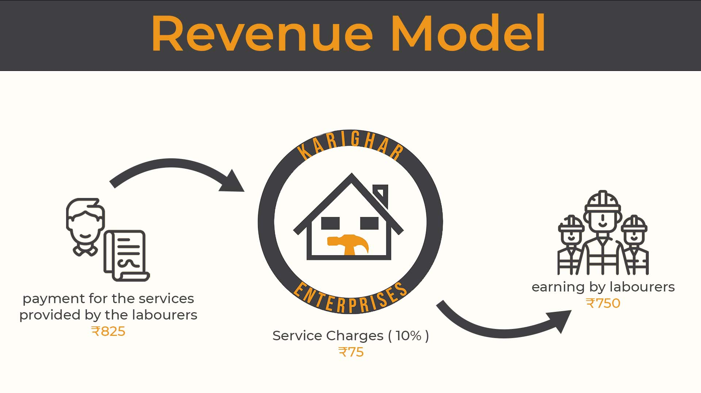

Slide 23
Thank You

