Slide 1
Design and Analysis of Algorithms
DAA - Unit - I Presentation Slides

Slide 2
Design & Analysis of Algorithms
Algorithm analysis
Analysis of resource usage of given algorithms (time , space)
Efficient algorithms
Algorithms that make an efficient usage of resources
Algorithm design
Methods for designing efficient algorithms
DAA - Unit - I Presentation Slides

Slide 3
Design & Analysis of Algorithms
"algos" = Greek word for pain.
"algor" = Latin word for to be cold.
Why study this subject?
Efficient algorithms lead to efficient programs.
Efficient programs sell better.
Efficient programs make better use of hardware.
Programmers who write efficient programs are preferred.
DAA - Unit - I Presentation Slides

Slide 4
Objectives
To gain experiences in fundamental techniques used for algorithm analysis and the main methodologies used for the design of efficient algorithms.
To study the most important computer algorithms of current practical use.
DAA - Unit - I Presentation Slides

Slide 5
Contents
Analysis of Iterative and Recursive Algorithms
Brute Force Algorithms
Recursive Algorithms
Major Algorithm Design Methodologies
Transform & Conquer Algorithms
Divide & Conquer Algorithms
Greedy Algorithms
Dynamic Programming
Backtracking Algorithms
Graph Algorithms
Branch & Bound
Other Strategies (Heuristics, String & Numerical Algorithms)
DAA - Unit - I Presentation Slides

Slide 6
What is an algorithm?
An algorithm is a list of steps (sequence of unambiguous instructions ) for solving a problem that transforms the input into the output.
problem
algorithm
input
“computer”
output
DAA - Unit - I Presentation Slides

Slide 7
Difference between Algorithm and Program
S.No | Algorithm | Program
1 | Algorithm is finite | Program need not to be finite
2 | Algorithm is written using natural language or algorithmic language | Programs are written using a specific programming language
DAA - Unit - I Presentation Slides

Slide 8
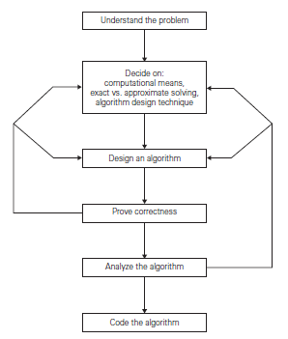
Fundamentals of Algorithm and Problem Solving
DAA - Unit - I Presentation Slides

Slide 9
Problem Solving Techniques
Understand the problem or Review the Specifications.
Plan the logic
a) (Informal Design)
i. List major tasks
ii. List subtasks,sub-subtasks & so on
b) (Formal Design)
i. Create formal design from task lists
ii. Desk check design
Writing an algorithm 5. Flowcharting 6. Coding
7. Translate the program into machine language
8. Test the program
i. If necessary debug the program
Documentation
Put the program into production. If necessary maintain the program.
DAA - Unit - I Presentation Slides

Slide 10
Example of computational problem: sorting
Arranging data in a specific order (increasing or decreasing) is called sorting. The data may be numerical data or alphabetical data.
A₁ ≤ A₂ ≤ A₃ ≤ …… ≤ A_{n} or
A_{n} ≥ A_{n–1} ≥ A_{n–2} ≥ …… ≥ A₁ ≥ A₀
Internal Sorting
Here, all data are held in primary memory during the sorting process.
External Sorting
Here, it uses primary memory for the data currently being sorted and uses secondary storage for string data.
DAA - Unit - I Presentation Slides

Slide 11
Types of Sorting
Internal Sorting
  Insertion (Insertion sort, Address Calculation sort, Shell sort)
  Selection (Selection sort, Heap sort)
  Exchange (Bubble sort, Quick sort, Radix sort)
External Sorting
  Natural sort
  Merge sort
  Multi-way merge sort
  Balanced sort
  Polyphase sort
DAA - Unit - I Presentation Slides

Slide 12
Selection Sort
Suppose A is an array which consists of ‘n’ elements namely A[l], A[2], . . . , A[N]. The selection sort algorithm will works as follows.
Step 1: a. First find the location LOC of the smallest element in the list A[l], A[2], . . . , A[N] and put it in the first position.
b. Interchange A[LOC] and A[1].
c. Now, A[1] is sorted.
2. Step 2: a. Find the location of the second smallest element in the list A[2], . . . , A[N] and put it in the second position.
b. Interchange A[LOC] and A[2].
c. Now, A[1] and A[2] is sorted. Hence, A[l] ≤ A[2].
3. Step 3: a. Find the location of the third smallest element in the list A[3], . . . , A[N] and put it in the third position.
b. Interchange A[LOC] and A[3].
c. Now, A[1], A[2] and A[3] is sorted. Hence, A[l] ≤ A[2] ≤ A[3].
. . . . . . . . . . . . . . . . . . . . . . . . . . . . . . . .. . . . . . . . . . . . . . . . . . . . . . . . . . . .
N-1. Step N–1 : a. Find the location of the smallest element in the list A[A–1] and A[N].
b. Interchange A[LOC] and A[N–1] & put into the second last position.
c. Now, A[1], A[2], …..,A[N] is sorted. Hence, A[l] ≤ … ≤ A[N–1] ≤A[N].
DAA - Unit - I Presentation Slides

Slide 13
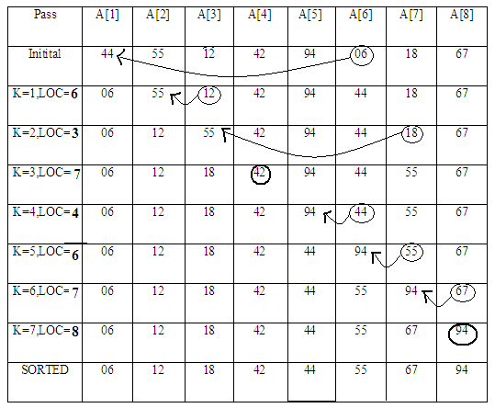
DAA - Unit - I Presentation Slides

Slide 14
Some Well-known Computational Problems
Sorting
Searching
Shortest paths in a graph
Minimum spanning tree
Primality testing
Traveling salesman problem
Knapsack problem
Chess
Towers of Hanoi
Program termination
Some of these problems don’t have efficient algorithms, or algorithms at all!
DAA - Unit - I Presentation Slides
Notes:
1-4 have well known efficient (polynomial-time) solutions
5: primality testing has recently been found to have an efficient solution
This is a great problem to discuss because it has recently been in the news
(see mathworld news at: http://mathworld.wolfram.com/news/2002-08-07_primetest/
or original article: http://www.cse.iitk.ac.in/primality.pdf)
6(TSP)-9(chess) are all problems for which no efficient solution has been found
it is possible to informally discuss the “try all possibilities” approach that is required
to get exact solutions to such problems
10: Towers of Hanoi is a problem that has only exponential-time solutions (simply
because the output required is so large)
11: Program termination is undecidable

Slide 15
Basic Issues Related to Algorithms
How to design algorithms
How to express algorithms
Proving correctness
Efficiency (or complexity) analysis
  Theoretical analysis
  Empirical analysis
Optimality
DAA - Unit - I Presentation Slides

Slide 16
Algorithm design strategies
Brute force
Divide and conquer
Decrease and conquer
Transform and conquer
Greedy approach
Dynamic programming
Backtracking and branch-and-bound
Space and time tradeoffs
DAA - Unit - I Presentation Slides

Slide 17
PROPERTIES OF AN ALGORITHM
An algorithm takes zero or more inputs
An algorithm results in one or more outputs
All operations can be carried out in a finite amount of time
An algorithm should be efficient and flexible
It should use less memory space as much as possible
An algorithm must terminate after a finite number of steps.
Each step in the algorithm must be easily understood for some reading it
An algorithm should be concise and compact to facilitate verification of their correctness.
DAA - Unit - I Presentation Slides

Slide 18
STEPS FOR WRITING AN ALGORITHM
An algorithm consists of two parts.
  The first part is a paragraph, which tells the purpose of the algorithm, which identifies the variables, occurs in the algorithm and the lists of input data.
  The second part consists of the list of steps that is to be executed.
DAA - Unit - I Presentation Slides

Slide 19
STEPS FOR WRITING AN ALGORITHM (Contd…)
Step 1: Identifying Number
Each algorithm is assigned an identifying number. Example: Algorithm 1. Algorithm 2 etc.,
Step 2: Comment
Each step may contain comment brackets, which identifies or indicates the main purpose of the step.
The Comment will usually appear at the beginning or end of the step. It is usually indicated with two square brackets [ ].
Example :
Step 1: [Initialize]
set K : = 1
DAA - Unit - I Presentation Slides

Slide 20
STEPS FOR WRITING AN ALGORITHM (Contd…)
Step 3 : Variable Names
It uses capital letters. Example MAX, DATA. Single letter names of variables used as counters or subscripts.
Step 4 : Assignment Statement
It uses the dot equal notation (: =). Some text uses → or ← or = notations
Step 5 : Input and Output
Data may be input and assigned to variables by means of a Read statement. Its syntax is :
READ : variable names
Example:
READ: a,b,c
Similarly, messages placed in quotation marks, and data in variables may be output by means of a write or print statement. Its syntax is:
WRITE : Messages and / or variable names.
Example:
Write: a,b,c
DAA - Unit - I Presentation Slides

Slide 21
STEPS FOR WRITING AN ALGORITHM (Contd…)
Step 7 : Controls:
It has three types
(i) : Sequential Logic :
It is executed by means of numbered steps or by the order in which the modules are written
(ii) : Selection or Conditional Logic
It is used to select only one of several alternative modules. The end of structure is usually indicated by the statement.
[ End - of-IF structure]
The selection logic consists of three types
Single Alternative, Double Alternative and Multiple Alternative
DAA - Unit - I Presentation Slides

Slide 22
STEPS FOR WRITING AN ALGORITHM (Contd…)
a). Single Alternative : Its syntax is : b) Double alternative : Its syntax is IF condition, then : IF condition, then :
[ module a] [module A]
[ End - of-IF structure] Else :
[ module B]
[ End - of-IF structure]
c). Multiple Alternative : Its syntax is :
IF condition(1), then :
[module A1]
Else IF condition (2), then:
[Module A2]
Else IF condition (2) then.
[module A2]
.............
Else IF condition (M) then :
[ Module Am]
Else [ Module B]
[ End - of-IF structure]
DAA - Unit - I Presentation Slides

Slide 23
STEPS FOR WRITING AN ALGORITHM (Contd…)
Iteration or Repetitive
It has two types. Each type begins with a repeat statement and is followed by the module, called body of the loop. The following statement indicates the end of structure.
[End of loop ]
(a) Repeat for loop
It uses an index variable to control the loop.
Repeat for K = R to S by T:
[Module]
[End of loop]
(b) Repeat while loop
It uses a condition to control the loop.
Repeat while condition:
[Module]
[End of loop]
iv) EXIT :
The algorithm is completed when the statement EXIT is encountered.
DAA - Unit - I Presentation Slides

Slide 24
Important problem types
sorting
searching
string processing
graph problems
combinatorial problems
geometric problems
numerical problems
1-<number>
DAA - Unit - I Presentation Slides

Slide 25
Real-World Applications
Hardware design: VLSI chips
Compilers
Computer graphics: movies, video games
Routing messages in the Internet
Searching the Web
Distributed file sharing
Computer aided design and manufacturing
Security: e-commerce, voting machines
Multimedia: CD player, DVD, MP3, JPG, HDTV
DNA sequencing, protein folding
and many more!
DAA - Unit - I Presentation Slides

Slide 26
Some Important Problem Types
Sorting
  a set of items
Searching
  among a set of items
String processing
  text, bit strings, gene sequences
Graphs
  model objects and their relationships
Combinatorial
  find desired permutation, combination or subset
Geometric
  graphics, imaging, robotics
Numerical
  continuous math: solving equations, evaluating functions
DAA - Unit - I Presentation Slides

Slide 27
Algorithm Design Techniques
Brute Force & Exhaustive Search
  follow definition / try all possibilities
Divide & Conquer
  break problem into distinct subproblems
Transformation
  convert problem to another one
Dynamic Programming
  break problem into overlapping subproblems
Greedy
  repeatedly do what is best now
Iterative Improvement
  repeatedly improve current solution
Randomization
  use random numbers
DAA - Unit - I Presentation Slides

Slide 28
Searching
Find a given value, called a search key, in a given set.
Examples of searching algorithms
  Sequential search
  Binary search
  Interpolation search
  Robust interpolation search
DAA - Unit - I Presentation Slides

Slide 29
String Processing
A string is a sequence of characters from an alphabet.
Text strings: letters, numbers, and special characters.
String matching: searching for a given word/pattern in a text.
Examples:
searching for a word or phrase on WWW or in a Word document
searching for a short read in the reference genomic sequence
DAA - Unit - I Presentation Slides

Slide 30
Graph Problems
Informal definition
  A graph is a collection of points called vertices, some of which are connected by line segments called edges.
Modeling real-life problems
  Modeling WWW
  Communication networks
  Project scheduling …
  Examples of graph algorithms
    Graph traversal algorithms
    Shortest-path algorithms
    Topological sorting
DAA - Unit - I Presentation Slides

Slide 31
Analysis of Algorithms
How good is the algorithm?
  Correctness
  Time efficiency
  Space efficiency
Does there exist a better algorithm?
  Lower bounds
  Optimality
DAA - Unit - I Presentation Slides

Slide 32
PERFORMANCE ANALYSIS OF AN ALGORITHM
Any given problem may be solved by a number of algorithms. To judge an algorithm there are many criteria. Some of them are:
It must work correctly under all possible condition
It must solve the problem according to the given specification
It must be clearly written following the top down strategy
It must make efficient use of time and resources
It must be sufficiently documented so that anybody can understand it
It must be easy to modify, if required.
It should not be dependent on being run on a particular computer.
DAA - Unit - I Presentation Slides

Slide 33
Algorithm Classification
There are various ways to classify algorithms:
  1. Classification by implementation :
    Recursion or iteration:
    Logical:
    Serial or parallel or distributed:
    Deterministic or non-deterministic:
    Exact or approximate:
  2.Classification by Design Paradigm :
    Divide and conquer.
    Dynamic programming.
    The greedy method.
    Linear programming.
    Reduction.
    Search and enumeration.
    The probabilistic and heuristic paradigm.

Slide 34
Solution Methods
Try every possibility (n-1)! possibilities –
grows faster than exponentially
To calculate all possibilities when n = 100
Optimising Methods obtain guaranteed optimal solution,
but can take a very, very, long time
III. Heuristic Methods obtain ‘good’ solutions ‘quickly’ by intuitive methods.
No guarantee of optimality. Heuristic algorithm for the Traveling Salesman Problem (T.S.P)

Slide 35
Euclid’s Algorithm
Problem: Find gcd(m,n), the greatest common divisor of two nonnegative, not both zero integers m and n
Examples: gcd(60,24) = 12, gcd(60,0) = 60, gcd(0,0) = ?
Euclid’s algorithm is based on repeated application of equality
  gcd(m,n) = gcd(n, m mod n) (OR)
(ii) gcd(m, n) = gcd(m − n, n) for m ≥ n > 0.
until the second number becomes 0, which makes the problem
trivial.
Example: gcd(60,24) = gcd(24,12) = gcd(12,0) = 12
gcd(60,24) = gcd(36,24) = gcd(12,24)
DAA - Unit - I Presentation Slides
Notes:
Euclid’s algorithm is good for introducing the notion of an algorithm because it
makes a clear separation from a program that implements the algorithm.
It is also one that is familiar to most students.
Al Khowarizmi (many spellings possible...) – “algorism” (originally) and then
later “algorithm” come from his name.

Slide 36
Two descriptions of Euclid’s algorithm
Step 1 If n = 0, return m and stop; otherwise go to Step 2
Step 2 Divide m by n and assign the value of the remainder to r
Step 3 Assign the value of n to m and the value of r to n. Go to
Step 1.
while n ≠ 0 do
r ← m mod n
m← n
n ← r
return m
DAA - Unit - I Presentation Slides

Slide 37
Other methods for computing gcd(m,n)
Consecutive integer checking algorithm
Step 1 Assign the value of min{m,n} to t
Step 2 Divide m by t. If the remainder is 0, go to
Step 3; otherwise, go to Step 4
Step 3 Divide n by t. If the remainder is 0, return t and stop; otherwise, go to Step 4
Step 4 Decrease t by 1 and go to Step 2
Is this slower than Euclid’s algorithm? How much slower?
DAA - Unit - I Presentation Slides

Slide 38
Other methods for gcd(m,n) [cont.]
Middle-school procedure
Step 1 Find the prime factorization of m
Step 2 Find the prime factorization of n
Step 3 Find all the common prime factors
Step 4 Compute the product of all the common prime factors and return it as gcd(m,n)
Is this an algorithm?
How efficient is it?
Time complexity: O(sqrt(n))
DAA - Unit - I Presentation Slides

Slide 39
Problem. Find gcd(31415, 14142) by applying Euclid’s algorithm
gcd(31415, 14142) = gcd(14142, 3131)
= gcd(3131, 1618)
= gcd(1618, 1513)
= gcd(1513, 105)
= gcd(1513, 105)
= gcd(105, 43)
= gcd(43, 19)
= gcd(19, 5)
= gcd(5, 4)
= gcd(4, 1) = gcd(1, 0) = 1.
DAA - Unit - I Presentation Slides

Slide 40
Estimate how many times faster it will be to find gcd(31415, 14142) by Euclid’s algorithm compared with the algorithm based on checking consecutive integers from min{m, n} down to gcd(m, n).
The number of divisions made by Euclid’s algorithm is 11 .
The number of divisions made by the consecutive integer checking algorithm on each of its 14142 iterations is either 1 and 2; hence the total number of multiplications is between
1·14142 and 2·14142.
Therefore, Euclid’s algorithm will be between
1·14142/11 ≈ 1300 and 2·14142/11 ≈ 2600 times faster.
DAA - Unit - I Presentation Slides

Slide 41
Algorithm Efficiency
The efficiency of an algorithm is usually measured by its CPU time and Storage space.
The time is measured by counting the number of key operations, that is how much time does it take to run the algorithm. For example, in sorting and searching algorithms, number of comparisons.
The space is measured by counting the maximum of memory needed by the algorithm. That is, the amount of memory required by an algorithm to run to completion
DAA - Unit - I Presentation Slides

Slide 42
Time and space complexity
  This is generally a function of the input size
    E.g., sorting, multiplication
  How we characterize input size depends:
    Sorting: number of input items
    Multiplication: total number of bits
    Graph algorithms: number of nodes & edges
    Etc
DAA - Unit - I Presentation Slides

Slide 43
Algorithm Analysis
We only analyze correct algorithms
  An algorithm is correct
  If, for every input instance, it halts with the correct output
Incorrect algorithms
  Might not halt at all on some input instances
  Might halt with other than the desired answer
Analyzing an algorithm
  Predicting the resources that the algorithm requires
  Resources include
    Memory, Communication bandwidth, Computational time (usually most important)
Factors affecting the running time
  computer , compiler, algorithm used
  input to the algorithm
    The content of the input affects the running time
    typically, the input size (number of items in the input) is the main consideration
      E.g. sorting problem ⇒ the number of items to be sorted
      E.g. multiply two matrices together ⇒ the total number of elements in the two matrices
Machine model assumed
  Instructions are executed one after another, with no concurrent operations ⇒ Not parallel computers
DAA - Unit - I Presentation Slides

Slide 44
Algorithm Analysis (Contd…)
Many criteria affect the running time of an algorithm, including
  speed of CPU, bus and peripheral hardware
  design think time, programming time and debugging time
  language used and coding efficiency of the programmer
  quality of input (good, bad or average)
DAA - Unit - I Presentation Slides

Slide 45
Algorithm Analysis (Contd…)
Programs derived from two algorithms for solving the same problem should both be
  Machine independent
  Language independent
  Environment independent (load on the system,...)
  Amenable to mathematical study
  Realistic
DAA - Unit - I Presentation Slides

Slide 46
Faster Algorithm vs. Faster CPU
A faster algorithm running on a slower machine will always win for large enough instances
Suppose algorithm S1 sorts n keys in 2n² instructions
Suppose computer C1 executes 1 billion instruc/sec
  When n = 1 million, takes 2000 sec
Suppose algorithm S2 sorts n keys in 50nlog₂n instructions
Suppose computer C2 executes 10 million instruc/sec
  When n = 1 million, takes 100 sec
DAA - Unit - I Presentation Slides

Slide 47
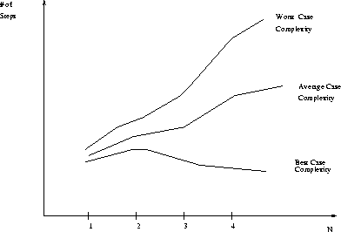
Performance measures: worst case, average case and Best case
DAA - Unit - I Presentation Slides

Slide 48
LINEAR LOOPS
Example :
i=1
Loop (i <=1000)
Application code i=i+1
Assume that i is an integer.
Example:
i=1
Loop (i <=1000)
Application code
i=i+2
Example:
i=1
Loop (i <=1000)
Application code
i=i/2
DAA - Unit - I Presentation Slides

Slide 49
LOGARITHMIC LOOPS
f(n) = log₂n.
Multiply Loop Divide Loop
i=1 i=1000
Loop (i < 1000) Loop (i >1)
Application code Application code
i=i* 2 i=i / 2
Multiply → 2^{iterations} < 1000 ; Divide → 1000 / 2^{iterations} > = 1
Multiply |  | Divide
Iteration | Value of I | Iteration | Value of I
1 | 1 | 1 | 1000
2 | 2 | 2 | 500
3 | 4 | 3 | 250
4 | 8 | 4 | 125
5 | 16 | 5 | 62
6 | 32 | 6 | 31
7 | 64 | 7 | 15
8 | 128 | 8 | 7
9 | 256 | 9 | 3
10 | 512 | 10 | 1
(exit) | 1024 | (exit) | 0
DAA - Unit - I Presentation Slides

Slide 50
NESTED LOOPS
When we analyze loops, we must determine how many iterations each loop completes. The total is then the product of the number of iterations for the inner loop and the number of iterations in the outer loop.
Iterations = outer loop iterations x inner loop iterations
i=1
Loop (i < = 10)
j=1
Loop (j<=10)
Application code
j=j*2
i=i+1
The number of iterations in the inner loop is log₂10. In the above program code, the inner loop is controlled by an outer loop. The above formula must be multiplied by the number of times the outer loop executes, which is 10. this gives us,
10 x log₂ 10. In general, f(n) = n x log₂ n
DAA - Unit - I Presentation Slides

Slide 51
DEPENDENT QUADRATIC
i=1
Loop (i < = 10)
j=1
Loop (j<=i)
Application code
j=j+1
i=i+1
Here, the outer loop is same as the previous loop. However, the inner loop is dependent on the outer loop for one of its factors. It is executed only once the first iteration, twice the second iteration, three times the third iteration and so on. The number of iterations in the body of the inner loop is 1+2+3+4+……+8+9+10 = 55.
If we compute the average of this loop, it is 5.5 (55/10), which is the same as the number of iterations (10) plus 1 divided by 2. this can be written as (n+1)/2.
Multiply the inner loop by the number of times the outer loop is executed gives the following formula:
f(n) =n . (n+1)/2
DAA - Unit - I Presentation Slides

Slide 52
QUADRATIC
i=1
Loop (i < = 10)
j=1
Loop (j<=10)
Application code
j=j+1
i=i+1
The outer loop executed 10 times. For each of its iterations, the inner loop is also executed ten times. The answer is 100. Thus, f(n) = n².
DAA - Unit - I Presentation Slides

Slide 53
What is the running time of this algorithm?
What is the running time of this algorithm?
What is the running time of this algorithm?
PUZZLE(x)
while x != 1
if x is even
then x = x / 2
else x = 3x + 1
Sample run: 7, 22, 11, 34, 17, 52, 26, 13, 40, 20, 10, 5, 16, 8, 4, 2, 1
DAA - Unit - I Presentation Slides

Slide 54
Write pseudocode for an algorithm for finding real roots of equation ax² + bx + c = 0 for arbitrary real coefficients a, b, and c. (You may assume the availability of the square root function sqrt (x).)
DAA - Unit - I Presentation Slides

Slide 55
Growth of Functions
The relative performance of an algorithms depends on input data size N. If there are multiple input parameters, we will try to reduce them to a single parameter, expressing some parameters in terms of the selected parameter.
We know that, the performance of algorithm on an input of size N is generally represented in terms of 1, logN, N, N log N, N², N³, 2^{N}., N!, and N^{N} The performance depends heavily on loops, and can be increased by minimizing the inner loops.
DAA - Unit - I Presentation Slides

Slide 56
Computing Big – O
The big-O notation can be derived from f(n) using the following steps.
In each term, set the co-efficient of the term to one
Keep the largest term in the function and discard the others. Terms are ranked from lowest to highest as shown below:
Log n n nlog n n² n³ … n^{k} 2^{n} n!
DAA - Unit - I Presentation Slides

Slide 57
Rate of growth of function
Logarithmic | Linear | Linear logarithmic | Quadratic | Polynomial | Exponential
Log₂n | N | nlog₂n | n² | n³ | 2^{n}
0 | 1 | 0 | 1 | 1 | 2
1 | 2 | 2 | 4 | 8 | 4
2 | 4 | 8 | 16 | 64 | 16
3 | 8 | 24 | 64 | 512 | 256
4 | 16 | 64 | 256 | 4096 | 65536
5 | 32 | 160 | 1024 | 32768 | 4294967296
3.322 | 10 | 33.22 | 10² | 10³ | > 10³
6.644 | 10² | 664.4 | 10⁴ | 10⁶ | > >10²⁵
9.966 | 10³ | 9966.0 | 10⁶ | 10 | > > 10²⁵⁰
DAA - Unit - I Presentation Slides

Slide 58
Asymptotic Algorithm Analysis
The asymptotic analysis of an algorithm determines the running time in big-Oh notation. To perform the asymptotic analysis
We find the worst-case number of primitive operations executed as a function of the input size
We express this function with big-Oh notation
  Since constant factors and lower-order terms are eventually dropped , we can disregard them when counting primitive operations.
DAA - Unit - I Presentation Slides

Slide 59
Asymptotic Performance
    Running time
    Memory/storage requirements
    Bandwidth/power requirements/logic gates/etc.

Slide 60
Analysis
Worst case
  Provides an upper bound on running time
  An absolute guarantee
Average case
  Provides the expected running time
  Very useful, but treat with care: what is “average”?
    Random (equally likely) inputs
    Real-life inputs

Slide 61
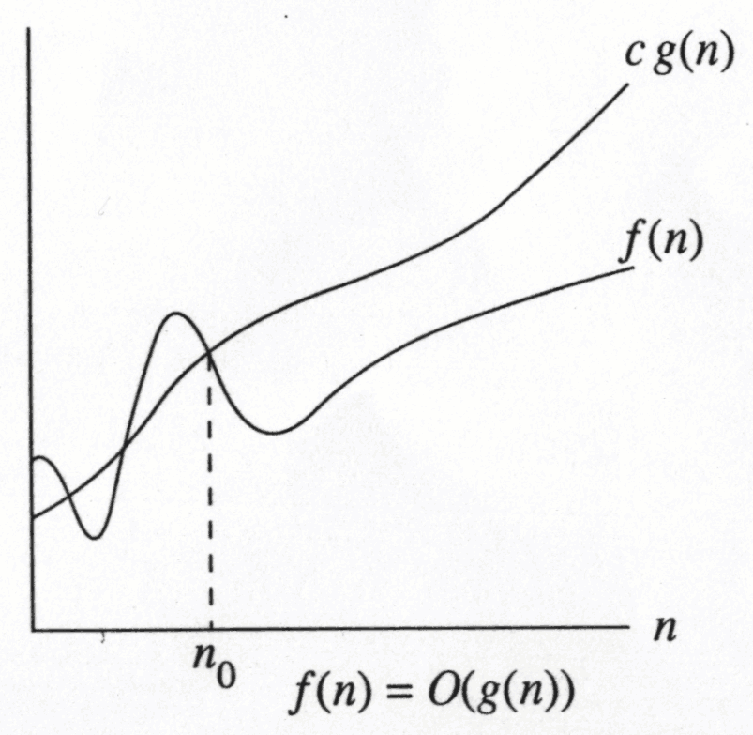
Asymptotic Notation – Big – Oh
The idea is to establish a relative order among functions for large n
  Given function f(n) and g(n) , we say that f(n) is O(g(n)) if there are positive constants c and n₀ such that f(n) ≤ cg(n) for n ≥ n₀.
The growth rate of f(N) is less than or equal to the growth rate of g(N)
g(N) is an upper bound on f(N)
DAA - Unit - I Presentation Slides

Slide 62
Big – Oh – Example
Let f(n) = 2N². Then
  f(n) = O(N⁴); f(n) = O(N³); f(N) = O(N²)
  (best answer, asymptotically tight)
O(N²): reads “order N-squared” or “Big-Oh N-squared”
N² / 2 – 3N = O(N²); 1 + 4N = O(N);
7N² + 10N + 3 = O(N²)
log₁₀ N = log₂ N / log₂ 10 = O(log₂ N) = O(log N)
sin N = O(1); 10 = O(1), 10¹⁰ = O(1);
log N + N = O(N); log_{k} N = O(N) for any constant k
N = O(2^{N}), but 2^{N} is not O(N); 2^{10N} is not O(2^{N})
DAA - Unit - I Presentation Slides

Slide 63
Rules for finding Big – Oh
If f(n) is a polynomial of degree d, then f(n) is O(n^{d}), i.e,
  Drop lowest term
  Drop constant factors
Use the simplest possible class of function
  Say “2n is O(n)” instead of “2n is O(n²)”
Use the simplest expression of the class
  Say “3n+5 is O(n)” instead of “3n+5 is O(3n)”
If T₁(N) = O(f(N) and T₂(N) = O(g(N)), then
  T₁(N) + T₂(N) = max(O(f(N)), O(g(N))),
  T₁(N) * T₂(N) = O(f(N) * g(N))
DAA - Unit - I Presentation Slides

Slide 64
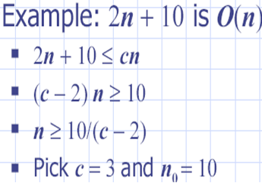
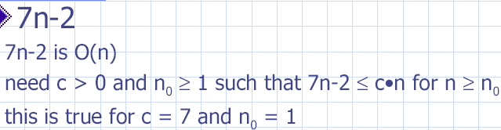
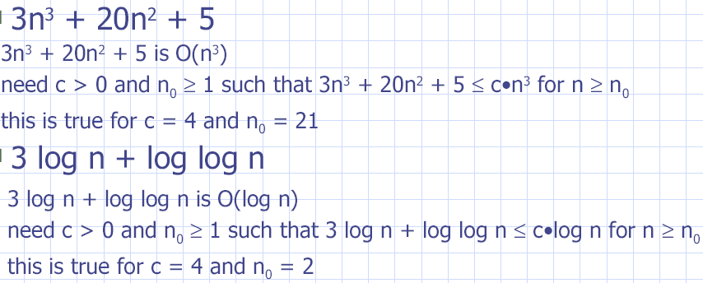
DAA - Unit - I Presentation Slides

Slide 65
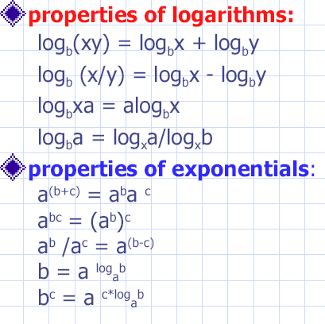
Math Review

Slide 66
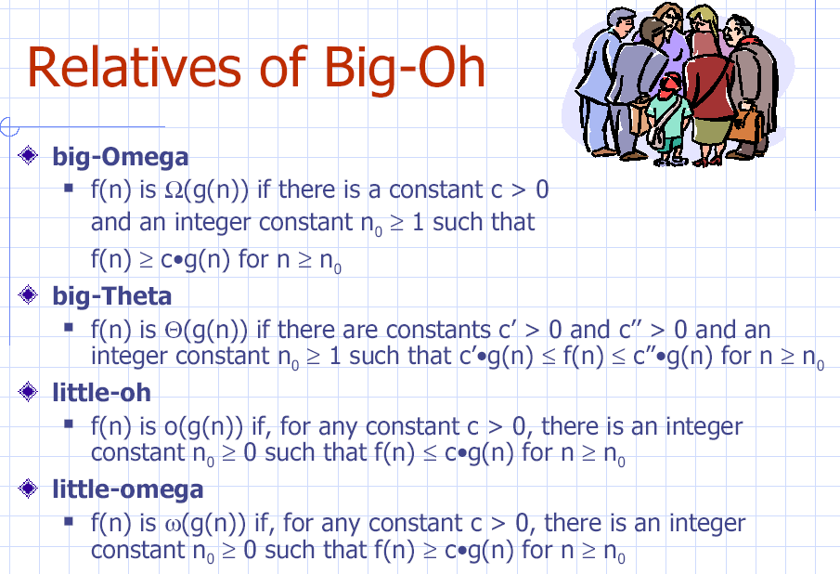

Slide 67
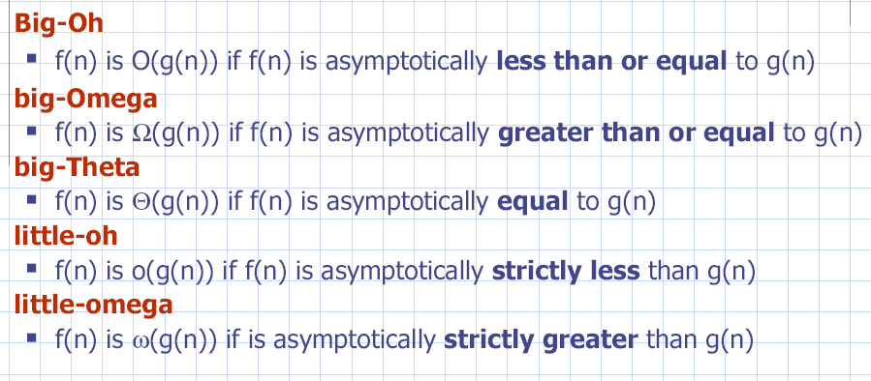
Intuition for Asymptotic Notation

Slide 68
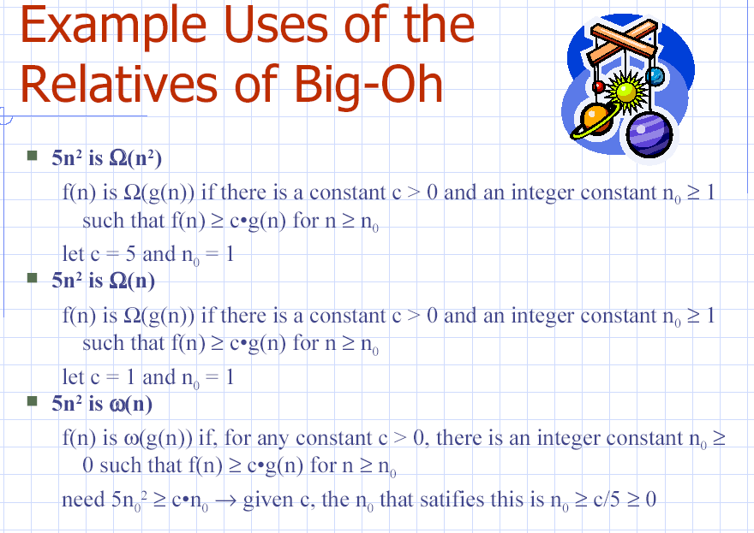

Slide 69
Recurrence Relation
A recurrence relation is an equation which is defined in terms of itself. That is, the nth term is expressed in terms of one or more previous elements. (a_{n-1}, a_{n-2} etc).
Example:
a_{n} = 2a_{n-1} + a_{n-2}

Slide 70
Two fundamental rules
  Must always have a base case
  Each recursive call must be a case that eventually leads toward a base case

Slide 71
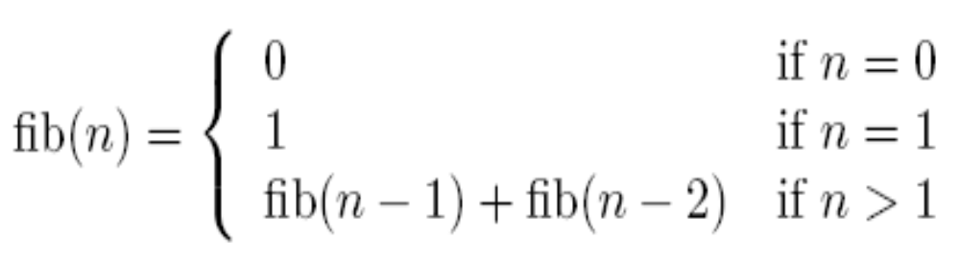
Recurrence Relation of Fibonacci Number fib(n):
{0, 1, 2, 3, 5, 8, 13, 21, 34, 55, 89, 144, …}

Slide 72
Example: Fibonacci Numbers
Problem: What is fib(200)? What about fib(n), where n is any positive integer?
Algorithm 1 fib(n)
if n = 0 then
return (0)
if n = 1then
return (1)
return (fib(n − 1) + fib(n − 2))

Slide 73

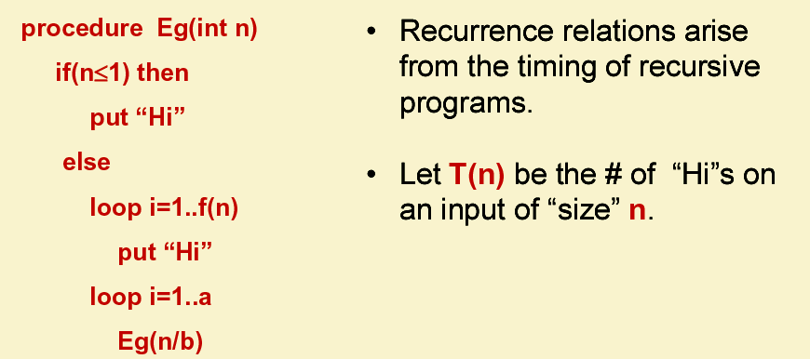

Slide 74

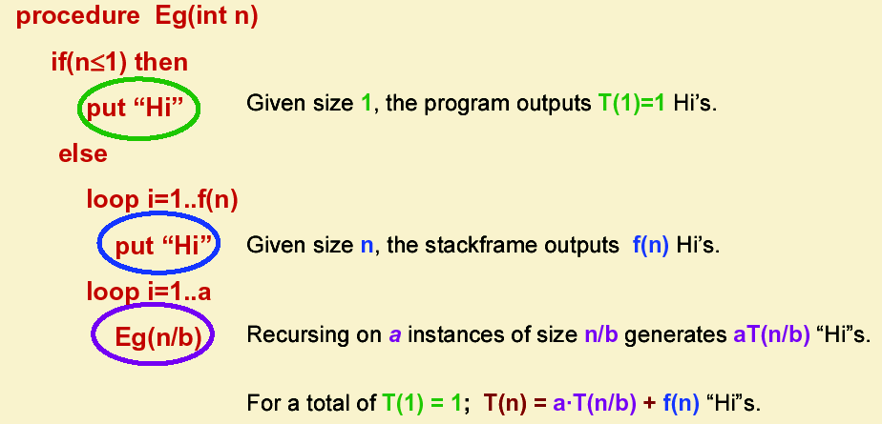

Slide 75

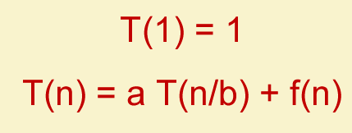

Slide 76
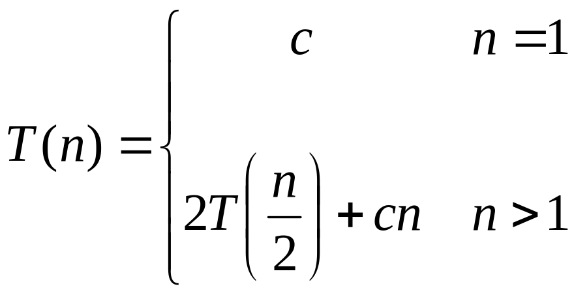
Recurrences
The expression:
is a recurrence.
  Recurrence: an equation that describes a function in terms of its value on smaller functions

Slide 77

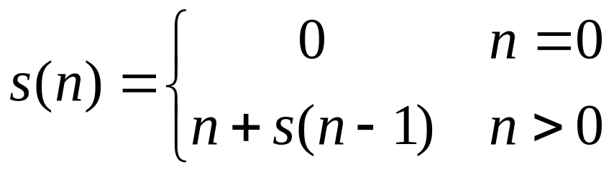

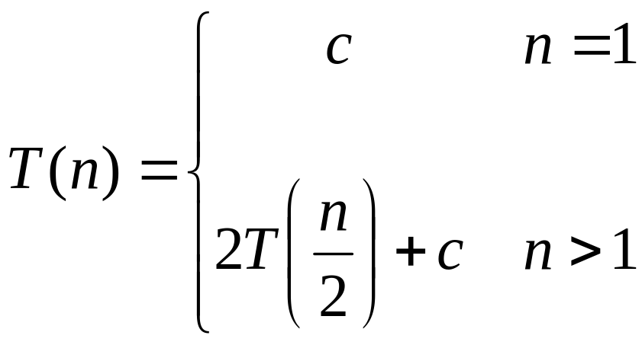
Recurrence Examples

Slide 78
Recursion Methods
Substitution Method
Recursion Tree or Iteration Method
Master Method

Slide 79
Substitution Method
Guess the form of the solution
Use mathematical induction to find the constants and show that the solution works.

Slide 80
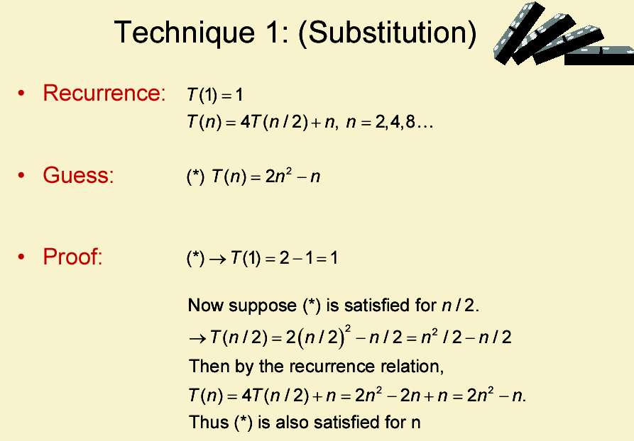

Slide 81
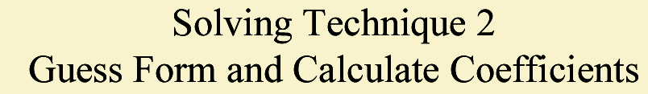
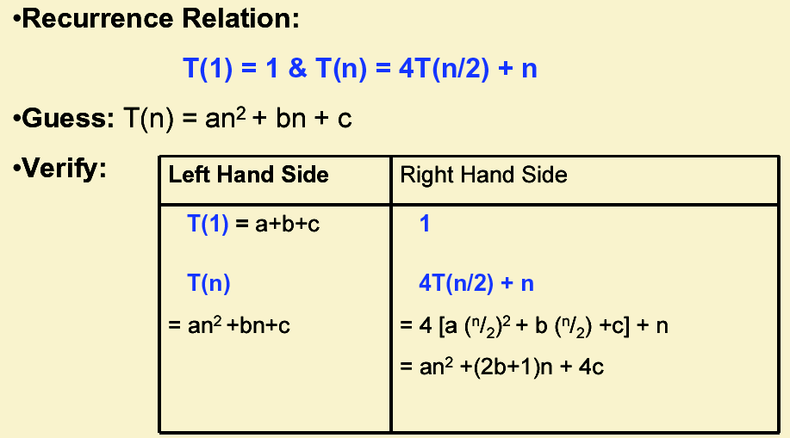

Slide 82
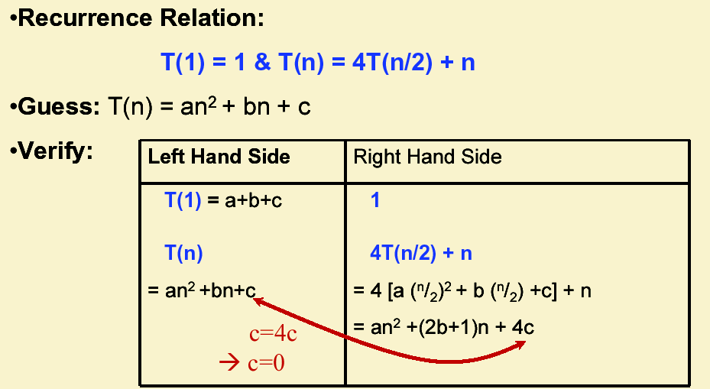

Slide 83
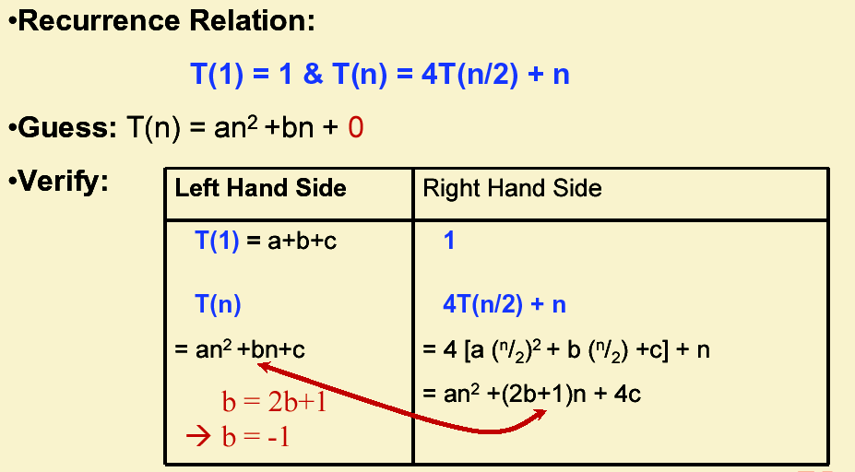

Slide 84
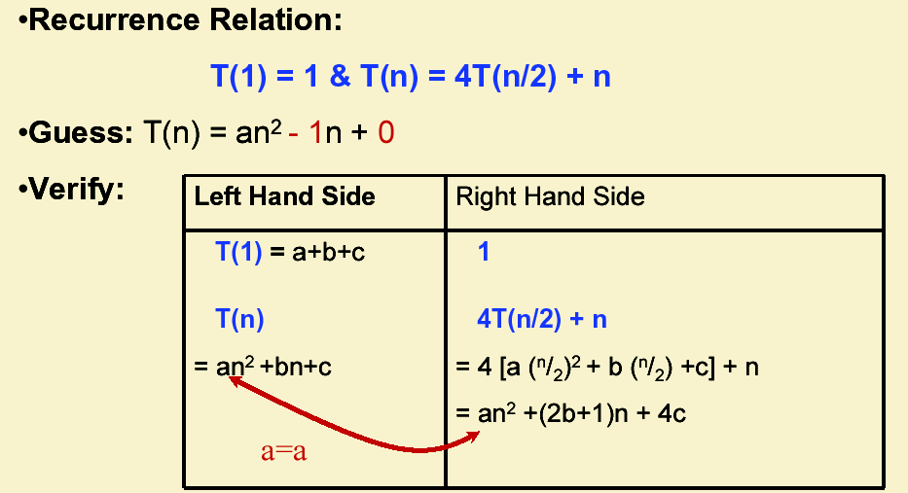

Slide 85
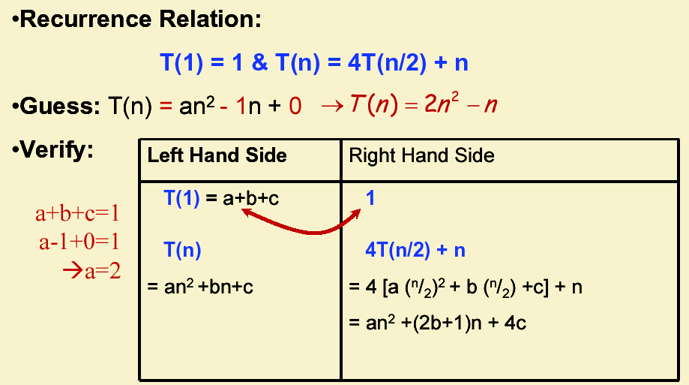

Slide 86
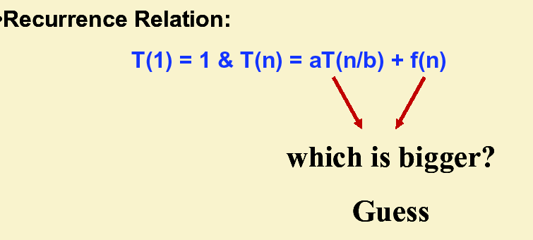
Solving Technique 3 Approximate Form and Calculate Exponent

Slide 87
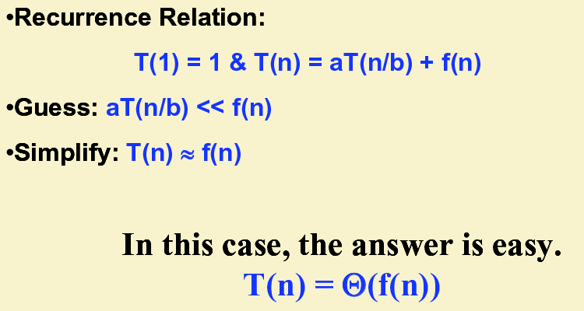

Slide 88
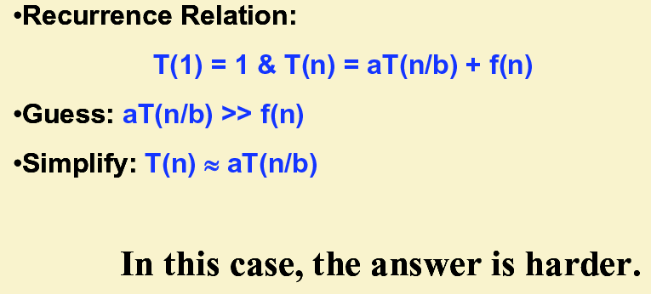

Slide 89
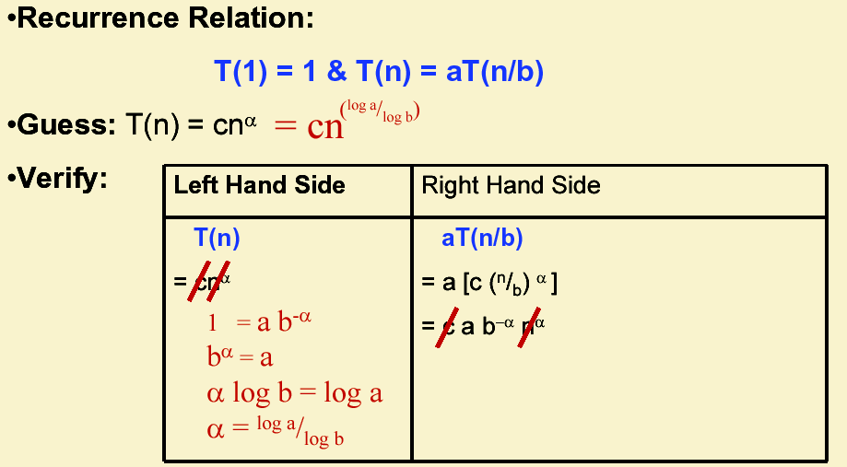

Slide 90
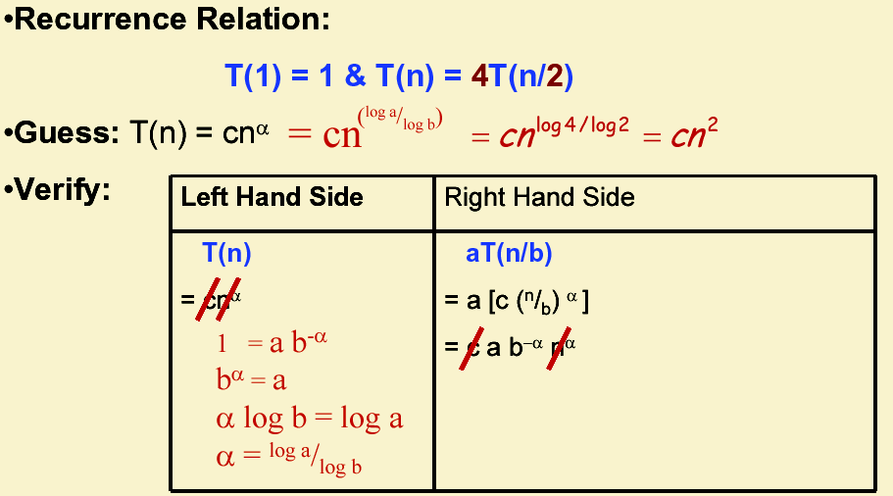

Slide 91
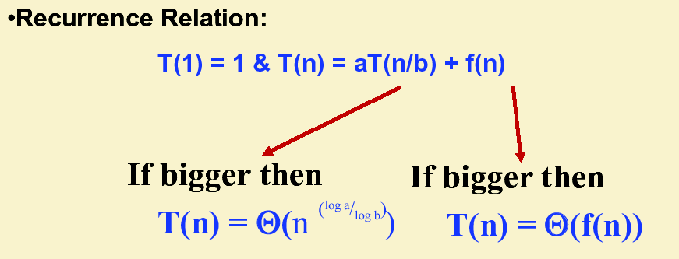

Slide 92
Iteration method
Expand the recurrence
  Work some algebra to express as a summation
  Evaluate the summation
We will show several examples

Slide 93

s(n) = c + s(n-1)
= c + c + s(n-2)
= 2c + s(n-2)
= 2c + c + s(n-3)
= 3c + s(n-3)
…
= kc + s(n-k) = ck + s(n-k)

Slide 94
So far for n >= k we have
  s(n) = ck + s(n-k)
What if k = n?
  s(n) = cn + s(0) = cn

Slide 95
So far for n >= k we have
  s(n) = ck + s(n-k)
What if k = n?
  s(n) = cn + s(0) = cn
So
Thus in general
  s(n) = cn

Slide 96
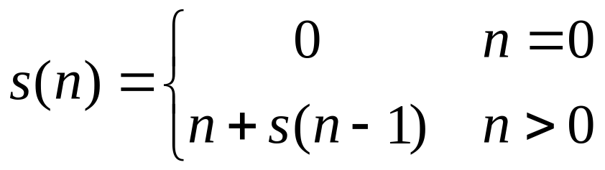
s(n) = n + s(n-1)
= n + n-1 + s(n-2)
= n + n-1 + n-2 + s(n-3)
= n + n-1 + n-2 + n-3 + s(n-4)
= …
= n + n-1 + n-2 + n-3 + … + n-(k-1) + s(n-k)

Slide 97
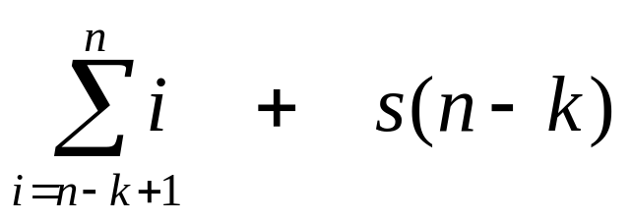
s(n)
  = n + s(n-1)
  = n + n-1 + s(n-2)
  = n + n-1 + n-2 + s(n-3)
  = n + n-1 + n-2 + n-3 + s(n-4)
  = …
  = n + n-1 + n-2 + n-3 + … + n-(k-1) + s(n-k)
  =

Slide 98
So far for n >= k we have

Slide 99
So far for n >= k we have
What if k = n?

Slide 100
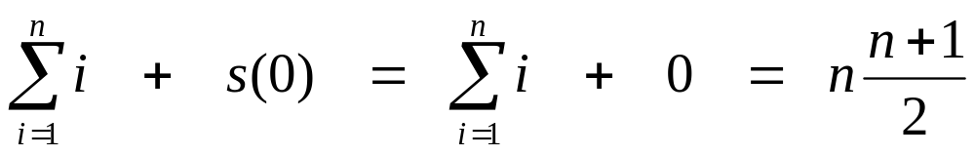
So far for n >= k we have
What if k = n?

Slide 101
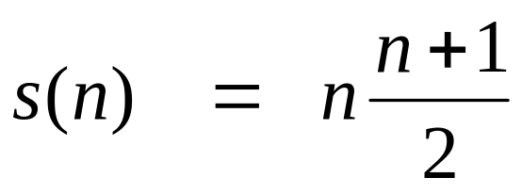
So far for n >= k we have
What if k = n?
Thus in general

Slide 102
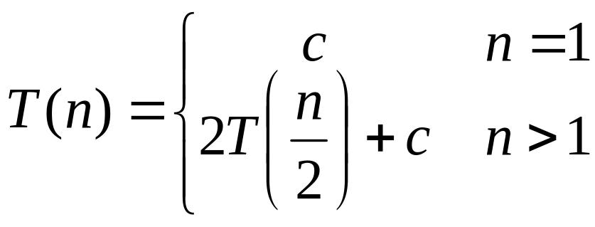
T(n) =
2T(n/2) + c
2(2T(n/2/2) + c) + c
2²T(n/2²) + 2c + c
2²(2T(n/2²/2) + c) + 3c
2³T(n/2³) + 4c + 3c
2³T(n/2³) + 7c
2³(2T(n/2³/2) + c) + 7c
2⁴T(n/2⁴) + 15c
…
2^{k}T(n/2^{k}) + (2^{k} - 1)c

Slide 103
So far for n > 2k we have
  T(n) = 2^{k}T(n/2^{k}) + (2^{k} - 1)c
What if k = lg n?
  T(n) = 2^{lg n} T(n/2^{lg n}) + (2^{lg n} - 1)c
  = n T(n/n) + (n - 1)c
  = n T(1) + (n-1)c
  = nc + (n-1)c = (2n - 1)c

Slide 104
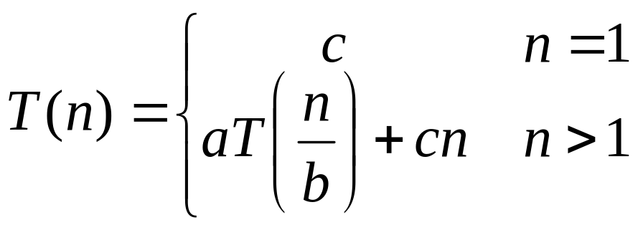
T(n) =
aT(n/b) + cn
a(aT(n/b/b) + cn/b) + cn
a²T(n/b²) + cna/b + cn
a²T(n/b²) + cn(a/b + 1)
a²(aT(n/b²/b) + cn/b²) + cn(a/b + 1)
a³T(n/b³) + cn(a²/b²) + cn(a/b + 1)
a³T(n/b³) + cn(a²/b² + a/b + 1)
…
a^{k}T(n/b^{k}) + cn(a^{k-1}/b^{k-1} + a^{k-2}/b^{k-2} + … + a²/b² + a/b + 1)

Slide 105
So we have
  T(n) = a^{k}T(n/b^{k}) + cn(a^{k-1}/b^{k-1} + ... + a²/b² + a/b + 1)
For k = log_{b} n
  n = b^{k}
  T(n) = a^{k}T(1) + cn(a^{k-1}/b^{k-1} + ... + a²/b² + a/b + 1)
  = a^{k}c + cn(a^{k-1}/b^{k-1} + ... + a²/b² + a/b + 1)
  = ca^{k} + cn(a^{k-1}/b^{k-1} + ... + a²/b² + a/b + 1)
  = cna^{k} /b^{k} + cn(a^{k-1}/b^{k-1} + ... + a²/b² + a/b + 1)
  = cn(a^{k}/b^{k} + ... + a²/b² + a/b + 1)

Slide 106
So with k = log_{b} n
  T(n) = cn(a^{k}/b^{k} + ... + a²/b² + a/b + 1)
What if a = b?
  T(n) = cn(k + 1)
  = cn(log_{b} n + 1)
  = Θ(n log n)

Slide 107
So with k = log_{b} n
  T(n) = cn(a^{k}/b^{k} + ... + a²/b² + a/b + 1)
What if a < b?

Slide 108
So with k = log_{b} n
  T(n) = cn(a^{k}/b^{k} + ... + a²/b² + a/b + 1)
What if a < b?
  Recall that Σ(x^{k} + x^{k-1} + … + x + 1) = (x^{k+1} -1)/(x-1)

Slide 109
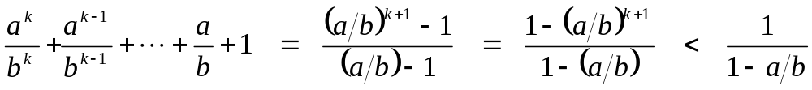
So with k = log_{b} n
  T(n) = cn(a^{k}/b^{k} + ... + a²/b² + a/b + 1)
What if a < b?
  Recall that (x^{k} + x^{k-1} + … + x + 1) = (x^{k+1} -1)/(x-1)
  So:

Slide 110
So with k = log_{b} n
  T(n) = cn(a^{k}/b^{k} + ... + a²/b² + a/b + 1)
What if a < b?
  Recall that Σ(x^{k} + x^{k-1} + … + x + 1) = (x^{k+1} -1)/(x-1)
  So:
  T(n) = cn ·Θ(1) = Θ(n)

Slide 111
So with k = log_{b} n
  T(n) = cn(a^{k}/b^{k} + ... + a²/b² + a/b + 1)
What if a > b?

Slide 112
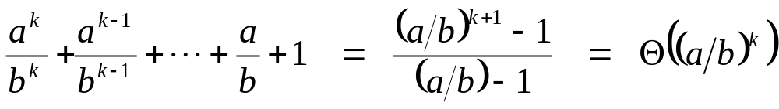
So with k = log_{b} n
  T(n) = cn(a^{k}/b^{k} + ... + a²/b² + a/b + 1)
What if a > b?

Slide 113
So with k = log_{b} n
  T(n) = cn(a^{k}/b^{k} + ... + a²/b² + a/b + 1)
What if a > b?
  T(n) = cn · Θ(a^{k} / b^{k})

Slide 114
So with k = log_{b} n
  T(n) = cn(a^{k}/b^{k} + ... + a²/b² + a/b + 1)
What if a > b?
  T(n) = cn · Θ(a^{k} / b^{k})
  = cn · Θ(a^{log n} / b^{log n}) = cn · Θ(a^{log n} / n)

Slide 115
So with k = log_{b} n
  T(n) = cn(a^{k}/b^{k} + ... + a²/b² + a/b + 1)
What if a > b?
  T(n) = cn · Θ(a^{k} / b^{k})
  = cn · Θ(a^{log n} / b^{log n}) = cn · Θ(a^{log n} / n)
  recall logarithm fact: a^{log n} = n^{log a}

Slide 116
So with k = log_{b} n
  T(n) = cn(a^{k}/b^{k} + ... + a²/b² + a/b + 1)
What if a > b?
  T(n) = cn · Θ(a^{k} / b^{k})
  = cn · Θ(a^{log n} / b^{log n}) = cn · Θ(a^{log n} / n)
  recall logarithm fact: a^{log n} = n^{log a}
  = cn · Θ(n^{log a} / n) = Θ(cn · n^{log a} / n)

Slide 117
So with k = log_{b} n
  T(n) = cn(a^{k}/b^{k} + ... + a²/b² + a/b + 1)
What if a > b?
  T(n) = cn · Θ(a^{k} / b^{k})
  = cn · Θ(a^{log n} / b^{log n}) = cn · Θ(a^{log n} / n)
  recall logarithm fact: a^{log n} = n^{log a}
  = cn · Θ(n^{log a} / n) = Θ(cn · n^{log a} / n)
  = Θ(n^{log a} )

Slide 118
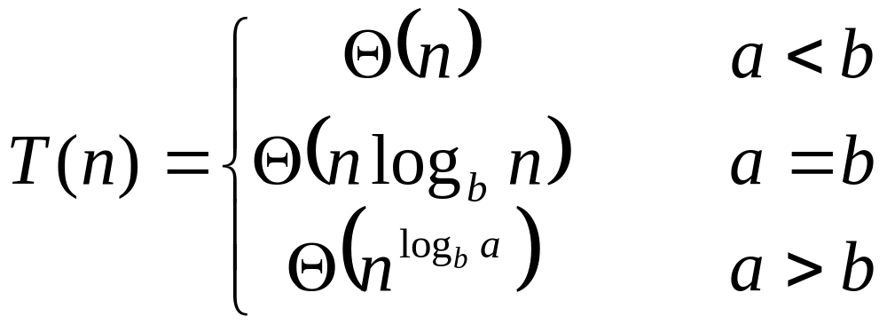
So…

Slide 119
Master Method
The master method provides a “cookbook” method for solving recurrences of the form
T(n) = aT(n/b)+f(n),
Where a ≥ 1, b > 1 and f(n) is a given function; it requires memorization of three cases, but once you do that, determining asymptotic bounds for many simple recurrences is easy.
DAA - Unit - I Presentation Slides

Slide 120
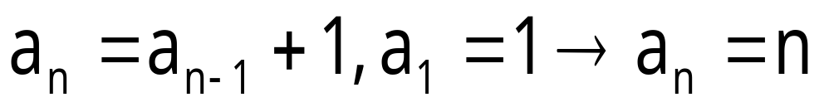
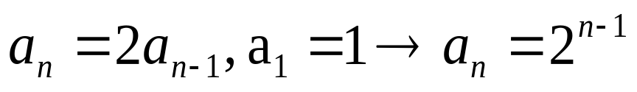
Example:
Many natural functions are easily expressed as recurrences:
(Polynomial)
(Exponential)
It is often easy to find a recurrence as the solution of a counting problem. Solving the recurrence can be done for many special cases. Example Fibonacci and Factorial of a number.
DAA - Unit - I Presentation Slides

Slide 121
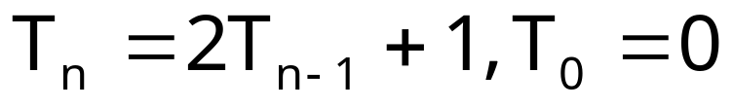
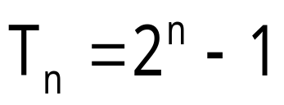
Recursion is Mathematical Induction
We have general and boundary conditions, with the general condition breaking the problem into smaller and smaller pieces. The initial or boundary condition terminate the recursion.
The induction provides a useful tool to solve recurrences - guess a solution and prove it by induction.
Example:
n | 0 | 1 | 2 | 3 | 4 | 5 | 6 | 7
 | 0 | 1 | 3 | 7 | 15 | 31 | 63 | 127
Prove that
by induction:
DAA - Unit - I Presentation Slides

Slide 122
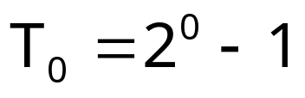

Proof:
= 0
Show that the basis is true
Now assume true for .
Using this assumption we show
DAA - Unit - I Presentation Slides

Slide 123
Solving recursive equations by repeated substitution
T(n) = T(n/2) + c substitute for T(n/2)
= T(n/4) + c + c substitute for T(n/4)
= T(n/8) + c + c + c
= T(n/2³) + 3c in more compact form
= …
= T(n/2^{k}) + kc “inductive leap”
T(n) = T(n/2^{logn}) + clogn “choose k = logn”
= T(n/n) + clogn
= T(1) + clogn
= b + clogn = θ(logn)
DAA - Unit - I Presentation Slides

Slide 124
Solving recursive equations by telescoping
T(n) = T(n/2) + c initial equation
T(n/2) = T(n/4) + c so this holds
T(n/4) = T(n/8) + c and this …
T(n/8) = T(n/16) + c and this …
…
T(4) = T(2) + c eventually …
T(2) = T(1) + c and this …
T(n) = T(1) + clogn sum equations, canceling the terms appearing on both sides
T(n) = θ(logn)
DAA - Unit - I Presentation Slides

Slide 125


Slide 126
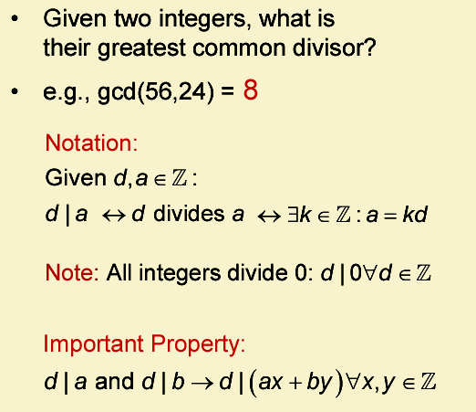

Slide 127
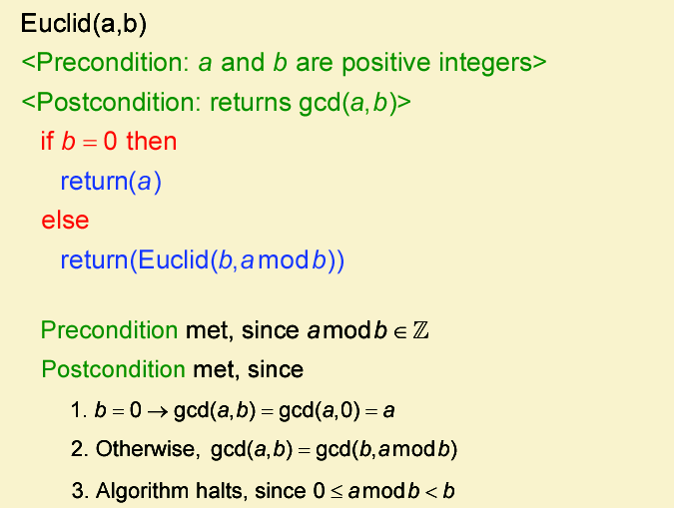

Slide 128

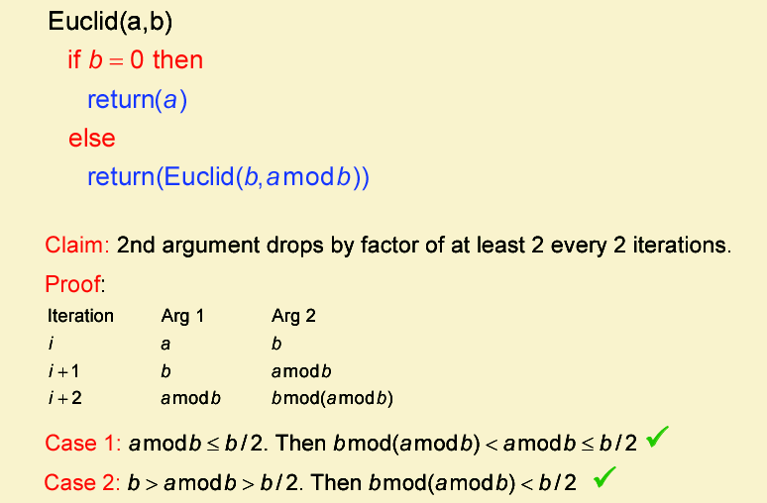

Slide 129
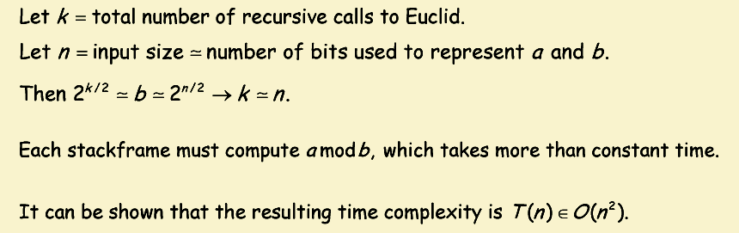

Slide 130
Mathematical Analysis of Non-Recursive Algorithms
Finding the value of the largest element in a list of n numbers.
General Plan for Analyzing the Time of Non-recursive Algorithms
  1. Decide on a parameter (or parameters) indicating an input’s size.
  2. Identify the algorithm’s basic operation.
  3. Check whether the number of times the basic operation is executed depends
    only on the size of an input. If it also depends on some additional property,
    the worst-case, average-case, and, if necessary, best-case efficiencies have to be investigated separately.
  4. Set up a sum expressing the number of times the algorithm’s basic operation is executed.
  5. Using standard formulas and rules of sum manipulation, either find a closed form
DAA - Unit - I Presentation Slides

Slide 131
Analysis of Linear Search
Another name - Sequential Search
Definition
  Suppose A is a linear array with n elements and ITEM is a given item of information. This algorithm finds the location LOC of ITEM in A, or sets LOC=0 if the search is unsuccessful.
  To do this, we compare ITEM with each element of A one by one. That is, first we test whether A[1]=ITEM, and then we test whether A[2]=ITEM and so on. This method, which traverses A sequentially to locate A, is called linear search or sequential search.
  To simplify the algorithm, we first assign ITEM to A[N+1]. Then the outcome LOC=N+1, signifies the search is unsuccessful.

Slide 132
Linear Search : Algorithm
Algorithm:LINEAR (A, N, ITEM, LOC)
Suppose A is a linear array with n elements and ITEM is a given item of information. This algorithm finds the location LOC of ITEM in A, or sets LOC=0 if the search is unsuccessful.
[Insert ITEM at the end of A]
Set A[N+1]=ITEM
[Initialize Counter]
Set LOC=1
[Search for ITEM]
Repeat while A[LOC] ≠ ITEM
Set LOC=LOC+1
[End of Loop]
5. [Successful?]
If Loc=N+1
Then:
Set Loc=0
6. Exit.

Slide 133
Analysis of Linear Search
The number of comparisons depends on where the target key appears in the list.
Two important cases to consider are the average case and worst case.
Location of the Element | No. of Comparison Reqd
0 | 1
1 | 2
2 | 3
: | :
N-1 | N
Not in the array | N

Slide 134
Average Case
Suppose if ITEM does appear in A. That is, if the desired record is the first one in the list, only one comparison is required. If the desired record is the second one in the list, two comparisons are required. If it is last one in the list, n comparisons are compulsory. The performance of a successful search will depend on where the target is found.

Slide 135
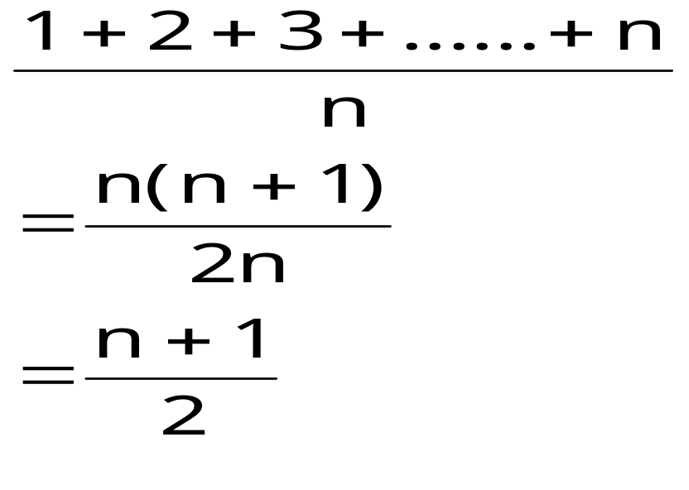
Average Case (Contd …)
Find the average number of key comparisons done in case of a successful sequential search by adding the number of comparisons needed for all the successful searches and divide it by n, the number of entries in the list as

Slide 136
Worst Case
If the search is unsuccessful, it makes n comparisons, as the target will be compared to all entries in the list. In this case, the algorithm requires f(n)= n+1 comparisons. Thus in the worst case, the running time is proportional to n.
Therefore, in both the cases, the number of comparisons is of the order of n denoted as O(n).

