Slide 1















E-commerce Customer Satisfaction
Supervised by :
Dr. Lydia Wahid
Eng. Omar Samir

Slide 2
Name | Section | BN
Karim Mohamed | 2 | 10

Slide 3
Problem Statement
in this project, we're looking at how satisfied customers are with their online shopping experiences. We're using data from Olist Stores, a big online shop in Brazil. Olist helps small businesses sell their stuff online easily. After people buy something on Olist, they get asked how happy they are with it. We're using this feedback to see if we can predict how satisfied customers will be based on their shopping data. Our goal is to find the best way to understand and predict customer satisfaction.

Slide 4
Project Pipeline
01
02
03
04
05
Data Cleaning
Data Exploration
Data preprocessing
Models
Association Rules

Slide 5
Data Cleaning
01.
Before Data Exploration, we Drop any unimportant columns, remove nulls values and mix any related columns into one columns then remove these related columns.
Data Preprocessing
Data Preprocessing
Before training models, we drop any unimportant column, convert all features into numerical features and split the data into train and test data
02.
Data Preprocessing
Before getting rules association, we convert all columns I will used to categorical columns to be able to get association rules easily
03.

Slide 6
Data Exploration
Extract visualizations and Insights

Slide 7
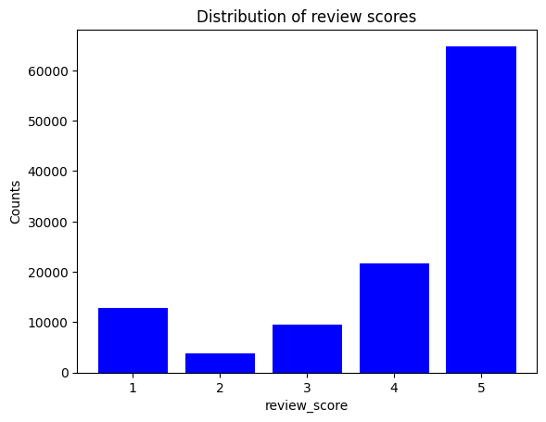
Distribution of review score which shows that a large percentage of of customers are satisfied with services and products

Slide 8
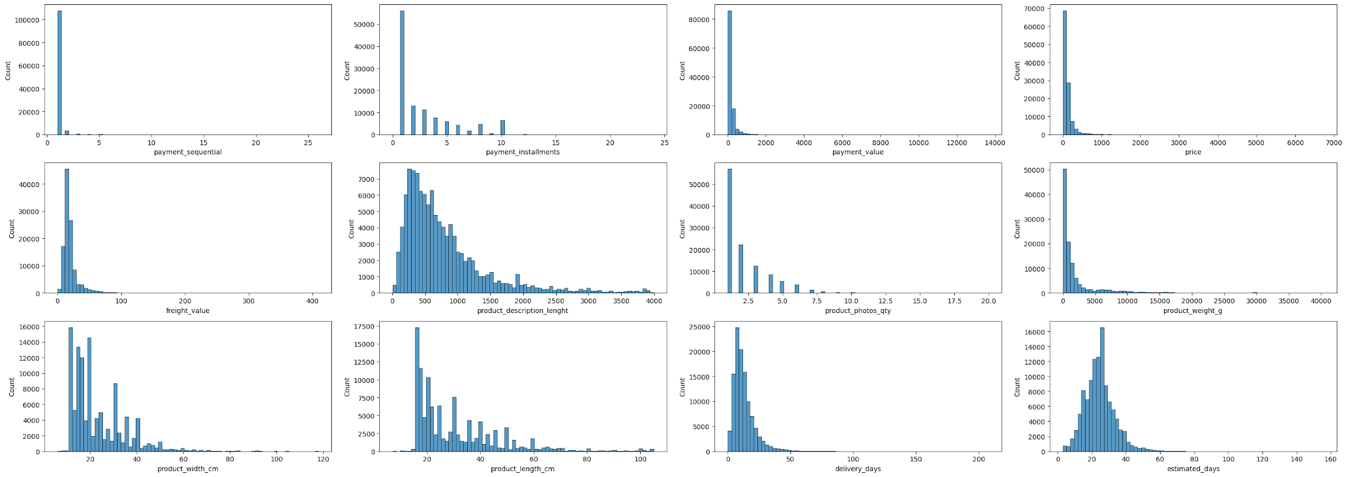
Distribution of numerical attributes that shows what the customers used more as services and also shows some distribution of returns

Slide 9
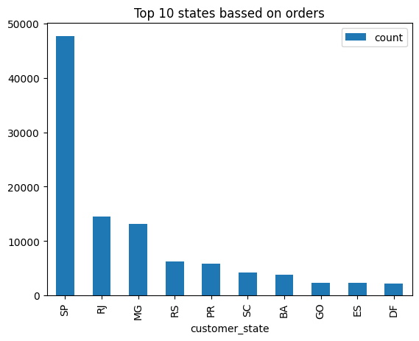
Top 10 customer states

Slide 10
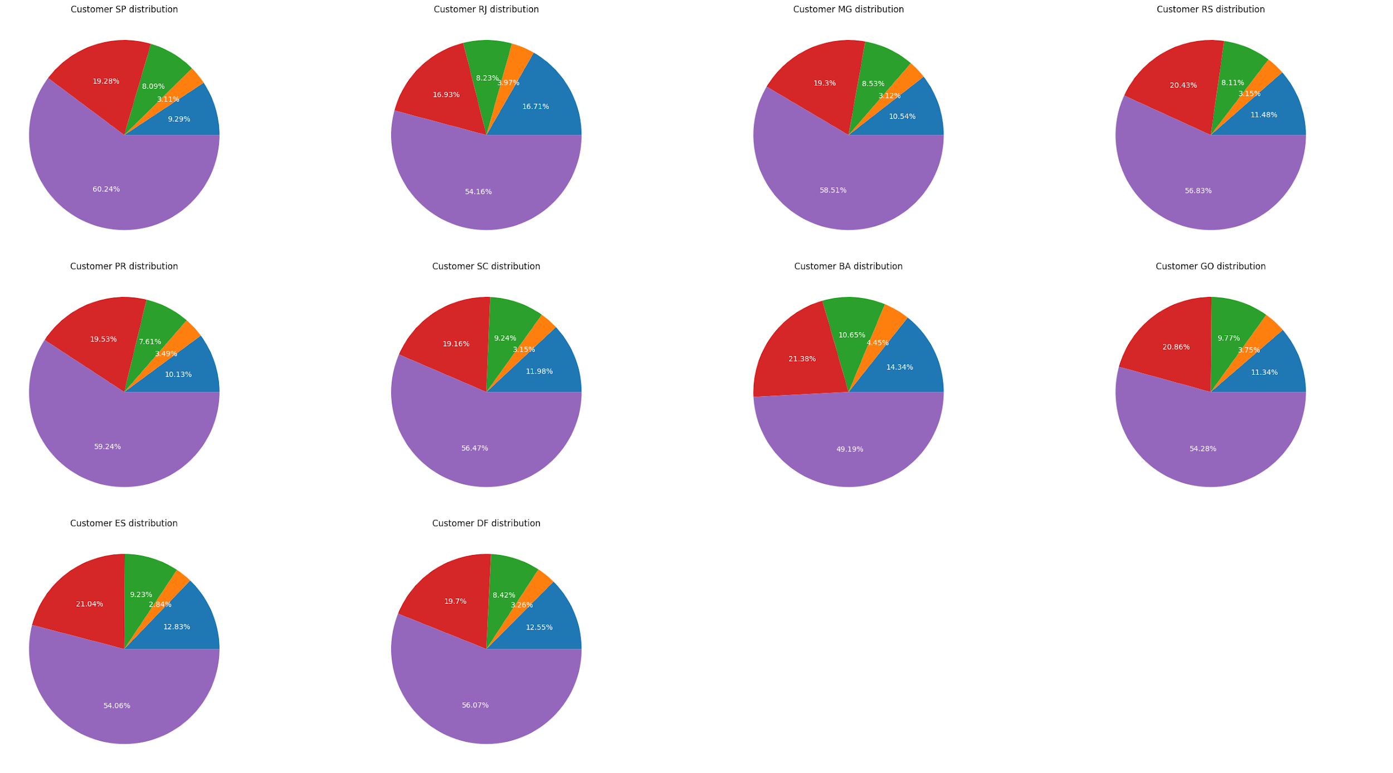
Review scores percentage for top 10 customer states

Slide 11
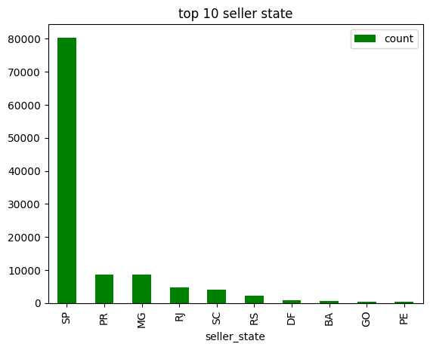
Top 10 seller states

Slide 12
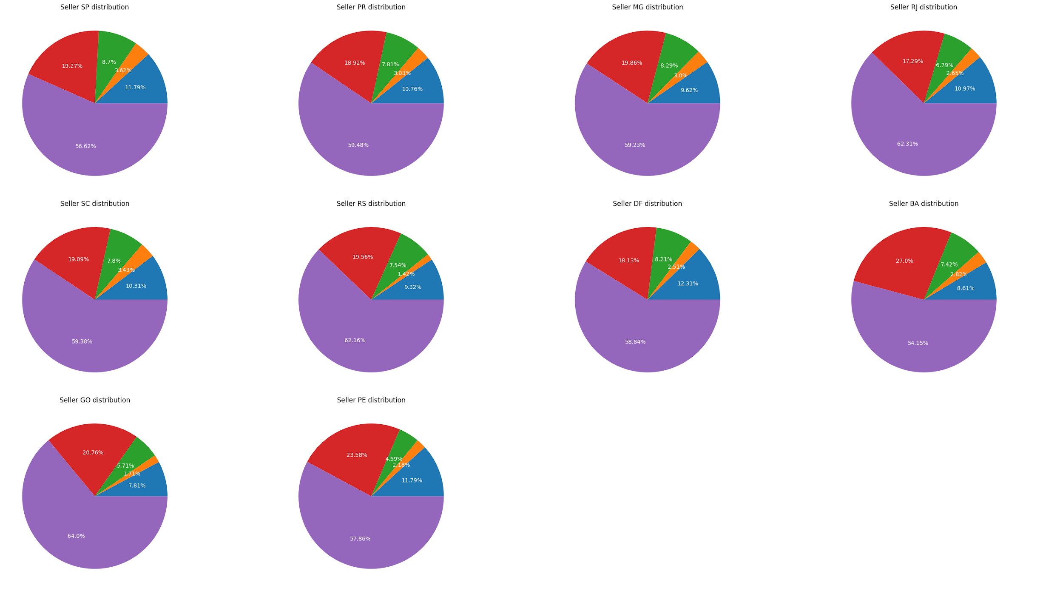
Review scores percentage for top 10 seller states

Slide 13
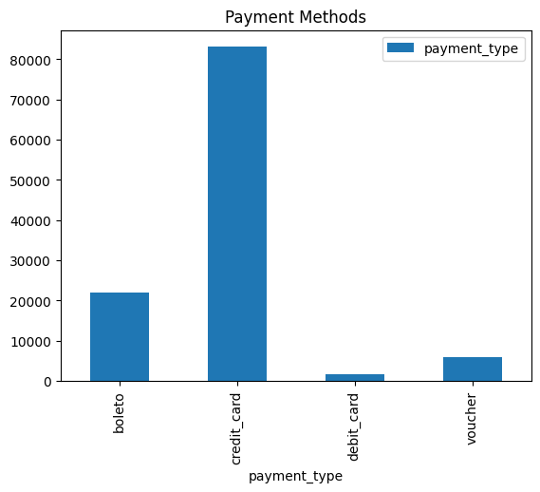
Most used payment methods for orders

Slide 14
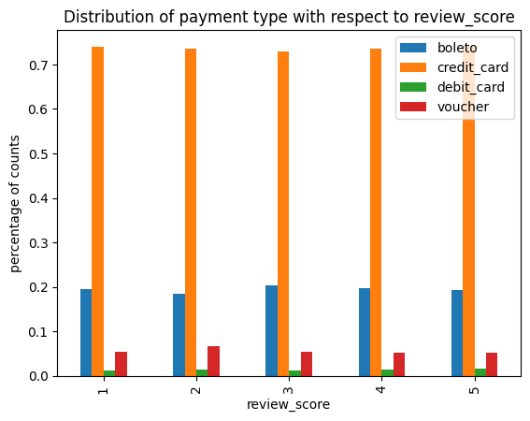
Distribution of payment type with respect to review score

Slide 15
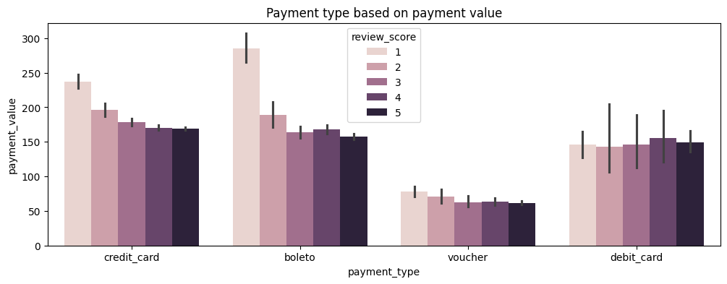
Payment type based on payment value

Slide 16
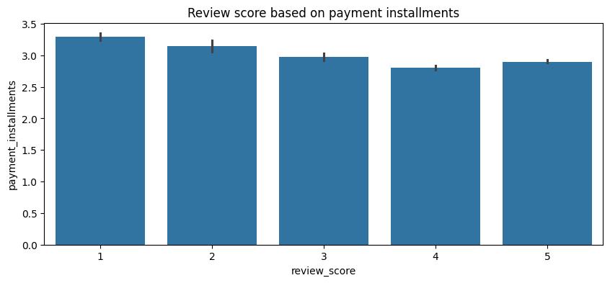
Review score based on payment installments

Slide 17
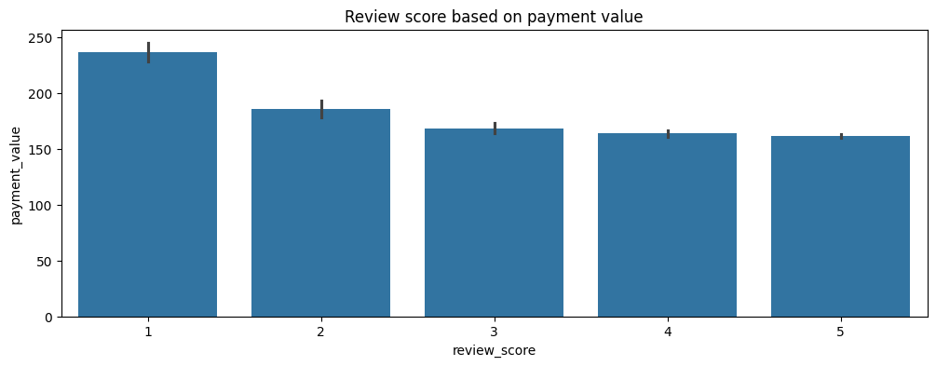
Review score based on payment value
Review score based on payment value

Slide 18
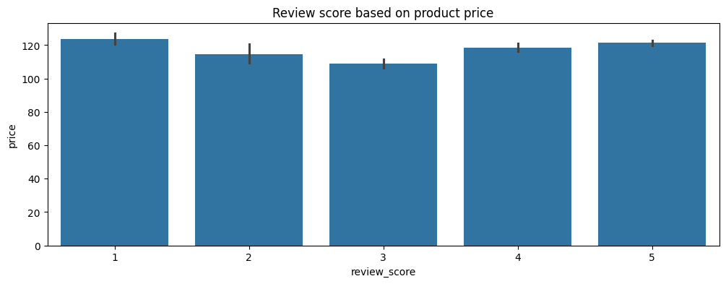
Review score based on payment value
Review score based on product price

Slide 19
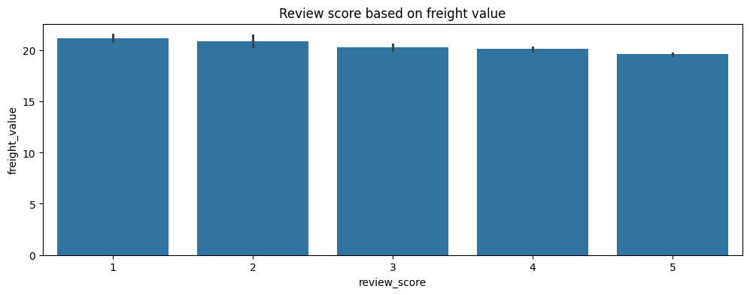
Review score based on payment value
Review score based on freight value

Slide 20
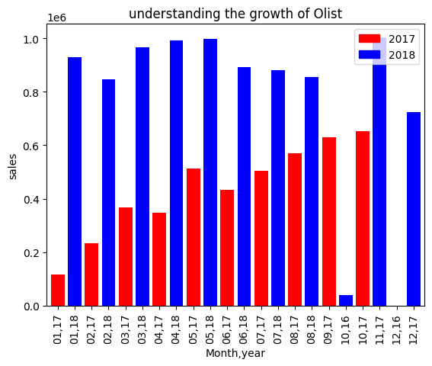
Review score based on payment value
Understand the growth of Olist

Slide 21
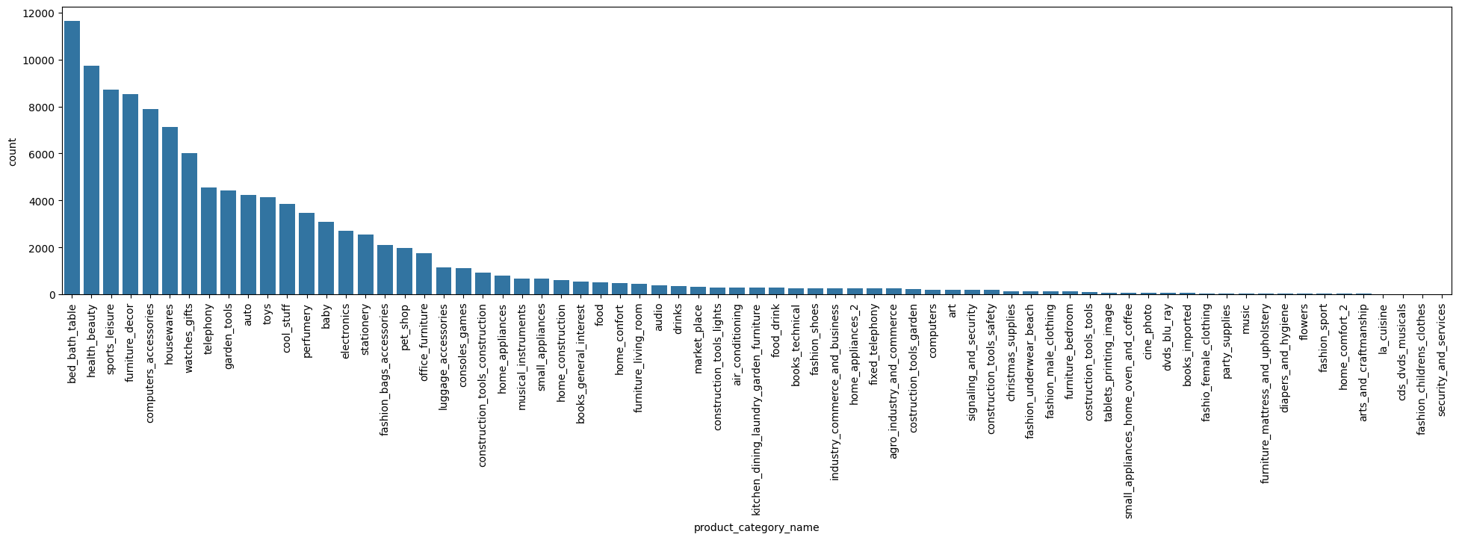
Review score based on payment value
Distribution of product category

Slide 22
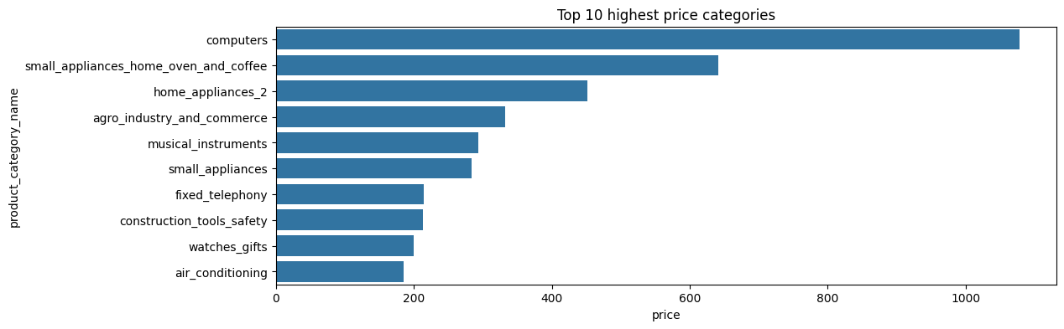
Review score based on payment value
Top 10 highest price category

Slide 23
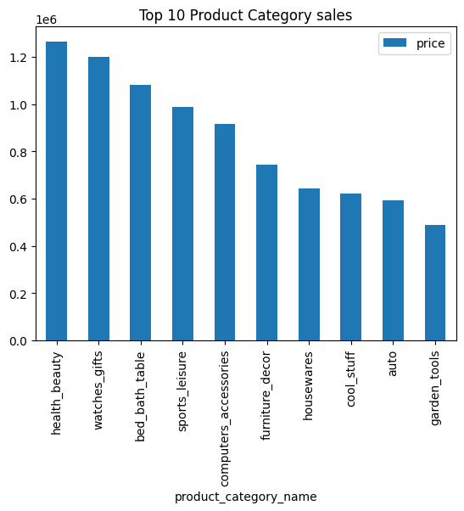
Review score based on payment value
Top 10 product category sales

Slide 24
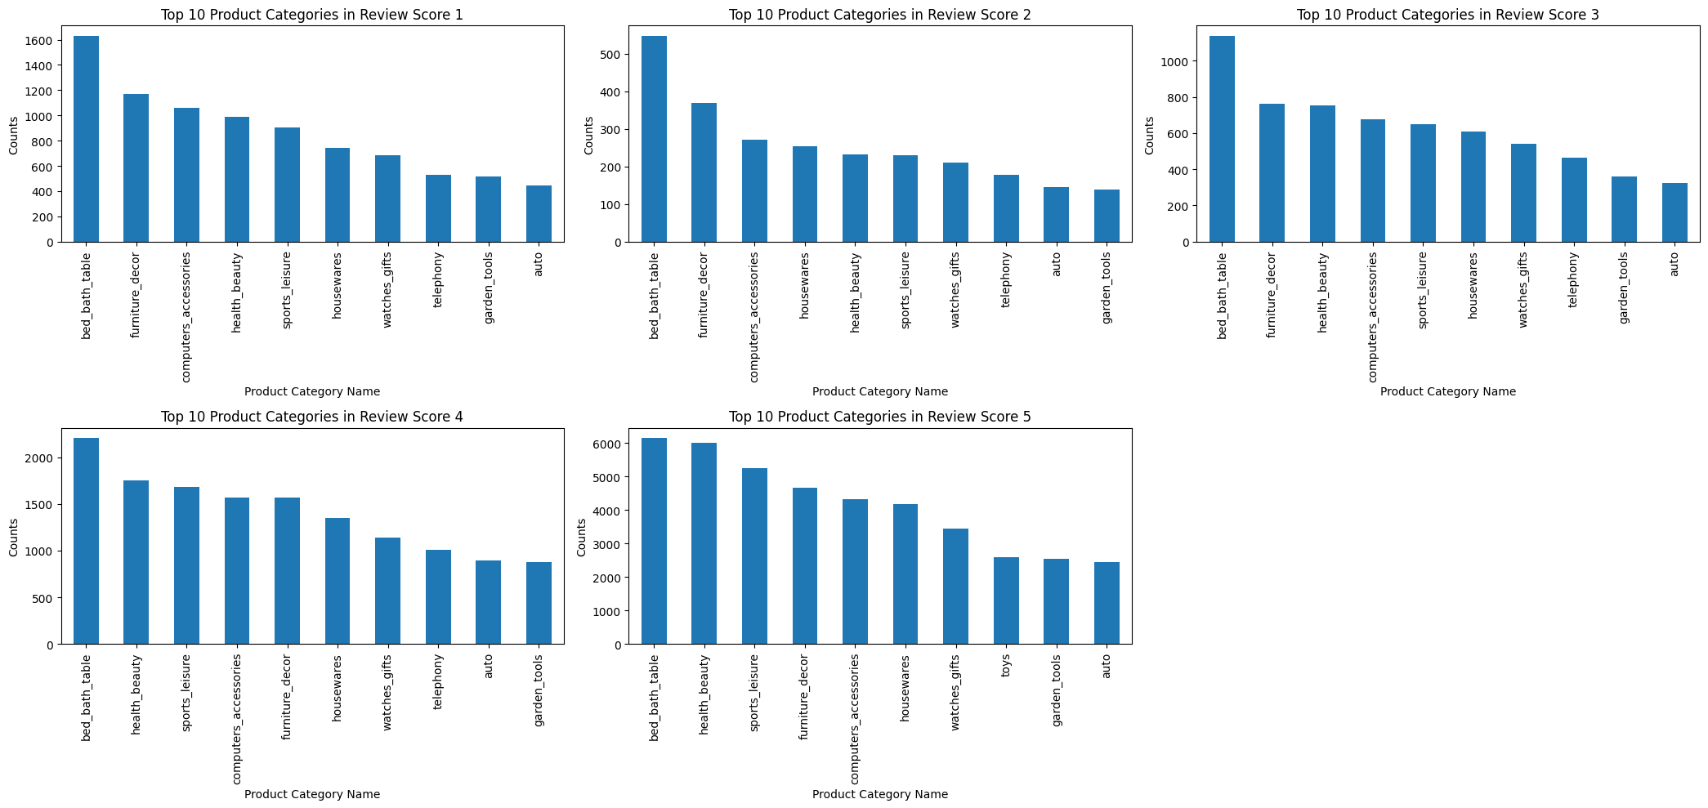
Top 10 product categories in review score

Slide 25
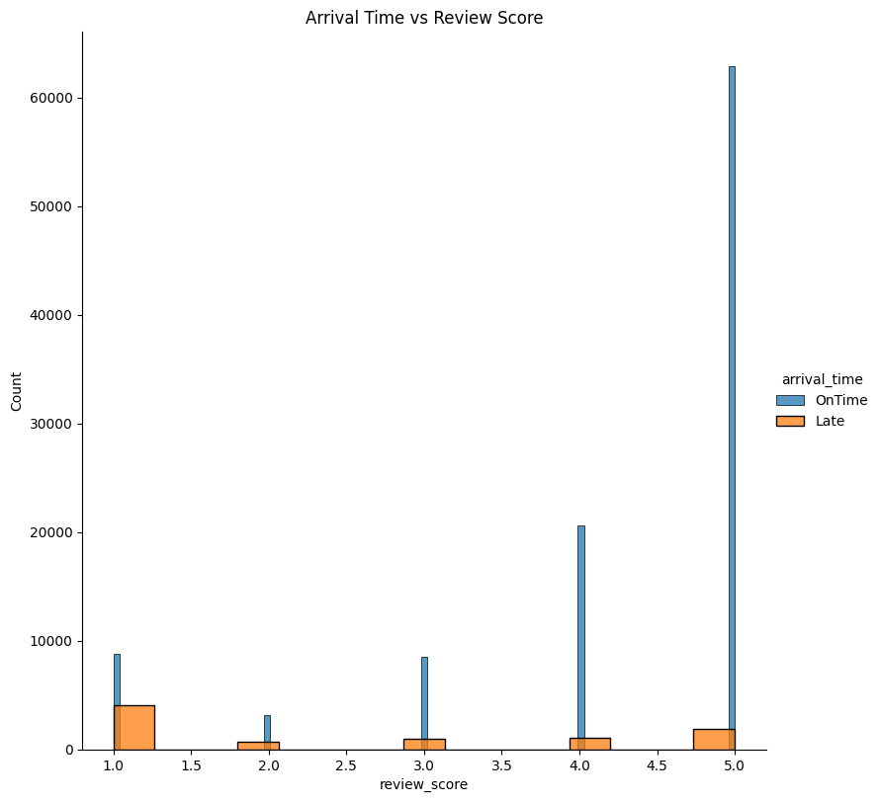
Arrival Time vs review score

Slide 26
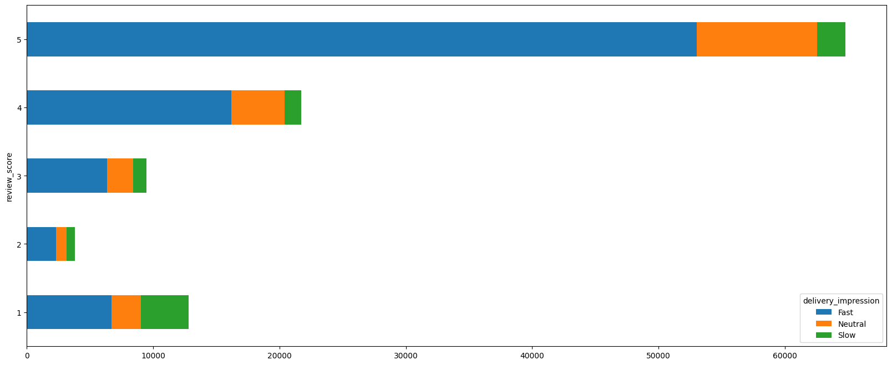
Arrival Time vs review score

Slide 27
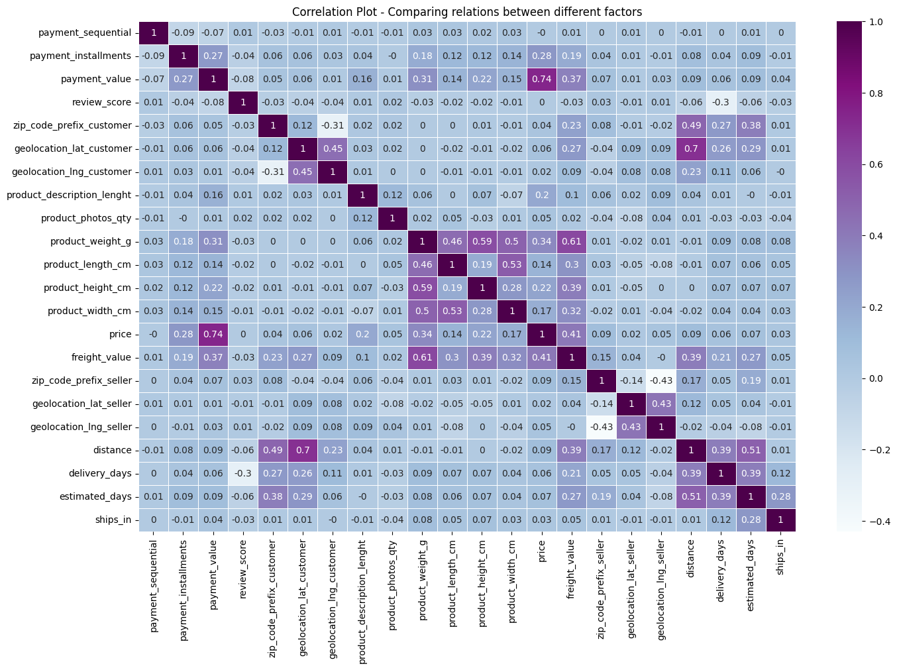
Correlation plot – comparing relations between different factors

Slide 28
Association Rules

Slide 29
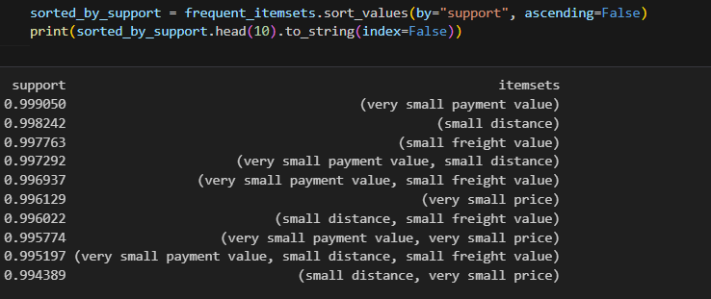
Review score based on payment value
Items with highest support

Slide 30

Payment type and review score
seller state and review score
excellent -> credit_card credit_card -> excellent
excellent -> SP SP -> excellent
Rules
Payment value and review score
Arrival time and review score
excellent -> very small payment value very small payment value -> excellent
excellent -> OnTime OnTime -> excellent
customer state and review score
Delivery impression and review score
SP -> excellent
Fast -> excellent excellent -> Fast

Slide 31
Review score based on payment value
Models / Results and Evaluation
Model | Accuracy | F1_Score
Random Forrest | 59.9 | 47.3
Logistic Regression | 59.7 | 47.4
Decision Tree | 60 | 47.3
Naïve Bayes | 54 | 47

Slide 32
Thank you very much!

