Slide 1
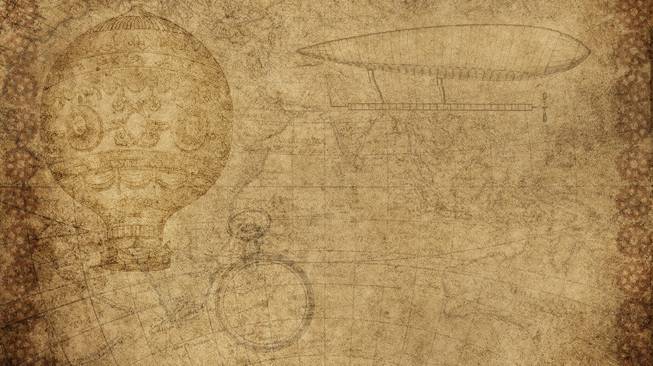
Basic TRAVEL AGENCY PROJECT
PREParED By :
20IT064 MANTHANSINH MAKWANA
20IT082 ARYAKUMAR PATEL
GUIDED BY.
PROF. PRIYANKA PATEL

Slide 2
CONTENTS
INTRODUCTION
REASON BEHIND SELECTING THIS PROJECT
FLOW CHART
MODULE OF PROJECT
PROJECT SCREENSHOTS
FUTURE SCOPE

Slide 3
INTRODUCTION
Travel agency website provide reservation facility to there customer.
Maximize travel policy compliance all areas including best fares, allowances and approval.
Customer will also see the trip services.
This webside provide reservation facility to there customer.

Slide 4
REASON
The purpose of website is established fact that internet users are increasing today. Today one of the main purposes of the website is to facilitate the offline customer online because customers cannot spend their precious time in markets trying to find out the best deal.
Our priority will be our customers and their travel requirements.
we will putting an effort to provide the right choice to the people when they plan a holiday and beware them from the false advertising.

Slide 5
ABOUT THIS PROJECT
This website is develop to provide best travelling services to the customers and travel agents. We have developed travel agency website to provide a search platform where a tourist can find their tour places according to their choices.
This website also helps to promote responsible and interesting tourism so that people can enjoy their holidays at their favorable places.
This website also helps to develop tourism with different cultures so that they enrich the tourism experience and build pride.

Slide 6
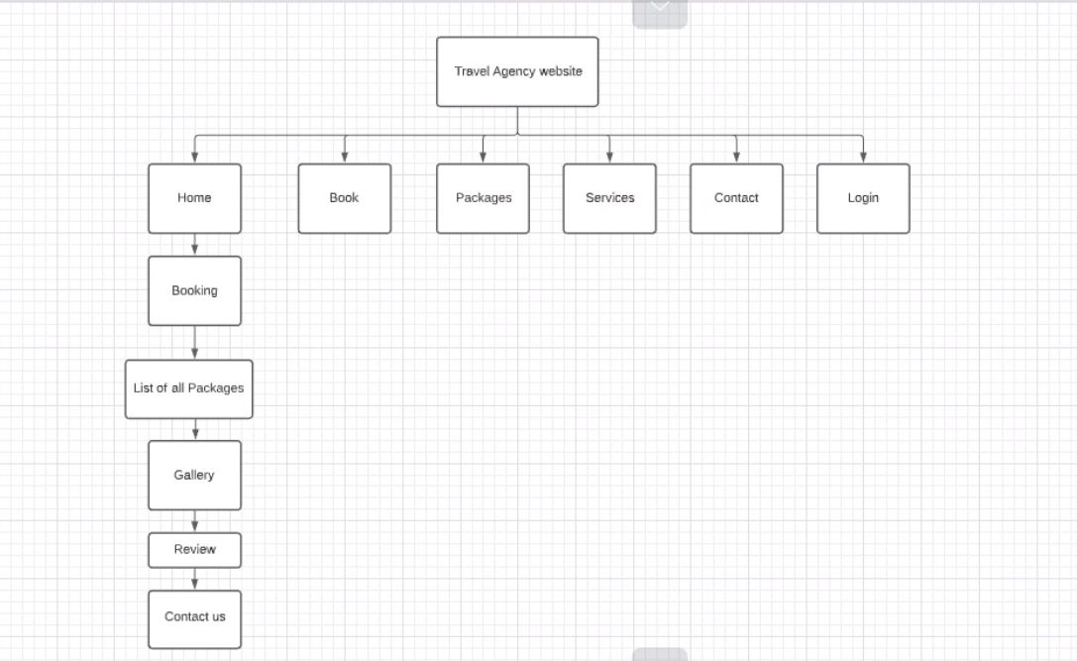
DATA Flow DIAGRAM

Slide 7
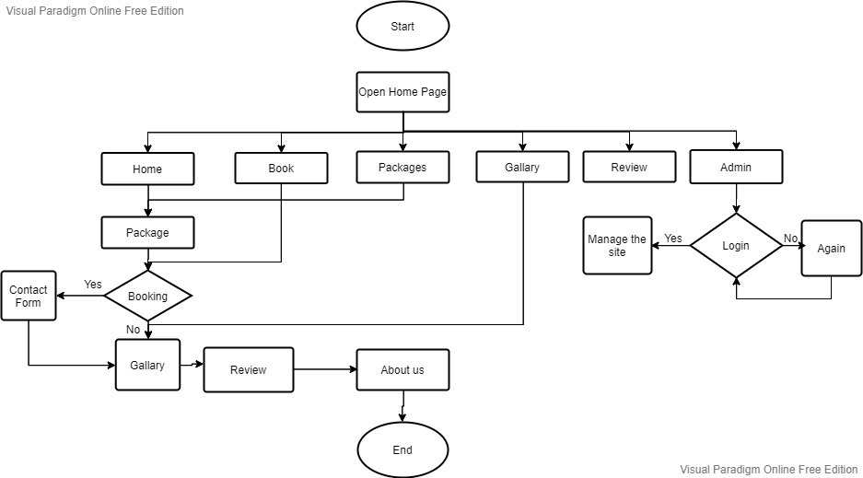
FLOW CHART

Slide 8
MODULE OF PROJECT
DEVELOPER :
LOGIN
MANAGE TOUR PACKAGES
MANAGE TICKET BOOKING
VIEW FEEDBACK
CUSTOMER :
CONTACT FORM
VIEW PACKAGES
BOOKING
GIVE FEEDBACK

Slide 9
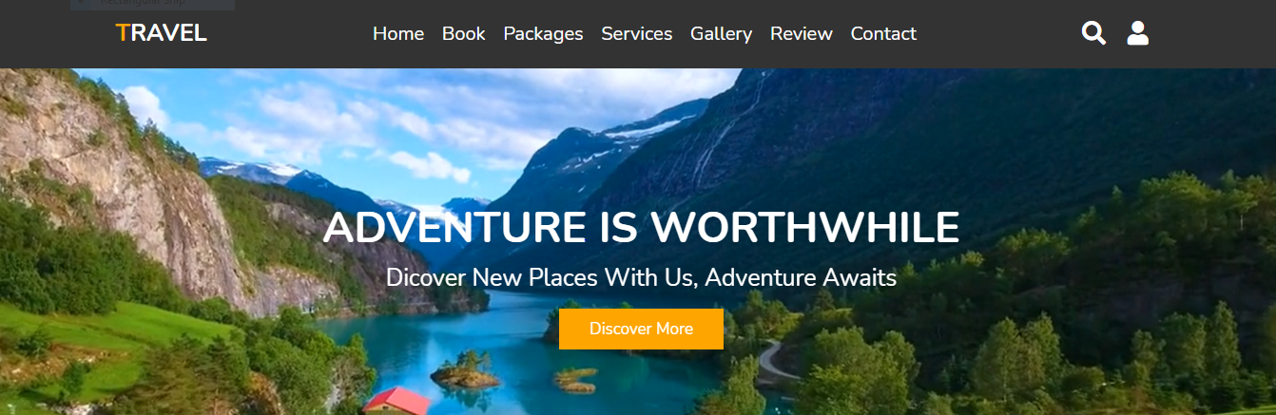
Home Page
PROJECT SCREENSHORTS

Slide 10
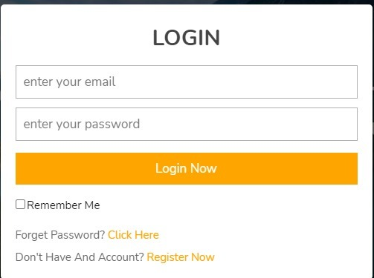
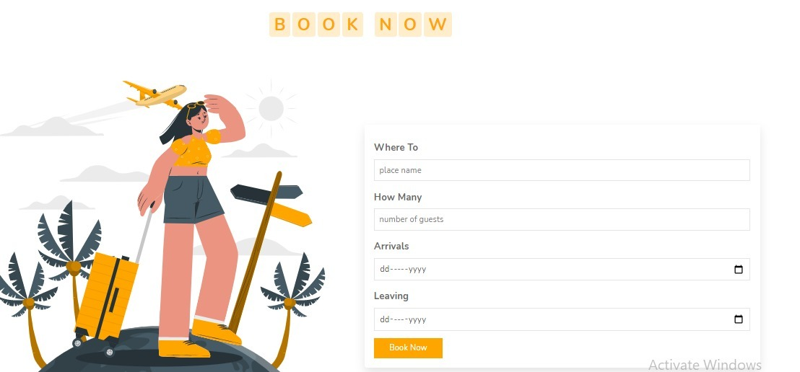
Login page & booking page

Slide 11
FUTURE SCOPE
We will include more functionality as per the user requirements.
We want to improved our home page , as it is the main thing which atteracts all user.
Not a single website is ever consider as complete forever firstly because there is always something new requirement also are growing day by day.

Slide 12
Tools and technology
The Website is built on the Visual Studio Code IDE.
In this Website , we use HTML,CSS and Basic JAVA SCRIPT Language to making this Project.

Slide 13
REFERENCES
https://www.yatra.com/
https://www.makemytrip.com/holidays-india/
https://www.akshartours.com/india-tour/

Slide 14
Github links:https://github.com/Arya1119/TravelAgency
Demolink:https://youtu.be/AV1_vLBx4R4
Blog link:https://aryapatl1119.blogspot.com/

Slide 15
T H A N K Y O U

