Slide 1
SysSoft Security
A quick refresher on Memory corruption and ABI
sanjay.rawat@Bristol.ac.uk

Slide 2
Lecture(s) Agenda
Motivation (non-technical)
Background
C to assembly
Memory layout
Example – Stack buffer Overflow

Slide 3
Motivation
Bruce Schneier wrote
"Security is a chain; it's only as secure as the weakest link."
cryptography is already strong (mathematically!)
problem lies in software, hardware, networks etc.
For now, we’ll focus on software parts

Slide 4
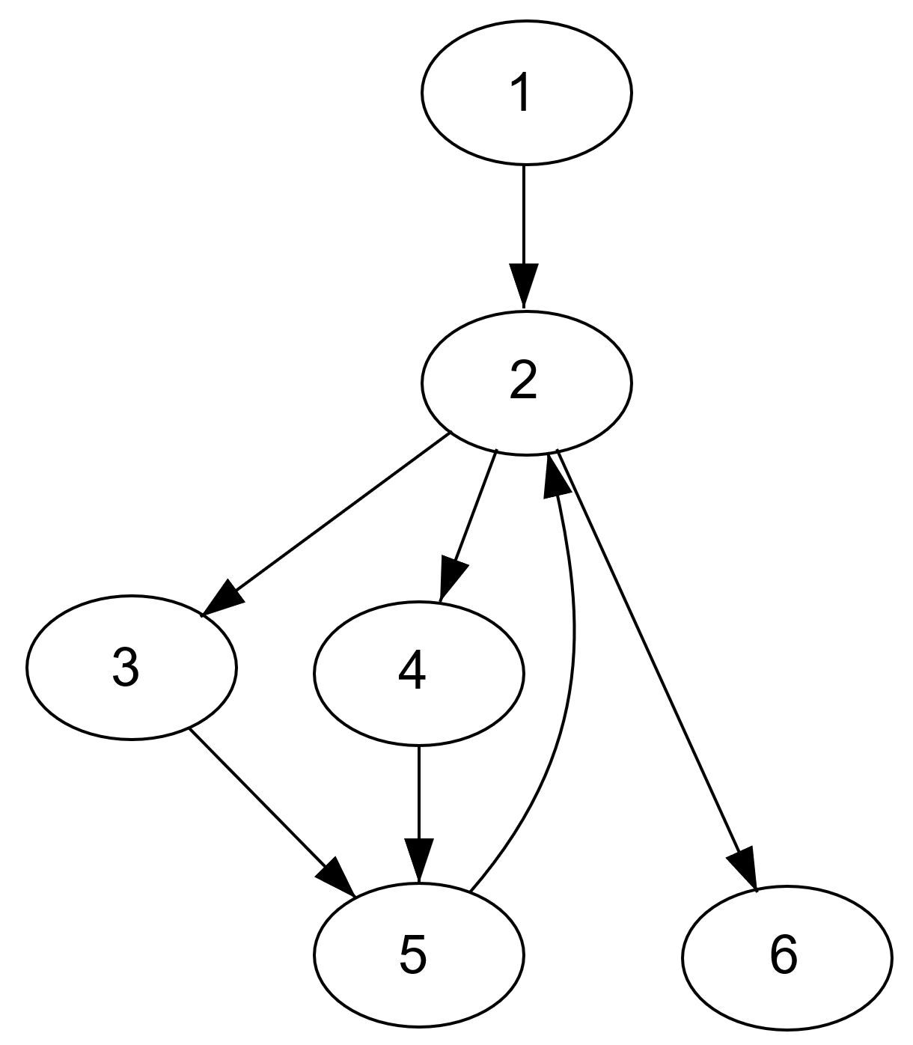
What is a computer program
Intended behavior
Functional
Security policy/objectives
Security feature
(crypto)
Unintended behavior
Intended behavior
Design flaw?
Low-level system bugs

Slide 5
Software Vulnerability
WEAKNESS: a type of behavior that has the potential for allowing an attacker to violate the intended security policy, if the behavior is made accessible to the attacker. e.g. overflow via strcpy()
VULNERABILITY: a set of one or more related weaknesses within a specific software product or protocol that allows an actor to access resources or behaviors that are outside of that actor's control sphere, i.e., that do not provide appropriate protection mechanisms to enforce the control sphere.
Vulnerability is the intersection of three elements: a system susceptibility or flaw, attacker access to the flaw, and attacker capability to exploit the flaw (there are mitigations!)

Slide 6
Exploits
Exploit:
An exploit is a piece of software or technique that takes advantage of a security vulnerability to violate an explicit or implicit security policy.
Vulnerabilities in software are subject to exploitation.
Exploits can take many forms, including worms, viruses, and trojans.

Slide 7
Exploits
Exploit:
Proof-of-concept exploits are developed to prove the existence of a vulnerability.
Proof-of-concept exploits are beneficial when properly managed (for example?).
Proof-of-concept exploit in the wrong hands can be quickly transformed into a worm or virus or used in an attack.

Slide 8
Memory Corruption Vulnerabilities
WYSINWYX: What You See Is Not What You eXecute by G. Balakrishnan et. al.
Higher level code -> low-level representation
Seemingly separate variables -> contiguous memory addresses
Contiguous memory locations allow for boundary violations!
We need to peep into the memory layout to understand → ABI

Slide 9
Side effects
Over/underflow
Sensitive data corruption
Control data corruption (control hijacking)
_{If done properly-exploit}
Otherwise crash!

Slide 10
Generic Approach to Vulnerability Detection
Find the weakness in the Software (sink)
Find the source of tainted input (source)
Find the tainted path from source to sink.
You may have to do this at binary level

Slide 11
Mitigations
Mitigation:
Mitigations are methods, techniques, processes, tools, or runtime libraries that can prevent or limit exploits against vulnerabilities.
At the code level, compiler assisted canary technique OR control flow integrity.
At a system or network level, a mitigation might involve turning off a port or filtering traffic to prevent an attacker from accessing a vulnerability OR OS provided techniques (ASLR, e.g.).

Slide 12
C and C++
C and C++:
Popular programming languages.
Many vulnerabilities that have been reported to the CERT/CC have occurred in programs written in one of these two languages.
By design, these are memory unsafe language.

Slide 13
What is the Problem with C?
Programmer errors
Failing to prevent writing beyond the boundaries of an array,
Failing to catch integer overflows and truncations,
Lack of type safety.
Operations can legally act on signed and unsigned integers of differing lengths using implicit conversions and producing unrepresentable results.

Slide 14
Legacy Code
A significant amount of legacy C code was created (and passed on) before the standardization of the language.
Legacy C code is at higher risk for security flaws because of the looser compiler standards and is harder to secure because of the resulting coding style.

Slide 15
Motivating example
#include <stdio.h>
int get_cookie()
{
return rand();//random number
}
int main()
{
int guess; char name[20];
guess=get_cookie();
printf("Enter your name:\n");
gets(name);
if(guess == 0x41424344)
{ printf("Hurray... you win Dear %s\n",name); } else printf("Sorry, Better luck next time :( \n");
return 0;
}

Slide 16
Motivating example conti..
What does it do?
Does it do that as intended?
If not, why?
Where is the problem?
We need to look stuff behind our program!!!

Slide 17
Typical Memory Layout
Windows PE and Linux ELF file formats
Main segments of a compiled code:
The executable code (text segment)
The initialized data (data segment)
The uninitialized data (bss segment)
The heap (dynamic memory allocation)
The executable code and data of needed shared libraries (dynamically loaded into the space)
The program stack

Slide 18
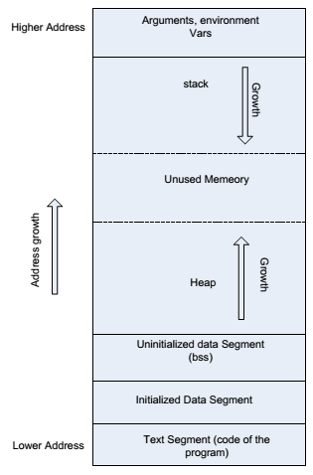

Slide 19

x86 Assembly (32-bit)
6 general purpose registers
EAX, EBX, ECX, EDX, ESI EDI
2 special registers ESP, EBP
1 very special register EIP
100s of instructions
Data movement
Arithmetic
jump
X86-64
Intel® 64 and IA-32 Architectures
Software Developer’s Manual
Volume 2 (2A, 2B, 2C & 2D): Instruction Set Reference, A-Z

Slide 20
Generic code syntax/semantic
Two address mode
Opcode operand1, operand2
Intel- operand1 is destination, mov rax, 10
AT&T- operand2 is destination, mov 10, rax
Arithmetic
Add, sub, mul… add rax, rbx -> rax=rax+rbx
Data movement
Mov, push pop… mov rax, 10 -> rax=10; mov eax, [ebx]
Jump
Jmp <address>

Slide 21
Calling conventions x86-32
cdecl – parameters are pushes onto the stack, caller cleans the stack
stdcall- parameters are pushes onto the stack, callee cleans the stack
fastcall- first 3 parameters passed in EAX, EDX, ECX, rest on stack.
thiscall- OOP, pointer to class object in ecx, rest are on stack.

Slide 22

Calling conventions x86-64
Microsoft x64 calling convention
Registers RCX, RDX, R8, R9 for the first four integer or pointer arguments (in that order)
XMM0, XMM1, XMM2, XMM3 are used for floating point arguments
Additional arguments are pushed onto the stack (right to left)
Unix like systems
The first six integer or pointer arguments are passed in registers RDI, RSI, RDX, RCX, R8, R9
XMM0, XMM1, XMM2, XMM3, XMM4, XMM5, XMM6 and XMM7 are used for certain floating point arguments
Additional arguments are passed on the stack
The return value is stored in RAX and RDX
If any of these argument registers are read first, before writing, it is fastcall / x86-64 calling convention

Slide 23
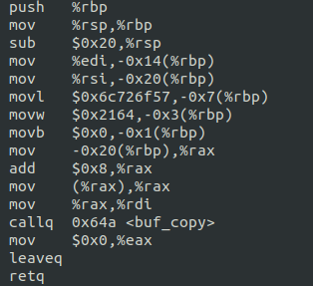
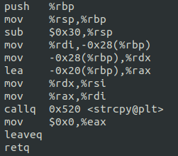
Stack operation
Lower addr
rsp
rbpB
rsp
rbpM
buf
M7 RET
rsp
main
rbpM
Saved rbp
Higher addr

Slide 24
Example: C to assembly
int main(int argc, char *argv[]) {
char name[]=”World!”;
buf_copy(argv[1]);
return 1;
}
int buf_copy(char *string) {
char buffer[20];
strcpy(buffer, string);
return 1;
}
Notes:
Explain the notion of process memory and then stack e.g. local var, arg, return.

Slide 25
Know your Tools
Disassembler/debugger
Windows: OllyDbg, PyDbg, Immunity Debugger, IDA Pro
Linux: GDB ☹ , Evan’s Debugger (EDB), IDA Pro
Language: Your choice, Python (my choice)
Hex viewer: HxD HexEditor

Slide 26
compiling options
Useful
GCC:
gcc -fno-stack-protector -z execstack vulnerable.c
-fno-stack-protector disables SSP (stack guard)
-z execstack marks the stack as executable
-mno-accumulate-outgoing-args -mpush-args
## forcing GCC to push the arguments on the stack
Windows CL
/GS-

Slide 27
Coming back to vulnerability
Finding vulnerability is first thing.
Find it and Patch it OR
How to exploit it?
Hijacking the control -> controlling which instruction(s) will be executed next.
Candidates: saved return addr, function pointers, SEH etc.

