Slide 1
Systems & Software Security COMSM0050 2020/2021

Slide 2
Race condition: Examples Reference Monitor

Slide 3
What is a reference monitor?

Slide 4
Example 2: implementing OS reference monitor
a reference monitor is a secure, always-used and fully-testable module that controls all software access to data objects or devices

Slide 5
Example 2: implementing OS reference monitor
system call table
System call table
Open

Slide 6
Example 2: implementing OS reference monitor
Modified
system call table
Wrapper
Open

Slide 7
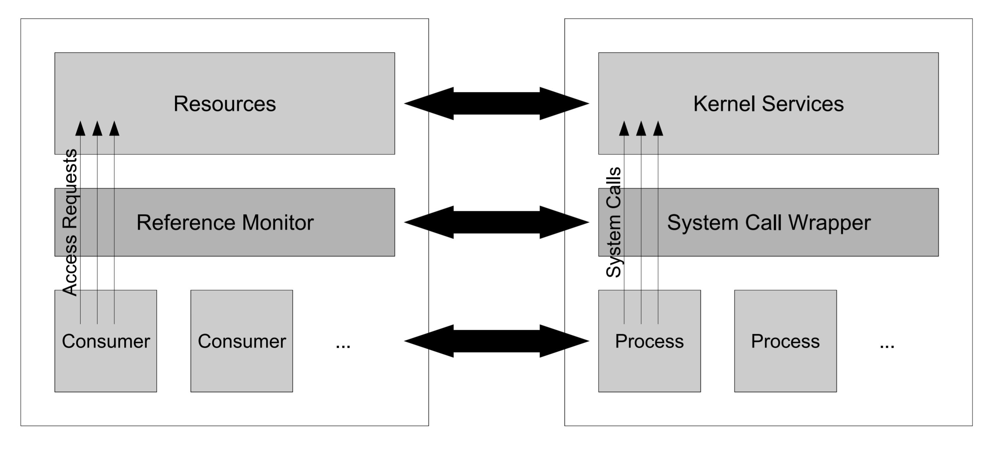
Example 2: implementing OS reference monitor
a reference monitor is a secure, always-used and fully-testable module that controls all software access to data objects or devices

Slide 8
Example 2: implementing OS reference monitor
Modified
system call table
Modifiedsystem call table
Wrapper
Open
e.g. LOMAC

Slide 9
Example 2: implementing OS reference monitor
Modified
system call table
Modifiedsystem call table
Wrapper
Open
[…]
len = strncpy_from_user(kname, filename, EMBEDDED_NAME_MAX);
[…]

Slide 10
Example 2: implementing OS reference monitor
Modified
system call table
Modifiedsystem call table
Wrapper
Open
[…]
len = strncpy_from_user(…)
[…]
Policy decision
OR
Transformation
etc…
[…]
len = strncpy_from_user(kname, filename, EMBEDDED_NAME_MAX);
[…]

Slide 11
Problem?

Slide 12
Example 2: implementing OS reference monitor
Wrapper and syscall work on two different copy of the buffer!
User space controlled buffer
Can be controlled by an attacker
The value checked to enforce policy!=value seen by syscall

Slide 13
Example 2: implementing OS reference monitor
Wrapper and syscall work on two different copy of the buffer!
User space controlled buffer
Can be controlled by an attacker
The value checked to enforce policy!=value seen by syscall
We will discuss how Linux implement its reference monitor in a future video

Slide 14
Example 2: implementing OS reference monitor
Wrapper and syscall work on two different copy of the buffer!
User space controlled buffer
Can be controlled by an attacker
The value checked to enforce policy!=value seen by syscall
We will discuss how Linux implement its reference monitor in a future video
Check Robert Watson paper for more in depth discussion on this topic

