Slide 1
Systems & Software Security COMSM0050 2020/2021

Slide 2
Speculative execution

Slide 3
How the CPU work
FETCH
DECODE
EXECUTE
WRITE BACK

Slide 4
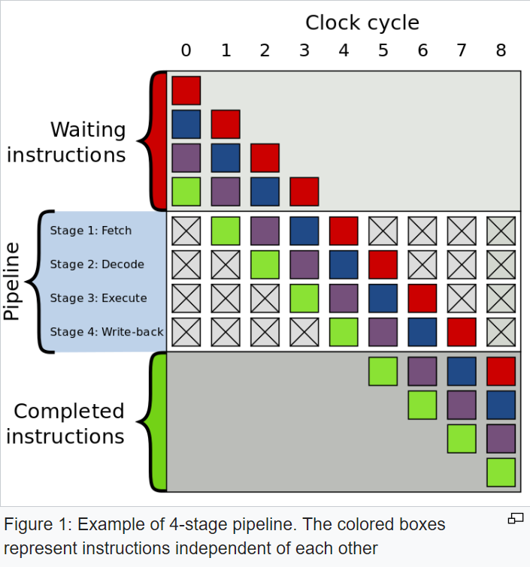
How the CPU work
FETCH
DECODE
EXECUTE
WRITE BACK

Slide 5
What happened on branch?
You evaluate the branch condition…
… but you need to wait to know what will be the next instruction
Your pipeline remains empty
That create a “bubble”

Slide 6
How can we avoid bubble?
We need branches…
We can guess what is likely to be executed next
branch predictor
If wrong roll back

Slide 7
How can we avoid bubble?
We need branches…
We can guess what is likely to be executed next
branch predictor
If wrong roll back
If we are not too bad at guessing we should be able to improve performance.

Slide 8
Static predictor
Simplest approach
Predict always taken
Predict always not taken
Backward branch predict taken; forward branch predict not taken
Can also be informed by the compiler (through a bit in the opcode)

Slide 9
Dynamic branch prediction
Prediction based on the execution history of a program
e.g. branch in a loop more likely to execute the loop code
During startup information is gathered
Can use static prediction
Once information has been gathered dynamic branch prediction become effective
Better Performance
More hardware complexity

Slide 10
Implementing dynamic prediction (simple)
Table associating branching address to prediction
1 bit
0 branch was not taken
1 branch was taken
If 0 predict not taken
If 1 predict taken

Slide 11
Implementing dynamic prediction (simple)
Table associating branching address to prediction
1 bit
0 branch was not taken
1 branch was taken
If 0 predict not taken
If 1 predict taken
In other word, predict the same branch will be taken as the branching was seen

Slide 12
Implementing dynamic prediction (simple)
Table associating branching address to prediction
1 bit
0 branch was not taken
1 branch was taken
If 0 predict not taken
If 1 predict taken
Let’s take a loop with 9 iterations
It will be correct in 80% of the time
First time predict exit instead of looping
Last iteration would predict continue instead of exit

Slide 13
More complex predictor
This is the simplest predictor
Obviously much more complex now
… but beyond the scope of this course
Take an architecture unit to know more!

