Slide 1
Introduction to Rowhammer
Sanjay Rawat

Slide 2
Effect of Rowhammer
Memory corruption but not via software bugs!
This changes the dynamics of software defence mechanism
Not easy to fix

Slide 3
Organization (main take-away)
General introduction to rowhammer
DRAM design (only parts that facilitate rowhammering)
Attack Example
The slides are based on:
1. Flipping Bits in Memory Without Accessing Them: An Experimental Study of DRAM Disturbance Errors, Kim et al.
2. Various talks/articles by Ander Fogh.
3. Exploiting the DRAM rowhammer bug to gain kernel privileges, Seaborn and Dullien

Slide 4
What is Rowhammer
DRAM is organized as rows/cells, which are densely populated
Activation of a row interferes with the adjacent rows
This results in discharge, thus change in the value they represent!
Rowhammer is an exploitation of DRAM design to flip bit
Flipped bits may correspond to control-bits, used for several checks

Slide 5
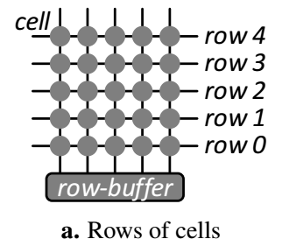
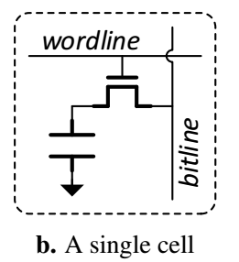
Design of DRAM
DRAM module, consists of DRAM ranks, which in turn are groups of DRAM chips.
DRAM is a two dimensional array of cells.
Each cell consists of a capacitor and an access-transistor.
Accessing a cell involved wordline and bitline

Slide 6
Accessing a row
Open Row. A row is opened by raising its wordline (ACT row_addr) . This connects the row to the bitlines, transferring all of its data into the bank’s row-buffer.
Read/Write Columns. The row-buffer’s data is accessed by reading or writing any of its columns as needed (READ/WRITE col_addr).
Close Row. Before a different row in the same bank can be opened, the original row must be closed by lowering its wordline (PRE bank_addr). In addition, the row-buffer is cleared.

Slide 7
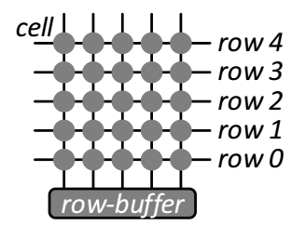
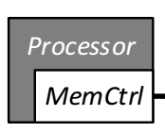
illustration

Slide 8
Rowhammer Primitive
Capacitor charge/discharge maps to binary data.
And it leaks charge, which requires refresh
DDR3 DRAM specifications guarantee a retention time of at least 64 milliseconds

Slide 9
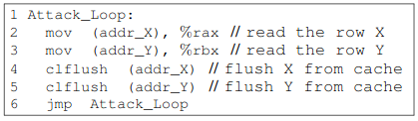
When a wordline’s voltage is toggled repeatedly, some cells in nearby rows leak charge at a much faster rate.
Such cells cannot retain charge for even 64ms, the time interval at which they are refreshed.
Ultimately, this leads to the cells losing data and experiencing disturbance errors.

Slide 10
How bits can be flipped
Single sided hammering
Double sided hammering
r0
aggressor
r0
r1
r1
aggressor
victim
r2
r2
r3
r3
victim
r4
aggressor
r4
aggressor
r5
victim
r5
Row buffer
Row buffer

Slide 11
A generic strategy
Identify data structure that, if randomly bit-flipped, yields improved privileges
Fill as much memory as possible with this data structure
Wait for the bit flip to occur

Slide 12
Sandbox escape Example
Sandbox for running native code (C/C++)
Applications can only access addresses inside the sandbox
Safe instruction sequence:
andl $~31, %eax // Truncate address to 32 bits
// and mask to be 32-byte-aligned.
addq %r15, %rax // Add %r15, the sandbox base address.
jmp *%rax // Indirect jump.
What if rax → rcx (which points to outside address!)
Jmpq %*rax code ff e0; jmpq %*rcx code ff e1
1111111111100000 → 1111111111100001

Slide 13
If interested more attacks, like page table entries hammering, read:
Exploiting the DRAM rowhammer bug to gain kernel privileges, Seaborn and Dullien

