Slide 1
SysSoft Security
A very quick Introduction to Stack Buffer Overflow
Sanjay.rawat@Bristol.ac.uk

Slide 2
Recap…
int func(arg1, arg2)
{
int var1;
int var2;
char arr[20];
int var3;
…
…
return 0;}
int main()
{
int x;
X= func(4, 10);
…
…
}
Lower address
rsp
var3
arr
var2
rbp
var1
Saved rbp
Ret addr
Call func
4
10
rdi=4
rsi=10
x
main’s stack
Higher address

Slide 3
Lecture Agenda
Buffer Overflow, in general
Stack Overflow
Heap Overflow (more details in other lecture)
Code patterns leading to such bugs.
Book Ref.
The Craft of System Security, by Sean Smith; John Marchesini. Chapter 6, section 6.1
24 DEADLY SINS OF SOFTWARE SECURITY- Programming Flaws and How to Fix Them. Section 5.
SANS report: https://www.sans.org/reading-room/whitepapers/threats/buffer-overflows-dummies-481

Slide 4
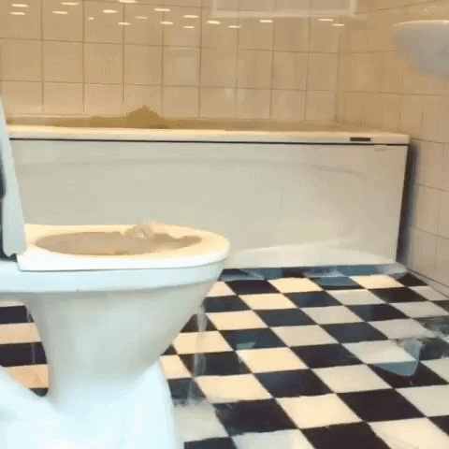
Buffer Overflow
Several decades old problem (still appears in SANS TOP 25 Software errors!!)
Main cause: putting more data than intended!!
Consequences: memory corruption (can be very dangerous!)

Slide 5
Stack based BoF
Cause
Stack grows downward
Local buffers are allocated onto the stack
With no memory protection, these variables can overflow!
Effect- security vulnerability
At CALL, return address is saved on the stack
Return address is POPed into the RIP
RIP can point to anywhere in the memory!

Slide 6
Side effects
Over/underflow
Sensitive data corruption
_{If done properly-exploit}
Otherwise crash!

Slide 7
Example
buf(char *string) {
char buffer[20];
strcpy(buffer, string);
return 1;
}
strcpy
buffer
buf
Saved ebp
String > buffer??
XYZ
Saved RET
esp
arbitrary machine code
Find address to jmp esp (XYZ)
main
Payload = junk data + return addr overflow + shellcode
Notes:
Give few examples to calculate the length of buffer to overflow (based on source code).

Slide 8
examples
int main ()
{
int x=1;
char array[20];
int y;
for (y=0;y<200;y++)
{
array[y]=‘A’;
}
…
….
}

Slide 9
Spot the defect!
HRESULT GetMachineName(WCHAR *pwszPath,
WCHAR wszMachineName[N + 1])
{
LPWSTR pwszServerName = wszMachineName;
while (*pwszPath != L'\\' )
*pwszServerName++ = *pwszPath++;
...
}
what if there is no ‘/’ in the URL?
Loop termination (exploited by Blaster worm)

Slide 10
What can be done? Exploit conditions
We should be able to overflow the buffer to inject our shellcode (Machine code that we want to execute) onto the stack.
The shellcode has overflowed in such a way that out of all general purpose registers, at least one register is pointing to shellcode’s beginning.
We should be able to overwrite the EIP to some memory location whose address is predictable and it does not throw error (e.g. access violation).
There exits an instruction at that location that will allow us to access/jump to the register pointing towards our shellcode

Slide 11
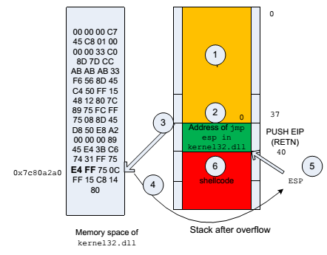
Regarding Exploits

