Slide 1
Systems & Software Security COMSM0050 2020/2021

Slide 2
Linux Security Module Framework

Slide 3
How do we bring Linux to grade B?
This was/is a real research problem
See reading material on the course website
Need to provide mechanism to implement one’s MAC policy
Need to be small and testable

Slide 4
How do we bring Linux to grade B?
This was/is a real research problem
See reading material on the course website
Need to provide mechanism to implement one’s MAC policy
Need to be small and testable
SOLUTION: Linux Security Module Framework

Slide 5
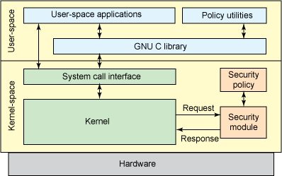
LSM Framework
LSM implement the reference monitor concept
Hooks call functions provided in a security module on interactions between subjects and objects
Framework is verified
Modules themselves should be small and verifiable

Slide 6
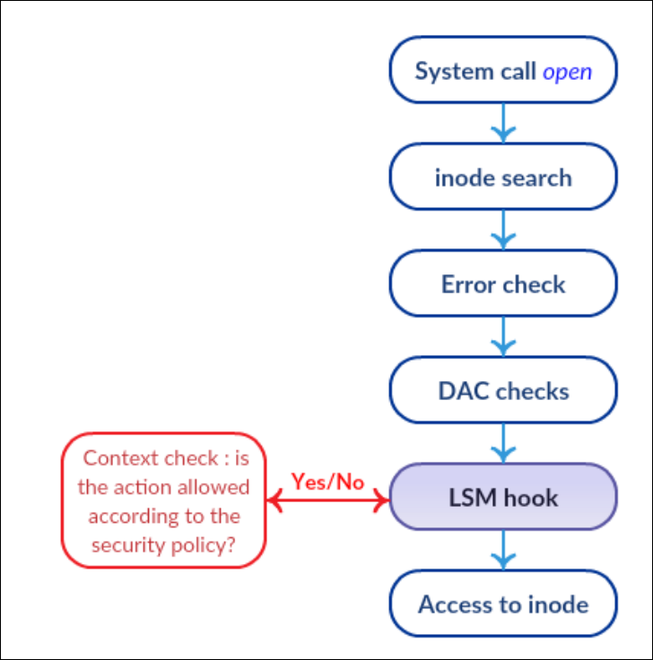
LSM Framework
Security Hooks are invoked on the path between any subject action and an object
Hook functions return access decision
0 -> access
ENOMEM -> no memory
EACCESS -> access denied
EPERM -> privilege are required
Hook function should be small
To be verifiable (security)
On critical path (performance)

Slide 7
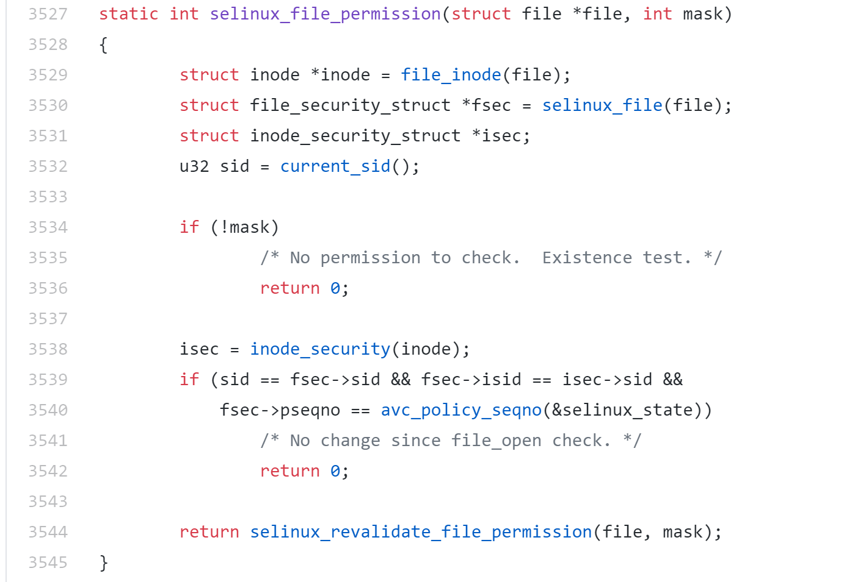
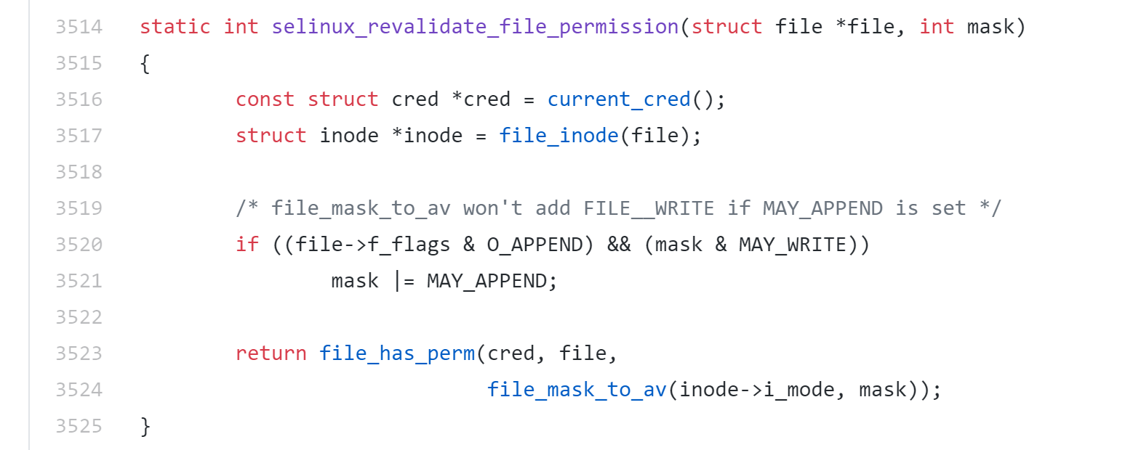
SELinux hook implementation example

Slide 8
Type of hooks
Managements hooks
Called to handle object life cycle
e.g. security_inode_allocate or security_inode_free
Used to manage security information
… in particular security blob (data that can be associated to subjects and objects)
Path based hooks
Related to pathnames
Used to implement named based policies (B1 from previous video)
Object based hooks
Path kernel structure corresponding to objects
Used to implement B2 type policies

Slide 9
Security pseudo file system
Need to interact with the security module from userspace
Loading or editing access rules
Reading some audit data
Modify module configuration
Achieved through a standard file interface

Slide 10
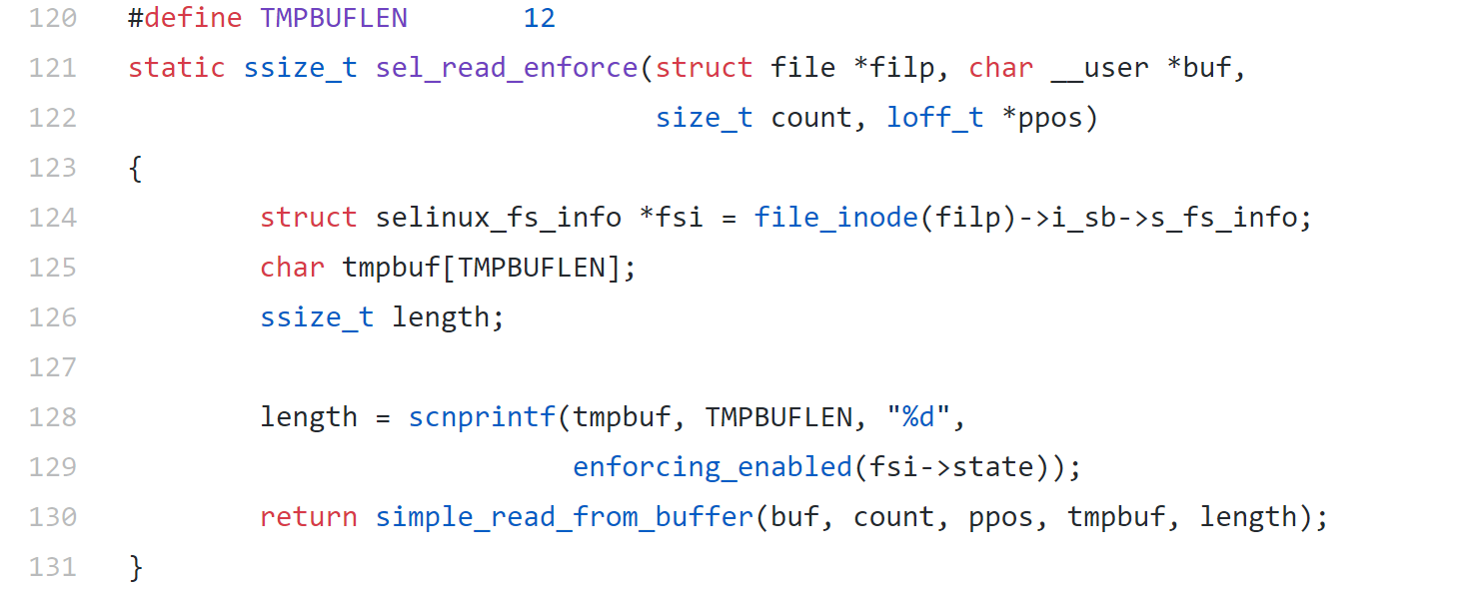
SELinux implementation example

Slide 11
SELinux
Implement MAC
Combine two approaches popular in the 90s:
Type Enforcement (TE)
Role Based Access Control (RBAC)
Labels all subjects with a security context
User
Domain
Role
Rules describe what each subject domains can do to an object domains

Slide 12
SELinux example
/etc/passwd contains information that should be read by any user
/etc/shadow contains sensitive information

Slide 13
SELinux example
allow user_t public_t : file read
user_t: “normal user”
public_t: “normal object”
Normal users are allowed to read normal files

Slide 14
SELinux example
allow passwd_t passwd_data_t : file {read write}
Users in passwd_t domain can have read/write access to file in the passwd_data_t domain.

Slide 15
SELinux example
allow user_t passwd_exec_t : file execute
allow user_t passwd_t : process transition
Allow normal users to actually execute the passwd program
Second rules allows the domain to transition when passwd_t is executed.

Slide 16
SELinux example
type_transition user_t passwd_exec_t : process passwd_t
The rules that actually makes the transition happen.

Slide 17
SELinux example
/etc/passwd contains information that should be read by any user
/etc/shadow contains sensitive information
allow user_t public_t : file read
allow passwd_t passwd_data_t : file {read write}
allow user_t passwd_exec_t : file execute
allow user_t passwd_t : process transition
type_transition user_t passwd_exec_t : process passwd_t

Slide 18
What do you think?

Slide 19
What do you think?
This is extremely complicated!
Available in Linux distributions (you can try it out on Fedora)
NSA provides a reference policy
It is hard to live with
Policy of around 20,000 rules
Most popular SELinux query?
How to turn off SELinux
Mostly appropriate for systems running fixed set of applications
Server
… used in Android too
Rule design is a non-trivial task

