Slide 1
Lab 3: Real-Time Streaming

Slide 2
ShopSmart: Use case
Use case
E-commerce website serving thousands of customers
Customers’ behavior (Customer Insights) is recorded for downstream tasks
Serving personalized recommendations/ads to the customers
Serving internal business teams with data critical to website growth
Customer Insights include high intensity data: views, clicks, purchases
Customer Insights must be ingested, processed, and analyzed in near real-time to be useful.

Slide 3
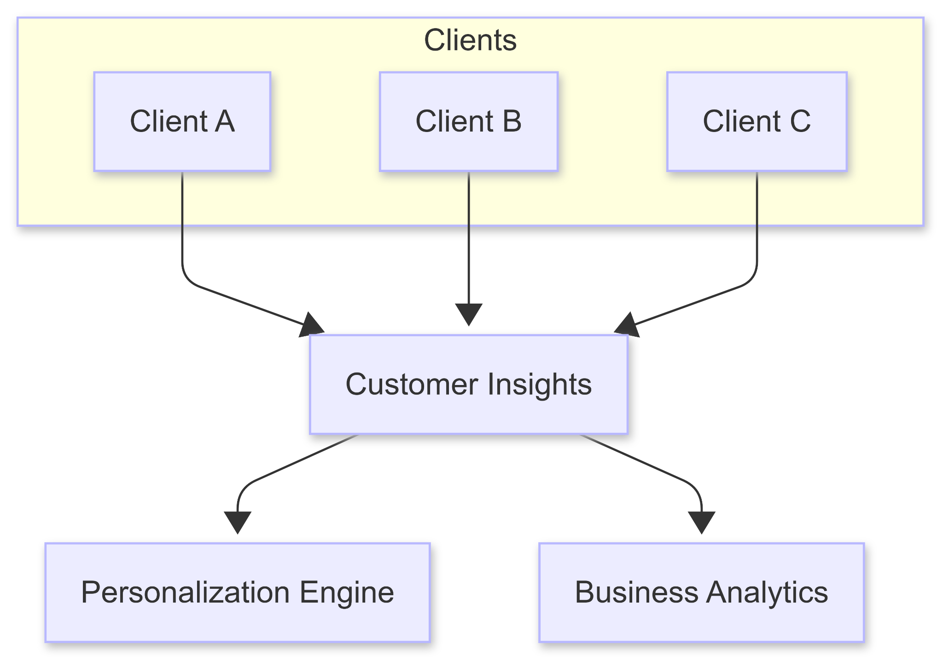
ShopSmart: Overview
Clients Generate Interactions.
Interactions are aggregated in a central logical point
Interactions are served in downstream tasks
Note:
This is an extremely write heavy use case traditional databases cannot handle this kind of workload

Slide 4
Approach 1: Writing to a DBMS
Customer Insights are written directly into a high throughput database (e.g: Cassandra, Dynamo)
Shortcomings:
High latency due to batch processing (Not suitable for RT applications)
Poor performance under high throughput

Slide 5
Message Passing

Slide 6
Messaging Patterns
Competing Consumers
Multiple consumers within a group share the workload for a given queue/partition, ensuring that each message is processed by one consumer.
Use case: Load balancing for high-volume processing.
Pub-Sub Model
One-to-many delivery, where messages are broadcast to multiple consumers (subscribers).
Use case: Broadcast notifications.

Slide 7
Message Queues: Point-to-Point
Producer publishes multiple messages on a queue
Consumers subscribes to a queue and listens to incoming messages
The consumer sends an ACK on the queue which gets routed to the producer
Exchange
Consumer
Producer
Queue

Slide 8
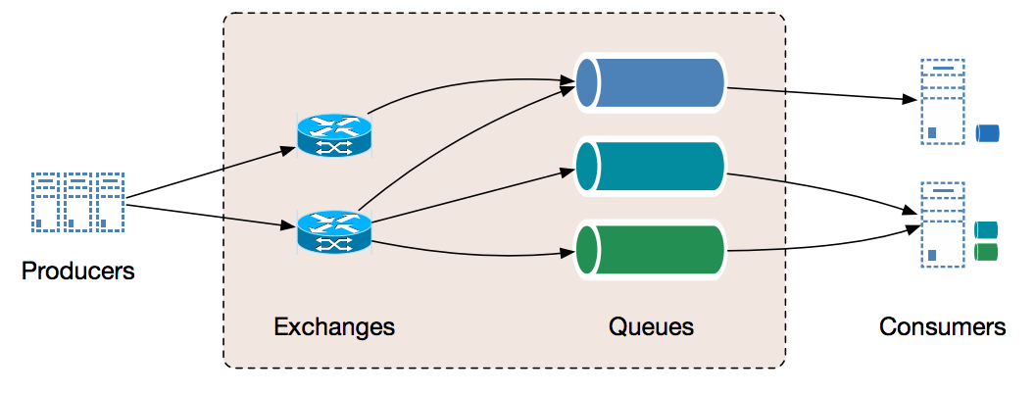
Message Queues: General Design
Producers publish message on an “exchange”
The exchange is responsible for routing messages for the appropriate queues
Consumers subscribe to a queue to receive sent messages

Slide 9
Message Queues: Consumer Patterns
Message queues are designed for competing consumers
Each message gets read once by a consumer
Solution: The client should replay the sent message?
Business
Analytics
Exchange
Client
Queue
Personalization
Notes:
Problem Each message is read once
Solution Replay the message
There are problems with the solution:
Maybe the same team consumes the messages due to having faster machinery, or less compute intensive workload
Problem BA and Personalization team services hang, this blocks the client as it is waiting for an ACK
Solution, disable ACK (because do I really care from a client POV?)

Slide 10
Message Queues: Fanout
Message queues are designed for competing consumers
Each message gets read once by a consumer
Business
Analytics
Queue
Exchange
Client
Personalization
Queue
Notes:
Problem:
We will have 1 queue per downstream task (useful but not scalable)

Slide 11

Message Queues: Conclusion
Message queues are designed for point-to-point communication
Adapting message queues for high throughput publish subscribe is not trivial nor as scalable as we ‘d hope
Looks like we ‘re using the wrong tool for the job
Notes:
While message queues are good for: 1) Job worker system
2) message queueing
3) Decoupling microservices with dependencies
They cannot solve the problem of streaming data efficiently for this we need something less coupled, since the root of the problem was the tight coupling, badawar 3ala 7aga army feeha el data w agry, welly ye2ra ye2ra

Slide 12
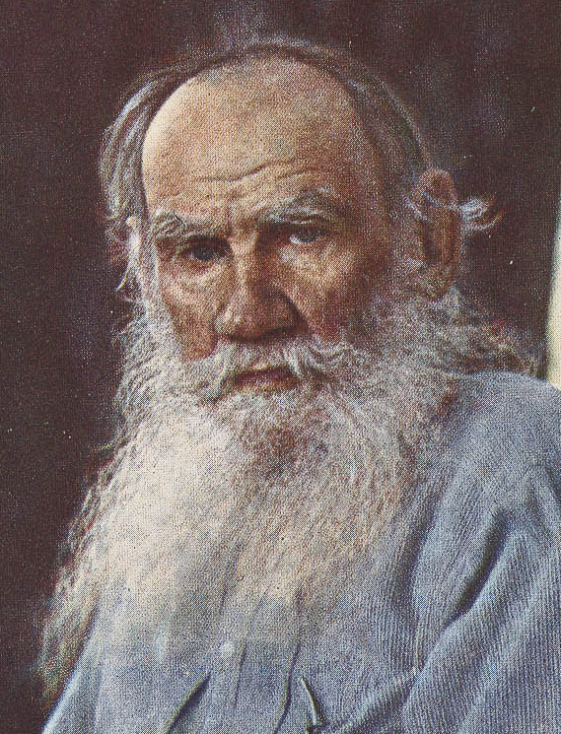
Distributed Logs: Introduction
“Each working data pipeline is a log;
each broken data pipeline is broken in its own way”
- Leo Tolstoy
Leo Tolstoy (1898 - 1920)

Slide 13
Distributed Logs: Introduction
A log is an immutable, append-only sequence of records
Benefits:
High sequential disk writes
Ability to replay events
A distributed log is a log which is partitioned on multiple machines
Benefits:
Parallel processing
High throughput
Replication

Slide 14

Apache Kafka: A Distributed Streaming Platform
Apache Kafka is an open source distributed streaming platform
Designed for building real time data pipelines
Implements a partitioned log
Core Components
Producers: Publish data to Kafka topics
Consumers: Subscribe to topics and process the data
Brokers: Servers that store and manage the data
Topics: Categories to which records are sent by producers

Slide 15
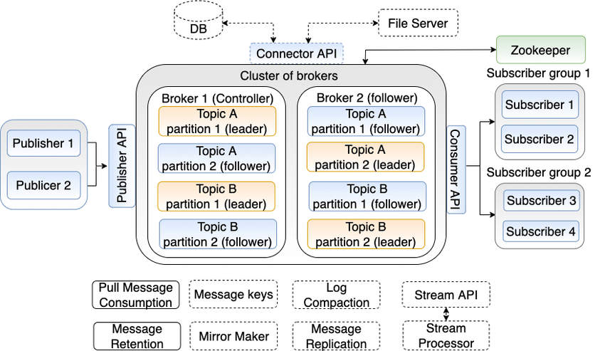
Apache Kafka: Architecture Overview
Source: Publish-Subscribe approaches for the IoT and the cloud: Functional and performance evaluation of open-source systems - Scientific Figure on ResearchGate.
Notes:
Key features
Topics, and topic partitioning; leader is the on responsible for writes the rest are responsible for reads
Consumer groups subscribing to a topic
State management is done at endpoints not at the Kafka cluster (publisher, does work that usually was done by the exchange at RMQ, while subscriber Producers (Publishers):
Who They Are: In our use case, the clients (e.g., the ShopSmart website, mobile apps) act as producers.
What They Do:
They capture customer interactions and choose which topic to send each event. For instance, one topic might be “CustomerClicks” while another is “PurchaseEvents.”
The publisher's internal logic includes state management: it decides the appropriate topic based on event type and may include metadata like timestamps or user identifiers.
Data Flow: Producers push data into Kafka by sending messages to the relevant topics.
Kafka Cluster (Brokers):
Cluster Role:
A Kafka cluster consists of multiple brokers (servers) working together.
Each topic is divided into partitions for parallel processing.
Partition Leaders and Replication:
For each partition, one broker is designated as the leader. This leader handles all reads and writes for that partition.
Other brokers act as followers, replicating data from the leader. This ensures that if one broker fails, the data remains available.
State Management:
The cluster maintains its own index and metadata (with the help of ZooKeeper or, in newer versions, Kafka’s internal quorum) to know which broker is the leader for each partition.
This indexing allows efficient retrieval of messages and guarantees that data is stored in the order it was received within each partition.
Consumers (Subscribers):
Who They Are: These are the systems or applications that need to process customer insights—for example, the personalization engine (to deliver targeted ads) or the business analytics dashboard.
What They Do:
Consumers subscribe to one or more topics using the Consumer API.
They pull messages from the partitions, processing them in the order maintained by each partition.
Subscriber Groups:
Consumers can form a subscriber group (also known as a consumer group). In a group, each partition’s data is processed by only one consumer, which enables parallel processing while ensuring that each event is processed just once.
In our ShopSmart example, one consumer group might handle personalization (each consumer in the group processes different partitions of the “CustomerClicks” topic), while another group handles analytics.
Data Flow Recap Linked to ShopSmart:
Publishing: When a customer clicks on a product or makes a purchase, the ShopSmart client (acting as a producer) sends this event to a designated topic. The producer decides on the topic based on the type of event.
Cluster Processing: The event enters a partition of that topic in the Kafka cluster. The partition leader receives the event, and the data is replicated to follower brokers. The cluster maintains an index of all events, ensuring they are stored in order.
Consumption:
Personalization Engine: A consumer group dedicated to real-time ad personalization subscribes to the relevant topics. Each consumer in the group gets a different subset of partitions, processes the data, and triggers personalized recommendations.
Business Analytics: Another consumer group subscribes to the same or different topics to generate insights on user behavior, sales trends, and overall website growth.

Slide 16
Why Apache Kafka is Fast, Scalable, and Fault Tolerant
Performance
Batch processing and asynchronous I/O reduce network overhead.
Zero-copy mechanism minimizes CPU usage.
Scalability
Horizontal scaling via partitions and dynamic consumer group rebalancing.
Ability to handle millions of messages per second.
Fault Tolerance
Data replication across brokers ensures no data loss.
Configurable retention policies and exactly-once semantics.
Flow Control
Consumer-driven pull mechanism ensures that backpressure is naturally applied.

Slide 17
Why Apache Kafka is Fast, Scalable, and Fault Tolerant
Performance
Batch processing and asynchronous I/O reduce network overhead.
Zero-copy mechanism minimizes CPU usage.
Scalability
Horizontal scaling via partitions and dynamic consumer group rebalancing.
Ability to handle millions of messages per second.
Fault Tolerance
Data replication across brokers ensures no data loss.
Configurable retention policies and exactly-once semantics.
Flow Control
Consumer-driven pull mechanism ensures that backpressure is naturally applied.

Slide 18
Scenario Overview
Imagine an online retail platform that not only sells products but also aims to maximize user engagement by
Delivering Interaction-Based (Targeted) Ads
ML models analyze real-time user interactions (clicks, views, hover events) to deliver personalized ad content.
Conducting User Behavior Analysis
Aggregated interaction data is used by the company’s analytics team to derive insights into user preferences, browsing patterns, and conversion funnels.
Notes:
Given that the platform handles millions of users concurrently—especially during peak events like flash sales—the system must be designed to scale and process vast volumes of data without degrading performance.

Slide 19
Bottlenecks in a Synchronous Architecture
Front-End Event Collection
Millions of interactions; leading to increased latency, dropped events, and resource contention.
Immediate Processing of Events
The system can’t have a backlog; a sudden traffic surge exhausts the available processing capacity.
ML Model Invocation for Ads
Concurrent multiple model invocations, slow down ad delivery which reduces ad relevance.
Data Aggregation for Analytics
Running heavy analytics synchronously would block the system.
Notes:
Front-End Event Collection:
Problem: When users interact with the website (e.g., clicking a product or navigating between pages), each event is sent synchronously to the backend.
Bottleneck: Web servers can become overwhelmed when millions of interactions arrive at once, leading to increased latency, dropped events, and resource contention.
Immediate Processing of Events:
Problem: Synchronously processing each event (e.g., updating user session data or triggering an ad refresh) ties up server threads.
Bottleneck: Without decoupling, the system can’t apply backpressure, so a sudden traffic surge can quickly exhaust available processing capacity.
ML Model Invocation for Ads:
Problem: Targeted ads require real-time inference from ML models. If each event directly triggers a model evaluation, latency and resource usage spike.
Bottleneck: Direct integration limits the number of concurrent model invocations, slowing down ad delivery and reducing relevance.
Data Aggregation for Analytics:
Problem: Aggregating raw interaction data for analysis in near-real time is computationally heavy.
Bottleneck: Running heavy analytics synchronously would block the system, delaying insights and impairing user experience.

Slide 20
How Message Queues Solve These Bottlenecks
Instead of processing user interactions synchronously, the website uses a message queue (e.g., Apache Kafka) to decouple event ingestion from processing.
Here’s how it works:
Event Ingestion Layer (Producers):
Mechanism: Web servers and client-side publish user interactions to a Kafka topic.
Advantage: Producers don’t wait for immediate processing, improving responsiveness.
Notes:
Event Ingestion Layer (Producers):
Mechanism: Web servers and client-side JavaScript asynchronously publish user interactions (clicks, page views, product impressions) to a Kafka topic.
Advantage: Producers quickly enqueue events without waiting for immediate processing, reducing the response time and avoiding thread blockage.

Slide 21
How Message Queues Solve These Bottlenecks
Buffering & Backpressure
Mechanism: The Kafka topic acts as a distributed, partitioned log—each partition serves as an independent FIFO queue.
Backpressure & Throttling
Backpressure: Consumers pull events at a rate they can process.
Throttling: Producers can be configured to slow down (throttle) with high loads
Notes:
Backpressure & Throttling
Backpressure: Consumers pull events at a rate they can process. If consumers slow down, the system can detect increasing consumer lag (the number of messages waiting in the partition), which naturally applies backpressure.
Throttling: Producers can be configured to slow down (throttle) when the broker signals high load or when consumer lag metrics exceed predefined thresholds, ensuring the queue remains within manageable capacity.

Slide 22
How Message Queues Solve These Bottlenecks
Parallel Processing with Consumer Groups
Targeted Ads Pipeline
Consumer Group A subscribes to a dedicated Kafka topic containing user interaction events intended for ad personalization.
ML model inference services process these events in parallel, using the offset mechanism to maintain order within partitions.
Behavior Analysis Pipeline
Consumer Group B subscribes to the same or another topic that aggregates raw interactions.
This group processes data to compute aggregates, detect trends, and update dashboards for user behavior insights.
Scalability
Replicas can be created under high loads to minimize delays.
Notes:
Scalability:
New consumer instances can be added horizontally to either group based on the queue depth (consumer lag), ensuring that even under peak load the system processes messages without delay.

Slide 23
How Message Queues Solve These Bottlenecks
Dead-Letter Queues & Error Handling
Mechanism: Events that fail processing (due to malformed data or temporary service outages) are redirected to a dead-letter queue.
Advantage: This isolation ensures that problematic events do not block normal processing and can be analyzed or reprocessed later.
Flow Control & Monitoring
Consumer Lag Metrics
Flow Control
Notes:
Flow Control & Monitoring
Consumer Lag Metrics: Real-time monitoring of consumer lag provides insights into processing delays, enabling dynamic adjustments in consumer scaling.
Flow Control: Kafka’s pull-based consumption naturally supports flow control—consumers only retrieve what they can process, preventing overloading.

Slide 24
References
Stream Processing Overview
Differences Between Push and Pull
Kafka Introduction
Kafka Efficient Design
Kafka-Native Docker Image

