Slide 1
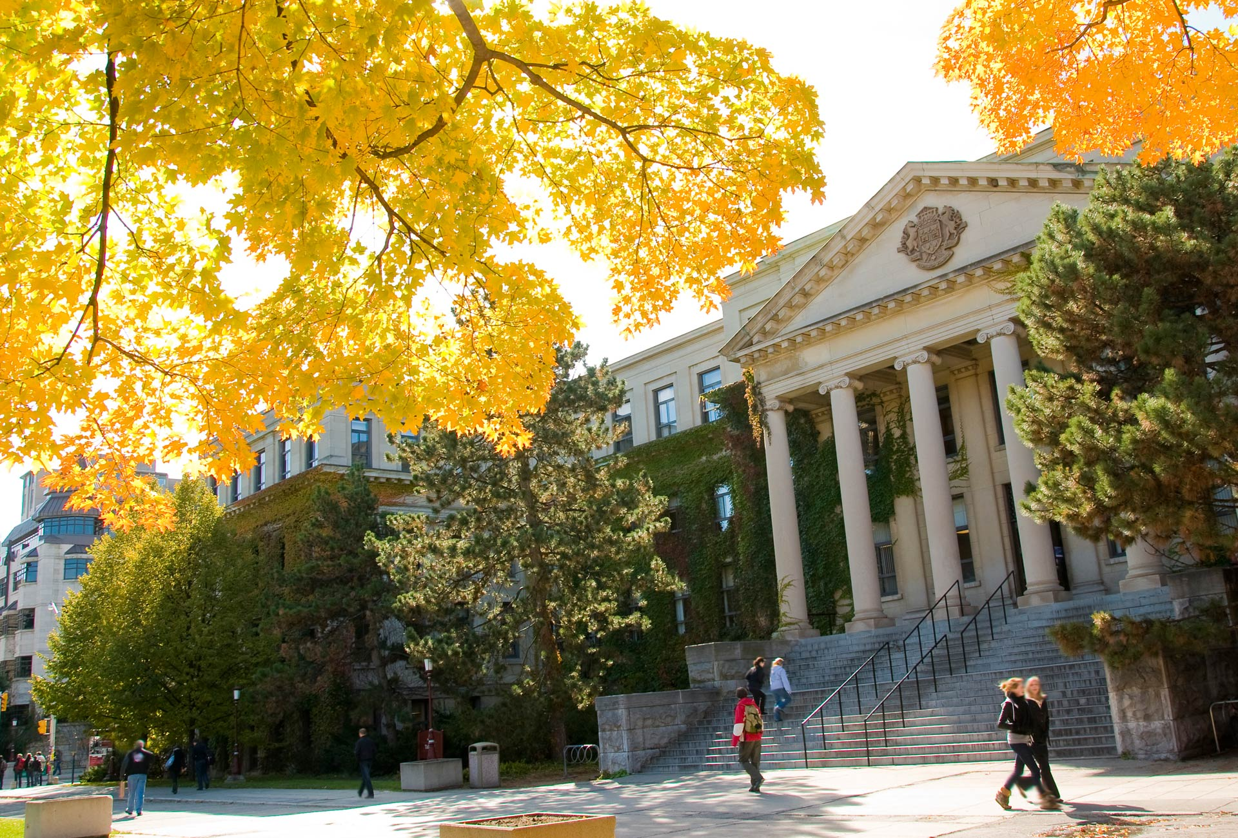

Flow Simulation through a Stenotic Capillary
Presented by: Karim Saade
uOttawa.ca

Slide 2
Outline
Motivation and Problem Statement
Discretization Method
Test Cases
Couette Flow
Lid Driven Cavity
Pipe Flow
Result
Conclusion

Slide 3
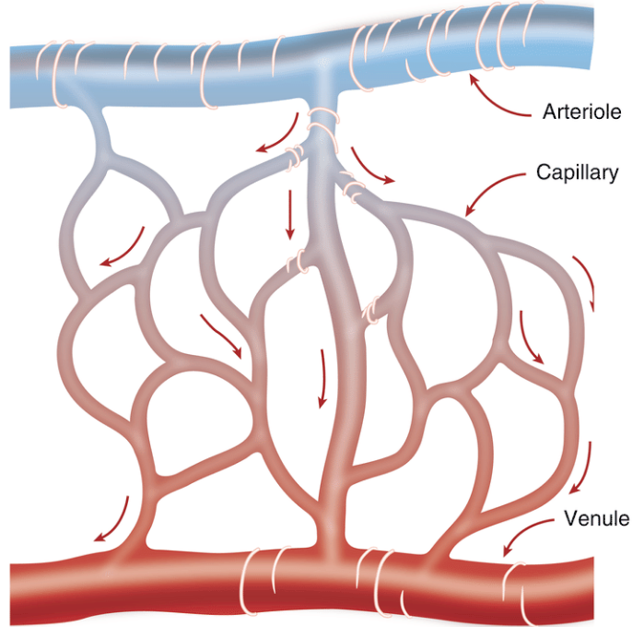
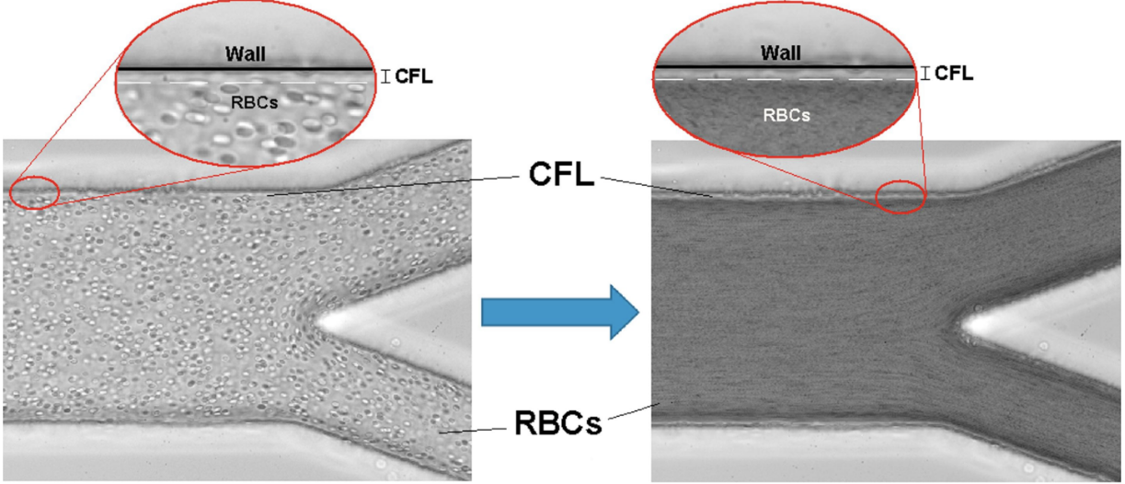
Motivation
Smallest vessels in the human body with size ranging from 5 μm to 10 μm.
Exchange nutrients and metabolites to organs in the body.
Cerebral micro-circulation consisting of capillary vessels is about 400 miles or 648 km!!!
Cell free layer is a layer near the walls of the vessels which carry no red blood cells and is only filled with plasma.
Stenosis is a reduction in the diameter of the capillary caused by:
Plaque build up.
Birth defects
…

Slide 4
Problem Statement
The goal of this project is to simulate blood flow through a stenotic capillary to understand the effect of velocity and pressure of the disturbed blood flow on the cell free layer.

Slide 5
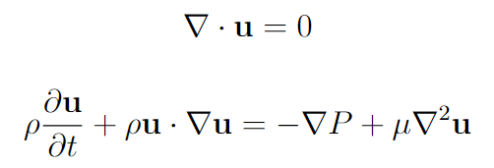
Governing Equation
The two governing equations are the continuity and Navier-Stokes equations.
Time Splitting Method with predictor and corrector step
WHY?

Slide 6

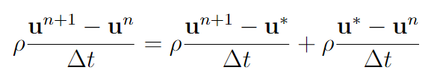

Temporal Discretization
Euler forward scheme
LHS ca be re-written as corrector step + predictor step.
The time-step ∆t should be chosen based on the Courant-Friedrichs-Lewy criteria, so that
$$u_{max}\frac{∆t}{∆x}<1$$

Slide 7
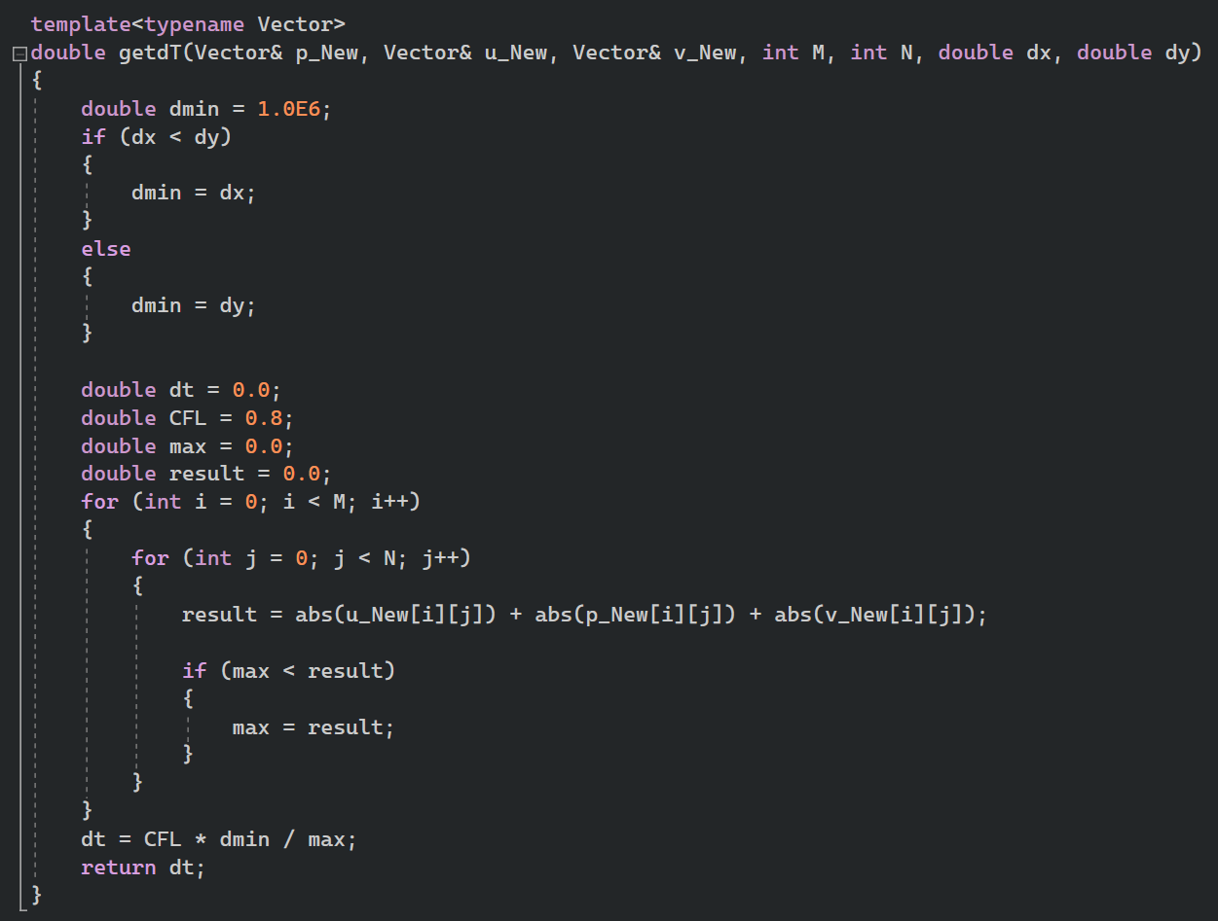
Code Snippet

Slide 8
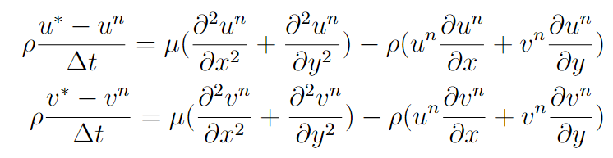
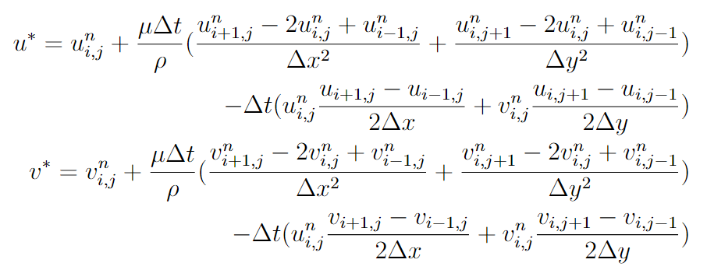
Spatial Discretization
Predictor Step
Utilizing 2nd order central difference

Slide 9
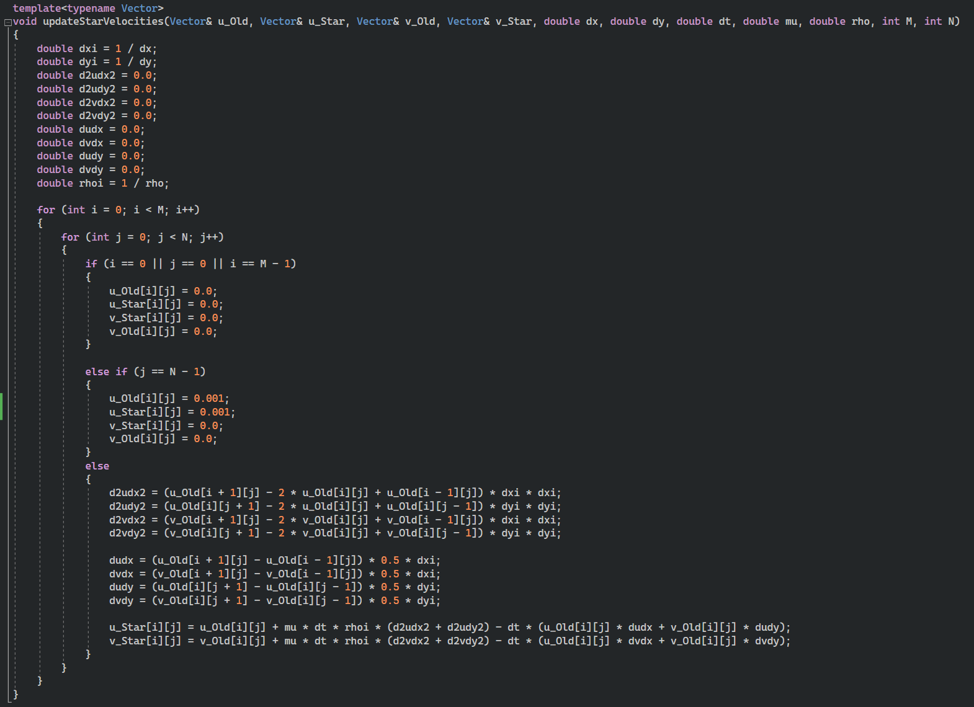
Code Snippet

Slide 10
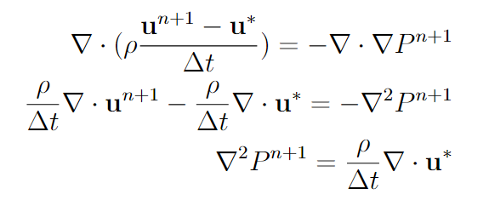
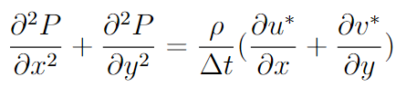
Poisson Equation
To satisfy the continuity equation, take the divergence of the corrector step and enforcing the continuity condition.
This is called the Poisson Equation

Slide 11
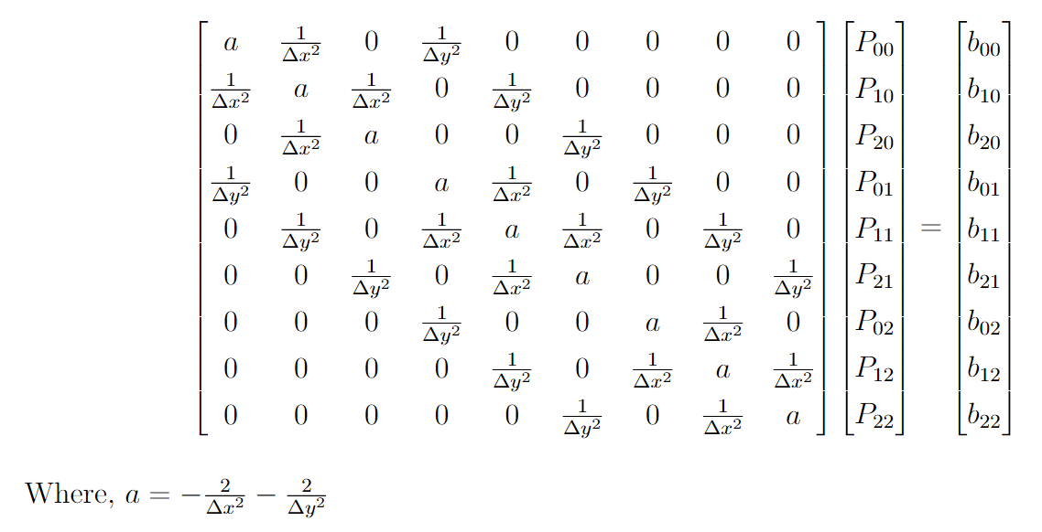
Poisson Equation
Using 2nd order central differences
2 ways to solve this, Gauss-Seidel or Linear Algebra where Ap = b

Slide 12
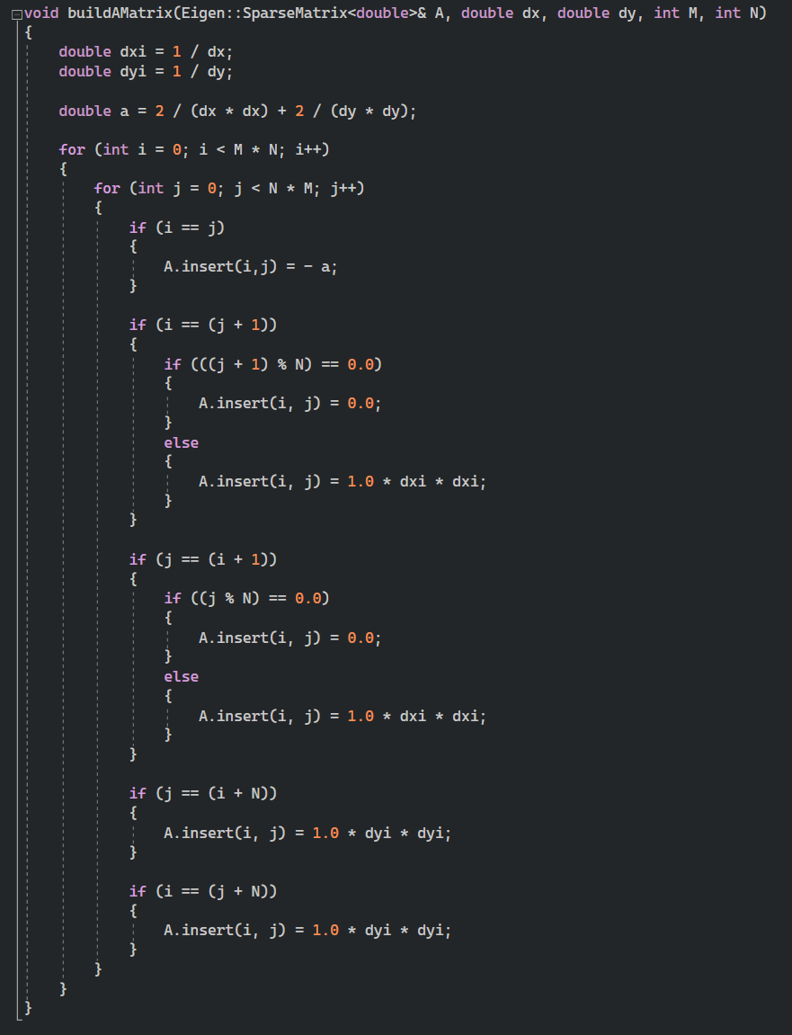
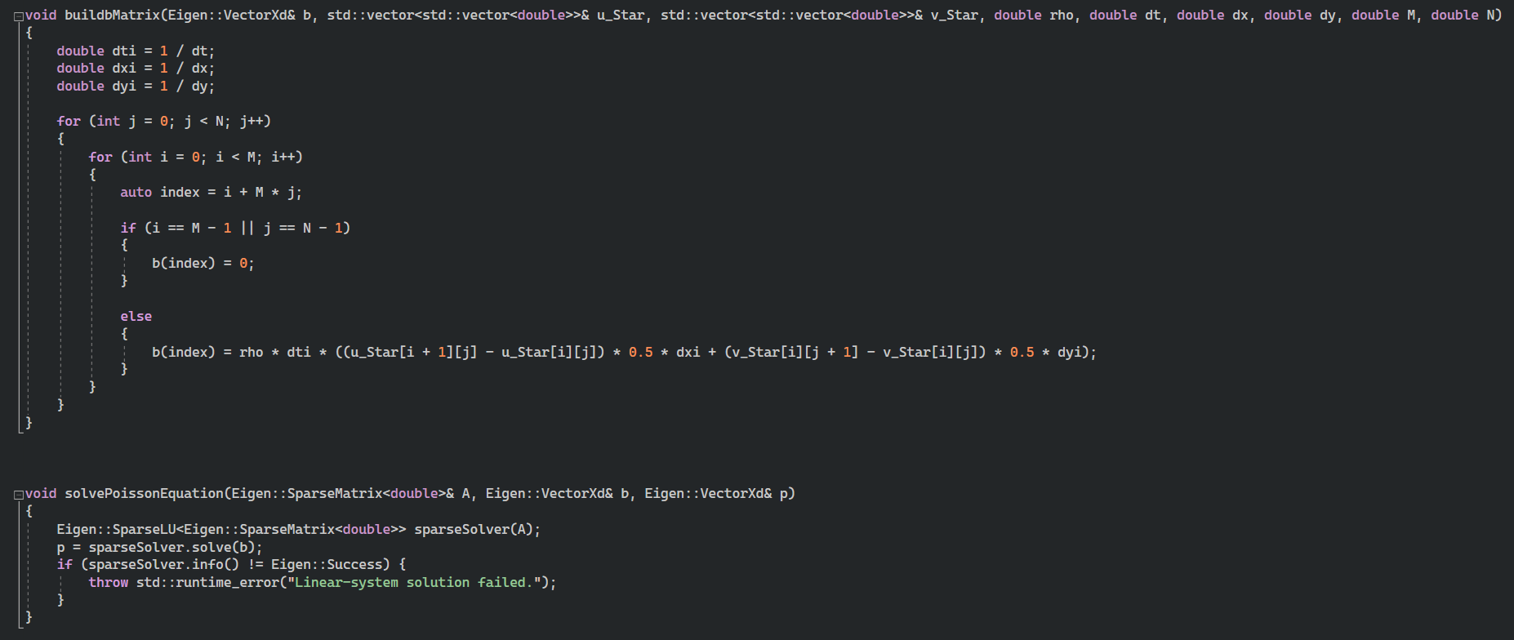
Code Snippet

Slide 13
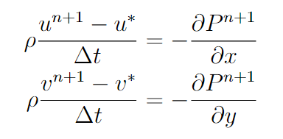
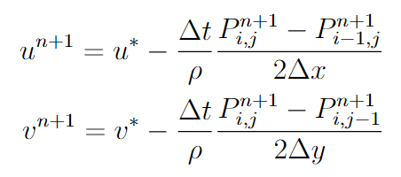
Spatial Discretization
Corrector Step
Utilizing 2nd order central difference
The schemes employed to discretize Navier-Stokes equation is first order in time and second order in space i.e. O(∆t, (∆x²))

Slide 14
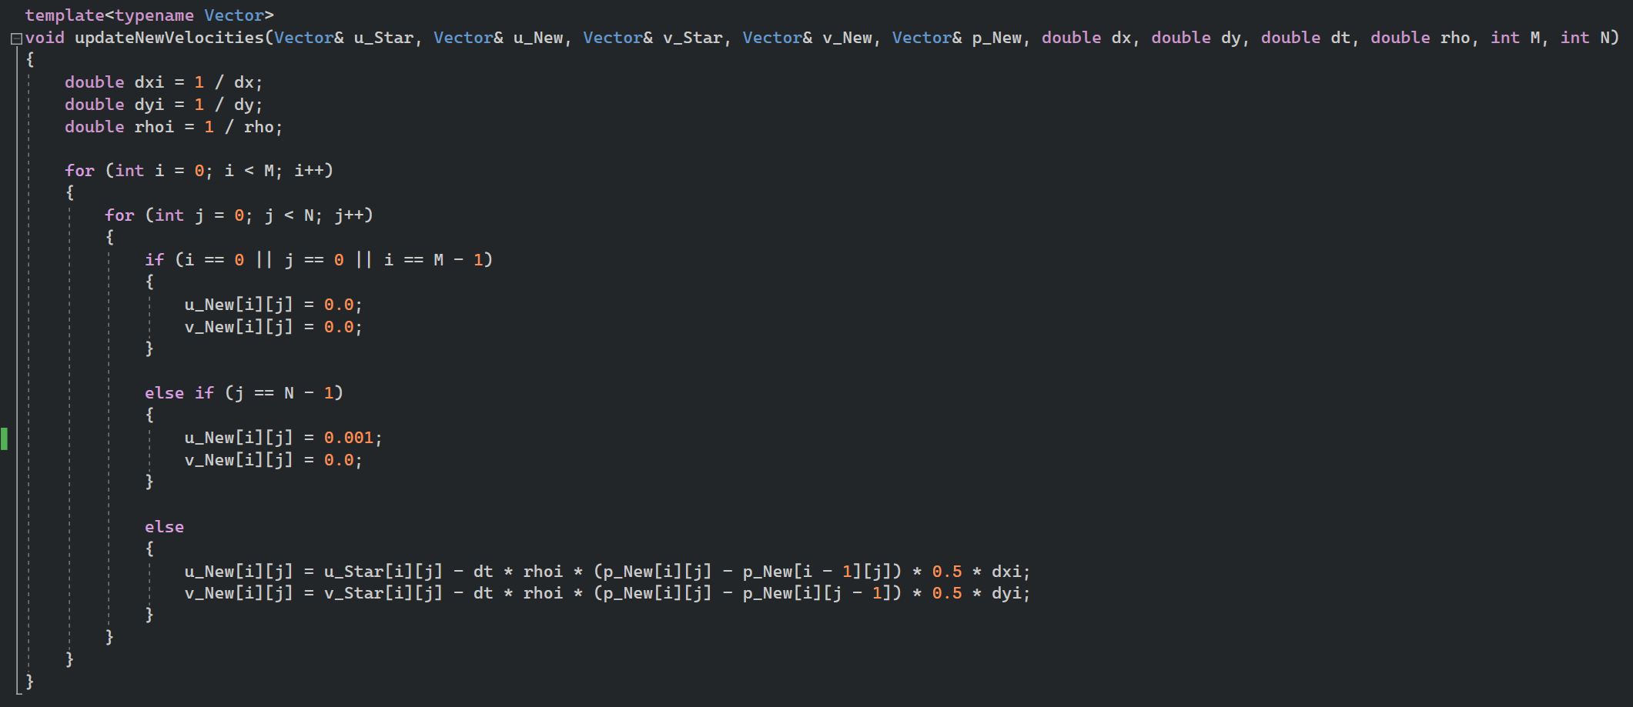
Code Snippet

Slide 15
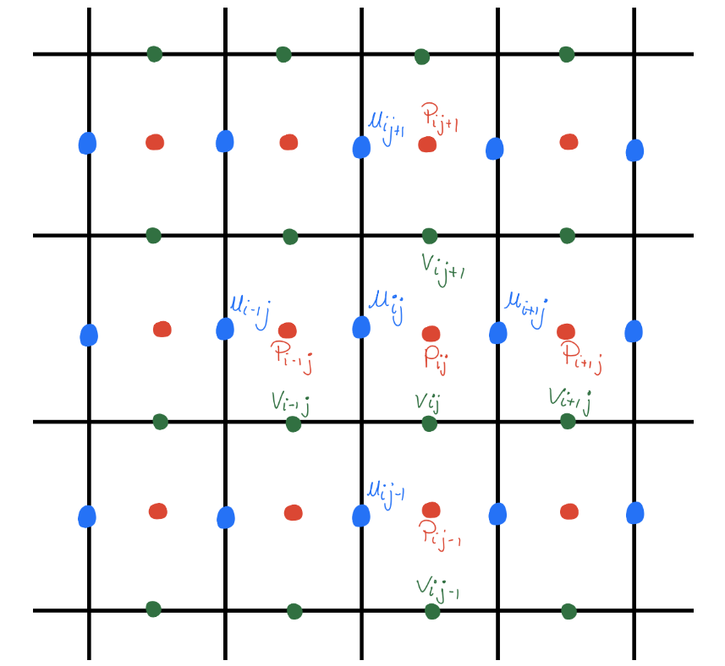
Grid

Slide 16
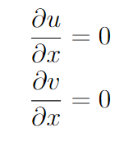
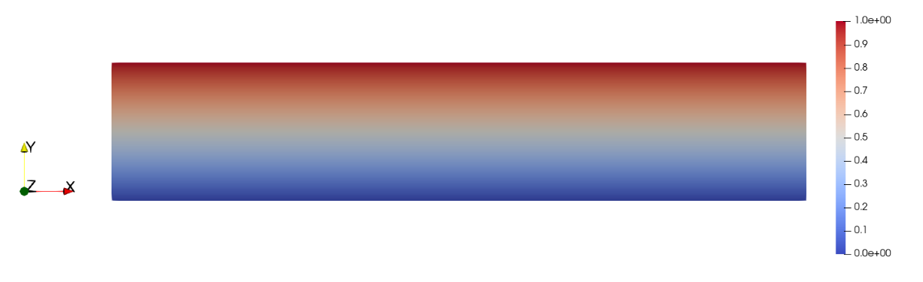
Test Case I – Couette Flow
Parameter used
U = 1.0 m/s
ρ = 1060 kg/m3
μ = 5.0 Pa.s
L = 5.0 m
H = 1.0 m
Re = 1060 < 2300 → Laminar
Grid size 200x200
Boundary Condition at x = 0 and x = L
s
U = 0 at y = 0

Slide 17
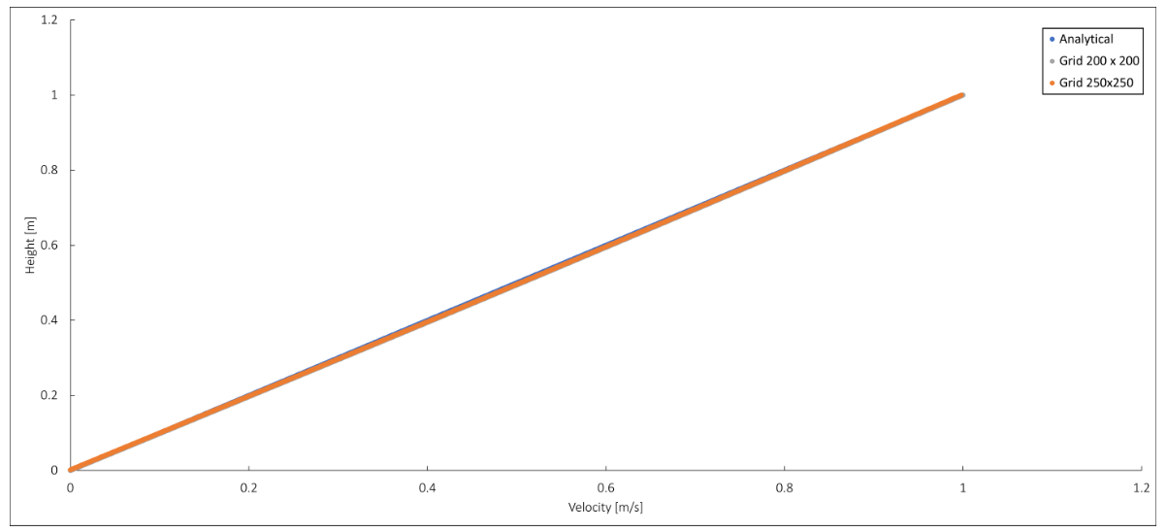

Test Case I – Couette Flow
The simulation result will be plotted against the theoretical,
$$u\left(y\right)=U_{top}\frac{y}{H}$$

Slide 18
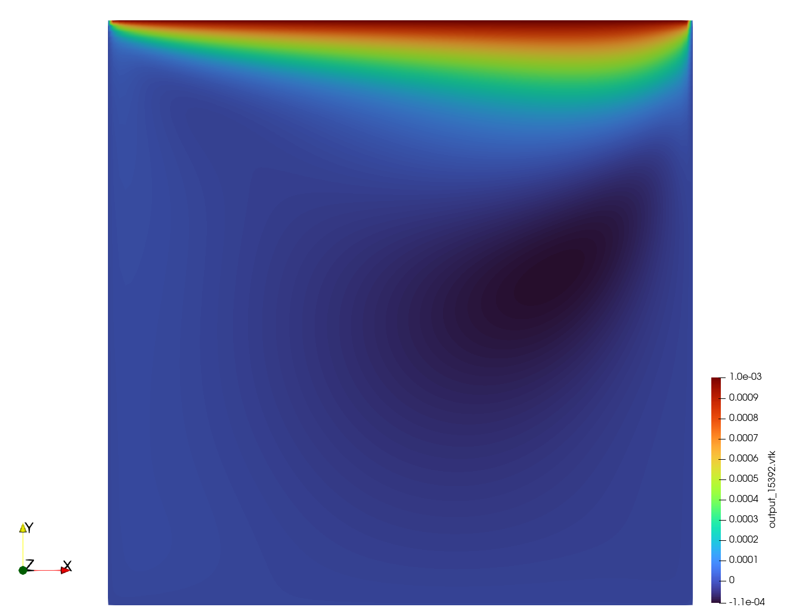
Test Case II – Lid Driven Cavity
Parameter used
U = 0.001 m/s
ρ = 1060 kg/m3
μ = 0.004 Pa.s
L = 1.0 m
H = 1.0 m
Re = 265 < 2300 → Laminar
Grid size 100x100
Boundary Condition at x = 0, x = L and y = 0,
U = 0
V = 0

Slide 19
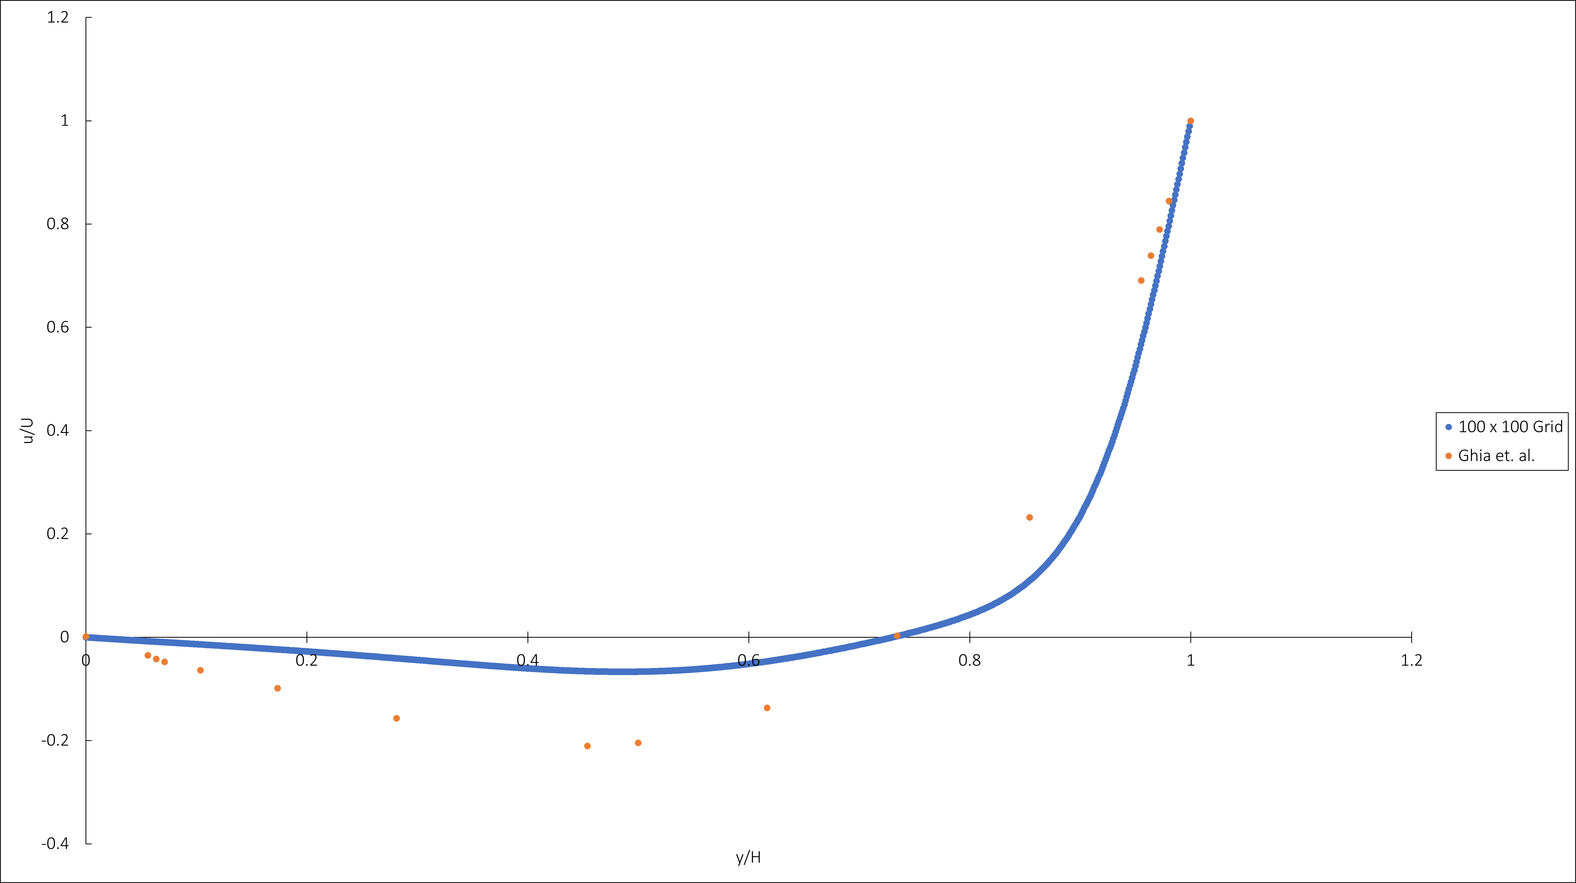
Test Case II – Lid Driven Cavity

Slide 20
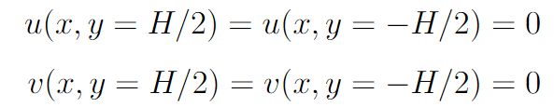
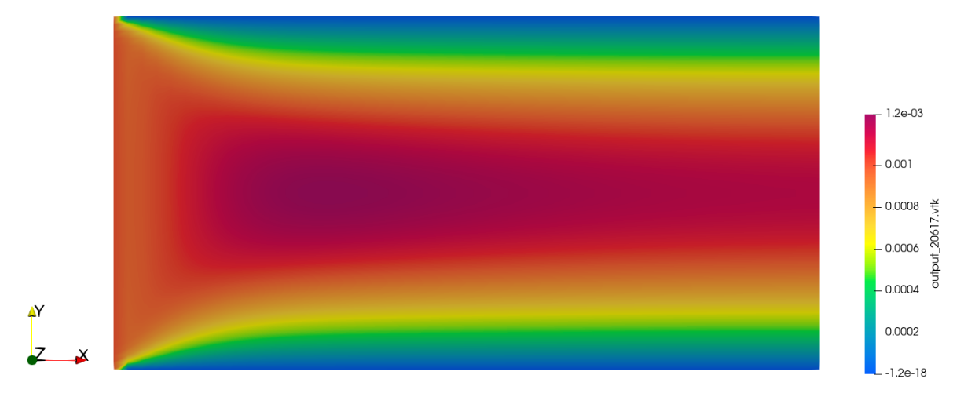
Test Case III – Pipe Flow
Parameter used
U = 0.001 m/s
ρ = 1060 kg/m3
μ = 6.0 Pa.s
L = 2.0 m
H = 1.0 m
Re = 0.353 < 1 → Stokes
Grid size 75x75
Boundary Condition at x = L

Slide 21
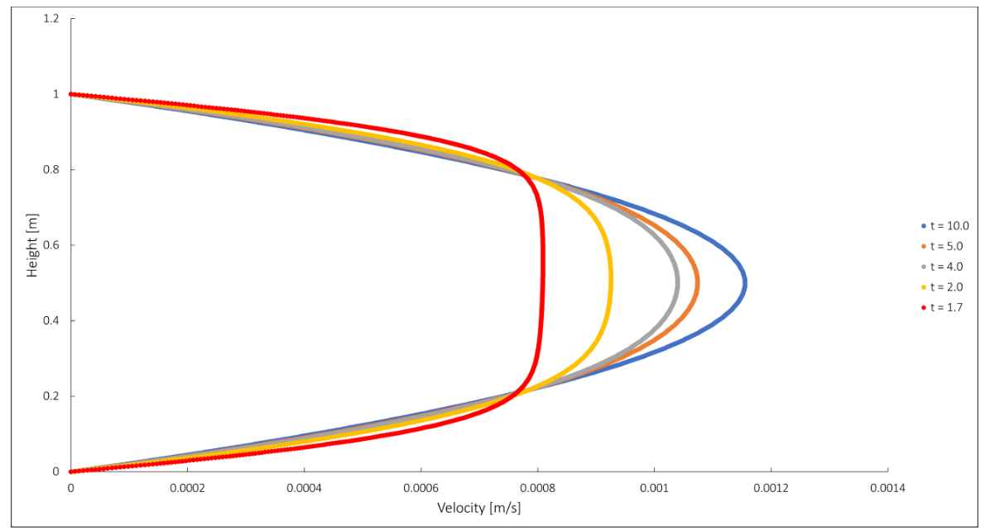
Test Case III – Pipe Flow
Maximum velocity is equal to 0.0012 m/s
Need to run the code for longer

Slide 22
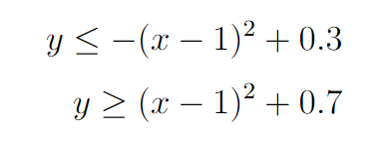
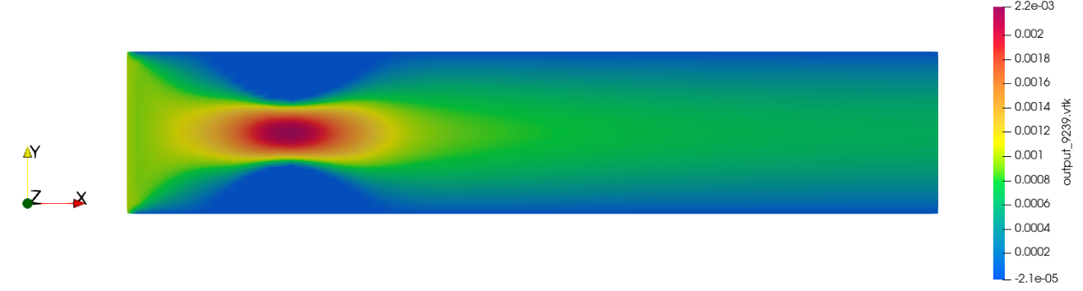
Stenotic Flow
To form the diameter reduction
Boundary Condition at x = L
Vortices will be generated near the wall.
Red blood cells will be exposed to the increased shear stress at the wall of the stenosis.

Slide 23
Conclusion and Future Work
Method employed to numerically solve the Navier-Stokes equation was successful
Parallel programming can be introduced
Different schemes can be used to obtain a more accurate output

Slide 24
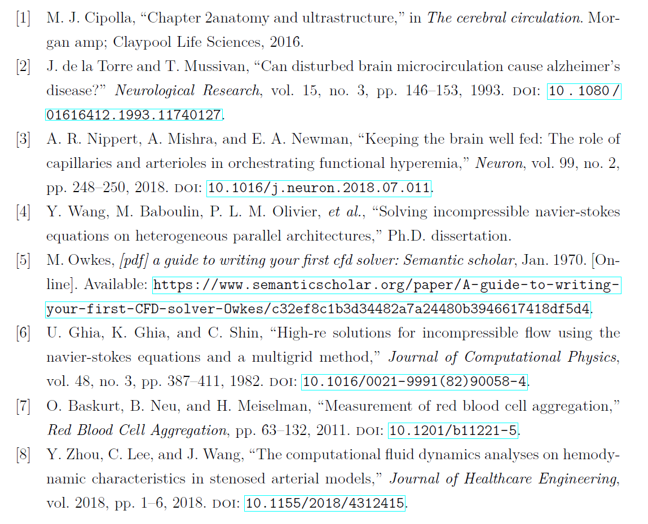
References

