Slide 1
Mini Project
20/06/2025

Slide 2
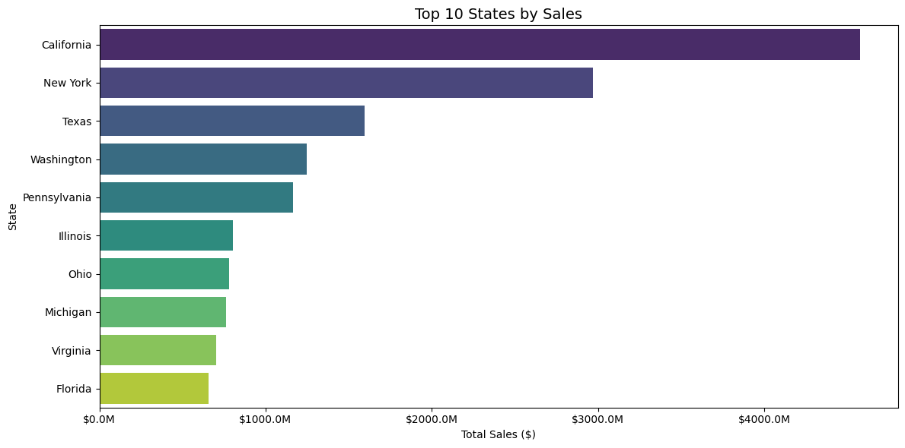
Best sellers per City
The three best sellers States are California, New York City and Texas. There is around $1M sales difference between each State.

Slide 3
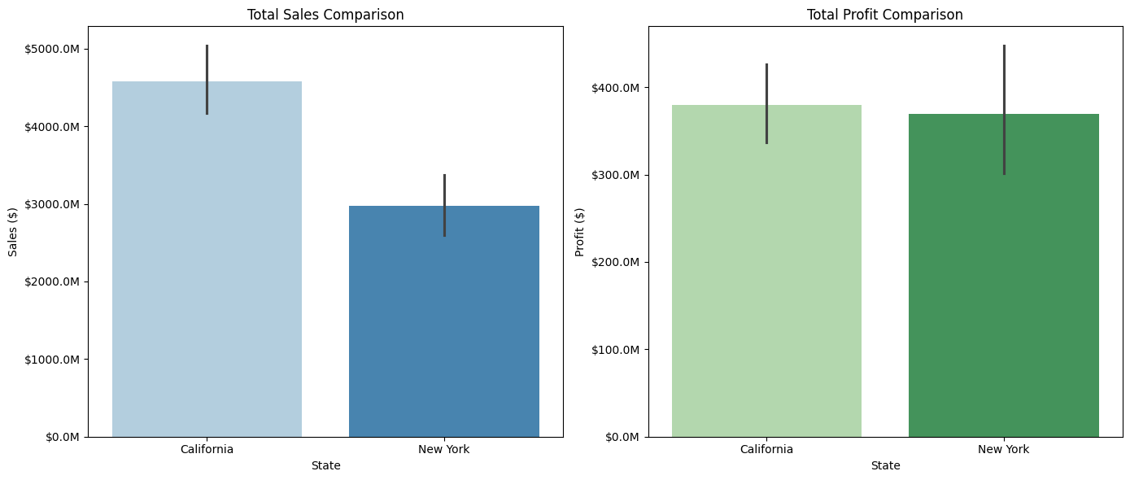
4. Deep analysis for the 3 best sellers
The three best sellers States are New York City, Los Angeles and Seattle.

Slide 4
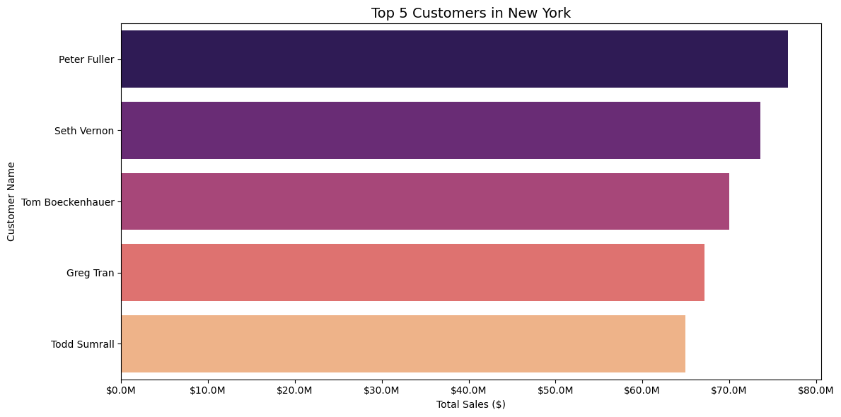
Ranking of the customers
The three best sellers States are New York City, Los Angeles and Seattle.

Slide 5
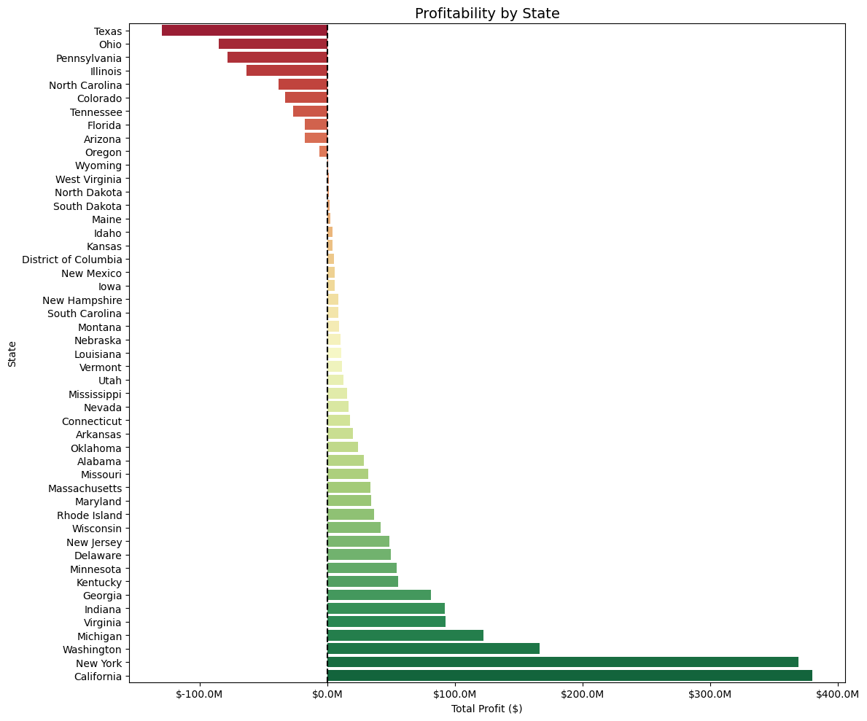
Profitability per State

Slide 6
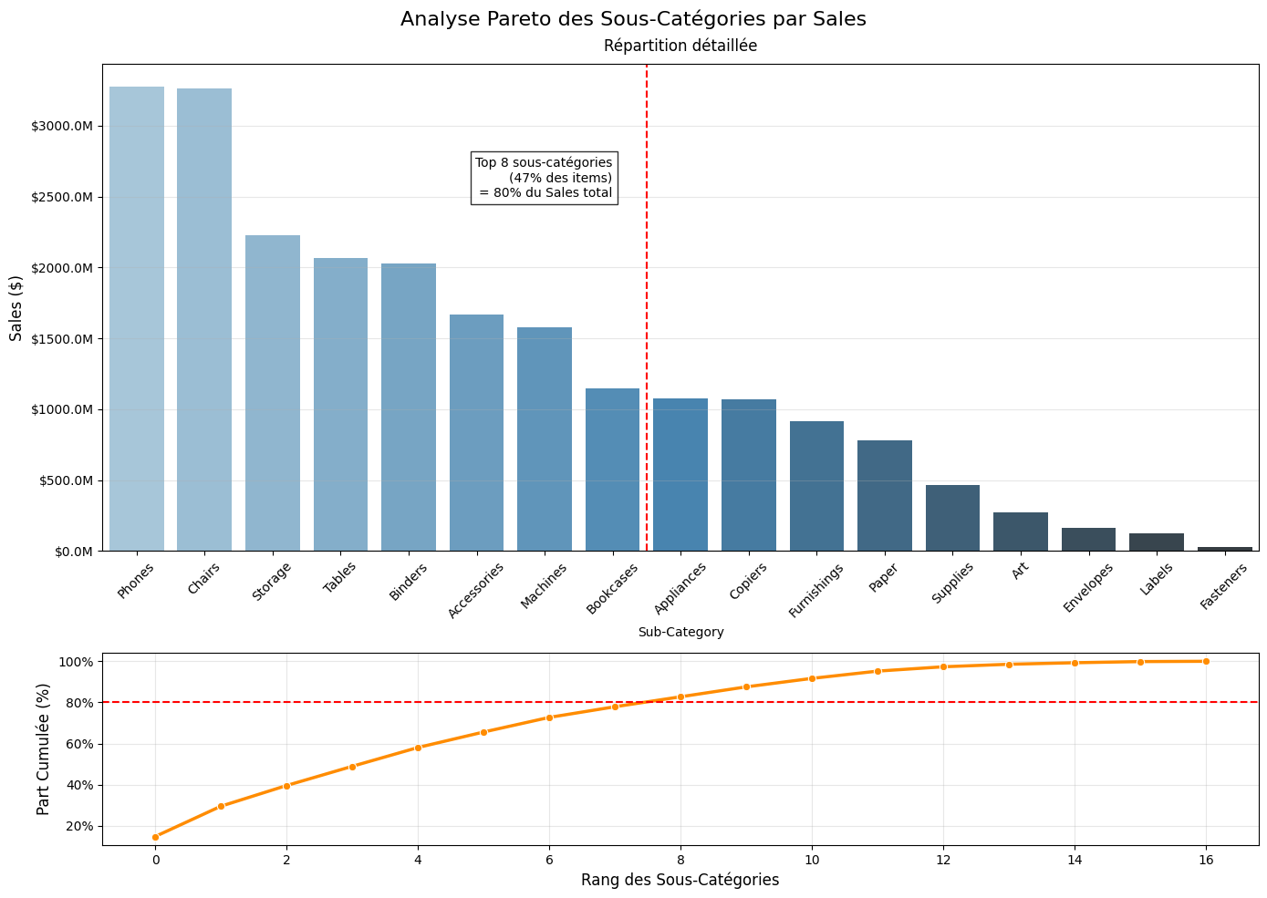
Pareto analysis for sales

Slide 7
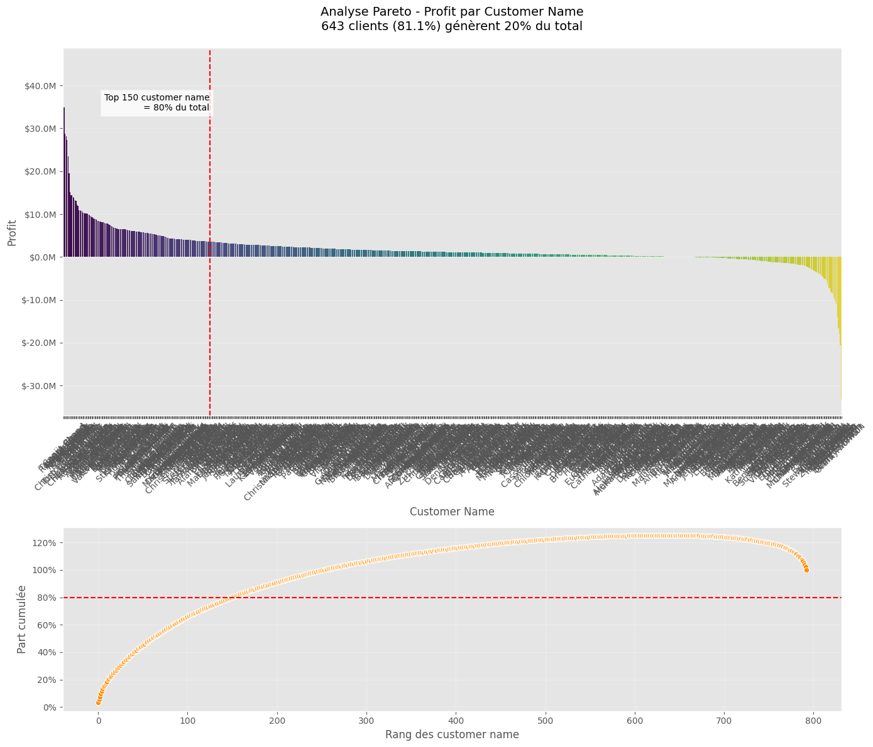
Pareto analysis for profit

Slide 8
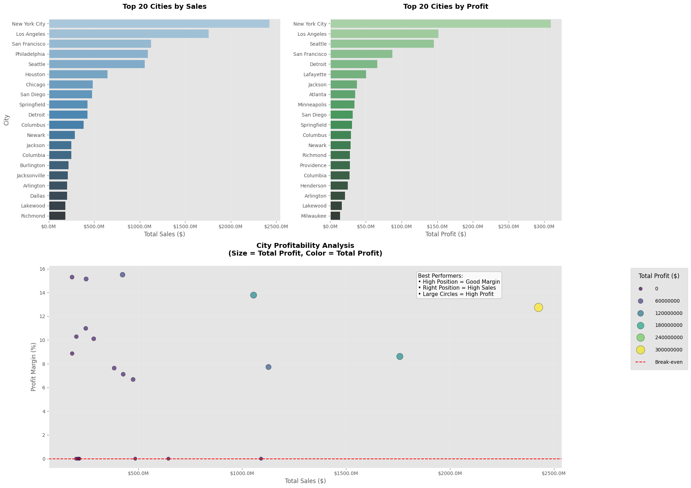
Pareto analysis for profit

Slide 9
Analysis per city
1. Villes Performantes (Top Sales & Profit)
Rang | Ville | Ventes Total | Profit Total | Marge (%)
1 | New York City | 2.43B$ | 309.2M$ | 12.7%
2 | Los Angeles | 1.76B$ | 151.5M$ | 8.6%
3 | San Francisco | 1.13B$ | 87.0M$ | 7.7%
4 | Seattle | 1.05B$ | 145.4M$ | 13.8%
5 | San Diego | 475.2M$ | 31.7M$ | 6.7%
6 | Detroit | 424.5M$ | 65.8M$ | 15.5%
7 | Richmond | 181.4M$ | 27.7M$ | 15.3%
Note : B = Milliards, M = Millions
2. Villes à Haute Rentabilité (Marges >15%)
Ville | Profit Total | Marge (%)
Detroit | 65.8M$ | 15.5%
Richmond | 27.7M$ | 15.3%
Jackson | 37.7M$ | 15.1%
3. Villes Rentables Hors Top Ventes
Ville | Profit Total | Particularité
Atlanta | 34.9M$ | Ventes non recensées
Minneapolis | 34.1M$ | Ventes non recensées
Henderson | 24.5M$ | Ventes non recensées
Points clés :
1. Meilleure performance : Detroit combine volume (424M$) ET marge (15.5%)
2. Efficacité remarquable : Seattle avec 13.8% de marge sur 1+ milliard$
3. Cas spéciaux : Atlanta et Minneapolis génèrent du profit sans être dans le top ventes

Slide 10
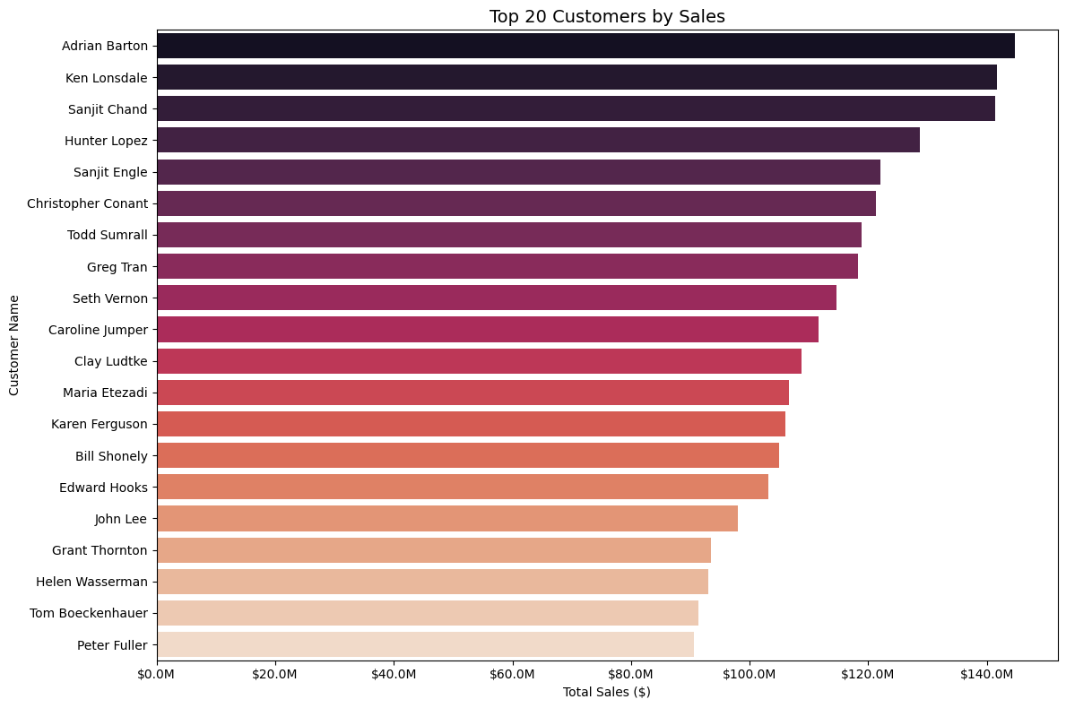
Customer analysis

Slide 11
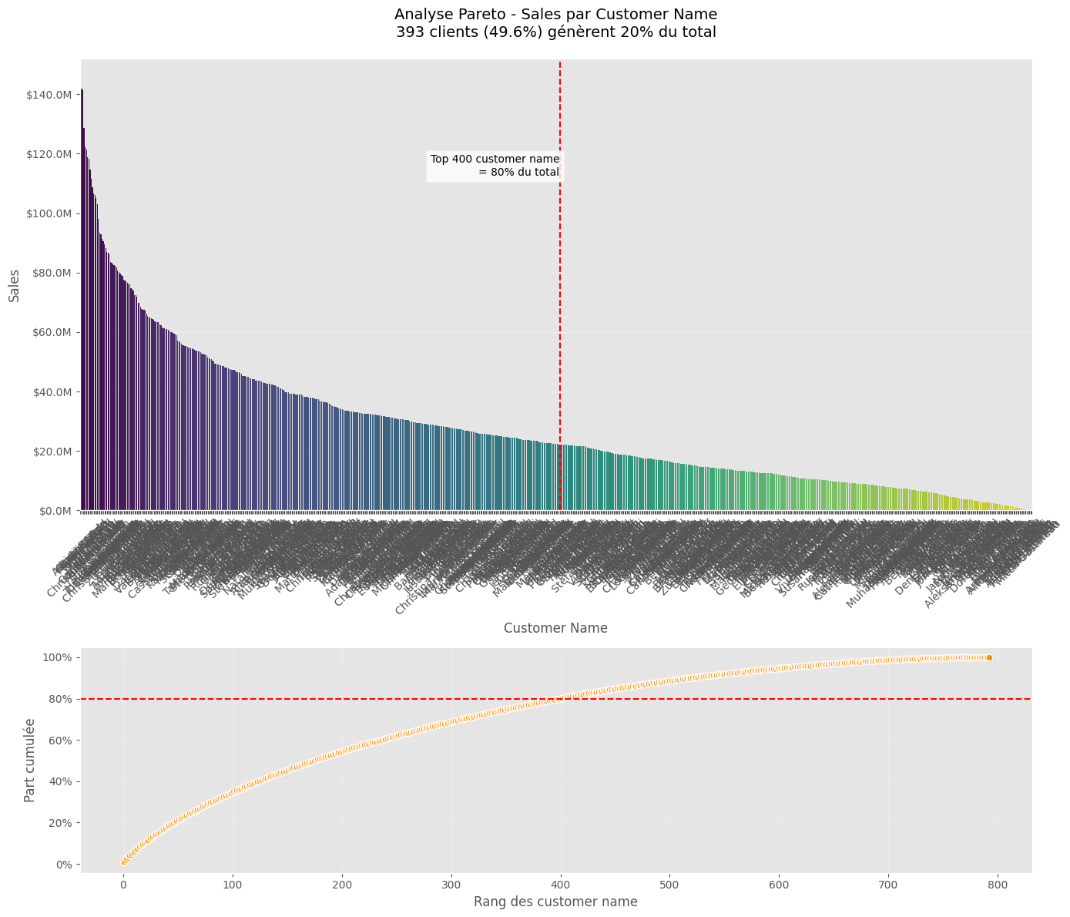
Pareto analysis for customer

